Slide 1



$$\hat{X}$$
Decoder
$$z$$
Encoder
$$X$$

Slide 2
INPUT
PROJECTION
OUTPUT
W(t-2)
W(t-1)
SUM
W(t)
W(t+1)
W(t+2)
CBOW

Slide 3
INPUT
PROJECTION
OUTPUT
W(t-2)
W(t-1)
W(t)
W(t+1)
W(t+2)

Slide 4
W(i+3)
OUTPUT
PROJECTION
INPUT
d
W(i)
W(i+1)
W(i+2)

Slide 5
W(i)
W(i+1)
W(i+2)
W(i+3)
OUTPUT
PROJECTION
INPUT
d

Slide 6
W(i+3)
OUTPUT
PROJECTION
INPUT
d
W(i)
W(i+1)
W(i+2)

Slide 7
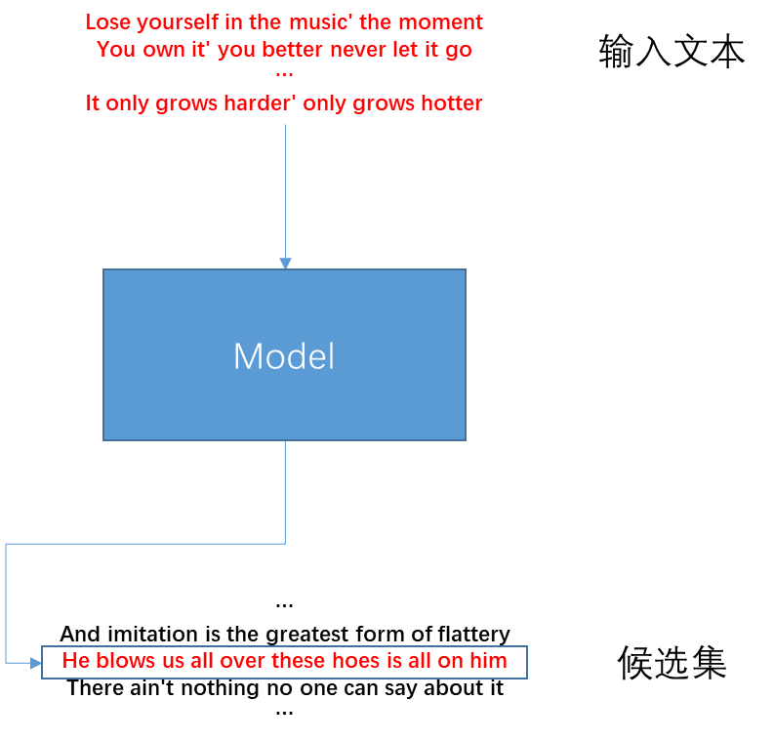
Lose yourself in the music' the moment
You own it' you better never let it go
…
It only grows harder' only grows hotter
输入文本
Model
…
And imitation is the greatest form of flattery
He blows us all over these hoes is all on him
There ain't nothing no one can say about it
…
候选集

Slide 8
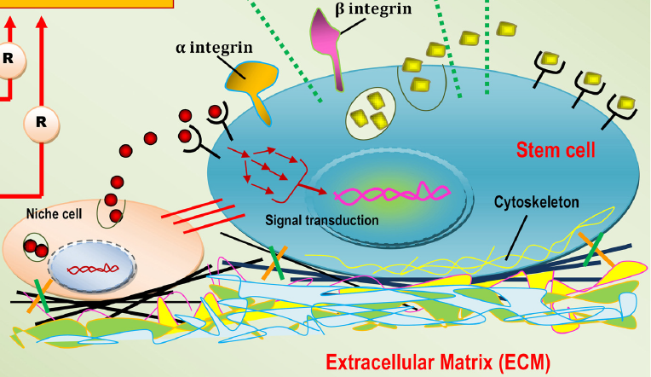

Slide 9
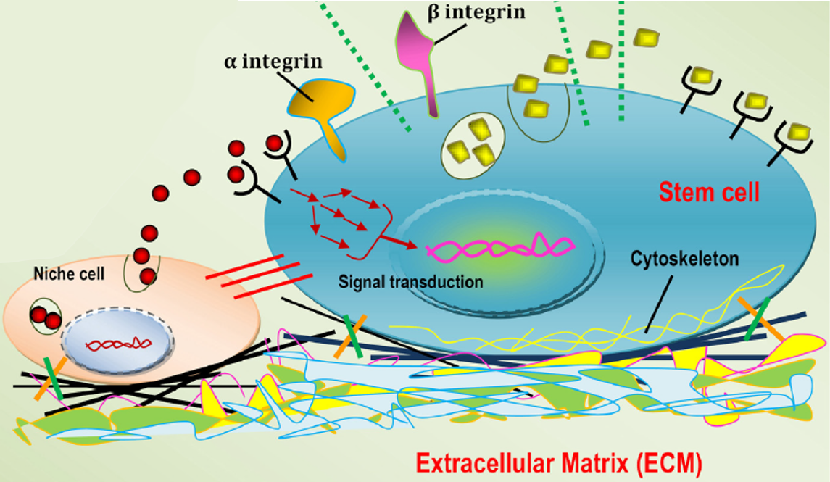

Slide 10


Slide 11
*

Slide 12
•
=

Slide 13
…
l'aIk d'u:
m'o@ l'aIk p'0l@n
,0n ,aU3 sk'Inz
'and
…
l
OUTPUT
Attention
…
m'o@ l'aIk p'0l@n
'and
…
PROJECTION
Attention
INPUT
…
l'aIk d'u:
,0n ,aU3 sk'Inz
…
v_{r}
l
‘
a

