Slide 1





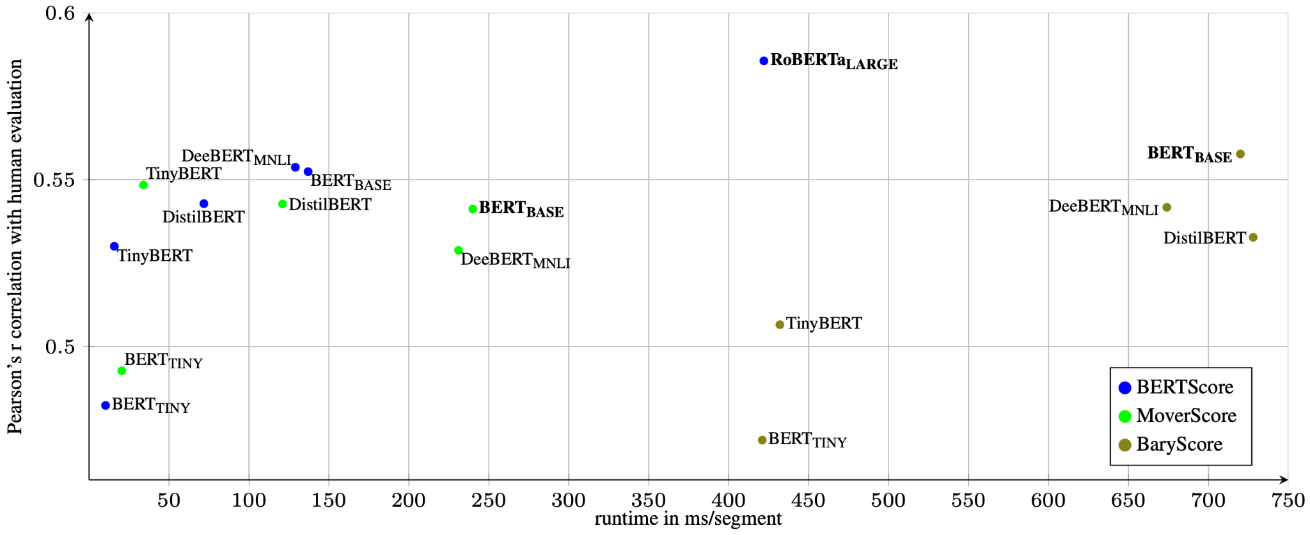
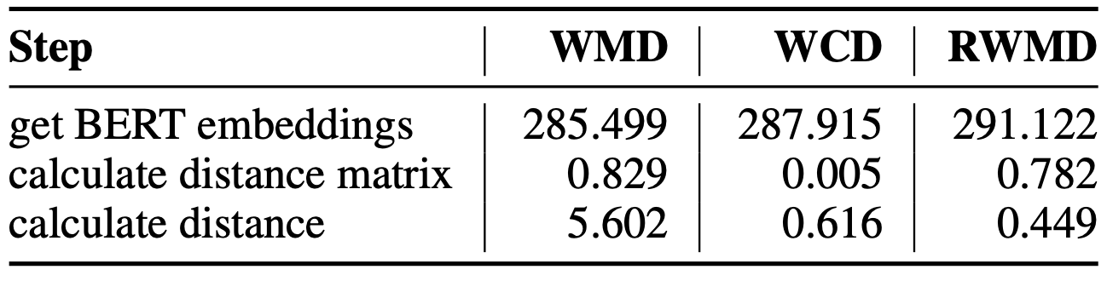
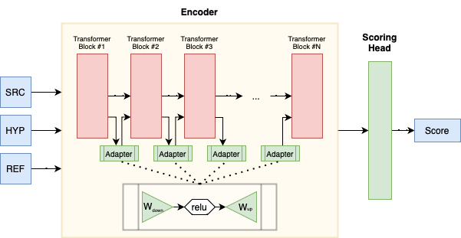
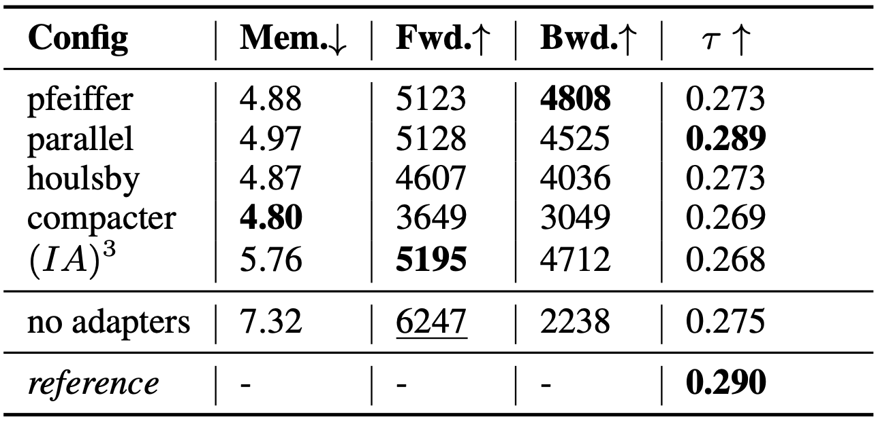
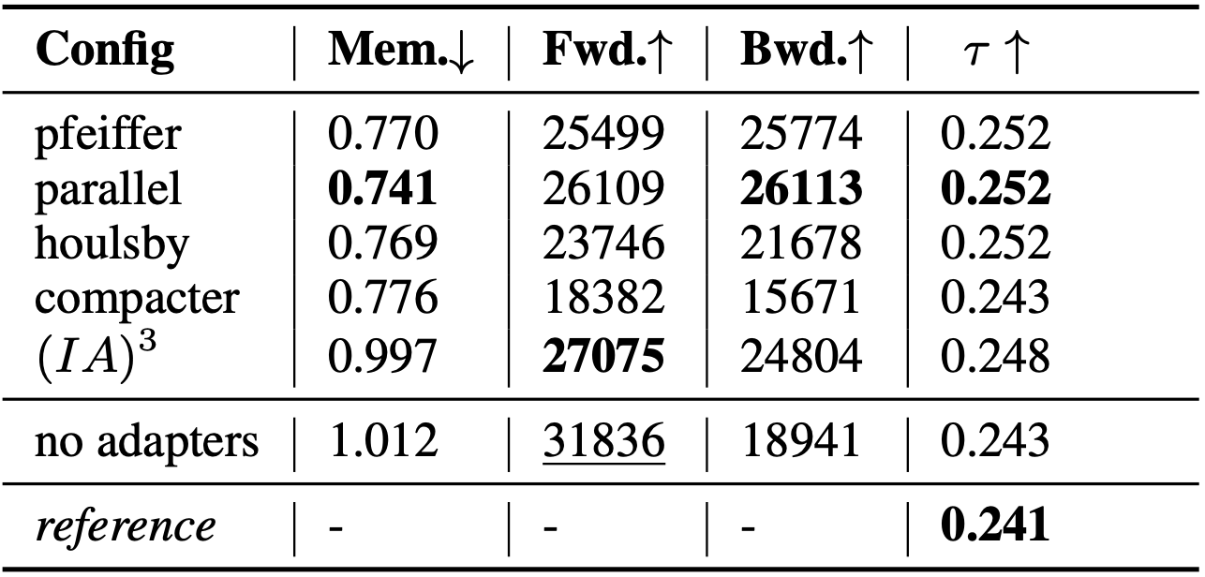

EffEval: A Comprehensive Evaluation of Efficiency for MT Evaluation Metrics
Daniil Larionov¹, Jens Grünwald², Christoph Leiter¹ and Steffen Eger¹
¹ Natural Language Learning Group, Bielefeld University
² Department of Computer Science, Technical University of Darmstadt
daniil.larionov@uni-bielefeld.de
Main Contributions
Motivation
We study 3 different aspects of computational efficiency in application to MT evaluation metrics.
We replace computationally-heavy transformer models with their light-weight alternatives for metrics like BERTScore, MoverScore, BaryScore.
We switch from costly alignment techniques (Word Mover Distance - WMD) to their approximations in MoverScore
We train COMET-like models efficiently with adapters
Inefficient metrics (like BERTScore with RoBERTa-Large) require expensive hardware to run in reasonable time, which prevents under-resourced practitioners from using it.
Even with good hardware it takes too much time and energy: 71 hours for BERTScore to evaluate (30k segments × 5 language pairs × 50 MT systems)
Metrics have loads of other applications which would benefit from an efficient option: RL reward functions, mined data filtering, online re-ranking
1. Efficient Transformers
Evaluation datasets: WMT 15/16/21
Measured runtime in ms/segment, on GPU and CPU, averaged across 3 runs.
Evaluated models:
RoBERTa-Large - Baseline
BERT-Base - Smaller model
DistilBERT - Distilled
TinyBERT - Adv. Distilled
BERT-Tiny - BERT miniatures
DeeBERT - Dyn. early exiting
Best tradeoff between quality/efficiency - TinyBERT
2. Approximations of Word Mover Distance
MoverScore uses WMD as measure of distance between two texts.
WMD calculates minimum cumulative distance that words from one text needs to travel to match the other text. Complexity is O(p³log p).
Word Centroid Distance (WCD) and Relaxed Word Mover Distance (RWMD) are two fast approximations of WMD.
3. COMET + Adapters = ❤️?
COMET is a trained MT evaluation metric, based on XLM-RoBERTa-Large. It is quite large and takes days to train fully. An ideal case for adapters!
We tested various adapter configurations: Pfeiffer et al, Houlsby et al, Parallel adapter, Compacter, (IA)3. Measured Mem. in MB/Token, Fwd. and Bwd. speed in Tokens/Second and Kendall-tau correlation on WMT21
Along with large COMET we also tested smaller COMETINHO.
Results:
Adapters decrease GPU RAM usage for training and improve backward pass speed
Models with adapter can outperform the ones without them!
Simpler adapters works better
Github

