Slide 1



Group - 9
NLP PROJECT PROPOSAL PRESENTATION
PRESENTED TO
Dr. Himangshu Sharma
PRESENTED BY
Alagadapa Jaya Harsh Vardhan
Srikar Chaturvedula
Parth Vijay
Sushant Kuril
Indic Language Converter (Hindi and Telugu)
4th Oct 2024

Slide 2



Problem Statement
Despite the growing demand for multilingual communication in a diverse country like India, there remains a significant gap in accessible, accurate, and user-friendly tools for real-time speech-to-speech translation between regional languages, such as Hindi and Telugu. This language barrier often restricts effective communication in various domains, including education, healthcare, and customer service, where clear understanding across languages is crucial.
This project aims to develop a robust Hindi-Telugu speech-to-speech converter that uses natural language processing (NLP) techniques to facilitate seamless communication between speakers of these languages.

Slide 3

Group - 9
Our Motivation?
India's linguistic diversity poses challenges for communication, especially between urban and rural areas where fluency in English or Hindi may be limited. While major languages have advanced NLP tools, regional languages like Telugu are often overlooked. A Hindi-Telugu speech-to-speech converter can bridge these gaps, enhance cultural exchange, and improve access to essential services, promoting inclusivity and reducing the technological divide.

Slide 4
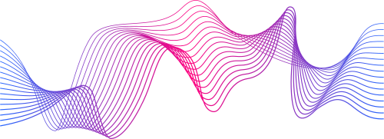
Group - 9
Related works
Improved Sentence Alignment for Building a Parallel Subtitle Corpus
Statistical Machine Translation System for Indian Languages
Given here are some research papers

Slide 5








High Level Flow
Clean the data before feeding it to me.
Subtitle
file: hin-tel
Parallel corpus
Alignment with
Time Overlaps.
Length-Based Sentence Alignment.
Dynamic Time
Wrapping
Group - 9

Slide 6
Group - 9
Phase 1
Subtitle format detection and conversion(Usage of only one source (.srt file)
Character encoding conversion (Convert all files to UTF-8 for consistency Using chardet)
Language checking (languageDetection Using langDetect)
Removing background noise.
Removing html tags (eg., <i></i>`& [U+202B] and [U+202C])
Tokenization and sentence splitting
Removing unprintable characters
Removing characters outside the language pair
Normalizing whitespace (Removal of extra space)
Deaccenting accented characters (Converting the accented to their base form)
Standardizing punctuation
Standardizing numbers

Slide 7
Group - 9
Phase 2
Phase 3
Length-Based Sentence Alignment.
Alignment with Time Overlaps.
Combining Length and Time-Based Approaches.
Handling Misalignments.
Similarity Scoring.
File Format
Final Cleaning
Sentence Pair Shuffling

Slide 8

Contribution - Parth
Group - 9
Standardizing Punctuations
Standardizing Numbers
1) Consistency
2) Improved Token Matching
1) Simplicity
2) Easy Vacabulary
3) Reduced Ambiguity
(–, —) to a single dash type (-)
quotes (" ") to straight quotes (" ")
Converting १२३ (Devanagari) to 123 (standard numerals)
...(ellipse) to . . .(even spaced period)

Slide 9

Contribution - Parth
Group - 9
Length-Based Algorithim
Compares character lengths of subtitles
Matches subtitles with similar lengths
Pros: Language-independent, handles timing errors
Cons: May misalign short sentences

Slide 10
Contribution - Parth
Group - 9
Time-Based Alignment
Uses subtitle timestamps for matching
Aligns subtitles with overlapping time ranges
Pros: Accurate for well-timed subtitles
Cons: Sensitive to timing inconsistencies

Slide 11
Contribution - Parth
Group - 9
Dynamic Time Warping (DTW)
Finds optimal alignment between two sequences
Uses character counts as a similarity measure
Pros: Handles non-linear alignments, robust to timing differences
Cons: Computationally intensive for large datasets

Slide 12
Contribution - Parth
Group - 9
Hybrid Approach: Combining Strengths
Step 1: Initial Time-Based Alignment
Start with time-based matching for high accuracy
Identifies obvious matches based on timing overlap
Step 2: Length-Based Refinement
Refine time-based matches using character length comparison
Filters out misalignments due to timing inconsistencies
Step 3: DTW for Unaligned Segments
Apply DTW to remaining unaligned subtitles
Captures alignments missed by time and length-based methods
Step 4: Scoring and Final Alignment
Score all potential alignments (time-based, length-based, DTW)
Combine scores for final alignment decision
Ensures best overall alignment considering all factors

Slide 13
Contribution - Sushant
Group - 9
Language Detection
using lang-detect
N-gram Model: LangDetect uses n-gram frequency models for each language (e.g., "he", "th").
Language Detection: It compares the n-gram frequency in the input text to pre-trained models to predict the language.
Handling Uncertainty: If the text is too short, mixed, or poorly represented, LangDetect raises an exception (handled as `detected_lang = None`).
Reliability: Works best with longer, coherent text. Short or noisy lines may affect accuracy.

Slide 14
Contribution - Sushant
Group - 9
Tokenization by using BPE Alogrithm
Initialization: Each word is treated as a sequence of characters. The frequency of individual characters and character pairs is calculated.
Merging: The most frequent character or subword pairs are merged iteratively (e.g., 't' + 'h' = 'th'). The vocabulary grows with each merge
Stopping: Merging continues until a target vocabulary size is reached, creating a mix of characters, subwords, and full words.
Tokenization: BPE tokenizes new words by applying the learned merges, splitting words into subwords (e.g., "hello" might become "he" + "llo").

Slide 15
Contribution - Sushant
Group - 9
Similarity Scoring
Here we are trying to find the similarity between the 2 languages in the dataset. It uses different techniques to measure this similarity based on the characters in the text, the structure (like the sentence pattern or punctuation), and the length of the sentences.
Step 1: Character-Level Similarity
Sentences are broken into small character chunks called n-grams (e.g., for "house," 1-grams: ['h', 'o', 'u', 's', 'e'], 2-grams: ['ho', 'ou', 'us', 'se']).
TfidfVectorizer converts these n-grams into numbers, and cosine similarity compares how close the Hindi and Telugu sentences are based on their n-grams.

Slide 16
Contribution - Sushant
Group - 9
Similarity Scoring
Step 2: Structural Similarity
Characters in a sentence are categorized (e.g., 'A' as L for letter, punctuation as P).
Sentences are compared based on their structural patterns (e.g., "Hello!" becomes ['L', 'L', 'L', 'L', 'P']).
Step 3: Length-Based Similarity
Sentences are compared by their lengths; the similarity score decreases if one sentence is much longer than the other.

Slide 17
Contribution - Sushant
Group - 9
Sentence Pair Shuffling
Why Shuffle Sentence Pairs?
Data Augmentation: Increases training data diversity, helping models generalize better.
Testing Model Robustness: Evaluates how well models handle noise in data.
Simulating Real-World Conditions: Mimics imperfect sentence alignments, preparing models for practical applications.
Avoiding Overfitting: Introduces randomness to prevent models from overfitting to fixed sequences.

Slide 18
Contribution - Srikar
Group - 9
Subtitle Dataset Collection and Preprocessing
Manual Alignment Verification:
Manually cross-checked subtitle alignment for timing and semantic accuracy, ensuring proper synchronization between different language subtitles.
Key Challenges:
Unprintable Characters:
Identified hidden and special characters, which could disrupt the alignment process, making the data misaligned in text-based analysis tools.
Excessive Whitespace:
Discovered inconsistent spacing, which distorted the structure of the data and increased noise during alignment checks.

Slide 19
Contribution - Srikar
Group - 9
Adressing challenges through algorithms
Preprocessing Steps:
Used Python’s .split() function to normalize and manage whitespace.
Applied ASCII filtering to detect and remove unprintable characters.
Working on an algorithm to check the alignment confidence between subtitles.
tokenized the sentence, checking lexical similarity and confidence score calculations.

Slide 20

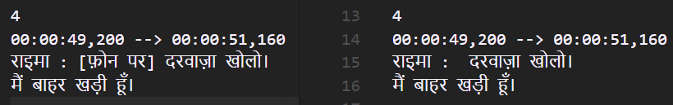
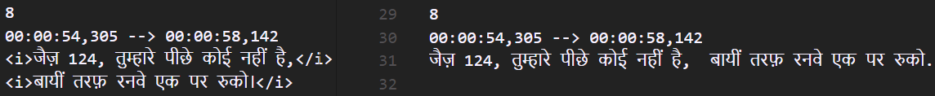
Group - 9
Contribution - AJ Harsh Vardhan
Subtitle format detection and correction:
Checking formats of all subtitle files using p python.
Character encoding: Used Chardet to detect encoding changed to UTF-8 (https://pypi.org/project/chardet/)
Removing background noise: The subtitles contains noise such as {[थीम म्यूज़िक बजता है]} which was removed using regex
\[.*?\] and test with re module
Removing html tags (eg.,<i></i>, {\an8} [U+202B] and [U+202C])

Slide 21

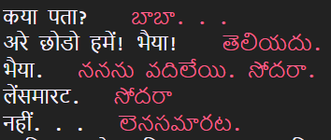
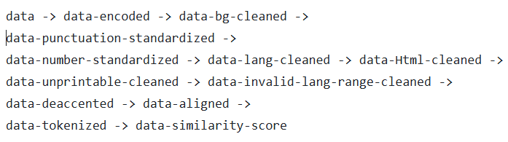
Group - 9
Contribution - Harsh Vardhan
Removing characters outside the language pairs.
Handling Misalignments. (using scripts to move rows in vertical directions)
Manual corpus checking and running preprocessing scripts. (hin to tel map)
Data collection techniques: Efficient ways to download data and maintaining file structures.
Managing file flow: Instructed team members to test scripts on the right folders in current flow

Slide 22
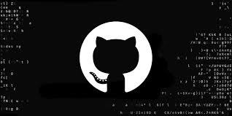
Group - 9
Contribution - Harsh Vardhan
Version Control:
Supervised the versioning of github to control project flow and helped teammates to work on the same data by fetching and pushing code to GitHub.
Stop Words:
Wrote a python script to remove stop words from the parallel corpus of hindi and telugu.

Slide 23

Group - 9
Review 3
Proposed Timeline
Real-Time Translation: Model that converts spoken Telugu into Hindi text and then synthesizes it into spoken Hindi .
Provides natural-sounding translations for effective multilingual communication between Telugu and Hindi speakers.
When can you expect?

Slide 24

Group - 9
Mind Map:
Model Tuning
Model training
Model selection
Model Evaluation
Language Translation
Data Collection
HINDI-TELUGU
TRANSLATOR
Alignment Checking, lowercasing
Data preprocessing
Text summarization(tentative)
Text Normalization, Tokenization
ASR, TTS

Slide 25
Group - 9
Dataset
1,05,000 lines
Created a parallel corpus using OpenSubtitles.org from scratch (1,05,000 rows of parallel corpus)
Each team member collected 80-90 hindi, telugu subtitle files!

Slide 26
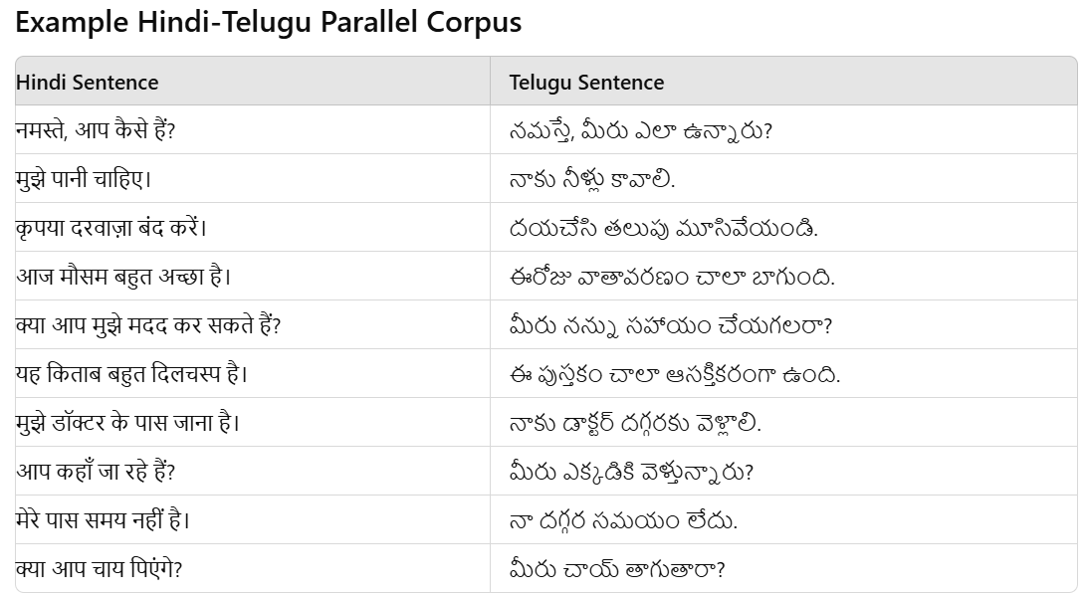
Group - 9
Parallel corpus example
Image is just for representative proposes. The real dataset may vary.

Slide 27




Project Flow
Data preprocessing
Speech and text output in language Y
High level picture
ASR
MT
TTS
Language X
Language Y
Text

Slide 28
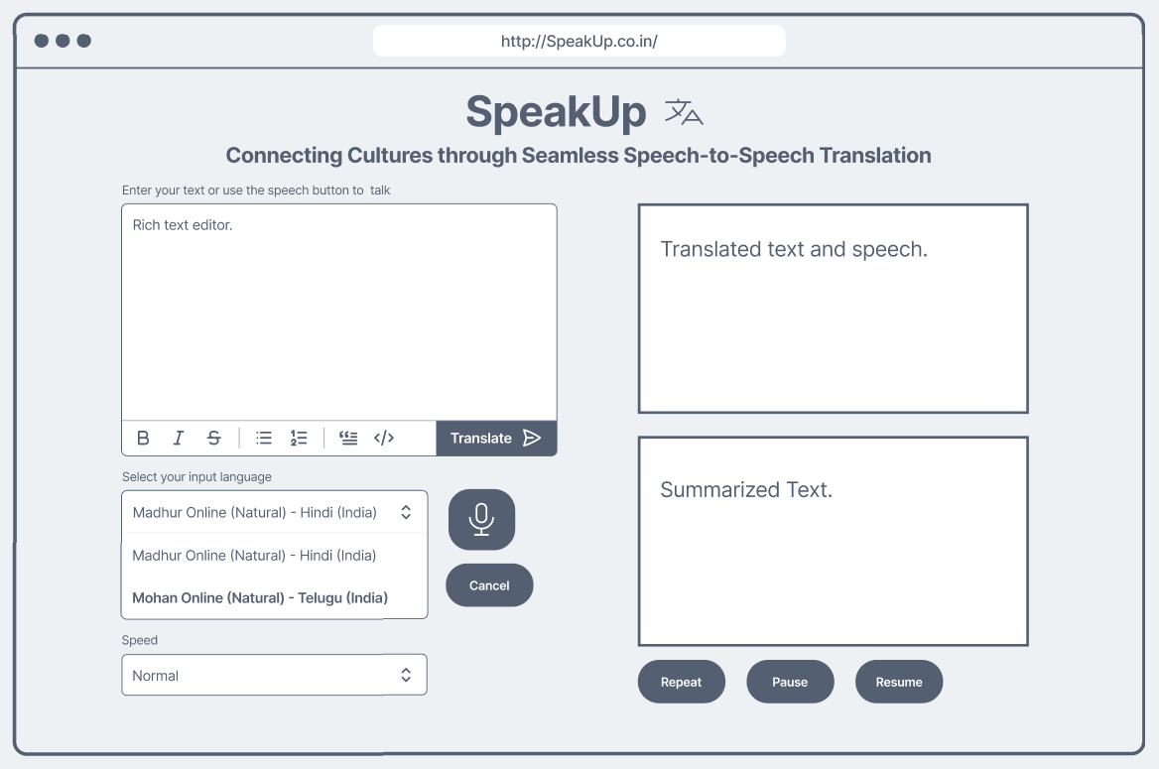
Wireframe for project

Slide 29

Group - 9
Our Team
A
Alagadapa Jaya Harsh Vardhan (S20220010011)
Meet our team of 4 members
S
Srikar Chaturvedula (S20220010207)
P
Parth Vijay (S20220010166)
S
Sushant Kuril (S20220010219)

