Slide 1
Amazon Fine Food reviews Analysis
Group - 4 members
Henry Jones Inbaraj
Megha Chauhan
Harish Reddy Konatham
Amritha Gyawali
Lakshmi Vaishnavi
Muhammad Ibraheem
Jibin Madayil John
Meenakshi

Slide 2
How does the industry work?
Food review analysis enhances dining by interpreting customer feedback.
It empowers restaurants to tailor their services based on customer expectations, contributing to food and service quality enhancements.
Advanced analytics and NLP revolutionize feedback beyond traditional methods in this industry.
This industry offers a data-driven approach for precise insights and targeted improvements in customer satisfaction
Food review analysis empowers consumers, shaping a dynamic feedback loop for better quality food and services.

Slide 3
Addressing the Core Challenges: Defining the Problem
Lengthy reviews can be time-consuming for users to read, leading to potential information overload. Our App will tell customer’s emotions.

Slide 4
Goal
An App to understand customer emotions !!!

Slide 5
Dataset
Dataset: https://snap.stanford.edu/data/web-FineFoods.html
Data : Amazon food revies
Number of Reviews : 568,454
Size: 350 MB
Time span: Oct 1999 – Oct 2012

Slide 6
WORK FLOW
Collection of Reviews
Sentiment Analysis
Data Preprocessing
UI Creation
App Deployment

Slide 7
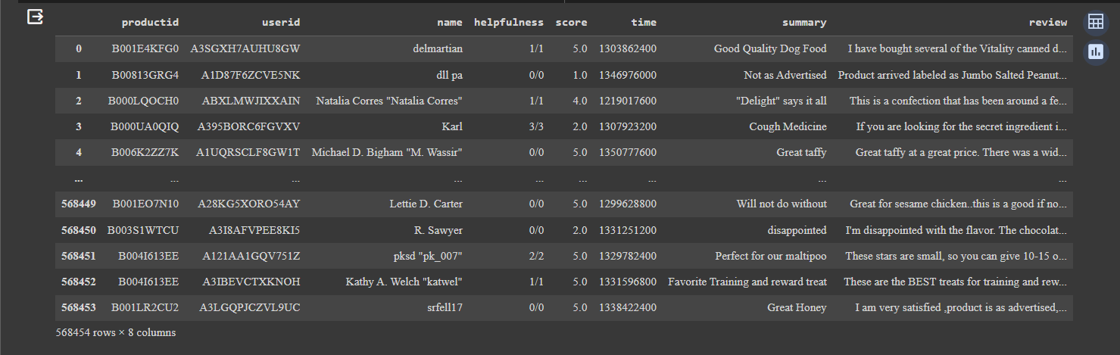
Optimizing Data for Analysis: Data Preprocessing and Feature Engineering

Slide 8
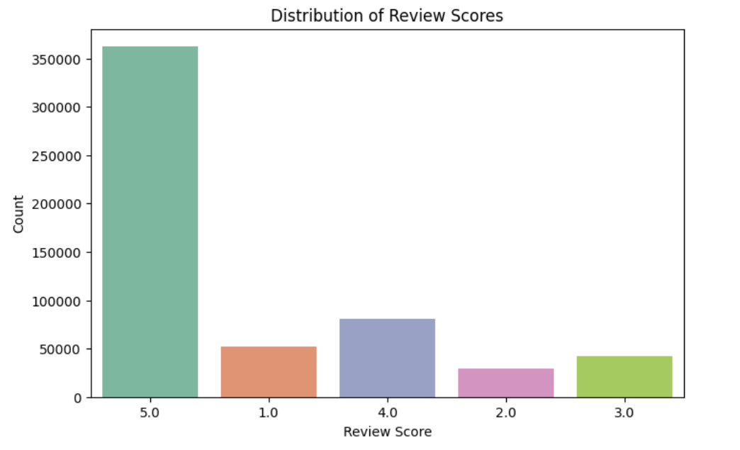
Distribution of Review scores

Slide 9
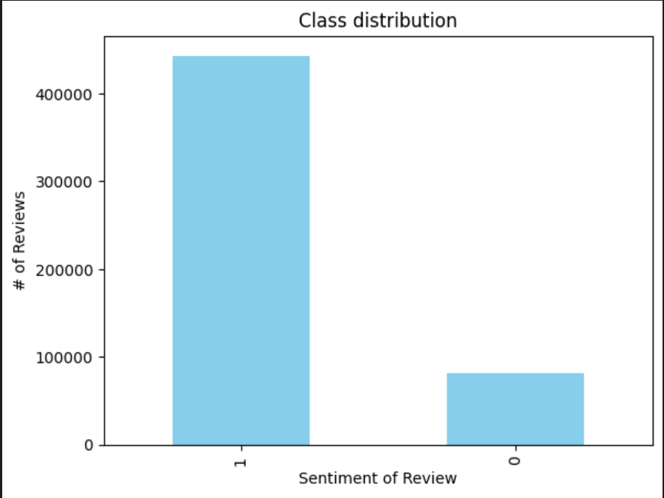
Class Distribution

Slide 10
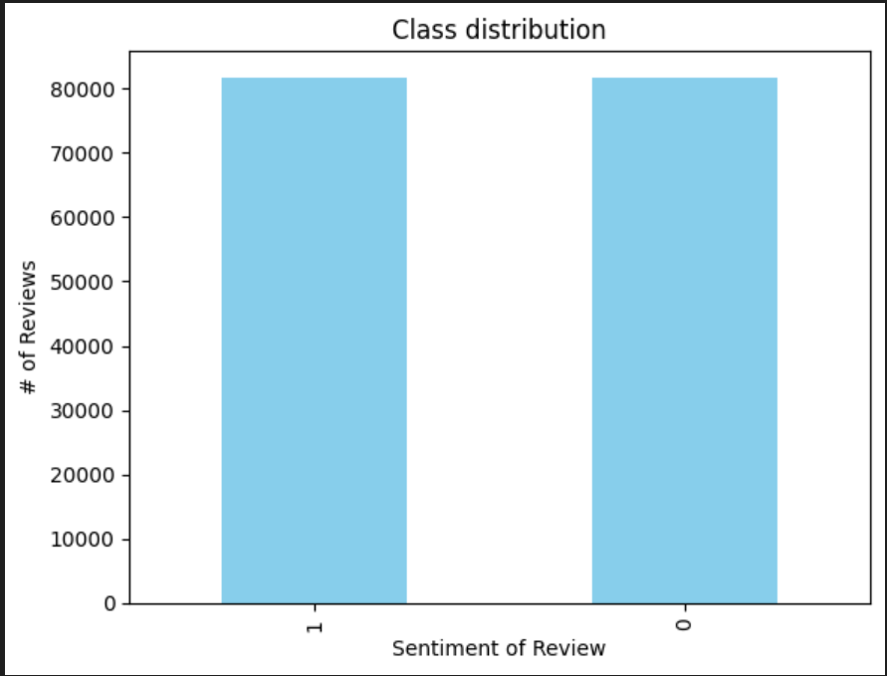
Balanced class distribution

Slide 11
Multinomial Naïve Bayes Model for Sentiment Analysis
Machine Learning Model (Naive Bayes):
Split the data into training and testing sets.
Train a Multinomial Naive Bayes classifier on the training data.
Evaluate the model on the testing data and training using accuracy.
Flowchart (High-Level):
Load Data → Data Cleaning and Preprocessing → Sentiment Analysis → Machine Learning Model (Naive Bayes)
Trained and evaluated model using TF-IDF vectors.

Slide 12
Logistic Regression Model for Sentiment Analysis
Logistic Regression Model:
Flowchart (High-Level):
Load Data → Data Cleaning and Preprocessing → Sentiment Analysis → Machine Learning Model (Logistic Regression Model)
Split the data into training and testing sets.
Trained and evaluated model using TF-IDF vectors.
Train a Logistic Regression model on the training data.
Evaluate the model on the testing data using accuracy.

Slide 13

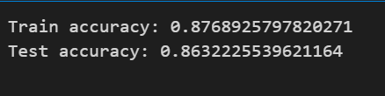
LOGISTIC REGRESSION VS MULTINOMIAL NAÏVE BAYES
Logistic Regression
MULTINOMIAL NAÏVE BAYES MODEL

Slide 14

Hyperparameter tuning
Grid Search CV (Logistic Regression)

Slide 15
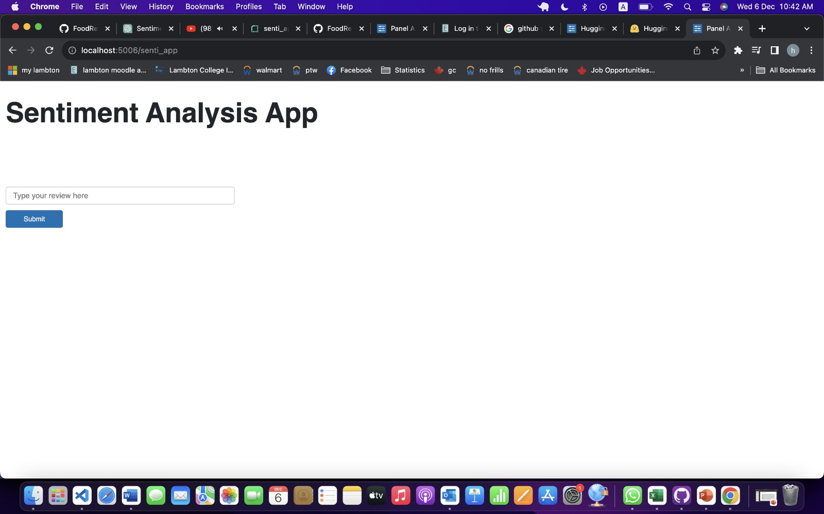
APPLICATION USER INTERFACE

Slide 16
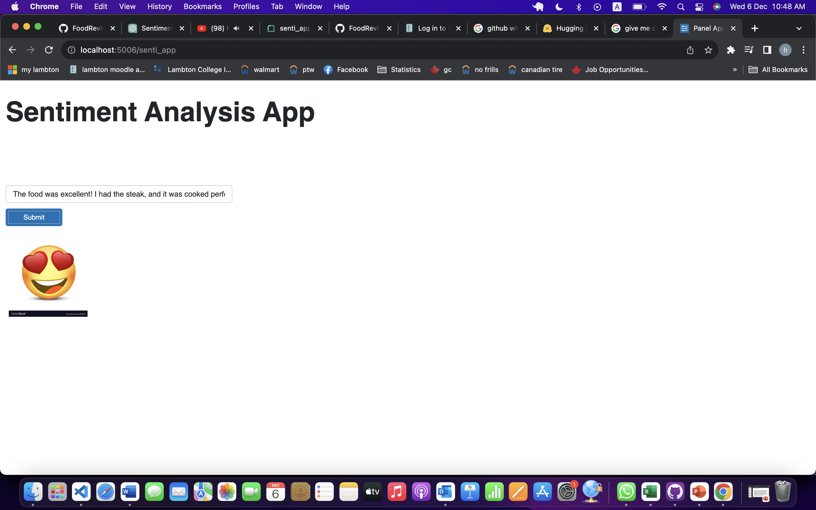
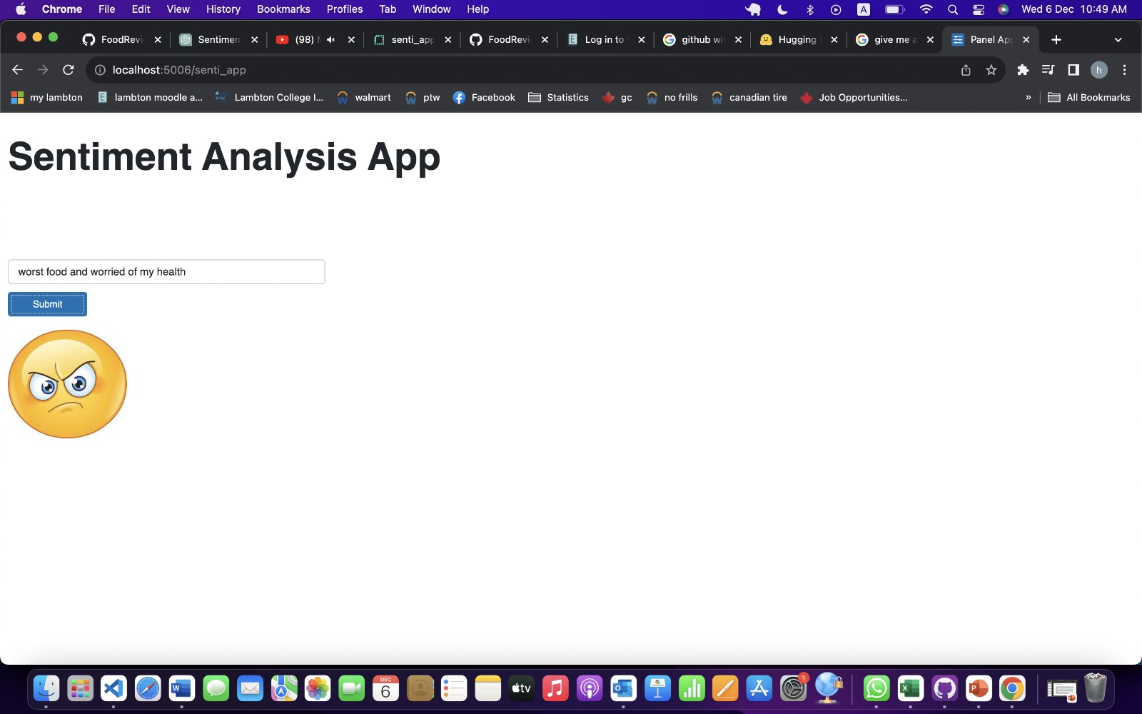
APPLICATION UI
Positive sentiment
Negative sentiment

Slide 17
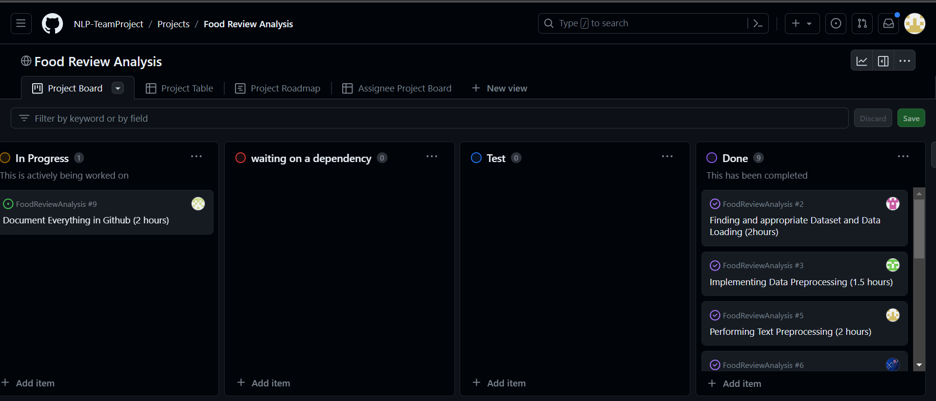
Navigating the Project Board: Best Practices for Team Efficiency
https://github.com/orgs/NLP-TeamProject/projects/2/views/2

Slide 18
Thank You

