Slide 1
NER（EMNLP 2018）
向玥佳

Slide 2
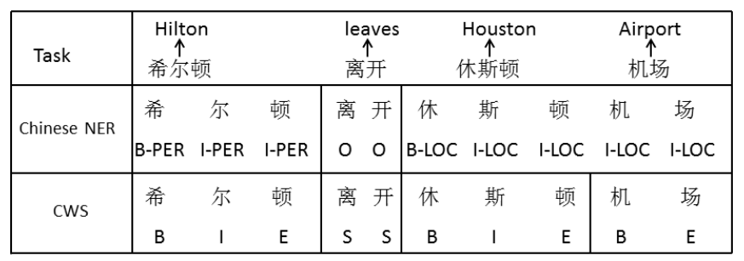
Adversarial Transfer Learning
similarities and specificities between Chinese NER and CWS

Slide 3
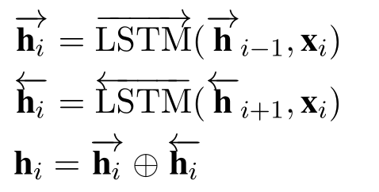

LSTM

Slide 4


Self-Attention

Slide 5
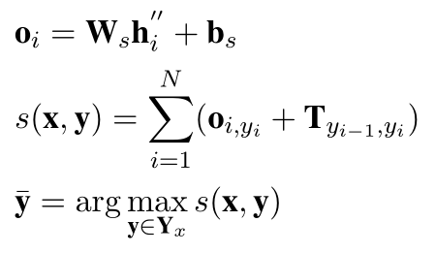

CRF

Slide 6


Task Discriminator

Slide 7
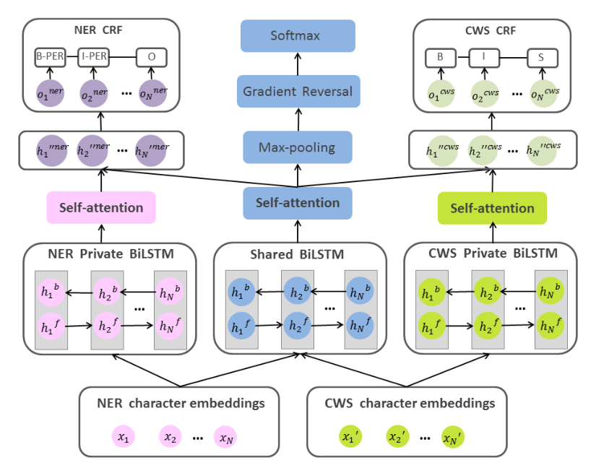
Training

Slide 8
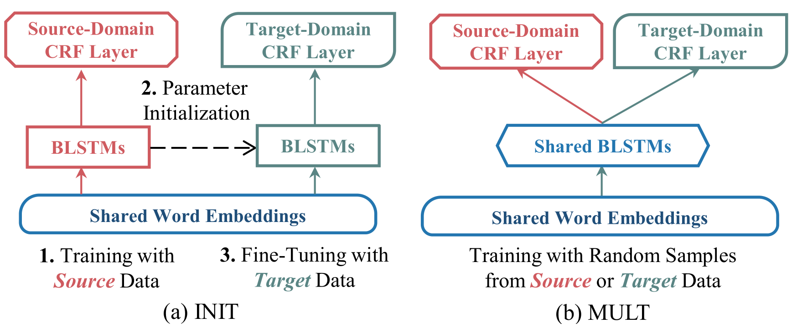
Neural Adaptation Layers
Two existing adaptation approaches for NER

Slide 9
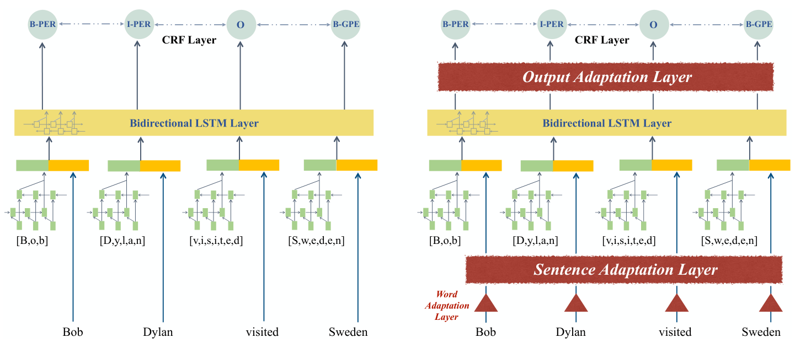
Insert Adaptation Layers

Slide 10



Projection Learning

Slide 11
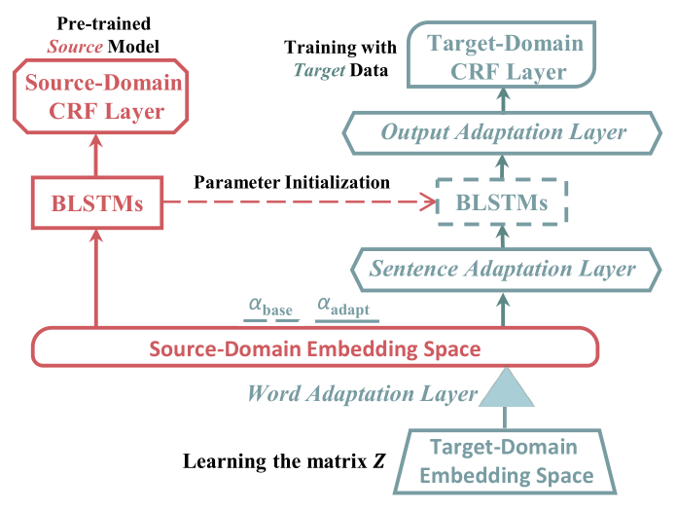
Overview

