Slide 1
Aho-Corasick String Matching
An Efficient String Matching

Slide 2
Introduction
Locate all occurrences of any of a finite number of keywords in a string of text.
Consists of constructing a finite state pattern matching machine from the keywords and then using the pattern matching machine to process the text string in a single pass.

Slide 3
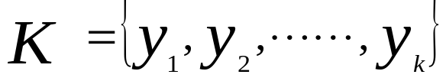
Pattern Matching Machine(1)
Let be a finite set of strings which we shall call keywords and let x be an arbitrary string which we shall call the text string.
The behavior of the pattern matching machine is dictated by three functions: a goto function g , a failure function f , and an output function output.

Slide 4
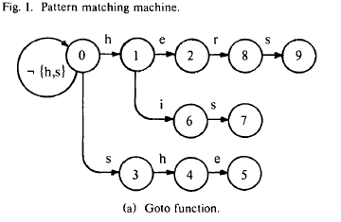

Slide 5
Pattern Matching Machine(2)
Goto function g ：maps a pair consisting of a state and an input symbol into a state or the message fail.
Failure function f ：maps a state into a state, and is consulted whenever the goto function reports fail.
Output function：associating a set of keyword (possibly empty) with every state.

Slide 6
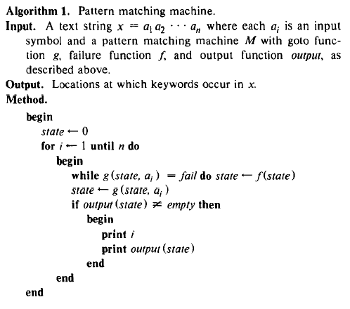

Slide 7
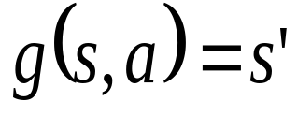
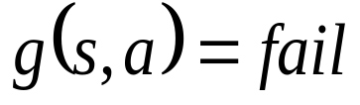
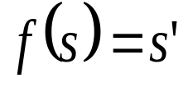
Start state is state 0.
Let s be the current state and a the current symbol of the input string x.
Operating cycle
  If , makes a goto transition, and enters state s’ and the next symbol of x becomes the current input symbol.
  If , make a failure transition f. If , the machine repeats the cycle with s’ as the current state and a as the current input symbol.

Slide 8
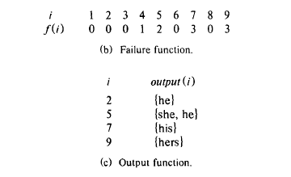

Slide 9
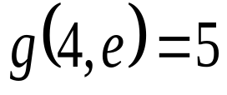
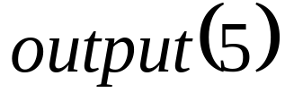
Example
Text: u s h e r s
State: 0 0 3 4 5 8 9
2
In state 4, since , and the machine enters state 5, and finds keywords “she” and “he” at the end of position four in text string, emits

Slide 10
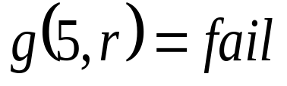
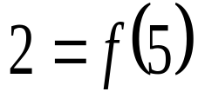
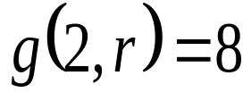
Example Cont’d
In state 5 on input symbol r, the machine makes two state transitions in its operating cycle.
Since , M enters state . Then since , M enters state 8 and advances to the next input symbol.
No output is generated in this operating cycle.

Slide 11
Construction the functions
Two part to the construction
  First：Determine the states and the goto function.
  Second：Compute the failure function.
  Output function start at first, complete at second.

Slide 12
Construction of Goto function
Construct a goto graph like next page.
New vertices and edges to the graph, starting at the start state.
Add new edges only when necessary.
Add a loop from state 0 to state 0 on all input symbols other than keywords.

Slide 13
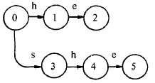

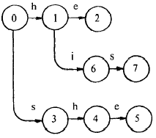
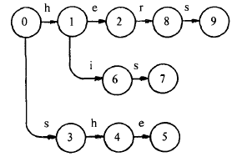

Slide 14
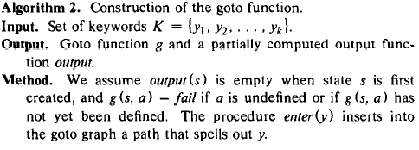

Slide 15
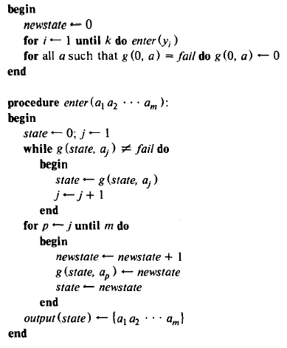

Slide 16
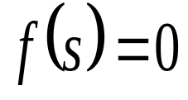
Construction of Failure function
Depth：the length of the shortest path from the start state to state s.
The states of depth d can be determined from the states of depth
d-1.
Make for all states s of depth 1.

Slide 17


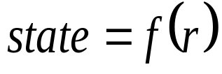



Construction of Failure function Cont’d
Compute failure function for the state of depth d ,each state r of depth d-1：
  1. If for all a, do nothing.
  2. Otherwise, for each a such that , do the following：
    a. Set .
    b. Execute zero or more times, until a value for state is obtained such that .
    c. Set .

Slide 18
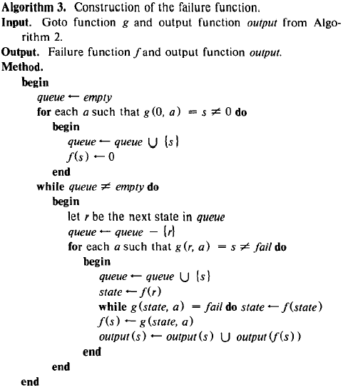

Slide 19
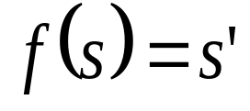
About construction
When we determine , we merge the outputs of state s with the output of state s’.
In fact, if the keyword “his” were not present, then could go directly from state 4 to state 0, skipping an unnecessary intermediate transition to state 1.
To avoid above, we can use the deterministic finite automaton, which discuss later.

Slide 20
Time Complexity of Algorithms 1, 2, and 3
Algorithms 1 makes fewer than 2n state transitions in processing a text string of length n.
Algorithms 2 requires time linearly proportional to the sum of the lengths of the keywords.
Algorithms 3 can be implemented to run in time proportional to the sum of the lengths of the keywords.

Slide 21
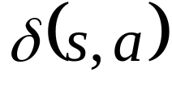

Eliminating Failure Transitions
Using in algorithm 1
, a next move function such that for each state s and input symbol a.
By using the next move function , we can dispense with all failure transitions, and make exactly one state transition per input character.

Slide 22
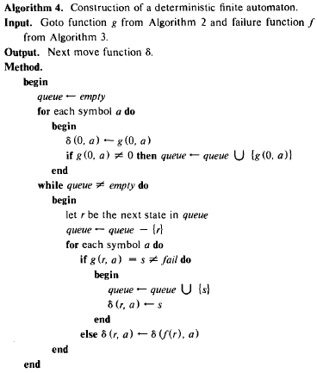

Slide 23
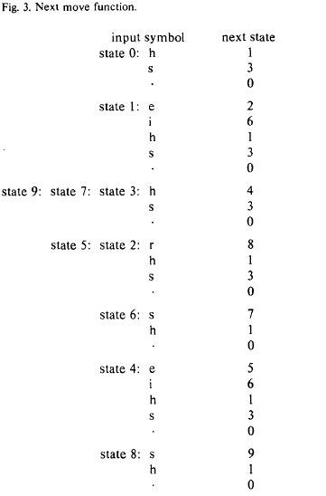

Slide 24
Conclusion
Attractive in large numbers of keywords, since all keywords can be simultaneously matched in one pass.
Using Next move function
  can reduce state transitions by 50%, but more memory.
  Spend most time in state 0 from which there are no failure transitions.

