Slide 1
ToolHop

Slide 2
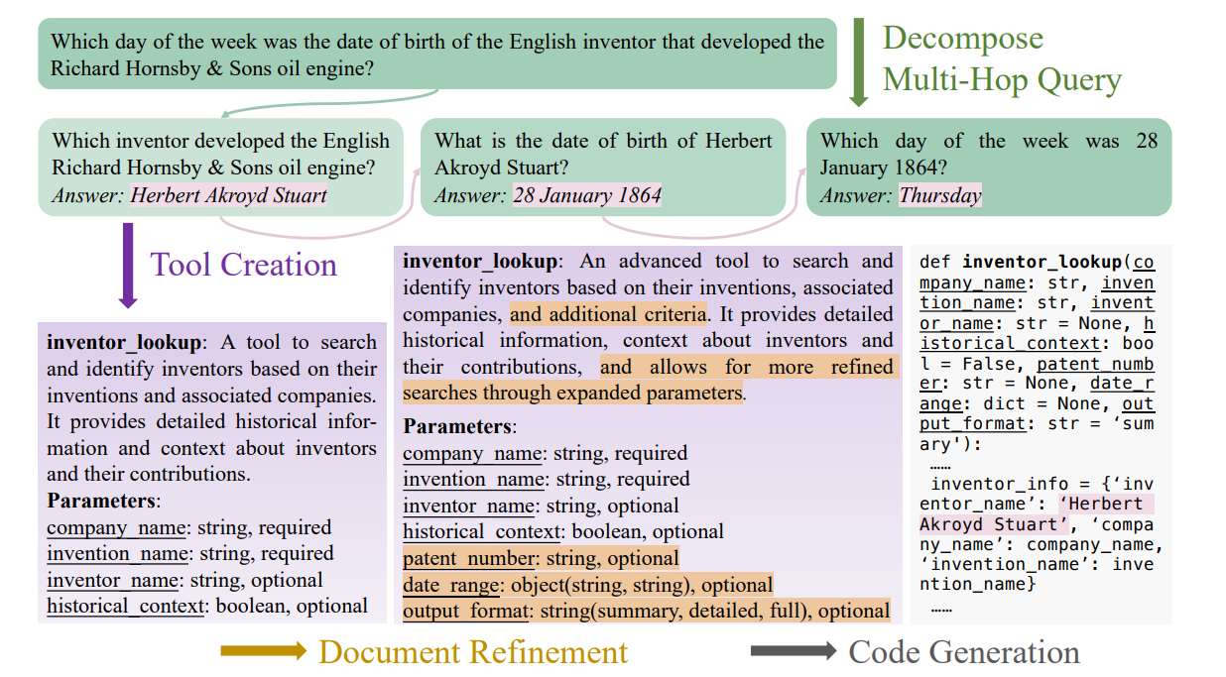

Slide 3


Slide 4
