Slide 1
Generating News Headlines with Recurrent Neural Networks
Tsai-Chung,Ting Wen-Bin, Han
NTHU NLP Lab
ting@nlplab.cc
vincent.han@nlplab.cc

Slide 2
Outline
Extractive vs Abstractive
Purpose
Model
Dataset
Evaluation
Result
Error
Future Work

Slide 3
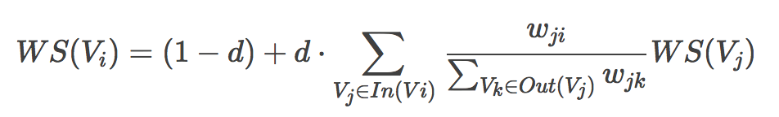
Extractive vs Abstractive
Extractive:
extracts words and word phrases from the original text
Ex: TextRank (Gensim,PyTeaser,PyTextRank……)
Abstractive:
Learns an representation model to generate more human-like text

Slide 4
Purpose
Use an encoder-decoder LSTM model and attention model to automatic text summarization.
Compare global attention mechanism dot,mlp,general
Compare LSTM’s model with use pre-train word2vec model and none
Use Copy attention mechanism to overcome OOV

Slide 5
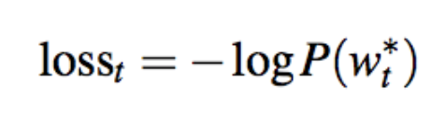
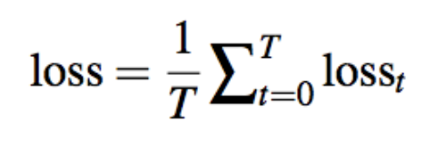
Loss function
The loss for timestamp t is the negative log likelihood of the target word Wt*
The overall loss for the whole sequence

Slide 6
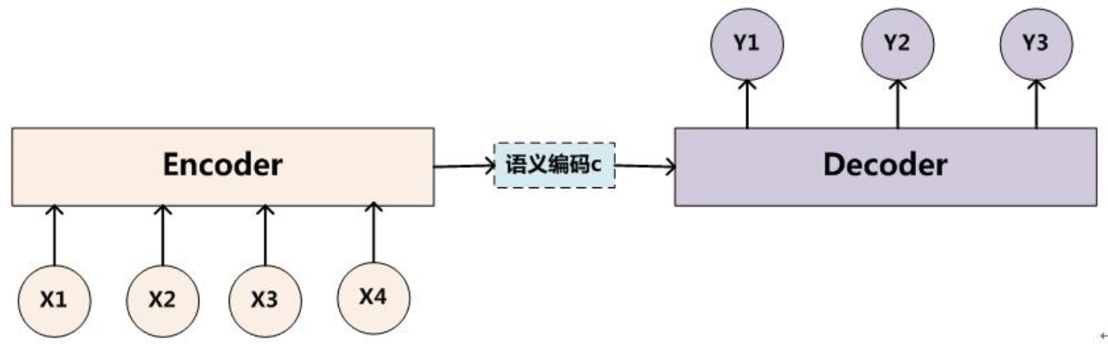
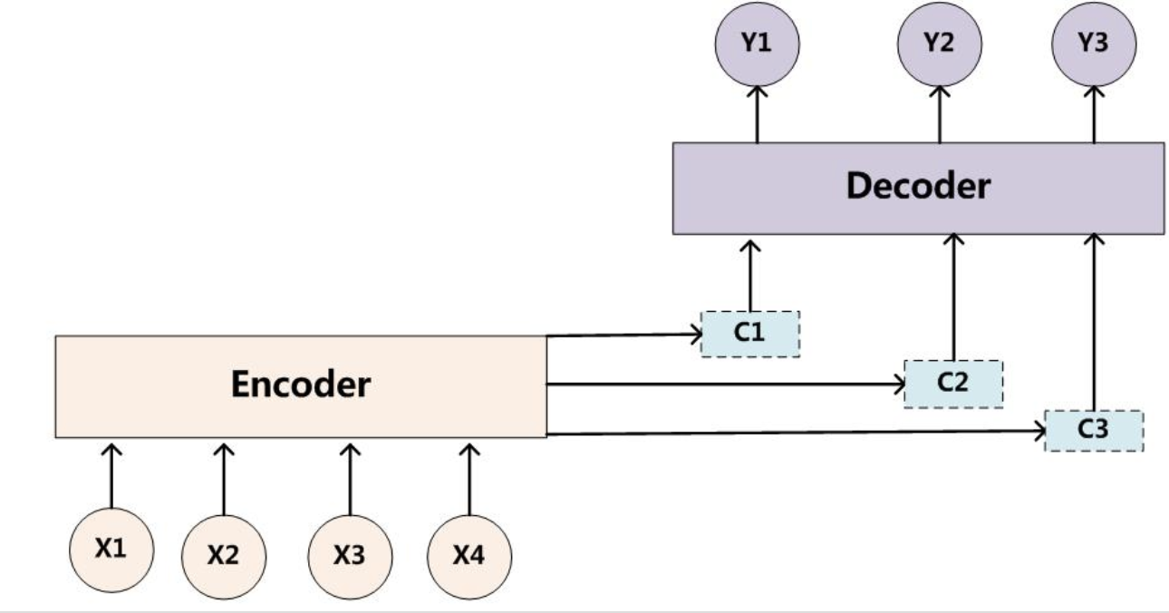
Attention
Attention mechanism : determine which input word is more influential to current predicted word
Before
After

Slide 7
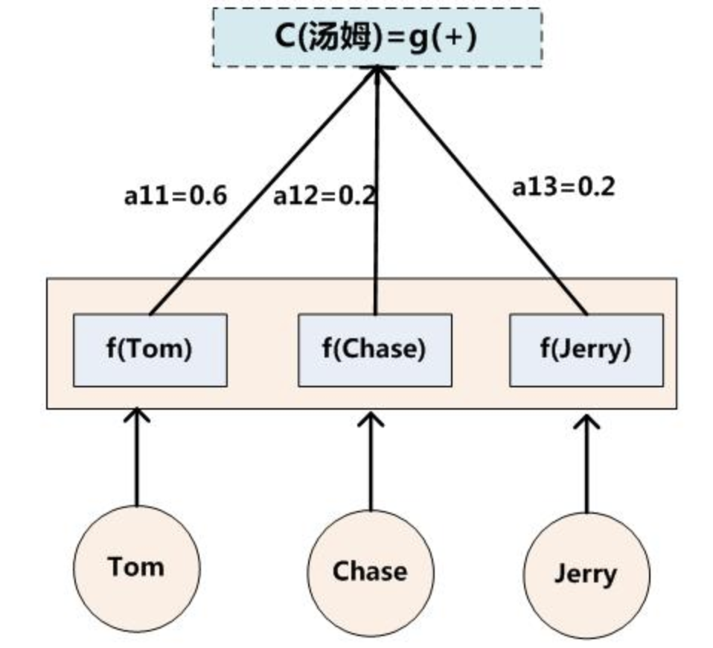
Generate Ci

Slide 8
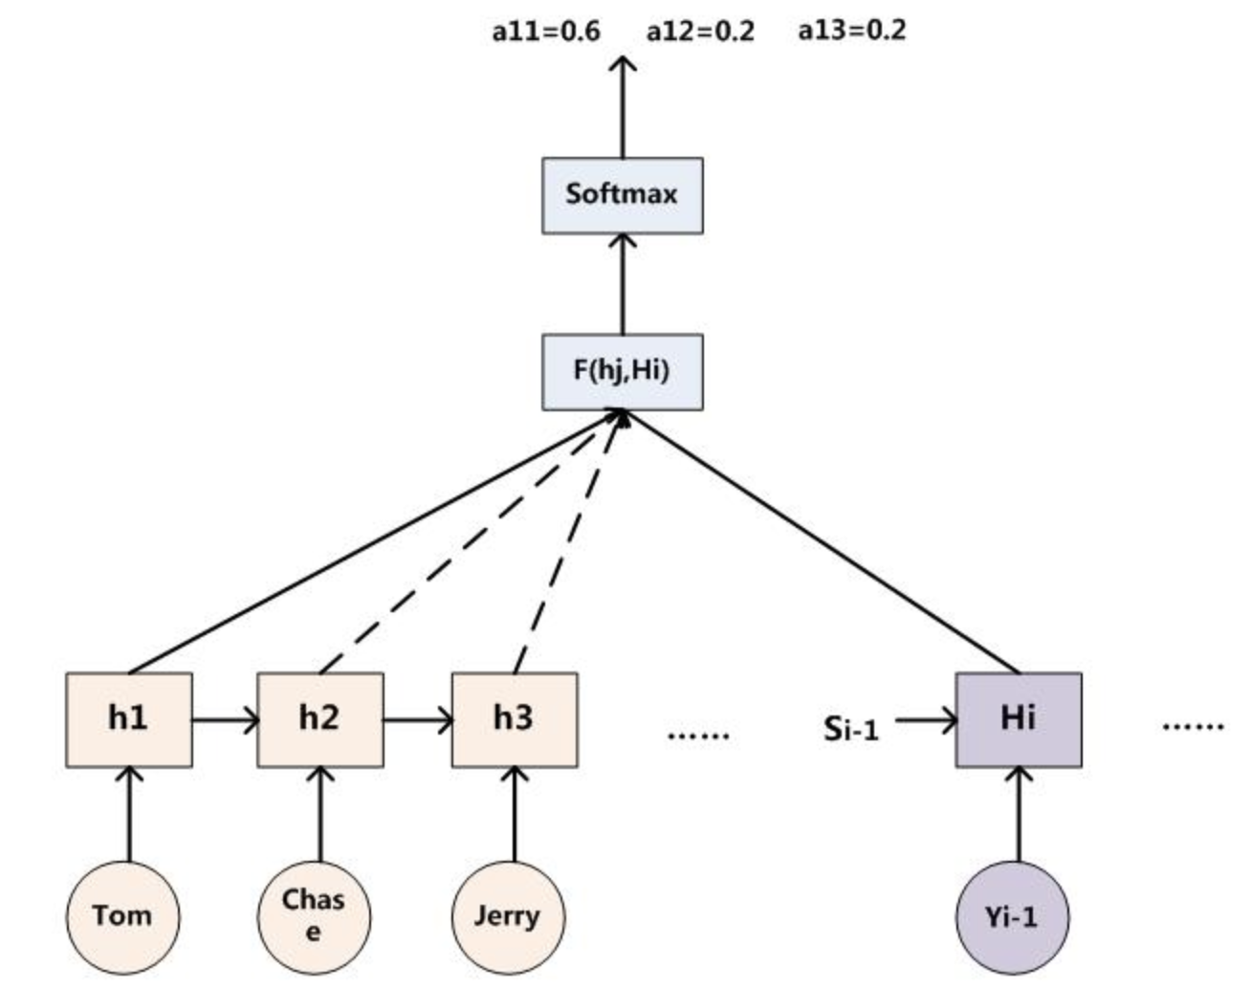
Generate the weights of aij
Dot
MLP
General
Concat
Cosine

Slide 9

Handling Out-of-Vocabulary Words
Copy attention:
(1) Incorporating Copying Mechanism in Sequence-to-Sequence Learning 2016
(2) Decide whether to either generate a new word or to copy from the source

Slide 10
“Teacher Forcing”
Seq2Seq take previous (t-1) output as (t) input
Problem: wrong prediction will affect all afterward units
Solve: correct the answer before feed as input
Problem? Disconnect between training and testing
Solve : Randomly feed in a generated word to train model

Slide 11
Pre-train Model
GloVe
Wikipedia 2014 + Gigaword (6B tokens, 400K vocab)
50、100、200、300 dimension

Slide 12
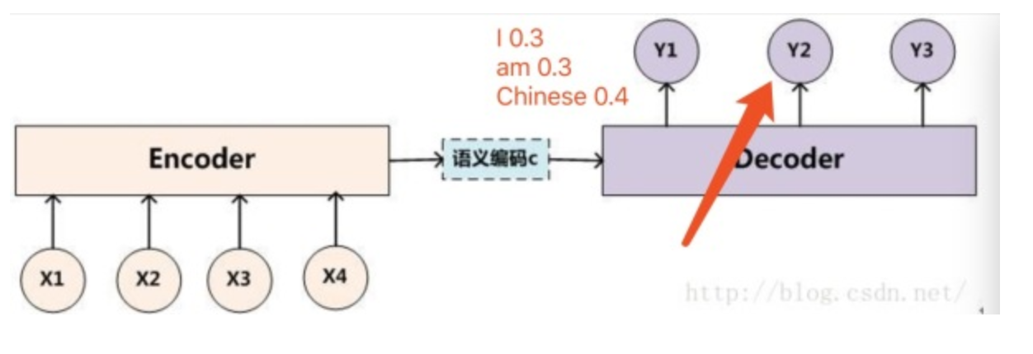
Beam Search
When to use it?
Testing
Why to use it?
In order to increase the accuracy of the output.
Explain beam size? Ex: beam size = 2
Find two sequences with the highest probability

Slide 13
Model Parameter
Word embeddings : 256
2 hidden layers of LSTM，each layer has 512 hidden units.
Encoder_type : Brnn
Decoder_type : Rnn
Dropout 0.3
Learning rate of 0.01 along with the Adam
train for 16 epochs
Global attention type : dot, MLP and General

Slide 14
Dataset
English Gigaworod :
1. Come from harvarnlp
2. train : 3.8M news articles with 119M words
3. valid : 190K news articles with 6M words
Preprocessing :
1. lowercased, tokenized
2. Only take the first paragraph of the text.
3. <Eos> symbol is added to both headline and text.
4. headline lengths exceed 50 tokens and text lengths exceed 100 tokens
5. keeping only the 50000 most frequently words.

Slide 15
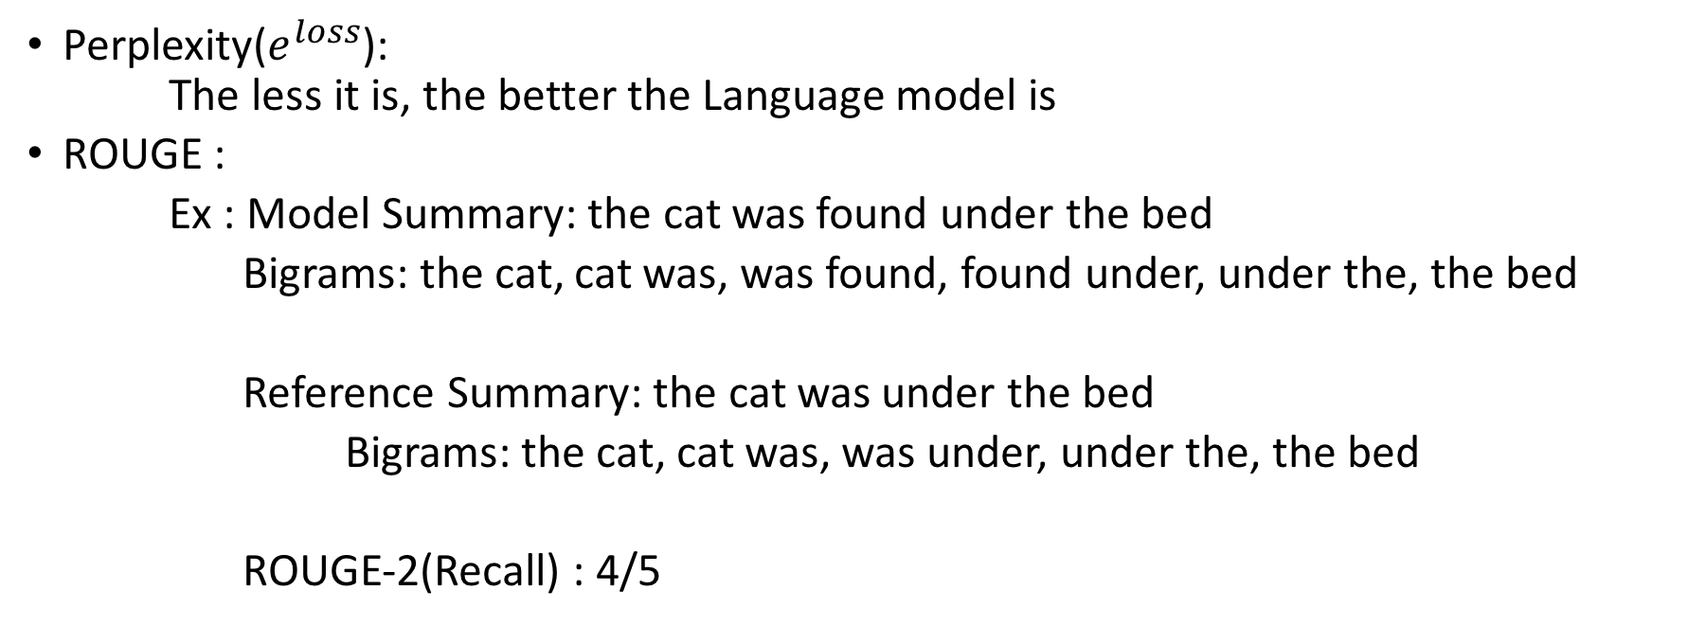
Evaluation
Perplexity($e^{loss}$):
The less it is, the better the Language model is
ROUGE :
Ex : Model Summary: the cat was found under the bed
Bigrams: the cat, cat was, was found, found under, under the, the bed
Reference Summary: the cat was under the bed
Bigrams: the cat, cat was, was under, under the, the bed
ROUGE-2(Recall) : 4/5

Slide 16
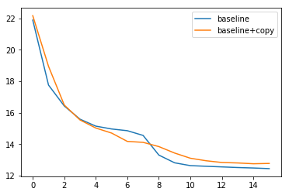
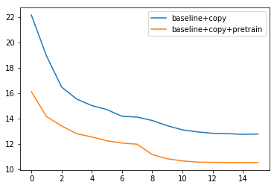
Analysis- Perplexity

Slide 17
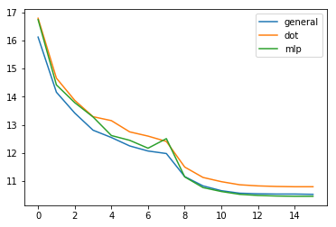
Analysis- Perplexity

Slide 18
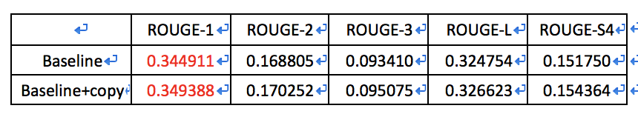
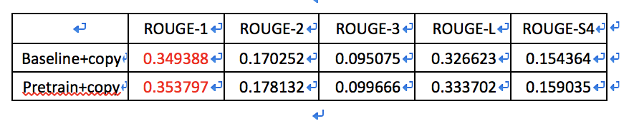
Analysis-ROUGE
Baseline vs Baseline + Copy attention
Baseline + Copy attention vs Pretrain + Copy attention

Slide 19
Analysis-ROUGE
Pretrain + attention ( MLP vs Dot vs General )

Slide 20
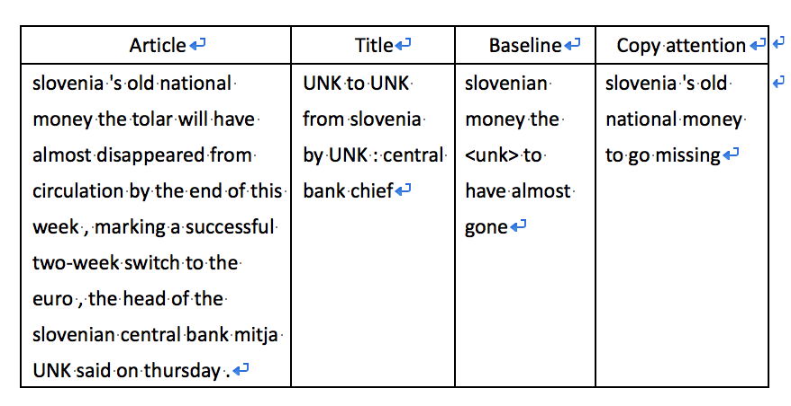
Result-Copy
Copy attention
Notes:
斯洛文尼亞的舊國債將在本週末幾乎消失，標誌著歐元兩周成功轉型。
斯洛文尼亞的錢幾乎沒有了

Slide 21
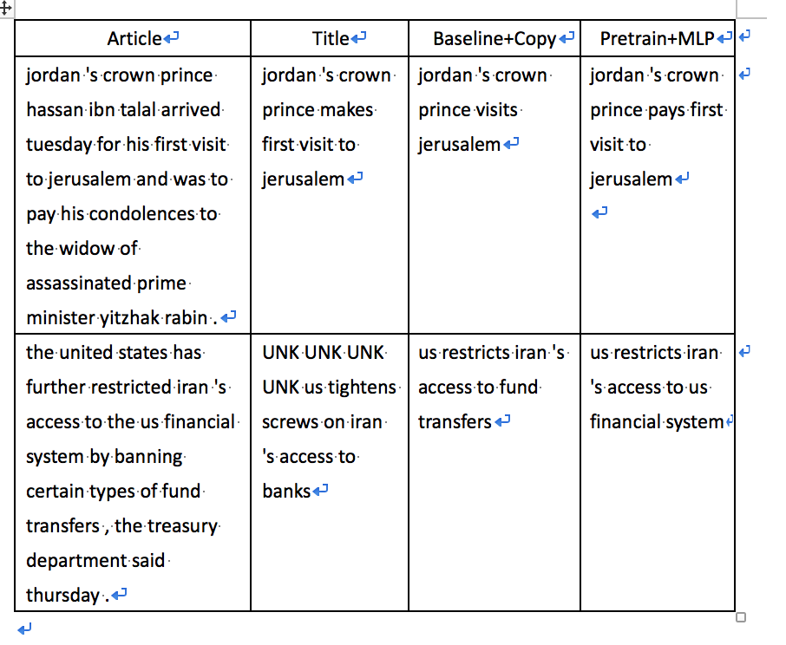
Result
Notes:
約旦首相哈桑·本·塔拉爾星期二抵達耶路撒冷，並向遇刺遇刺的總理伊扎克·拉賓的遺pay表示哀悼
約旦王儲訪問耶路撒冷
約旦王儲首次訪問耶路撒冷
美國財政部周四表示，美國通過禁止某些類型的資金轉移，進一步限制了伊朗進入美國的金融體系
我們限制伊朗的資金轉移
我們限制伊朗進入我們的金融體

Slide 22
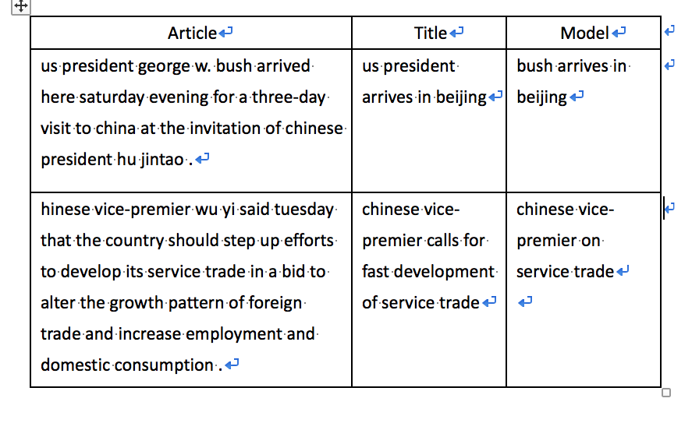
Error
The network fails to focus on the core of the source text.
The network incorrectly composes fragments of the source text

Slide 23
Future Work
Extractive
Pretrain Gigaword word vector
coverage attention
Tf-Idf

Slide 24
QA

