Slide 1
Using Deep Learning and Word2vec
to generate spelling candidate
106065503 蔡仲庭
106065523 謝毅霖

Slide 2
Purpose
Seq2Seq
Word2vec
Test Dataset
Evaluation
Outline
System
Future

Slide 3
1
Purpose

Slide 4
Find new way to…
Correct non-words and real-word errors
Create word candidate

Slide 5
2
Seq2Seq

Slide 6
Character-based Seq2Seq
appla
apple
a
p
p
l
e
<End>
a
p
p
l
a
<End>
Encoder
Decoder

Slide 7
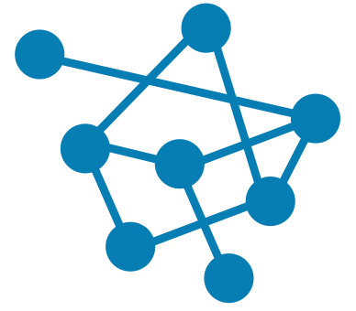
Training Data and Parameter
720 thousands
EFCAMDAT + Wiki + Birkbeck
60 dim
Word vector size

Slide 8
RNN
LSTM
(BRNN)
2 Layers
Attention

Slide 9
3
Word2vec

Slide 10
V('king') - V('man') + V('woman') = V('queen')
Word2vec
V('catt') - V('cat') = transformation vector
V('spelll') - transformation vector = V('spell')

Slide 11

Training Data and Vector Model
719,667 words
EFCAMDAT
GloVe
using Common Crawl
(840B tokens, 2.2M vocab, cased, 300d vectors)

Slide 12
Word2vec - Method
V(misspelling) - V(correct word) / len(corpus) = transformation vector
V('catt') - transformation vector = Vi
Find 100 neighbors near Vi
Use edit distance to filter noise word
Sorted candidate

Slide 13
4
Test Dataset

Slide 14
Test Dataset - word
270
words
400
words
2455
words
2455
words
Test 1
Test 2
Aspell
Wikipedia

Slide 15
5
Evaluation

Slide 16
Evaluation - misspelling
 | enchant | Seq2Seq | Word2vec
Test 1 | 0.66 | 0.737 | 0.733
Test 2 | 0.67 | 0.73 | 0.69
Aspell | 0.72 | 0.683 | 0.73
Wikipedia | 0.693 | 0.683 | 0.73

Slide 17
6
System

Slide 18
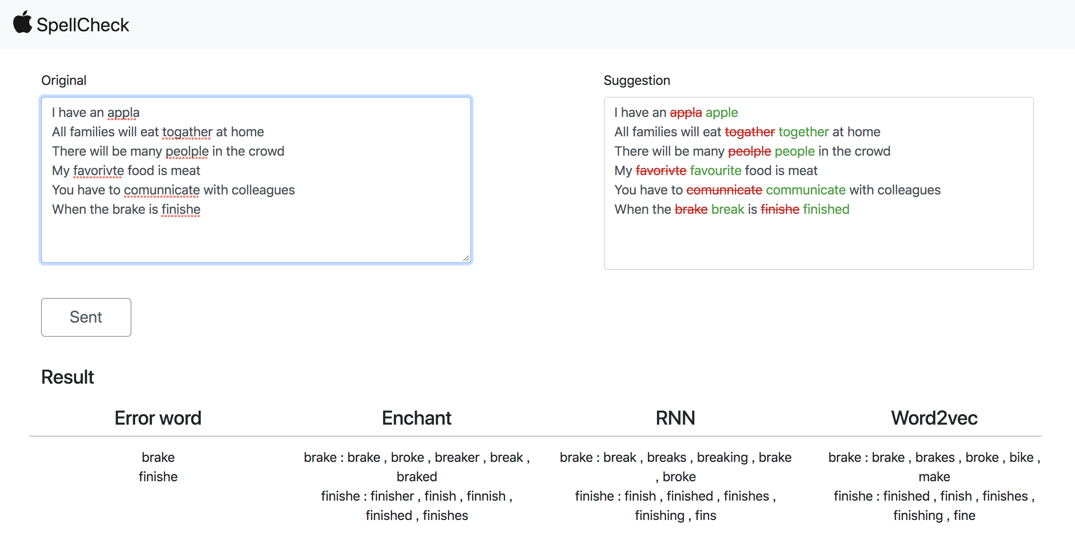

Slide 19
7
Future

Slide 20
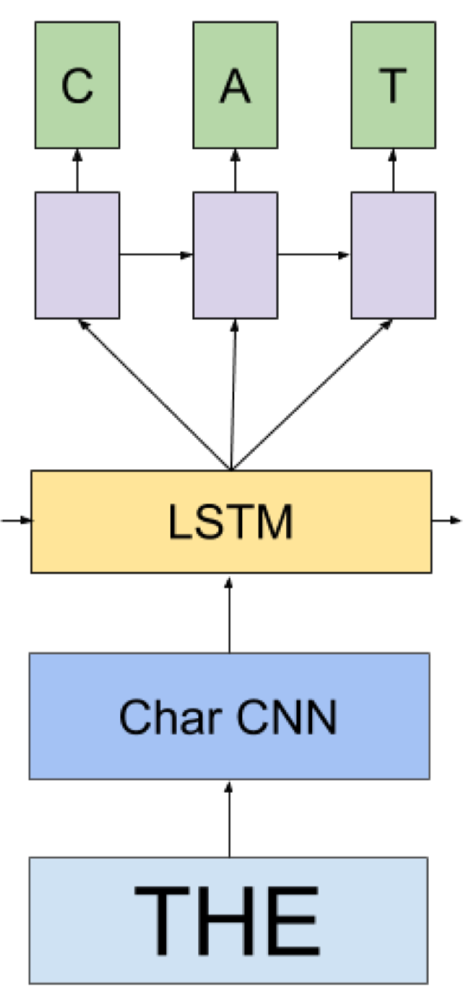
Future
Seq2Seq + NER (Name Entity Recognition)
RNN LM v.s. Linggle LM

Slide 21
Thanks!

