Slide 1
Data Structures and algorithms-3
25CS2103E
Topic: String Algorithms

Slide 2
String Matching Problem
String matching also called pattern matching is one of the most fundamental problems in Computer Science.
It is widely used in text processing, search engines, bioinformatics, plagiarism detection, data mining, and cybersecurity.
The objective is to determine whether a pattern occurs inside a larger text, and if it does, identify all its occurrences.

Slide 3
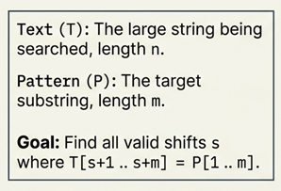
String Matching Problem
Definition:- Given a text T of length n and a pattern P of length m (where m ≤ n), find all positions (shifts) in T where P occurs. We say the pattern P occurs with shift s in the text T if 0 ≤ s ≤ n − m and T[s + 1 .. s + m] = P[1 .. m]. Such a shift s is called a valid shift; otherwise it is an invalid shift.

Slide 4
The string-matching problem is the problem of finding all valid shifts with which a given pattern P occurs in a given text T.
Eg: Find pattern P= abaa in the text T = abcabaabcabac.
The pattern occurs only once in the text, at shift s =3, which is a valid shift.

Slide 5
Example
Given T =
and P = ABC
The first occurrence starts at T[2]
The second occurrence starts at T[8]
The third occurrence starts at T[12]
A | B | A | B | C | A | B | D | A | B | C | A | A | B | C
0 | 1 | 2 | 3 | 4 | 5 | 6 | 7 | 8 | 9 | 10 | 11 | 12 | 13 | 14

Slide 6
Naive String Pattern Matching Algorithm
The naive string matching algorithm is the simplest, brute-force method for finding all occurrences of a specific pattern within a larger text.
It does not use any information from previous comparisons, simply shifting the pattern by one character after a mismatch or a successful match.
Like brute force, it also checks for all characters of the main string in order to find the pattern. Hence, its time complexity is O(mn) where the 'm' is the size of pattern and 'n' is the size of the main string. This algorithm is helpful for smaller texts only.
The naive pattern searching algorithm does not require any pre-processing phases.
It does not occupy extra space to perform the operation.

Slide 7
Text: a b c d a b f a b e g Pattern: abe
Text | a b c d a b f a b e g | No of comparisons
1st iteration | a b e | 3
2nd | a b e | 1

Slide 8
Text: a b c d a b f a b e g Pattern: abe
Text | a b c d a b f a b e g | No of comparisons
1st iteration | a b e | 3
2nd | a b e | 1
3rd | a b e | 1
4th | a b e | 1
5th | a b e | 3
6th | a b e | 1
7th | a b e | 1
8th | a b e | 3
Result in 8th iteration and the number of comparisons are 14

Slide 9
Let's go through an example with T=ababcabdabcaabc and P=abc.
Text: ababcabdabcaabc
Pattern: abc
The algorithm checks for the pattern at every position in the text:
At position 0: T[0..2] = aba (no match)
At position 1: T[1..3] = bab (no match)
At position 2: T[2..4] = abc (match found, index 2)
At position 3: T[3..5] = bca (no match)
At position 4: T[4..6] = cab (no match)
At position 5: T[5..7] = abd (no match)
At position 6: T[6..8] = bda (no match)
At position 7: T[7..9] = dab (no match)
At position 8: T[8..10] = abc (match found, index 8)
At position 9: T[9..11] = bca (no match)
At position 10: T[10..12] = caa (no match)
At position 11: T[11..13] = aab (no match)
At position 12: T[12..14] = abc (match found, index 12)
The matches are found in indices 2, 8, and 12.

Slide 10
Naïve Algorithm
Algorithm naïve_string(Text, Pattern)
begin
n=length(Text)
m=length(Pattern)
for i=0 to n-m step 1 do
for j=0 to m-1 step 1 do
if Text[i+j]!= Pattern[j]:
break
end if
end for
if j==m then
print "Pattern found at index", i
end if
end for
stop
Text (index i)
A | B | A | B | C
0 | 1 | 2 | 3 | 4
Pattern (index j)
A B C

Slide 11
public static void main(String[] args) {
// TODO Auto-generated method stub
String text1 = "AABAACAADAABAABA";
String pat1 = "AABA";
System.out.println("First string output " + text1+" "+pat1);
search(text1,pat1);
String text2 = "ababcabdabcaabc";
String pat2 = "abc";
System.out.println("Second string output " + text2+" "+pat2);
search(text2,pat2);
}
}
//Naive string pattern matching program
public class Naivestring {
public static void search(String text, String pat) {
int m=text.length();
int m=pat.length();
int i,j;
for (i=0;i<=n-m;i++)
{
for (j=0;j<m;j++)
{
if (text.charAt(i+j)!=pat.charAt(j))
break;
}
if (j==m)
System.out.println("Pattern found at index " +i);
}
}
OUTPUT:
First string output AABAACAADAABAABA AABA
Pattern found at index 0
Pattern found at index 9
Pattern found at index 12
Second string output ababcabdabcaabc abc
Pattern found at index 2
Pattern found at index 8
Pattern found at index 12

Slide 12
Consider the worst case: P = "aaab" style patterns against runs of the same character.
Text T = "aaaaaaaaab" (n=10), keyword P = "aaab" (m=4). Windows i = 0…6:
i=0: a a a b vs T[0..3]=a a a a → a=a,a=a,a=a,b≠a → 4 comparisons, FAIL
i=1: a a a b vs T[1..4]=a a a a → a=a,a=a,a=a,b≠a → 4 comparisons, FAIL
i=2: a a a b vs T[2..5]=a a a a → 4 comparisons, FAIL
i=3: a a a b vs T[3..6]=a a a a → 4 comparisons, FAIL
i=4: a a a b vs T[4..7]=a a a a → 4 comparisons, FAIL
i=5: a a a b vs T[5..8]=a a a a → 4 comparisons, FAIL
i=6: a a a b vs T[6..9]=a a a b → 4 comparisons, MATCH
Now look at what was redundant: the character T[3]='a' alone was compared four separate times, at i=0, then again at i=1, i=2, i=3.

Slide 13
Naïve pattern matching is simple and correct but it lets the text pointer backtrack after every mismatch and ignores the pattern's internal structure, causing the same text characters to be compared repeatedly.
Its cost is O(n·m) in the worst case, triggered precisely by the repetitive, partially-matching keyword text.
The repeated comparisons are the redundant re-examination of characters already inspected in earlier alignments and eliminating them is the whole motivation for KMP, Boyer–Moore, and Rabin–Karp.

Slide 14
Complexity Analysis
Time Complexity (Worst Case): O(n*m). This occurs in cases where the text and pattern have many repetitive characters (e.g., Text: AAAAA, Pattern: AAA) or have near matches. For every possible starting position, nearly the entire pattern is compared.
Time Complexity (Best Case): O(n). This occurs when the first character of the pattern does not appear in the text at all, leading to an immediate mismatch at most positions.
Space Complexity: O(1). The algorithm requires a constant amount of extra memory regardless of the input size, as it only uses a few variables for indices and lengths.

Slide 15
Advantages
Very simple to understand and implement.
No preprocessing and no extra memory required (O(1) space).
Works well for short patterns, small texts, or when matches are rare.
Disadvantages
Inefficient for large or highly repetitive inputs — up to O(n·m) time.
Re-examines characters it has already compared, wasting work.
Slower than smarter algorithms (KMP, Boyer–Moore, Rabin–Karp) that avoid redundant comparisons.

Slide 16
Applications Naïve String Pattern Matching Algorithm
Text searching
Find and replace
Spell checking
DNA sequence analysis
Plagiarism detection
Log file analysis
Source code search
Database search
Configuration file search
Virus signature detection
Educational demonstrations
Simple command-line search utilities

Slide 17
Knuth-Morris-Pratt (KMP) algorithm
The Knuth-Morris-Pratt (KMP) algorithm is a string pattern matching algorithm developed by Donald Knuth, James Morris and Vaughan Pratt. Hence the name Knuth-Morris-Pratt (KMP) Algorithm.
The Knuth-Morris-Pratt (KMP) algorithm is a highly efficient string-searching method that searches for occurrences of a pattern within a text in linear O(n + m) time.
Unlike the naive brute-force method, which resets completely and backtracks the text pointer after a mismatch, KMP uses the structural information of the pattern itself to skip redundant comparisons.
It achieves this by preprocessing the pattern string to construct a Failure Function.
The failure function, denoted as π or lps[] (Longest Proper Prefix which is also a Suffix), stores the length of the longest proper prefix of the pattern substring that is also a suffix of that substring.
Proper Prefix: A prefix of a string that is not the entire string itself (e.g., proper prefixes of "abc" are "", "a", and "ab").
Suffix: A concluding segment of a string (e.g., suffixes of "abc" are "", "c", "bc", and "abc").
When a mismatch occurs at a specific index in the pattern, the failure function tells the algorithm exactly where to slide the pattern to resume matching, ensuring the text pointer never backtracks.

Slide 18
lps[] table for the pattern string: P = "ABABC"
Index (i) | Substring P[0...i] | Proper Prefixes | Suffixes | Longest Matching Length (lps[i])
0 | "A" | None | "A" | 0
1 | "AB" | "A" | "B" | 0
2 | "ABA" | "A", "AB" | "A", "BA" | 1 (Prefix "A" = Suffix "A")
3 | "ABAB" | "A", "AB", "ABA" | "B", "AB", "BAB" | 2 (Prefix "AB" = Suffix "AB")
4 | "ABABC" | "A", "AB", "ABA", "ABAB" | "C", "BC", "ABC", "BABC" | 0
Final lps array for "ABABC": [0, 0, 1, 2, 0]

Slide 19
Examples for creating an LPS array for different patterns
1 2 3 4 5 6 7 8 9 10
  P1: a b c d a b e a b f

Slide 20
Examples for creating an LPS array for different patterns
1 2 3 4 5 6 7 8 9 10
  P1: a b c d a b e a b f
  0 0 0 0 1 2 0 1 2 0

Slide 21
Examples for creating an LPS array for different patterns
1 2 3 4 5 6 7 8 9 10
  P1: a b c d a b e a b f
  0 0 0 0 1 2 0 1 2 0
  P2: a b c d e a b f a b c

Slide 22
Examples for creating an LPS array for different patterns
1 2 3 4 5 6 7 8 9 10
  P1: a b c d a b e a b f
  0 0 0 0 1 2 0 1 2 0
  P2: a b c d e a b f a b c
  0 0 0 0 0 1 2 0 1 2 3
  P3: a a b c a d a a b e
  0 1 0 0 1 0 1 2 3 0
  P4: a a a a b a a c d
  0 1 2 3 0 1 2 0 0

Slide 23
How KMP Algorithm works
Text : a b a b c a b c a b a b a b d
0 1 2 3 4 5 6 7 8 9 10 11 12 13 14
Pattern: a b a b d
First, we will prepare the “π” Table (LPS[] array)
0 1 2 3 4
a | b | a | b | d
0 | 0 | 1 | 2 | 0
Notes:
To compute p, we use Horner’s rule
p = P[m] + 10(P[m-1] + 10(P[m-2] + … + 10(P[2] + 10(P[1]) …))
in which we can compute in time O(m).

Slide 24
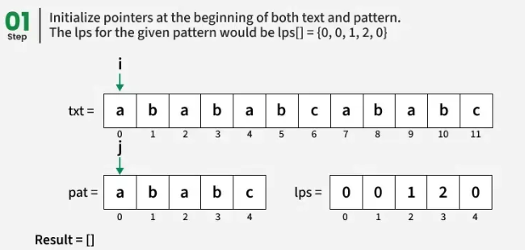
Working of KMP

Slide 25
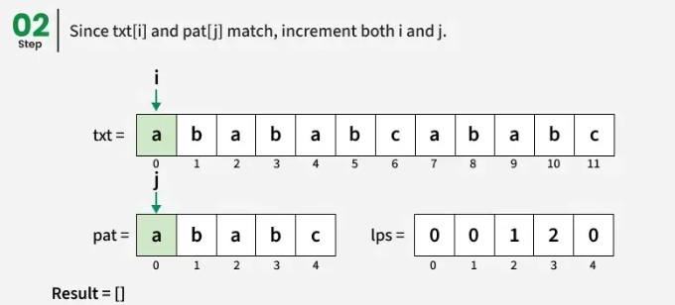
Working of KMP

Slide 26
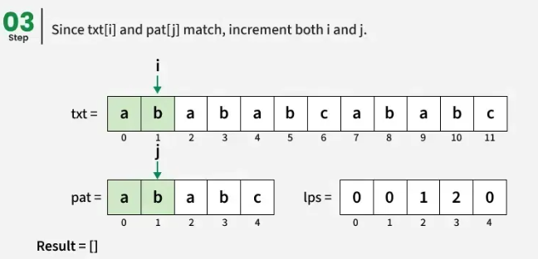
Working of KMP

Slide 27
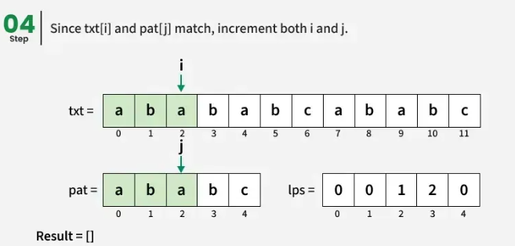
Working of KMP

Slide 28
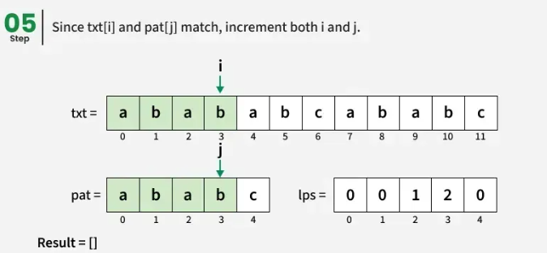
Working of KMP

Slide 29
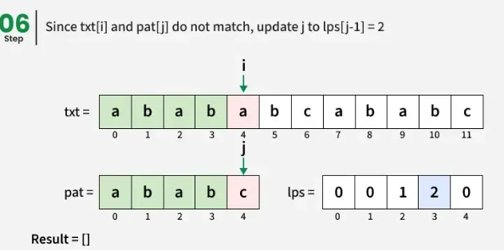
Working of KMP

Slide 30
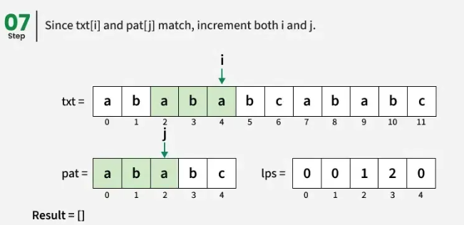
Working of KMP

Slide 31
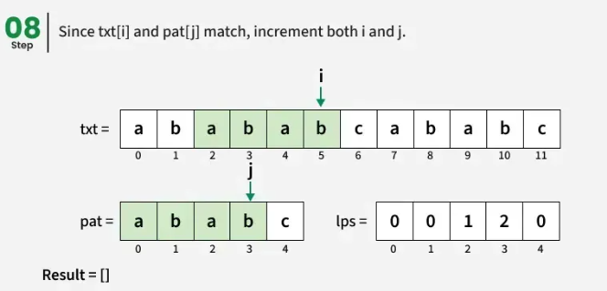
Working of KMP

Slide 32
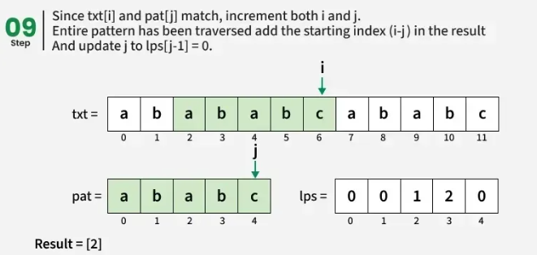
Working of KMP

Slide 33
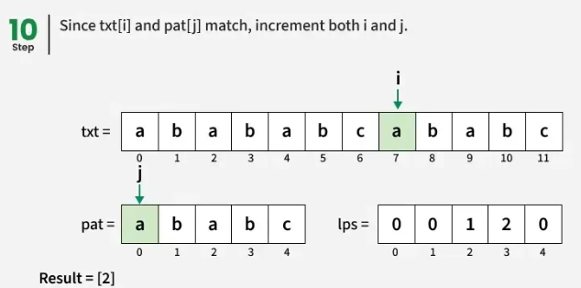
Working of KMP

Slide 34
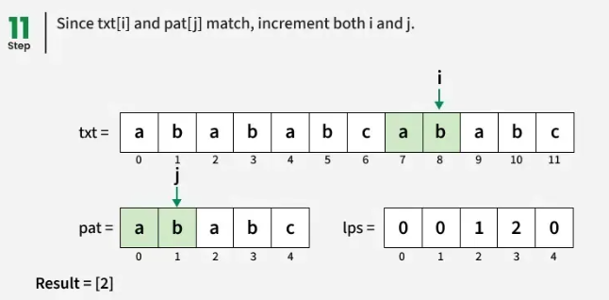
Working of KMP

Slide 35
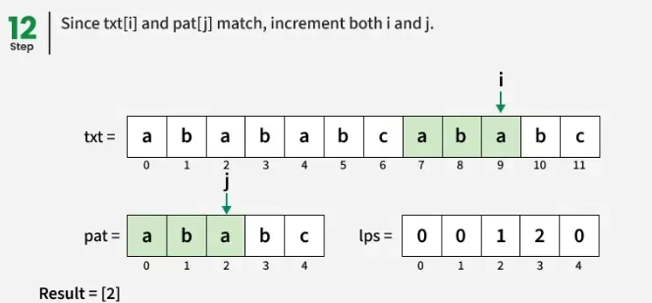
Working of KMP

Slide 36
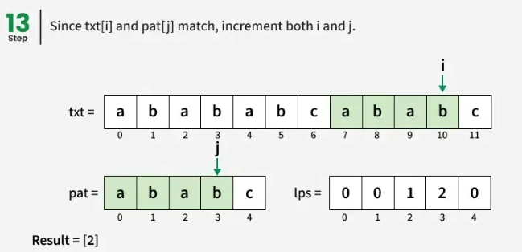
Working of KMP

Slide 37
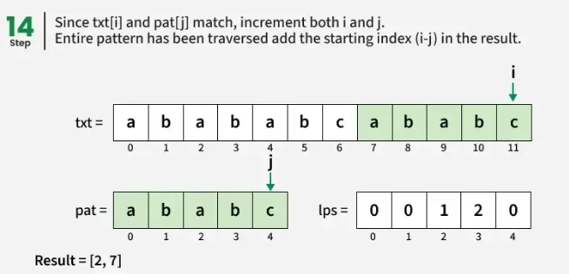
Working of KMP

Slide 38

How KMP Algorithm works
i
Pattern ->
Text: a b a b c a b c a b a b a b d
0 1 2 3 4 5 6 7 8 9 10 11 12 13 14
‘i’ - T [index] ->
j
Now, Compare, Text[i] with the Pattern[j].
If Matched, Increment both ‘j’ & ‘i’ by 1.
Else if not matched, move the ‘j’ to the index numbered by LPS[j]
‘j’ – P [index] ->
0 1 2 3 4 5
a | b | a | b | d
0 | 0 | 1 | 2 | 0
Pattern
$$ᴨ$$
Notes:
To compute p, we use Horner’s rule
p = P[m] + 10(P[m-1] + 10(P[m-2] + … + 10(P[2] + 10(P[1]) …))
in which we can compute in time O(m).

Slide 39

How KMP Algorithm works
i
Pattern ->
Text: a b a b c a b c a b a b a b d
0 1 2 3 4 5 6 7 8 9 10 11 12 13 14
‘i’ - T [index] ->
j
Now, Compare, Text[i] with the Pattern[j].
If Matched, Increment both ‘j’ & ‘i’ by 1.
Else if not matched, move the ‘j’ to the index numbered by LPS[j]
‘j’ – P [index] ->
0 1 2 3 4 5
Pattern
a | b | a | b | d
0 | 0 | 1 | 2 | 0
$$ᴨ$$
Notes:
To compute p, we use Horner’s rule
p = P[m] + 10(P[m-1] + 10(P[m-2] + … + 10(P[2] + 10(P[1]) …))
in which we can compute in time O(m).

Slide 40
How KMP Algorithm works
i
Pattern ->
Text: a b a b c a b c a b a b a b d
0 1 2 3 4 5 6 7 8 9 10 11 12 13 14
‘i’ - T [index] ->
j
Now, Compare, Text[i] with the Pattern[j].
If Matched, Increment both ‘j’ & ‘i’ by 1.
Else if not matched, move the ‘j’ to the index numbered by LPS[j]
‘j’ – P [index] ->
0 1 2 3 4 5
a | b | a | b | d
0 | 0 | 1 | 2 | 0
Pattern
$$ᴨ$$
Notes:
To compute p, we use Horner’s rule
p = P[m] + 10(P[m-1] + 10(P[m-2] + … + 10(P[2] + 10(P[1]) …))
in which we can compute in time O(m).

Slide 41
How KMP Algorithm works
i
Pattern ->
Text: a b a b c a b c a b a b a b d
0 1 2 3 4 5 6 7 8 9 10 11 12 13 14
‘i’ - T [index] ->
j
Now, Compare, Text[i] with the Pattern[j].
If Matched, Increment both ‘j’ & ‘i’ by 1.
Else if not matched, move the ‘j’ to the index numbered by LPS[j]
‘j’ – P [index] ->
0 1 2 3 4 5
a | b | a | b | d
0 | 0 | 1 | 2 | 0
Pattern
$$ᴨ$$
Notes:
To compute p, we use Horner’s rule
p = P[m] + 10(P[m-1] + 10(P[m-2] + … + 10(P[2] + 10(P[1]) …))
in which we can compute in time O(m).

Slide 42
How KMP Algorithm works
i
Pattern ->
Text: a b a b c a b c a b a b a b d
0 1 2 3 4 5 6 7 8 9 10 11 12 13 14
‘i’ - T [index] ->
j
Now, Compare, Text[i] with the Pattern[j].
If Matched, Increment both ‘j’ & ‘i’ by 1.
Else if not matched, move the ‘j’ to the index numbered by LPS[j]
‘j’ – P [index] ->
0 1 2 3 4
a | b | a | b | d
0 | 0 | 1 | 2 | 0
Pattern
$$ᴨ$$
Notes:
To compute p, we use Horner’s rule
p = P[m] + 10(P[m-1] + 10(P[m-2] + … + 10(P[2] + 10(P[1]) …))
in which we can compute in time O(m).

Slide 43
How KMP Algorithm works
i
The Basic Idea in KMP is If a substring of a pattern is again appeared in the pattern, then no need to compare again and again. In that way, we can reduce the number of comparisons.
Here, we are not backtracking the ‘i’, only ‘j’ is backtracking.
The Time Complexity of KMP is
O( m + n )
O(m+n) – This is one of the Fastest algorithm in Pattern Matching Algorithms.
LPS Array Search
Notes:
To compute p, we use Horner’s rule
p = P[m] + 10(P[m-1] + 10(P[m-2] + … + 10(P[2] + 10(P[1]) …))
in which we can compute in time O(m).

Slide 44
KMP Algorithm
Step 1: Read the Text (T) and Pattern (P).
Step 2: Construct the LPS (Longest Prefix Suffix) array for the pattern.
Step 3: Initialize two indices:
    i = 0 (for the Text)
    j = 0 (for the Pattern)
Step 4: Compare the current characters of the Text and Pattern.
If the characters match:
  Move both indices (i and j) to the next character.
If all characters of the pattern are matched (j = m):
  Display "Pattern Found".
  Continue searching using the LPS value.
If a mismatch occurs:
  If j is not 0, set j = LPS[j − 1] and continue matching.
  Otherwise, move to the next character in the text (i = i + 1).
Step 5: Repeat the above steps until the entire text has been searched.
Step 6: Stop.

Slide 45
Pseudocode
KMP Search
Constructing the LPS Array
function KMP(T, n, P, m):
lps = computeLPS(P, m)
i = 0 # index into text T
j = 0 # index into pattern P
while i < n:
if T[i] == P[j]:
i = i + 1
j = j + 1
if j == m:
report match at index (i - j)
j = lps[j - 1] # continue searching for more matches
else:
if j != 0:
j = lps[j - 1] # shift pattern, reuse matched prefix
else:
i = i + 1
# no more matches
function computeLPS(P, m):
lps[0] = 0
len = 0 # length of previous longest prefix-suffix
i = 1
while i < m:
if P[i] == P[len]:
len = len + 1
lps[i] = len
i = i + 1
else:
if len != 0:
len = lps[len - 1] # fall back, do NOT advance i
else:
lps[i] = 0
i = i + 1
return lps

Slide 46
//JAVA program for implementation of KMP pattern searching algorithm
class KMPString {
void KMPSearch(String pat, String txt){
  int M = pat.length();
  int N = txt.length();
  int lps[] = new int[M];
  int j = 0;
computeLPSArray(pat, M, lps);
  int i = 0;
  while (i < N) {
if (pat.charAt(j) == txt.charAt(i)) {
j++; i++; }
if (j == M) {
System.out.println("Found pattern "+ "at index "+(i- j));
j = lps[j - 1];
}
else if (i < N && pat.charAt(j) != txt.charAt(i))
{
      if (j != 0)
      j = lps[j - 1];
      else
      i = i + 1;
} //else if close
} //while close
} //function close

Slide 47
void computeLPSArray(String pat, int M, int lps[]){
  int len = 0;
  int i = 1;
  lps[0] = 0;
  while (i < M) {
  if (pat.charAt(i) == pat.charAt(len)) {
    len++; lps[i] = len;i++; }
  else
    {
      if (len != 0)
      len = lps[len - 1];
      else
      {
        lps[i] = len;
        i++;
      }
  }
  }
  }
public static void main(String args[])
{
  String txt = "ABABDABACDABABCABAB";
  String pat ="ABA";
  new KMPString().KMPSearch(pat, txt);
}
} //KMPSgtring class close
Output:
Found pattern at index 0
Found pattern at index 5
Found pattern at index 10
Found pattern at index 15

Slide 48
Comparison Between Naïve and KMP
Feature | Naïve Pattern Matching | KMP Algorithm
Pattern Preprocessing | No | Yes (LPS array)
Uses Failure Function | No | Yes
Repeated Comparisons | Yes | No
Restart After Mismatch | From beginning | From LPS value
Worst-Case Time | O(n × m) | O(n + m)
Extra Space | O(1) | O(m)
Suitable For | Small texts | Large texts and repeated searches

Slide 49
Applications of KMP
Search engines
Text editors (Find and Replace)
DNA sequence analysis
Bioinformatics
Plagiarism detection
Antivirus signature matching
Log file analysis
Network intrusion detection
Digital libraries
Information retrieval systems

Slide 50
Rabin-Karp Algorithm
Like the Naive Algorithm, the Rabin-Karp algorithm also check every substring. But unlike the Naive algorithm, the Rabin Karp algorithm matches the hash value of the pattern with the hash value of the current substring of text. So Rabin Karp algorithm has the following step
Compute the hash of the pattern and All the substrings of the text of length m, where m is the length of the pattern.
Compare pattern's hash with the hashes of all substrings (of same length as pattern) of the text. If the hashes match, we do a character-by-character check to confirm (to avoid errors due to hash collisions).

Slide 51
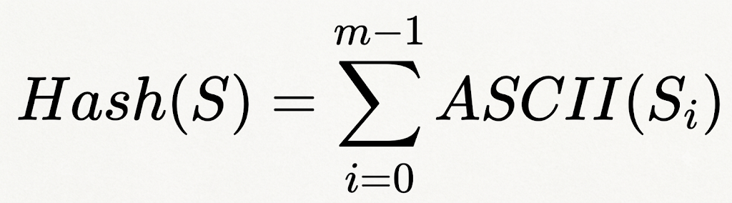
1) Simple Additive Hash:- The simplest hashing method computes the sum of the ASCII values of all characters. Instead of ASCII values, we may also consider values like a=1, b=2, c=3, and so on
where S is the String and m is the length of the String
Example: Hash (ababc) = 1 + 2 + 1 + 2 + 3 = 9

Slide 52
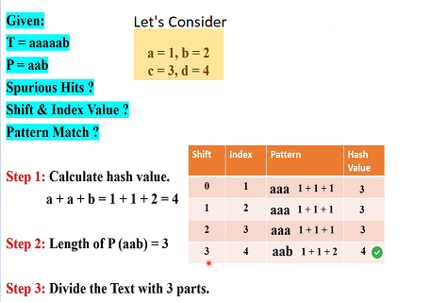
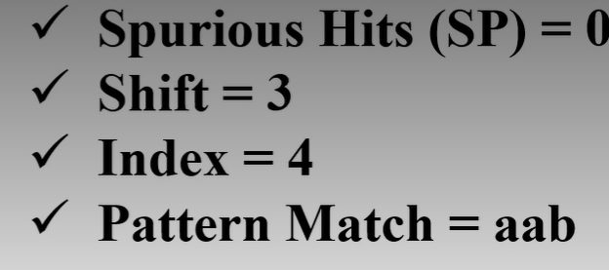

Slide 53
Text: a b c d a b a b c d Size of text (m)=10
Pattern: d a b a Size of Pattern (m) =4
consider values like a=1, b=2, c=3, d=4
1) Simple Additive Hash:- The simplest hashing method computes the sum of the ASCII values of all characters. Instead of ASCII values we can also consider values like a=1, b=2, c=3, and so on
where S is the String and m is the length of the String
Example: h(ababc) = 1 + 2 + 1 + 2 + 3 = 9

Slide 54
Example : Additive Hash
  Text T = "abcdababcd" (length n = 10)
  Pattern P = "daba" (length m = 4)
  Letter values: a=1, b=2, c=3, d=4
  Windows to test (positions 0–6): abcd, bcda, cdab, daba, abab, babc, abcd
  hash(pattern)= hash("daba") = 4+1+2+1 = 8.
Pos | Window | Sum | = 8? | Action
0 | a b c d
1 | b c d a
2 | c d a b
3 | d a b a
4 | a b a b
5 | b a b c
6 | a b c d

Slide 55
When the hash value of the pattern matches with the hash value of a window of the text but the window is not the actual pattern then it is called a spurious hit.
Additive Hash
  Text T = "abcdababcd" (length n = 10)
  Pattern P = "daba" (length m = 4)
Position | Window | Sum | = 8? | Action
0 | a b c d | 1+2+3+4 = 10 | ✗ | skip

Slide 56
When the hash value of the pattern matches with the hash value of a window of the text but the window is not the actual pattern then it is called a spurious hit.
Additive Hash
  Text T = "abcdababcd" (length n = 10)
  Pattern P = "daba" (length m = 4)
Position | Window | Sum | = 8? | Action
0 | a b c d | 1+2+3+4 = 10 | ✗ | skip
1 | b c d a | 2+3+4+1 = 10 | ✗ | skip

Slide 57
When the hash value of the pattern matches with the hash value of a window of the text but the window is not the actual pattern then it is called a spurious hit.
Additive Hash
  Text T = "abcdababcd" (length n = 10)
  Pattern P = "daba" (length m = 4)
Position | Window | Sum | = 8? | Action
0 | a b c d | 1+2+3+4 = 10 | ✗ | skip
1 | b c d a | 2+3+4+1 = 10 | ✗ | skip
2 | c d a b | 3+4+1+2 = 10 | ✗ | skip

Slide 58
When the hash value of the pattern matches with the hash value of a window of the text but the window is not the actual pattern then it is called a spurious hit.
Additive Hash
  Text T = "abcdababcd" (length n = 10)
  Pattern P = "daba" (length m = 4)
Position | Window | Sum | = 8? | Action
0 | a b c d | 1+2+3+4 = 10 | ✗ | skip
1 | b c d a | 2+3+4+1 = 10 | ✗ | skip
2 | c d a b | 3+4+1+2 = 10 | ✗ | skip
3 | d a b a | 4+1+2+1 = 8 | ✓ | verify → "daba"="daba" → MATCH

Slide 59
When the hash value of the pattern matches with the hash value of a window of the text but the window is not the actual pattern then it is called a spurious hit.
Additive Hash
  Text T = "abcdababcd" (length n = 10)
  Pattern P = "daba" (length m = 4)
Position | Window | Sum | = 8? | Action
0 | a b c d | 1+2+3+4 = 10 | ✗ | skip
1 | b c d a | 2+3+4+1 = 10 | ✗ | skip
2 | c d a b | 3+4+1+2 = 10 | ✗ | skip
3 | d a b a | 4+1+2+1 = 8 | ✓ | verify → "daba"="daba" → MATCH
4 | a b a b | 1+2+1+2 = 6 | ✗ | skip

Slide 60
When the hash value of the pattern matches with the hash value of a window of the text but the window is not the actual pattern then it is called a spurious hit.
Additive Hash
  Text T = "abcdababcd" (length n = 10)
  Pattern P = "daba" (length m = 4)
Position | Window | Sum | = 8? | Action
0 | a b c d | 1+2+3+4 = 10 | ✗ | skip
1 | b c d a | 2+3+4+1 = 10 | ✗ | skip
2 | c d a b | 3+4+1+2 = 10 | ✗ | skip
3 | d a b a | 4+1+2+1 = 8 | ✓ | verify → "daba"="daba" → MATCH
4 | a b a b | 1+2+1+2 = 6 | ✗ | skip
5 | b a b c | 2+1+2+3 = 8 | ✓ | verify → "babc"≠"daba" → false alarm (spurious hit.)

Slide 61
When the hash value of the pattern matches with the hash value of a window of the text but the window is not the actual pattern then it is called a spurious hit.
Additive Hash
  Text T = "abcdababcd" (length n = 10)
  Pattern P = "daba" (length m = 4)
Position | Window | Sum | = 8? | Action
0 | a b c d | 1+2+3+4 = 10 | ✗ | skip
1 | b c d a | 2+3+4+1 = 10 | ✗ | skip
2 | c d a b | 3+4+1+2 = 10 | ✗ | skip
3 | d a b a | 4+1+2+1 = 8 | ✓ | verify → "daba"="daba" → MATCH
4 | a b a b | 1+2+1+2 = 6 | ✗ | skip
5 | b a b c | 2+1+2+3 = 8 | ✓ | verify → "babc"≠"daba" → false alarm (spurious hit.)
6 | a b c d | 1+2+3+4 = 10 | ✗ | skip

Slide 62
How is Hash Value calculated in Rabin-Karp?
The hash value is calculated using a rolling hash function, which allows you to update the hash value for a new substring by efficiently removing the contribution of the old character and adding the contribution of the new character.
This makes it possible to slide the pattern over the text and calculate the hash value for each substring without recalculating the entire hash from scratch.

Slide 63
2) Polynomial Rolling Hash : This is the standard hash function used in the Rabin–Karp algorithm.
Here, C1 represents the ASCII value of the character ('a' = 97, 'b' = 98, ..., 'z' = 122)
b is the base, p is a prime number used as modulus (commonly 101, 1000000007, etc.),
modulo helps prevent integer overflow and reduces hash collisions.
Example: CAT : C = 67 , A = 65 , T = 84 , Base b=256 , Prime p=101
The polynomial formula is
H=(67×256² +65×256¹ +84×256⁰ ) mod 101 = 97

Slide 64
Hash Update Formula
Assuming Text as C A T D C D window of size -3 (size of pattern)
For: CAT : C = 67 , A = 65 , T = 84 , Base b=256 , Prime p=101
The Hash function H is
H=(67×256² +65×256¹ +84×256⁰ ) mod 101 = 97
For: ATD : A = 65 , T = 84 , D=68 Base b=256 , Prime p=101
Without rolling hash -Applied regular hash function
H = (65×256² +84×256¹ +68×256⁰ ) mod 101 = 4259840+21504+68 mod 101
=4281412 mod 101 = 22
With rolling hash function
H1 = (256 x (97 – (67×256² )) + 68) mod 101 = (256 x (97 -4390912))+68) mod 101
=1124048708 mod 101 = 22

Slide 65
Example 2: Polynomial Rolling Hash
Text T = "abcdababcd" (length n = 10) , Pattern P = "daba" (length m = 4)
Letter values: a=1, b=2, c=3, d=4 ,
Windows to test (positions 0–6): abcd, bcda, cdab, daba, abab, babc, abcd
Base b = 10, hash(s) = s₀·10³ + s₁·10² + s₂·10¹ + s₃.
Pattern: Hash value for “daba” taking a=1, b=2, c=4, d=4 and so on and 13 as prime number
hash("daba") = (4·1000 + 1·100 + 2·10 + 1)%13 = 4121%13 = 0 hash value for the pattern is 0
Pos | Window | Computation | Hash Value | Is Hash Value=0?
0 | a b c d | (1·1000+2·100+3·10+4)%13 | 12 | ✗

Slide 66
Example 2: Polynomial Rolling Hash
Text T = "abcdababcd" (length n = 10) , Pattern P = "daba" (length m = 4)
Letter values: a=1, b=2, c=3, d=4 ,
Windows to test (positions 0–6): abcd, bcda, cdab, daba, abab, babc, abcd
Base b = 10, hash(s) = s₀·10³ + s₁·10² + s₂·10¹ + s₃.
Pattern: Hash value for “daba” taking a=1, b=2, c=4, d=4 and so on and 13 as prime number
hash("daba") = (4·1000 + 1·100 + 2·10 + 1)%13 = 4121%13 = 0 hash value for the pattern is 0
Pos | Window | Computation | Hash Value | Is Hash Value=0?
0 | a b c d | (1·1000+2·100+3·10+4)%13 | 12 | ✗
1 | b c d a | (2·1000+3·100+4·10+1)%13 | 1 | ✗

Slide 67
Example 2: Polynomial Rolling Hash
Text T = "abcdababcd" (length n = 10) , Pattern P = "daba" (length m = 4)
Letter values: a=1, b=2, c=3, d=4 ,
Windows to test (positions 0–6): abcd, bcda, cdab, daba, abab, babc, abcd
Base b = 10, hash(s) = s₀·10³ + s₁·10² + s₂·10¹ + s₃.
Pattern: Hash value for “daba” taking a=1, b=2, c=4, d=4 and so on and 13 as prime number
hash("daba") = (4·1000 + 1·100 + 2·10 + 1)%13 = 4121%13 = 0 hash value for the pattern is 0
Pos | Window | Computation | Hash Value | Is Hash Value=0?
0 | a b c d | (1·1000+2·100+3·10+4)%13 | 12 | ✗
1 | b c d a | (2·1000+3·100+4·10+1)%13 | 1 | ✗
2 | c d a b | (3·1000+4·100+1·10+2)%13 | 6 | ✗

Slide 68
Example 2: Polynomial Rolling Hash
Text T = "abcdababcd" (length n = 10) , Pattern P = "daba" (length m = 4)
Letter values: a=1, b=2, c=3, d=4 ,
Windows to test (positions 0–6): abcd, bcda, cdab, daba, abab, babc, abcd
Base b = 10, hash(s) = s₀·10³ + s₁·10² + s₂·10¹ + s₃.
Pattern: Hash value for “daba” taking a=1, b=2, c=4, d=4 and so on and 13 as prime number
hash("daba") = (4·1000 + 1·100 + 2·10 + 1)%13 = 4121%13 = 0 hash value for the pattern is 0
Pos | Window | Computation | Hash Value | Is Hash Value=0?
0 | a b c d | (1·1000+2·100+3·10+4)%13 | 12 | ✗
1 | b c d a | (2·1000+3·100+4·10+1)%13 | 1 | ✗
2 | c d a b | (3·1000+4·100+1·10+2)%13 | 6 | ✗
3 | d a b a | (4·1000+1·100+2·10+1)%13 | 0 | ✓ → verify → MATCH

Slide 69
Example 2: Polynomial Rolling Hash
Text T = "abcdababcd" (length n = 10) , Pattern P = "daba" (length m = 4)
Letter values: a=1, b=2, c=3, d=4 ,
Windows to test (positions 0–6): abcd, bcda, cdab, daba, abab, babc, abcd
Base b = 10, hash(s) = s₀·10³ + s₁·10² + s₂·10¹ + s₃.
Pattern: Hash value for “daba” taking a=1, b=2, c=4, d=4 and so on and 13 as prime number
hash("daba") = (4·1000 + 1·100 + 2·10 + 1)%13 = 4121%13 = 0 hash value for the pattern is 0
Pos | Window | Computation | Hash Value | Is Hash Value=0?
0 | a b c d | (1·1000+2·100+3·10+4)%13 | 12 | ✗
1 | b c d a | (2·1000+3·100+4·10+1)%13 | 1 | ✗
2 | c d a b | (3·1000+4·100+1·10+2)%13 | 6 | ✗
3 | d a b a | (4·1000+1·100+2·10+1)%13 | 0 | ✓ → verify → MATCH
4 | a b a b | (1·1000+2·100+1·10+2)%13 | 3 | ✗

Slide 70
Example 2: Polynomial Rolling Hash
Text T = "abcdababcd" (length n = 10) , Pattern P = "daba" (length m = 4)
Letter values: a=1, b=2, c=3, d=4 ,
Windows to test (positions 0–6): abcd, bcda, cdab, daba, abab, babc, abcd
Base b = 10, hash(s) = s₀·10³ + s₁·10² + s₂·10¹ + s₃.
Pattern: Hash value for “daba” taking a=1, b=2, c=4, d=4 and so on and 13 as prime number
hash("daba") = (4·1000 + 1·100 + 2·10 + 1)%13 = 4121%13 = 0 hash value for the pattern is 0
Pos | Window | Computation | Hash Value | Is Hash Value=0?
0 | a b c d | (1·1000+2·100+3·10+4)%13 | 12 | ✗
1 | b c d a | (2·1000+3·100+4·10+1)%13 | 1 | ✗
2 | c d a b | (3·1000+4·100+1·10+2)%13 | 6 | ✗
3 | d a b a | (4·1000+1·100+2·10+1)%13 | 0 | ✓ → verify → MATCH
4 | a b a b | (1·1000+2·100+1·10+2)%13 | 3 | ✗
5 | b a b c | (2·1000+1·100+2·10+3)%13 | 4 | ✗

Slide 71
Example 2: Polynomial Rolling Hash
Text T = "abcdababcd" (length n = 10) , Pattern P = "daba" (length m = 4)
Letter values: a=1, b=2, c=3, d=4 ,
Windows to test (positions 0–6): abcd, bcda, cdab, daba, abab, babc, abcd
Base b = 10, hash(s) = s₀·10³ + s₁·10² + s₂·10¹ + s₃.
Pattern: Hash value for “daba” taking a=1, b=2, c=4, d=4 and so on and 13 as prime number
hash("daba") = (4·1000 + 1·100 + 2·10 + 1)%13 = 4121%13 = 0 hash value for the pattern is 0
Pos | Window | Computation | Hash Value | Is Hash Value=0?
0 | a b c d | (1·1000+2·100+3·10+4)%13 | 12 | ✗
1 | b c d a | (2·1000+3·100+4·10+1)%13 | 1 | ✗
2 | c d a b | (3·1000+4·100+1·10+2)%13 | 6 | ✗
3 | d a b a | (4·1000+1·100+2·10+1)%13 | 0 | ✓ → verify → MATCH
4 | a b a b | (1·1000+2·100+1·10+2)%13 | 3 | ✗
5 | b a b c | (2·1000+1·100+2·10+3)%13 | 4 | ✗
6 | a b c d | (1·1000+2·100+3·10+4)%13 | 12 | ✗

Slide 72
text= “ababcdd”
First Substring “aba”
Second Substring “bab”
bab ...old is ‘a’…new character is ‘b’
abc ...old is ‘b’…new character is ‘c’

Slide 73
Example 3: Rolling hash function
Text (T): c c a c c a a e d b a , Pattern (P): d b a H_{new}=(H_{old}−Old×10^{m−1})×10+New
Since m=3 10^{m−1}=10²=100 H_{new}​=(H_{old}​−Old×100)×10+New
Character Codes: a = 1, b = 2, c = 3, d = 4, e = 5 , Base (d): 10
Pattern = d b a Hash(pattern)=4*10² +2*10¹ + 1 * 10⁰ =4*100+2*10+1=400+20+1=421
Step | Current Window | Old Char Removed | New Char Added | Rolling Hash Calculation | New Hash | Pattern Hash | Match
1 | cca | – | – | Initial Hash = 3x100+3x10+1= 331 | 331 | 421 | No

Slide 74
Example 3: Rolling hash function
Text (T): c c a c c a a e d b a , Pattern (P): d b a H_{new}=(H_{old}−Old×10^{m−1})×10+New
Since m=3 10^{m−1}=10²=100 H_{new}​=(H_{old}​−Old×100)×10+New
Character Codes: a = 1, b = 2, c = 3, d = 4, e = 5 , Base (d): 10
Pattern = d b a Hash(pattern)=4*10² +2*10¹ + 1 * 10⁰ =4*100+2*10+1=400+20+1=421
Step | Current Window | Old Char Removed | New Char Added | Rolling Hash Calculation | New Hash | Pattern Hash | Match
1 | cca | – | – | Initial Hash = 3x100+3x10+1= 331 | 331 | 421 | No
2 | cac | c (3) | c (3) | (331−3×100)×10+3=(331−300)×10+3=31×10+3 | 313 | 421 | No

Slide 75
Example 3: Rolling hash function
Text (T): c c a c c a a e d b a , Pattern (P): d b a H_{new}=(H_{old}−Old×10^{m−1})×10+New
Since m=3 10^{m−1}=10²=100 H_{new}​=(H_{old}​−Old×100)×10+New
Character Codes: a = 1, b = 2, c = 3, d = 4, e = 5 , Base (d): 10
Pattern = d b a Hash(pattern)=4*10² +2*10¹ + 1 * 10⁰ =4*100+2*10+1=400+20+1=421
Step | Current Window | Old Char Removed | New Char Added | Rolling Hash Calculation | New Hash | Pattern Hash | Match
1 | cca | – | – | Initial Hash = 3x100+3x10+1= 331 | 331 | 421 | No
2 | cac | c (3) | c (3) | (331−3×100)×10+3=(331−300)×10+3=31×10+3 | 313 | 421 | No
3 | acc | c (3) | c (3) | (313−3×100)×10+3=(313−300)×10+3=13×10+3 | 133 | 421 | No

Slide 76
Example 3: Rolling hash function
Text (T): c c a c c a a e d b a , Pattern (P): d b a H_{new}=(H_{old}−Old×10^{m−1})×10+New
Since m=3 10^{m−1}=10²=100 H_{new}​=(H_{old}​−Old×100)×10+New
Character Codes: a = 1, b = 2, c = 3, d = 4, e = 5 , Base (d): 10
Pattern = d b a Hash(pattern)=4*10² +2*10¹ + 1 * 10⁰ =4*100+2*10+1=400+20+1=421
Step | Current Window | Old Char Removed | New Char Added | Rolling Hash Calculation | New Hash | Pattern Hash | Match
1 | cca | – | – | Initial Hash = 3x100+3x10+1= 331 | 331 | 421 | No
2 | cac | c (3) | c (3) | (331−3×100)×10+3=(331−300)×10+3=31×10+3 | 313 | 421 | No
3 | acc | c (3) | c (3) | (313−3×100)×10+3=(313−300)×10+3=13×10+3 | 133 | 421 | No
4 | cca | a (1) | a (1) | (133−1×100)×10+1=(133−100)×10+1=33×10+1 | 331 | 421 | No

Slide 77
Example 3: Rolling hash function
Text (T): c c a c c a a e d b a , Pattern (P): d b a H_{new}=(H_{old}−Old×10^{m−1})×10+New
Since m=3 10^{m−1}=10²=100 H_{new}​=(H_{old}​−Old×100)×10+New
Character Codes: a = 1, b = 2, c = 3, d = 4, e = 5 , Base (d): 10
Pattern = d b a Hash(pattern)=4*10² +2*10¹ + 1 * 10⁰ =4*100+2*10+1=400+20+1=421
Step | Current Window | Old Char Removed | New Char Added | Rolling Hash Calculation | New Hash | Pattern Hash | Match
1 | cca | – | – | Initial Hash = 3x100+3x10+1= 331 | 331 | 421 | No
2 | cac | c (3) | c (3) | (331−3×100)×10+3=(331−300)×10+3=31×10+3 | 313 | 421 | No
3 | acc | c (3) | c (3) | (313−3×100)×10+3=(313−300)×10+3=13×10+3 | 133 | 421 | No
4 | cca | a (1) | a (1) | (133−1×100)×10+1=(133−100)×10+1=33×10+1 | 331 | 421 | No
5 | caa | c (3) | a (1) | (331−3×100)×10+1=(331−300)×10+1=31×10+1 | 311 | 421 | No

Slide 78
Example 3: Rolling hash function
Text (T): c c a c c a a e d b a , Pattern (P): d b a H_{new}=(H_{old}−Old×10^{m−1})×10+New
Since m=3 10^{m−1}=10²=100 H_{new}​=(H_{old}​−Old×100)×10+New
Character Codes: a = 1, b = 2, c = 3, d = 4, e = 5 , Base (d): 10
Pattern = d b a Hash(pattern)=4*10² +2*10¹ + 1 * 10⁰ =4*100+2*10+1=400+20+1=421
Step | Current Window | Old Char Removed | New Char Added | Rolling Hash Calculation | New Hash | Pattern Hash | Match
1 | cca | – | – | Initial Hash = 3x100+3x10+1= 331 | 331 | 421 | No
2 | cac | c (3) | c (3) | (331−3×100)×10+3=(331−300)×10+3=31×10+3 | 313 | 421 | No
3 | acc | c (3) | c (3) | (313−3×100)×10+3=(313−300)×10+3=13×10+3 | 133 | 421 | No
4 | cca | a (1) | a (1) | (133−1×100)×10+1=(133−100)×10+1=33×10+1 | 331 | 421 | No
5 | caa | c (3) | a (1) | (331−3×100)×10+1=(331−300)×10+1=31×10+1 | 311 | 421 | No
6 | aae | c (3) | e (5) | (311−3×100)×10+5=(311−300)×10+5=11×10+5 | 115 | 421 | No

Slide 79
Example 3: Rolling hash function
Text (T): c c a c c a a e d b a , Pattern (P): d b a H_{new}=(H_{old}−Old×10^{m−1})×10+New
Since m=3 10^{m−1}=10²=100 H_{new}​=(H_{old}​−Old×100)×10+New
Character Codes: a = 1, b = 2, c = 3, d = 4, e = 5 , Base (d): 10
Pattern = d b a Hash(pattern)=4*10² +2*10¹ + 1 * 10⁰ =4*100+2*10+1=400+20+1=421
Step | Current Window | Old Char Removed | New Char Added | Rolling Hash Calculation | New Hash | Pattern Hash | Match
1 | cca | – | – | Initial Hash = 3x100+3x10+1= 331 | 331 | 421 | No
2 | cac | c (3) | c (3) | (331−3×100)×10+3=(331−300)×10+3=31×10+3 | 313 | 421 | No
3 | acc | c (3) | c (3) | (313−3×100)×10+3=(313−300)×10+3=13×10+3 | 133 | 421 | No
4 | cca | a (1) | a (1) | (133−1×100)×10+1=(133−100)×10+1=33×10+1 | 331 | 421 | No
5 | caa | c (3) | a (1) | (331−3×100)×10+1=(331−300)×10+1=31×10+1 | 311 | 421 | No
6 | aae | c (3) | e (5) | (311−3×100)×10+5=(311−300)×10+5=11×10+5 | 115 | 421 | No
7 | aed | a (1) | d (4) | (115−1×100)×10+4=(115−100)×10+4=15×10+4 | 154 | 421 | No

Slide 80
Example 3: Rolling hash function
Text (T): c c a c c a a e d b a , Pattern (P): d b a H_{new}=(H_{old}−Old×10^{m−1})×10+New
Since m=3 10^{m−1}=10²=100 H_{new}​=(H_{old}​−Old×100)×10+New
Character Codes: a = 1, b = 2, c = 3, d = 4, e = 5 , Base (d): 10
Pattern = d b a Hash(pattern)=4*10² +2*10¹ + 1 * 10⁰ =4*100+2*10+1=400+20+1=421
Step | Current Window | Old Char Removed | New Char Added | Rolling Hash Calculation | New Hash | Pattern Hash | Match
1 | cca | – | – | Initial Hash = 3x100+3x10+1= 331 | 331 | 421 | No
2 | cac | c (3) | c (3) | (331−3×100)×10+3=(331−300)×10+3=31×10+3 | 313 | 421 | No
3 | acc | c (3) | c (3) | (313−3×100)×10+3=(313−300)×10+3=13×10+3 | 133 | 421 | No
4 | cca | a (1) | a (1) | (133−1×100)×10+1=(133−100)×10+1=33×10+1 | 331 | 421 | No
5 | caa | c (3) | a (1) | (331−3×100)×10+1=(331−300)×10+1=31×10+1 | 311 | 421 | No
6 | aae | c (3) | e (5) | (311−3×100)×10+5=(311−300)×10+5=11×10+5 | 115 | 421 | No
7 | aed | a (1) | d (4) | (115−1×100)×10+4=(115−100)×10+4=15×10+4 | 154 | 421 | No
8 | edb | a (1) | b (2) | (154−1×100)×10+2=(154−100)×10+2=54×10+2 | 542 | 421 | No

Slide 81
Example 3: Rolling hash function
Text (T): c c a c c a a e d b a , Pattern (P): d b a H_{new}=(H_{old}−Old×10^{m−1})×10+New
Since m=3 10^{m−1}=10²=100 H_{new}​=(H_{old}​−Old×100)×10+New
Character Codes: a = 1, b = 2, c = 3, d = 4, e = 5 , Base (d): 10
Pattern = d b a Hash(pattern)=4*10² +2*10¹ + 1 * 10⁰ =4*100+2*10+1=400+20+1=421
Step | Current Window | Old Char Removed | New Char Added | Rolling Hash Calculation | New Hash | Pattern Hash | Match
1 | cca | – | – | Initial Hash = 3x100+3x10+1= 331 | 331 | 421 | No
2 | cac | c (3) | c (3) | (331−3×100)×10+3=(331−300)×10+3=31×10+3 | 313 | 421 | No
3 | acc | c (3) | c (3) | (313−3×100)×10+3=(313−300)×10+3=13×10+3 | 133 | 421 | No
4 | cca | a (1) | a (1) | (133−1×100)×10+1=(133−100)×10+1=33×10+1 | 331 | 421 | No
5 | caa | c (3) | a (1) | (331−3×100)×10+1=(331−300)×10+1=31×10+1 | 311 | 421 | No
6 | aae | c (3) | e (5) | (311−3×100)×10+5=(311−300)×10+5=11×10+5 | 115 | 421 | No
7 | aed | a (1) | d (4) | (115−1×100)×10+4=(115−100)×10+4=15×10+4 | 154 | 421 | No
8 | edb | a (1) | b (2) | (154−1×100)×10+2=(154−100)×10+2=54×10+2 | 542 | 421 | No
9 | dba | e (5) | a (1) | (542−5×100)×10+1=(542−500)×10+1=42×10+1 | 421 | 421 | Yes ✓

Slide 82
Pseudocode for Rabin Karp Algorithm
Algorithm rabin_karp(T, P, d, q)
{
n=length(T)
m =length(P)
h = d^{(m-1)} mod q
p=0
t =0
for i = 0 to m-1 step1 do
p ← (d*p + P[i]) mod q
t ← (d*t + T[i]) mod q
end for
for i = 0 to n-m step1 do
if p == t then
if T[i…i+m-1] == P then
print "Pattern found at index", i
end if
end if
if i < n-m then
t ← (d*(t - T[i]*h) + T[i+m]) mod q
if t < 0 then
t ← t + q
end if
end if
end for
}

Slide 83
for (i=0;i<=n-m;i++) {
  if(p==t)
  {
for(j=0;j<m;j++)
  {
    if(txt.charAt(i+j)!=pattern.charAt(j))
    break;
    }
if(j==m)
System.out.println("Pattern at position: " + (i + 1));
}
if(i<n-m)
{
  t=(d*(t-txt.charAt(i)*h)+txt.charAt(i+m))%q;
  if (t<0)
  t=(t+q);
  }
} //for loop i<=n-m close
}// function close
public static void main(String[] args) {
String txt = "ABCCDDAEFG"; String pattern = "DDA";int q = 13;
rabinkarpsearch(pattern, txt, q);
}}
package algorithm;
public class Rabinkarp {
public final static int b = 10; //base
static void rabinkarpsearch(String pattern, String txt, int q)
{
int m=pattern.length();
int n=txt.length();
int i, j;
int p=0; // hash value of pattern
int t=0; //hash value of text
int h=1;
// h = (b^(m-1)) % q
for (i=0;i<m-1;i++)
h=(h*b)%q;
// Compute initial hash values for pattern and the first text window
for (i=0;i<m;i++) {
  p=(b*p+pattern.charAt(i))%q;
  t=(b*t+txt.charAt(i))%q;
}
Output: Pattern is found at position: 5

Slide 84
Time and Space complexity
Average Case Time Complexity: O(n+m)
Worst Case Time Complexity: O(n⋅m)
- due to hash collisions and character comparisons
Space Complexity: O(1)

Slide 85
Double Hashing in Rabin–Karp Algorithm
The Rabin–Karp algorithm searches for a pattern in a text by comparing hash values instead of comparing characters one by one.
A major drawback of using a single hash function is the possibility of hash collisions.
A hash collision occurs when:
  Two different strings produce the same hash value.
  The algorithm incorrectly assumes a possible match and performs unnecessary character comparisons.
To reduce this problem, Double Hashing is used.
Double Hashing computes two independent hash values for the pattern and every text window.
Instead of checking, Hash(Text Window) == Hash(Pattern),
The algorithm checks Hash1(Window) == Hash1(Pattern) AND Hash2(Window) == Hash2(Pattern)
Only if both hashes match does the algorithm compare the actual characters.

Slide 86
Text: ABCDABCD Pattern: BCD
Consider, base d = 10 , Use two different prime numbers 101 and 103
To calculate First hash, H1(S)=S mod 101
To calculate Second hash, H2(S)=S mod 103
Pattern Hash BCD = 2×100+3×10+4 =234
H1=234%101=32 H2=234%103=28
Window | String | Numeric Value | Hash1 (mod 101) | Hash2 (mod 103) | Hash1==H1 && Hash2==H2 ? | Decision
1 | ABC | 123 | 22 | 20 | 22==32 && 20==28? | No Match

Slide 87
Text: ABCDABCD Pattern: BCD
Consider, base d = 10 , Use two different prime numbers 101 and 103
To calculate First hash, H1(S)=S mod 101
To calculate Second hash, H2(S)=S mod 103
Pattern Hash BCD = 2×100+3×10+4 =234
H1=234%101=32 H2=234%103=28
Window | String | Numeric Value | Hash1 (mod 101) | Hash2 (mod 103) | Hash1==H1 && Hash2==H2 ? | Decision
1 | ABC | 123 | 22 | 20 | 22==32 && 20==28? | No Match
2 | BCD | 234 | 32 | 28 | 32==32 && 28==28? | ✓ Match

Slide 88
Text: ABCDABCD Pattern: BCD
Consider, base d = 10 , Use two different prime numbers 101 and 103
To calculate First hash, H1(S)=S mod 101
To calculate Second hash, H2(S)=S mod 103
Pattern Hash BCD = 2×100+3×10+4 =234
H1=234%101=32 H2=234%103=28
Window | String | Numeric Value | Hash1 (mod 101) | Hash2 (mod 103) | Hash1==H1 && Hash2==H2 ? | Decision
1 | ABC | 123 | 22 | 20 | 22==32 && 20==28? | No Match
2 | BCD | 234 | 32 | 28 | 32==32 && 28==28? | ✓ Match
3 | CDA | 341 | 38 | 32 | 38==32 && 32==28? | No Match

Slide 89
Text: ABCDABCD Pattern: BCD
Consider, base d = 10 , Use two different prime numbers 101 and 103
To calculate First hash, H1(S)=S mod 101
To calculate Second hash, H2(S)=S mod 103
Pattern Hash BCD = 2×100+3×10+4 =234
H1=234%101=32 H2=234%103=28
Window | String | Numeric Value | Hash1 (mod 101) | Hash2 (mod 103) | Hash1==H1 && Hash2==H2 ? | Decision
1 | ABC | 123 | 22 | 20 | 22==32 && 20==28? | No Match
2 | BCD | 234 | 32 | 28 | 32==32 && 28==28? | ✓ Match
3 | CDA | 341 | 38 | 32 | 38==32 && 32==28? | No Match
4 | DAB | 412 | 8 | 0 | 8==32 && 0==28? | No Match

Slide 90
Text: ABCDABCD Pattern: BCD
Consider, base d = 10 , Use two different prime numbers 101 and 103
To calculate First hash, H1(S)=S mod 101
To calculate Second hash, H2(S)=S mod 103
Pattern Hash BCD = 2×100+3×10+4 =234
H1=234%101=32 H2=234%103=28
Window | String | Numeric Value | Hash1 (mod 101) | Hash2 (mod 103) | Hash1==H1 && Hash2==H2 ? | Decision
1 | ABC | 123 | 22 | 20 | 22==32 && 20==28? | No Match
2 | BCD | 234 | 32 | 28 | 32==32 && 28==28? | ✓ Match
3 | CDA | 341 | 38 | 32 | 38==32 && 32==28? | No Match
4 | DAB | 412 | 8 | 0 | 8==32 && 0==28? | No Match
5 | ABC | 123 | 22 | 20 | 22==32 && 20==28? | No Match

Slide 91
Text: ABCDABCD Pattern: BCD
Consider, base d = 10 , Use two different prime numbers 101 and 103
To calculate First hash, H1(S)=S mod 101
To calculate Second hash, H2(S)=S mod 103
Pattern Hash BCD = 2×100+3×10+4 =234
H1=234%101=32 H2=234%103=28
Window | String | Numeric Value | Hash1 (mod 101) | Hash2 (mod 103) | Hash1==H1 && Hash2==H2 ? | Decision
1 | ABC | 123 | 22 | 20 | 22==32 && 20==28? | No Match
2 | BCD | 234 | 32 | 28 | 32==32 && 28==28? | ✓ Match
3 | CDA | 341 | 38 | 32 | 38==32 && 32==28? | No Match
4 | DAB | 412 | 8 | 0 | 8==32 && 0==28? | No Match
5 | ABC | 123 | 22 | 20 | 22==32 && 20==28? | No Match
6 | BCD | 234 | 32 | 28 | 32==32 && 28==28? | ✓ Match

Slide 92
Applications
Searching for substrings in large texts.
Plagiarism detection.
Bioinformatics (e.g., searching DNA sequences).
Database querying for strings.

Slide 93
Time Complexity:
Average case: O(n + m) - Computing the hash of the pattern and the first substring of text takes O(m), and sliding the window over the text with hash comparisons takes O(n) on average. Character-by-character verification is rarely needed.
Worst case: O(n × m) - If many hash collisions occur, each substring may require a full character comparison.

Slide 94
Limitations of Rabin-Karp
Hash collisions may occur - different substrings can have the same hash.
Requires character-by-character check to confirm matches.
Risk of modulo overflow if not handled with care.
Performance depends on good hash function and prime modulus.
Slightly higher constant factors compared to simpler algorithms like KMP.

Slide 95
Types of Problems Rabin-Karp Can Solve
Pattern matching - Find all occurrences of a pattern in a large text
Plagiarism detection - Compare documents by checking for common substrings
Multiple pattern search - Efficiently search for several patterns at once
Substring comparison - Quickly compare substrings using hashes
Palindrome and DP problems - Used for hashing-based optimizations
Detect duplicate substrings - Find repeated sequences in strings
Longest common prefix/suffix - In constant time using precomputed hashes

Slide 96
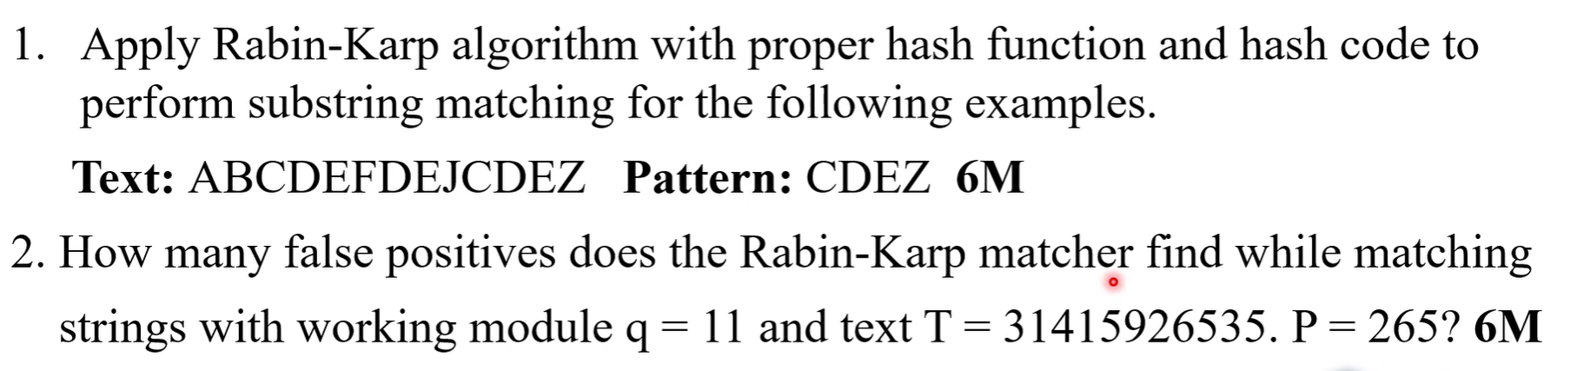

Slide 97
Z-Function
The Z-Function (or Z-Algorithm) is a linear-time string processing algorithm used to solve the string pattern matching problem efficiently.
It computes an array called the Z-array, where each element indicates the length of the longest substring starting at a given position that matches the prefix of the string.
The algorithm was introduced by Gusfield and is widely used in competitive programming, text editors, plagiarism detection, DNA sequence analysis, and bioinformatics.
Unlike the Naïve algorithm, which compares the pattern with the text at every possible position, the Z-Algorithm avoids repeated comparisons by utilizing previously computed matching information.

Slide 98
Definition of Z-Value
For a string S of length n, the Z-value at index i, denoted by Z[i], is the length of the longest substring beginning at position i that is also a prefix of S.
Z[i]=Longest Common Prefix(S[0...],S[i...])
Where Z[0] = 0 or n (length of the string)
For every other position, Z[i] tells how many characters match the beginning of the string.
Example
Consider the string:
S = A A B C A A B X A A B
Prefix of the string
A A B C A A B X A A B
Z-Array
Index (i) | 0 | 1 | 2 | 3 | 4 | 5 | 6 | 7 | 8 | 9 | 10
Character | A | A | B | C | A | A | B | X | A | A | B
Z[i] | 0 | 1 | 0 | 0 | 3 | 1 | 0 | 0 | 3 | 1 | 0
Explanation
Z[1] = 1 because only the first character (A) matches the prefix.
Z[4] = 3 because the substring starting at index 4 is AAB, which matches the prefix AAB.
Z[8] = 3 for the same reason.

Slide 99
Core Idea
Create a string that is concatenation of 3 things, pattern, a separator (that should be present in pattern) and text
Now we consider the above created string and at any point (starting from second index), if we find a substring that is also a prefix and is of same length as pattern, then the pattern is present at that point.
Instead of comparing characters repeatedly from scratch, the algorithm keeps track of a window called the Z-box (Z-window). L and R are two pointers that define the Z-box.
L (Left Boundary): The starting index of the current substring that matches the prefix of the string.
R (Right Boundary): The ending index of that matching substring.

Slide 100
Example: Search for the pattern "ABA" in the text "ABABABA" using the Z-Algorithm.
Step 1: Given Pattern (P): ABA
Text (T): ABABABA
Pattern length = 3
Step 2: Create the Combined String
The Z-Algorithm works by combining the pattern and text with a special separator ($).
S = Pattern + "$" + Text
S = ABA$ABABABA
Step 3: Index the Combined String
Index | 0 | 1 | 2 | 3 | 4 | 5 | 6 | 7 | 8 | 9 | 10
Character | A | B | A | $ | A | B | A | B | A | B | A
Step 4: Compute Z-values
The Z-value at each position ‘i’ is the length of the longest substring starting at i^{th} position that matches the prefixes of "ABA$ABABABA".

Slide 101
Prefixes of ABA$ABABABA –
A, AB, ABA, ABA$, ABA$A, ABA$AB, ABA$ABA, ABA$ABAB, ABA$ABABA, ABA$ABABAB, ABA$ABABABA

Slide 102
Prefixes of ABA$ABABABA – A, AB, ABA, ABA$, ABA$A, ABA$AB, ABA$ABA, ABA$ABAB, ABA$ABABA, ABA$ABABAB, ABA$ABABABA
i | Character | Substring starting at i | Matching Characters | Z[i] | L | R | Explanation
0 | A | ABA$ABABABA | — | 0 | 0 | 0 | Not computed

Slide 103
Prefixes of ABA$ABABABA – A, AB, ABA, ABA$, ABA$A, ABA$AB, ABA$ABA, ABA$ABAB, ABA$ABABA, ABA$ABABAB, ABA$ABABABA
i | Character | Substring starting at i | Matching Characters | Z[i] | L | R | Explanation
0 | A | ABA$ABABABA | — | 0 | 0 | 0 | Not computed
1 | B | BA$ABABABA | None | 0 | 0 | 0 | Starts with B, prefix starts with A

Slide 104
Prefixes of ABA$ABABABA – A, AB, ABA, ABA$, ABA$A, ABA$AB, ABA$ABA, ABA$ABAB, ABA$ABABA, ABA$ABABAB, ABA$ABABABA
i | Character | Substring starting at i | Matching Characters | Z[i] | L | R | Explanation
0 | A | ABA$ABABABA | — | 0 | 0 | 0 | Not computed
1 | B | BA$ABABABA | None | 0 | 0 | 0 | Starts with B, prefix starts with A
2 | A | A$ABABABA | A | 1 | 2 | 2 | Only first character matches

Slide 105
Prefixes of ABA$ABABABA – A, AB, ABA, ABA$, ABA$A, ABA$AB, ABA$ABA, ABA$ABAB, ABA$ABABA, ABA$ABABAB, ABA$ABABABA
i | Character | Substring starting at i | Matching Characters | Z[i] | L | R | Explanation
0 | A | ABA$ABABABA | — | 0 | 0 | 0 | Not computed
1 | B | BA$ABABABA | None | 0 | 0 | 0 | Starts with B, prefix starts with A
2 | A | A$ABABABA | A | 1 | 2 | 2 | Only first character matches
3 | $ | $ABABABA | None | 0 | 2 | 2 | Separator differs

Slide 106
Prefixes of ABA$ABABABA – A, AB, ABA, ABA$, ABA$A, ABA$AB, ABA$ABA, ABA$ABAB, ABA$ABABA, ABA$ABABAB, ABA$ABABABA
i | Character | Substring starting at i | Matching Characters | Z[i] | L | R | Explanation
0 | A | ABA$ABABABA | — | 0 | 0 | 0 | Not computed
1 | B | BA$ABABABA | None | 0 | 0 | 0 | Starts with B, prefix starts with A
2 | A | A$ABABABA | A | 1 | 2 | 2 | Only first character matches
3 | $ | $ABABABA | None | 0 | 2 | 2 | Separator differs
4 | A | ABABABA | ABA | 3 | 4 | 6 | Complete pattern matched

Slide 107
Prefixes of ABA$ABABABA – A, AB, ABA, ABA$, ABA$A, ABA$AB, ABA$ABA, ABA$ABAB, ABA$ABABA, ABA$ABABAB, ABA$ABABABA
i | Character | Substring starting at i | Matching Characters | Z[i] | L | R | Explanation
0 | A | ABA$ABABABA | — | 0 | 0 | 0 | Not computed
1 | B | BA$ABABABA | None | 0 | 0 | 0 | Starts with B, prefix starts with A
2 | A | A$ABABABA | A | 1 | 2 | 2 | Only first character matches
3 | $ | $ABABABA | None | 0 | 2 | 2 | Separator differs
4 | A | ABABABA | ABA | 3 | 4 | 6 | Complete pattern matched
5 | B | BABABA | None | 0 | 4 | 6 | Starts with B

Slide 108
Prefixes of ABA$ABABABA – A, AB, ABA, ABA$, ABA$A, ABA$AB, ABA$ABA, ABA$ABAB, ABA$ABABA, ABA$ABABAB, ABA$ABABABA
i | Character | Substring starting at i | Matching Characters | Z[i] | L | R | Explanation
0 | A | ABA$ABABABA | — | 0 | 0 | 0 | Not computed
1 | B | BA$ABABABA | None | 0 | 0 | 0 | Starts with B, prefix starts with A
2 | A | A$ABABABA | A | 1 | 2 | 2 | Only first character matches
3 | $ | $ABABABA | None | 0 | 2 | 2 | Separator differs
4 | A | ABABABA | ABA | 3 | 4 | 6 | Complete pattern matched
5 | B | BABABA | None | 0 | 4 | 6 | Starts with B
6 | A | ABABA | ABA | 3 | 6 | 8 | Complete pattern matched

Slide 109
Prefixes of ABA$ABABABA – A, AB, ABA, ABA$, ABA$A, ABA$AB, ABA$ABA, ABA$ABAB, ABA$ABABA, ABA$ABABAB, ABA$ABABABA
i | Character | Substring starting at i | Matching Characters | Z[i] | L | R | Explanation
0 | A | ABA$ABABABA | — | 0 | 0 | 0 | Not computed
1 | B | BA$ABABABA | None | 0 | 0 | 0 | Starts with B, prefix starts with A
2 | A | A$ABABABA | A | 1 | 2 | 2 | Only first character matches
3 | $ | $ABABABA | None | 0 | 2 | 2 | Separator differs
4 | A | ABABABA | ABA | 3 | 4 | 6 | Complete pattern matched
5 | B | BABABA | None | 0 | 4 | 6 | Starts with B
6 | A | ABABA | ABA | 3 | 6 | 8 | Complete pattern matched
7 | B | BABA | None | 0 | 6 | 8 | Starts with B

Slide 110
Prefixes of ABA$ABABABA – A, AB, ABA, ABA$, ABA$A, ABA$AB, ABA$ABA, ABA$ABAB, ABA$ABABA, ABA$ABABAB, ABA$ABABABA
i | Character | Substring starting at i | Matching Characters | Z[i] | L | R | Explanation
0 | A | ABA$ABABABA | — | 0 | 0 | 0 | Not computed
1 | B | BA$ABABABA | None | 0 | 0 | 0 | Starts with B, prefix starts with A
2 | A | A$ABABABA | A | 1 | 2 | 2 | Only first character matches
3 | $ | $ABABABA | None | 0 | 2 | 2 | Separator differs
4 | A | ABABABA | ABA | 3 | 4 | 6 | Complete pattern matched
5 | B | BABABA | None | 0 | 4 | 6 | Starts with B
6 | A | ABABA | ABA | 3 | 6 | 8 | Complete pattern matched
7 | B | BABA | None | 0 | 6 | 8 | Starts with B
8 | A | ABA | ABA | 3 | 8 | 10 | Complete pattern matched

Slide 111
Prefixes of ABA$ABABABA – A, AB, ABA, ABA$, ABA$A, ABA$AB, ABA$ABA, ABA$ABAB, ABA$ABABA, ABA$ABABAB, ABA$ABABABA
i | Character | Substring starting at i | Matching Characters | Z[i] | L | R | Explanation
0 | A | ABA$ABABABA | — | 0 | 0 | 0 | Not computed
1 | B | BA$ABABABA | None | 0 | 0 | 0 | Starts with B, prefix starts with A
2 | A | A$ABABABA | A | 1 | 2 | 2 | Only first character matches
3 | $ | $ABABABA | None | 0 | 2 | 2 | Separator differs
4 | A | ABABABA | ABA | 3 | 4 | 6 | Complete pattern matched
5 | B | BABABA | None | 0 | 4 | 6 | Starts with B
6 | A | ABABA | ABA | 3 | 6 | 8 | Complete pattern matched
7 | B | BABA | None | 0 | 6 | 8 | Starts with B
8 | A | ABA | ABA | 3 | 8 | 10 | Complete pattern matched
9 | B | BA | None | 0 | 8 | 10 | Starts with B

Slide 112
Prefixes of ABA$ABABABA – A, AB, ABA, ABA$, ABA$A, ABA$AB, ABA$ABA, ABA$ABAB, ABA$ABABA, ABA$ABABAB, ABA$ABABABA
i | Character | Substring starting at i | Matching Characters | Z[i] | L | R | Explanation
0 | A | ABA$ABABABA | — | 0 | 0 | 0 | Not computed
1 | B | BA$ABABABA | None | 0 | 0 | 0 | Starts with B, prefix starts with A
2 | A | A$ABABABA | A | 1 | 2 | 2 | Only first character matches
3 | $ | $ABABABA | None | 0 | 2 | 2 | Separator differs
4 | A | ABABABA | ABA | 3 | 4 | 6 | Complete pattern matched
5 | B | BABABA | None | 0 | 4 | 6 | Starts with B
6 | A | ABABA | ABA | 3 | 6 | 8 | Complete pattern matched
7 | B | BABA | None | 0 | 6 | 8 | Starts with B
8 | A | ABA | ABA | 3 | 8 | 10 | Complete pattern matched
9 | B | BA | None | 0 | 8 | 10 | Starts with B
10 | A | A | A | 1 | 10 | 10 | Single character match

Slide 113
Z[i] = number of characters starting at position i that match the prefix of the entire string.
S = A B A $ A B A B A B A
0 1 2 3 4 5 6 7 8 9 10
The prefix is: A B A $ A B A B A B A Z[0] = 0 L = 0 R = 0
i = 1
S[1...] = BA$ABABABA
Prefix = ABA$ABABABA
Compare first character: B ≠ A, So there is no match, Z[1] = 0
i = 2
S[2...] = A$ABABABA
Prefix = ABA$ABABABA
Compare first character: A = A ✓, $ ≠ B ✗ , Z[2] = 1
We have found a match from position 2 to position 2., So the new Z-box is: L = 2 R = 2

Slide 114
Final Z-array
Index | 0 | 1 | 2 | 3 | 4 | 5 | 6 | 7 | 8 | 9 | 10
String | A | B | A | $ | A | B | A | B | A | B | A
Z-value | 0 | 0 | 1 | 0 | 3 | 0 | 3 | 0 | 3 | 0 | 1
Step 5: Identify Pattern Matches
The pattern length = 3.
Whenever Z[i] = 3, the pattern is found
Index in Combined String | Z-value | Pattern Found?
4 | 3 | Yes
6 | 3 | Yes
8 | 3 | Yes
Step 6: Convert to Text Positions
The combined string is:
A B A $ A B A B A B A
0 1 2 3 4 5 6 7 8 9 10
The text starts at index 4 in the combined string.
The corresponding position in the original text is:
Text Position=i−(Pattern Length+1)
Since Pattern Length = 3,
Text Position=i−4
Combined String Index (i) | Formula | Position in Text
4 | 4 − 4 | 0
6 | 6 − 4 | 2
8 | 8 − 4 | 4
Final Result
Text:
A B A B A B A
0 1 2 3 4 5 6
Pattern "ABA" occurs at:
Position 0
Position 2
Position 4

Slide 115
Z-Algorithm
The algorithm maintains a window [L, R] — the Z-box — the interval with the rightmost right endpoint R seen so far, such that S[L..R] is a prefix of S. As i sweeps left to right, two cases arise for each new index.
Case 1 : i > R (outside the box)
We have no useful prior information. Compare S[i..] against S[0..] directly, character by character, to compute Z[i]. If Z[i] > 0, update the box to [i, i + Z[i] − 1].
Case 2 : i ≤ R (inside the box)
Because S[L..R] equals a prefix, position i inside the box corresponds to a mirror position k = i − L near the front of the string, whose value Z[k] is already known. Let remaining = R − i + 1 (how much of the box is left from i). Then:
If Z[k] < remaining: the mirror's match is fully contained in the box, so nothing new lies beyond R. Safely set Z[i] = Z[k].
If Z[k] ≥ remaining: the mirror's match runs to (or past) the box edge, so beyond R is unknown. Set Z[i] = remaining as a guaranteed floor, then extend by comparing S[R+1..] against S[remaining..] character by character, and update the box.

Slide 116
Algorithm: Z-Function (Z-Algorithm)
Input: String S (For pattern matching, S = Pattern + "" + Text)
Output: Z-array
Compute the length of the string n.
Create an array Z[0...n−1] and initialize all elements to 0.
Initialize L = 0 and R = 0.
For each position i from 1 to n−1, do the following:
  Case 1: If i > R (outside the current Z-box):
    Set L = R = i.
    Compare characters S[R−L] and S[R] while they match, incrementing R each time.
    Set Z[i] = R − L.
    Decrement R by 1.
  Case 2: If i ≤ R (inside the current Z-box):
    Compute k = i − L.
    If Z[k] < R − i + 1, set Z[i] = Z[k].
    Otherwise:
      Set L = i.
      Continue comparing characters beyond R while they match, incrementing R.
      Set Z[i] = R − L.
      Decrement R by 1.
Repeat Step 4 until all positions have been processed.
Return the Z-array.
For pattern matching, if Z[i] equals the pattern length, then the pattern occurs in the text at position:
Input: String S
Compute length n
Initialize Z[0...n−1] = 0
L = 0
R = 0
For i = 1 to n−1
If i > R
L = R = i
While R < n and S[R−L] == S[R]
R++
Z[i] = R−L
R--
Else
k = i−L
If Z[k] < R−i+1
Z[i] = Z[k]
Else
L = i
While R < n and S[R−L] == S[R]
R++
Z[i] = R−L
R--
Return Z

Slide 117
Role of the Z-Function Algorithm in String Processing
1. Exact Pattern Matching
  The Z-Algorithm is widely used to search for a pattern in a text efficiently.
  Construct a new string:
  Pattern + "$" + Text
  Compute the Z-array.
  If Z[i] = Pattern Length, the pattern occurs at that position in the text.
  Application: Text editors, search engines, document search
2. Finding Repeated Substrings
  The Z-array identifies repeated occurrences of the prefix within the string.
  Example
  String = "abcabcabc"
  The Z-array contains large values at positions where "abc" repeats.
  Applications:
  Data compression
  Duplicate detection
  Repeated sequence analysis

Slide 118
3. String Periodicity Detection
  The Z-Algorithm can determine whether a string is formed by repeating a smaller substring.
  Example
  String = "abcabcabc"
  The algorithm detects that "abc" is repeated three times.
  Applications:
  Compression algorithms
  Pattern recognition
  Sequence analysis
4. Plagiarism Detection
  Documents can be represented as strings. The algorithm efficiently finds common substrings between documents.
  Applications:
  Academic plagiarism detection
  Code similarity detection
  Document comparison

Slide 119
Aho-Corasick Algorithm
Aho-Corasick algorithm is an efficient multiple pattern matching algorithm used to search for many patterns simultaneously in a text. It was developed by Alfred V. Aho and Margaret J. Corasick in 1975.
Need for Aho-Corasick :
Instead, Aho-Corasick:
2. Creates Failure Links.
3. Scans the text only once.
4. Reports every occurrence of the given pattern.
Unlike algorithms such as KMP or Rabin-Karp that search for one pattern at a time, Aho-Corasick searches for all patterns in a single scan of the text.
Searching each pattern separately would require multiple scans of the text.
Suppose we have thousands of keywords: He , she, his, hers, hero, help….
1. Builds a Trie of all patterns.

Slide 120
Trie Data Structure : The Trie data structure is used to store a set of keys represented as strings. It allows for efficient retrieval and storage of keys, making it highly effective in handling large datasets.
Aho-Corasick Algorithm
Step-1
Build the Trie
Step-2
Number every node
Step-3
Build the Failure Array using BFS
Step-4
Build the Output Array
Step-5
Search the text character by character
Output Array : At this stage, the algorithm stores the indexes of all the patterns that end at a given state. It is also represented by a one-dimensional array.

Slide 121
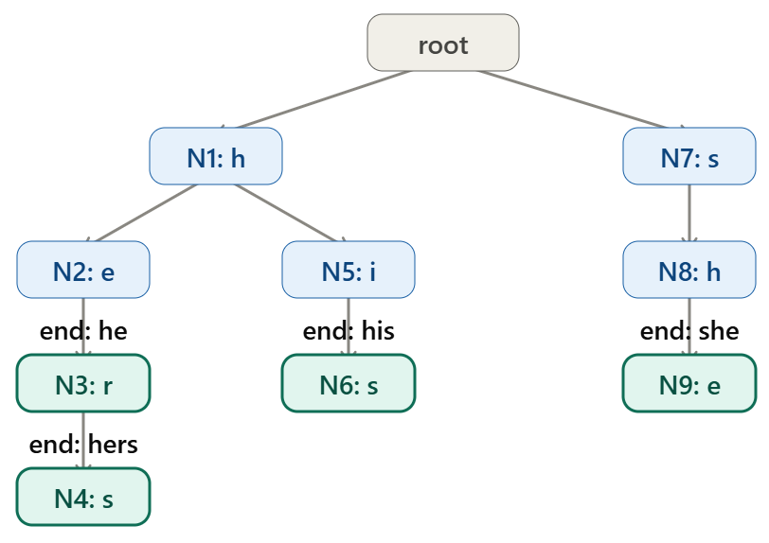
Step 2: Number Every Node
Example
Node No. | String Represented | End of Pattern?
0 | root | No
1 | h | No
2 | he | Yes ("he")
3 | her | No
4 | Hers | Yes ("hers")
5 | Hi | No
6 | His | Yes ("his")
7 | S | No
8 | Sh | No
9 | She | Yes ("she")
Input
Text = "ahishers"
Patterns = {"he", "she", "hers", "his"}
Step 1: Build the Trie

Slide 122
Failure Function
0

Slide 123
Failure Function
0
root

Slide 124
Failure Function
0
root
root

Slide 125
Failure Function
0
root
root
root

Slide 126
Failure Function
0
root
root
root
root

Slide 127
Failure Function
0
root
root
root
root
YES
h

Slide 128
Failure Function
0
root
root
root
root
YES h
root

Slide 129
Failure Function
0
root
root
root
root
YES h
root
YES
S

Slide 130
Failure Function
0
root
root
root
root
YES
h
root
YES
S
YES
he

Slide 131
Input
Text = "ahishers"
Patterns = {"he", "she", "hers", "his"}
Failure Function
0
root
root
root
root
YES
h
root
YES
S
YES
he
YES
S

Slide 132
Step 3: Build the Failure Array
Initially
Failure[0] = 0
Queue = [ ]
Children of root
h
s
Their failure links are always root.
Queue becomes
[h , s]
Iteration 1
Remove h
Queue
Before: [h, s]
After: [s]
Children of h
he
hi
Calculate Failure(he)
Parent = h
Failure(parent) = root
From root
Is there edge e?
No
Therefore
Failure(he)=root
Calculate Failure(hi)
Failure(parent)=
root
From root
Edge i ?
No
Therefore
Failure(hi)=root
Queue
[s, he, hi]
QUEUE
QUEUE
s | he | hi
h | s
What is a Failure Link?
A Failure Link tells the algorithm:
"If I cannot continue matching from the current node, where should I go next without starting over from the root?"
It allows the algorithm to reuse previously matched characters instead of rechecking them.

Slide 133
Step 3: Build the Failure Array
QUEUE
QUEUE
Iteration 2
Remove s
Queue Before:
[s, he, hi]
After: [he, hi]
Child: sh
Failure(parent)=root
From root
Edge h ? YES
So
Failure(sh)=h
Queue: [he, hi, sh]
Iteration 3
Remove he
Queue
Before:
[he, hi, sh]
After: [hi, sh]
Child: her
Failure(parent)=root
From root
Edge r ? No
Therefore
Failure(her)=root
Queue
[hi, sh, her]
Iteration 4
Remove hi
Queue
Before:
[hi, sh, her]
After: [sh, her]
Child: his
Failure(parent)=
root
From root
Edge s ? YES
Therefore
Failure(his)=s
Queue
[sh, her, his]
Iteration 5
Remove sh
Queue
Before:
[sh, her, his]
After:[her, his]
Child: she
Failure(parent)=h
Now go to node h
From h
Edge e ? YES
Therefore
Failure(she)=he
Queue
[her, his, she]
he | hi | sh
hi | sh | her
QUEUE
sh | her | his
her | his | she

Slide 134
Step 3: Build the Failure Array
his | she | hers
she | hers
Iteration 6
Remove her
Queue
Before
[her, his, she]
After :[his, she]
Child: hers
Failure(parent)=root
From root
Edge s ? YES
Therefore
Failure(hers)=s
Queue
[his, she, hers]
Iteration 7
Remove his
No children.
Queue
[she, hers]
Iteration 8
Remove she
No children.
Queue
[hers]
Iteration 9
Remove hers
No children.
Queue empty.
Construction finished.
hers

Slide 135
Complete Failure Links
Node | Represents | Failure Link | Reason
h | h | Root | Child of root
s | s | Root | Child of root
he | he | Root | No proper suffix is a pattern prefix
hi | hi | Root | No proper suffix is a pattern prefix
sh | sh | h | Suffix "h" is a pattern prefix
her | her | Root | No matching suffix-prefix
his | his | s | Suffix "s" is a pattern prefix
she | she | he | Suffix "he" is a pattern prefix
hers | hers | s | Suffix "s" is a pattern prefix
Own Output :
The pattern(s) that end exactly at the current trie node, before considering any failure links.
In other words,
When you insert patterns into the trie,
Whenever a pattern ends at a node,
Store that pattern at that node.
That stored pattern is the Own Output.
Node ID | Represents | Own Output
0 | Root | {}
1 | h | {}
2 | he | {he}
3 | her | {}
4 | hers | {hers}
5 | hi | {}
6 | his | {his}
7 | s | {}
8 | sh | {}
9 | she | {she}

Slide 136
Final Output(Current Node) =
Own Output(Current Node) + Final Output(Failure Node)
Search the Text
Step | Current Node | Own Output | Failure Link | Failure Node Output | Merge Operation | Final Output
1 | h | {} | Root | {} | {} ∪ {} | {}
2 | he | {he} | Root | {} | {he} ∪ {} | {he}
3 | her | {} | Root | {} | {} ∪ {} | {}
4 | hers | {hers} | s | {} | {hers} ∪ {} | {hers}
5 | hi | {} | Root | {} | {} ∪ {} | {}
6 | his | {his} | s | {} | {his} ∪ {} | {his}
7 | s | {} | Root | {} | {} ∪ {} | {}
8 | sh | {} | h | {} | {} ∪ {} | {}
9 | she | {she} | he | {he} | {she} ∪ {he} | {she, he}

Slide 137
Step 4: Output Array
Each node stores which patterns end there.
Initially
Node | Output
2 | he
4 | hers
6 | his
9 | she

Slide 138
Each node stores which patterns end there.
Initially
Now copy outputs from failure links.
Example
Failure(she)=he
Therefore
Output(she) = she + Output(he) = she, he
Step 4: Output Array
Node | Output
2 | he
4 | hers
6 | his
9 | she
Node | Output
2 | he
4 | hers
6 | his
9 | she, he
Final Output Table

Slide 139
ALGORITHM AHO_CORASICK(Patterns, Text)
Input:
Patterns = set of patterns P1, P2, ..., Pk
Text = string to be searched
Output:
All occurrences of all patterns in Text

Slide 140
--------------------------------------------------
STEP 1: CREATE TRIE
--------------------------------------------------
Create a root node
For each pattern P in Patterns do
current ← root
For each character c in P do
If current.children[c] does not exist then
current.children[c] ← new node
End If
current ← current.children[c]
End For
Add P to current.output
End For

Slide 141
--------------------------------------------------
STEP 2: INITIALIZE FAILURE LINKS
--------------------------------------------------
Create an empty queue Q
For each child of root do
child.failure ← root
Enqueue child into Q
End For

Slide 142
--------------------------------------------------
STEP 3: CONSTRUCT FAILURE LINKS USING BFS
--------------------------------------------------
While Q is not empty do current ← Dequeue(Q)
For each character c for which current.children[c] exists do
child ← current.children[c]
Enqueue child into Q
temp ← current.failure
While temp ≠ root AND temp.children[c] does not exist do
temp ← temp.failure
End While
If temp.children[c] exists then
child.failure ← temp.children[c]
Else
child.failure ← root
End If
// Inherit patterns from the failure node
child.output ← child.output ∪ child.failure.output
End For
End While

Slide 143
--------------------------------------------------
STEP 4: SEARCH THE TEXT
--------------------------------------------------
current ← root
For i ← 0 to length(Text) - 1 do
c ← Text[i]
// Follow failure links when there is no match
While current ≠ root AND current.children[c] does not exist do
current ← current.failure
End While
// Move to the next Trie node
If current.children[c] exists then
current ← current.children[c]
Else
current ← root
End If
// Check for patterns ending at current node
If current.output is not empty then
For each pattern P in current.output do
position ← i - length(P) + 1
Print "Pattern", P,
"found at position", position
End For
End If
End For

Slide 144
Suffix Arrays, Longest Common Prefix (LCP) Arrays and Kasai Algorithm
What is a Suffix?
A suffix is a substring that starts at any position in the string and extends to the end.
For example,
String = banana
All suffixes are:
There are n suffixes for a string of length n.
Starting Index | Suffix
0 | banana
1 | anana
2 | nana
3 | ana
4 | na
5 | a

Slide 145
What is a Suffix Array?
A Suffix Array (SA) is an array containing the starting indices of all suffixes sorted in lexicographical (dictionary) order.
Example
String: banana
Step 1: Generate all suffixes
Step 2: Sort the suffixes alphabetically
Rank | Suffix | Original Index
1 | a | 5
2 | ana | 3
3 | anana | 1
4 | banana | 0
5 | na | 4
6 | nana | 2
Index | Suffix
0 | banana
1 | anana
2 | nana
3 | ana
4 | na
5 | a

Slide 146
Step 3: Construct the Suffix Array
The suffix array stores only the starting indices.
Why Sort the Suffixes?
Sorting places similar prefixes next to each other.
Example:
a
ana
anana
All begin with a, making comparisons efficient.
Time Complexity: Sorting-O(n² log n)
Sorting requires approximately: O(nlogn)
Each suffix comparison can take: O(n)
Therefore: O(nlogn)×O(n)
Rank | Suffix Array (SA)
0 | 5
1 | 3
2 | 1
3 | 0
4 | 4
5 | 2
Therefore,
SA = [5,3,1,0,4,2]

Slide 147
Longest Common Prefix (LCP) Array
The LCP Array stores the length of the common prefix between two adjacent suffixes in the sorted suffix array.
Sorted suffixes:
Example
Compare Adjacent Suffixes
Compare "a" and "ana"
a
ana
Common prefix:
a
Length = 1
Compare "ana" and "anana"
ana
anana
Common prefix:
ana
Length = 3
Compare "anana" and "banana"
No common prefix.
Length = 0
Compare "banana" and "na"
No common prefix.
Length = 0
Compare "na" and "nana"
Common prefix:
na
Length = 2
Rank | Suffix
0 | a
1 | ana
2 | anana
3 | banana
4 | na
5 | nana

Slide 148
LCP Array
The first suffix has no previous suffix, so its LCP is defined as 0.
Each LCP value tells how many starting characters are identical between neighbouring suffixes.
Rank | Suffix | LCP
0 | a | 0
1 | ana | 1
2 | anana | 3
3 | banana | 0
4 | na | 0
5 | nana | 2
Therefore,
LCP = [0,1,3,0,0,2]

Slide 149
Kasai Algorithm
The Kasai Algorithm efficiently constructs the LCP array from the suffix array in O(n) time.
Main Idea of Kasai Algorithm
If two suffixes share a common prefix of length k, then the next suffix comparison will share at least k− 1 characters.
Instead of comparing from the beginning every time, Kasai reuses previous comparisons.
Without Kasai, comparing every adjacent suffix character by character would take O(n²).
Kasai reduces this to O(n).

Slide 150
Kasai Algorithm Steps
Step 1
Given Suffix Array (SA)
Example
Suffix Array, SA = [5,3,1,0,4,2]
Construct the Rank Array.
The rank array stores the position of each suffix in the suffix array.
Step 2
Initialize
k = 0
where k is the current common prefix length.
Step 3
For every suffix:
Find its rank.
Compare it with the next suffix in sorted order.
Count matching characters.
Store the LCP.
Decrease k by one before moving to the next suffix (if k > 0).
Initial Array
Sorted Array
Index | SA
0 | 5
1 | 3
2 | 1
3 | 0
4 | 4
5 | 2
Rank Array
Rank | Suffix
0 | a
1 | ana
2 | anana
3 | banana
4 | na
5 | nana
"At what position does this suffix appear in the suffix array?“
Index | Suffix
0 | banana
1 | anana
2 | nana
3 | ana
4 | na
5 | a
Suffix array sorted
SA | Rank (index)
0 | 3
1 | 2
2 | 5
3 | 1
4 | 4
5 | 0
Suffix Array SA = [5,3,1,0,4,2]
Rank Array RA = [3,2,5,1,4,0]

Slide 151
Suffix Index | Rank
0 | 3
1 | 2
2 | 5
3 | 1
4 | 4
5 | 0
Rank Array
Rank | Suffix
0 | a
1 | ana
2 | anana
3 | banana
4 | na
5 | nana
Suffix Array
SA = [5,3,1,0,4,2]
Goal of Kasai
Kasai wants to build
LCP = ?
Rank Array
RA = [3,2,5,1,4,0]
Step | Current Index (i) | Current Suffix | Rank[i] | Previous Suffix in SA (SA[Rank[i]-1]) | Characters Compared | LCP Found | Store at LCP Position | k after storing
1 | 0 | BANANA | 3 | ANANA | B vs A → Different | 0 | LCP[3]=0 | 0
2 | 1 | ANANA | 2 | ANA | A=A, N=N, A=A | 3 | LCP[2]=3 | (3−1)=2
3 | 2 | NANA | 5 | NA | First 2 chars already known (NA), no extra comparison needed | 2 | LCP[5]=2 | (2−1)=1
4 | 3 | ANA | 1 | A | First 1 char already known (A) | 1 | LCP[1]=1 | 0 (1−1)
5 | 4 | NA | 4 | BANANA | N vs B → Different | 0 | LCP[4]=0 | 0
6 | 5 | A | 0 | No previous suffix | Skip | — | — | 0

Slide 152
KASAI Algorithm
i | SA[i] | Suffix | LCP[i]
0 | 5 | A | 0
1 | 3 | ANA | 1
2 | 1 | ANANA | 3
3 | 0 | BANANA | 0
4 | 4 | NA | 0
5 | 2 | NANA | 2
Step 4: Search the pattern
pattern is: P = ANA
Pattern length: m = 3
Since the suffixes are sorted, search among them for suffixes beginning with ANA.
SA[1] = 3 → ANA
SA[2] = 1 → ANANA
Now look at: LCP[2] = 3
This means:
Suffix SA[1] = ANA
Suffix SA[2] = ANANA Common prefix = ANA Length = 3
Since:LCP[2] >= pattern length,3 >= 3…. the pattern ANA occurs in both suffixes.
Therefore the actual positions in the original text are: SA[1] = 3, SA[2] = 1
So: ANA occurs at positions 1 and 3.
search is performed using the suffix array, while Kasai provides the LCP array used to identify the common-prefix/matching region.

Slide 153
KASAI PROCEDURE
For any source text and pattern, use these steps:
1. Construct the suffix array
SA = sorted starting indices of all suffixes
2. Apply Kasai
Kasai constructs: LCP[i] = LCP(SA[i], SA[i-1])
3. Search the pattern in the suffix array
Because the suffixes are sorted, use binary search to find the range of suffixes that can start with the pattern.
4. Use LCP values
For a pattern of length m:
if LCP >= m
↓
the complete pattern is common to the relevant suffixes
5. Get the original positions
For every matching suffix: position = SA[i], These are the positions where the pattern occurs in the source text.

Slide 154
Kasai Algorithm
Create the Rank Array
  Create an array Rank of size n.
  For each position i in the Suffix Array:
    Set Rank[SA[i]] = i.
  The Rank array stores the position of each suffix in the sorted Suffix Array.
Initialize the LCP Array
  Create an array LCP of size n.
  Set all elements to 0.
Initialize a Variable
  Set k = 0.
  k stores the length of the Longest Common Prefix (LCP) computed in the previous iteration.
Traverse All Suffixes
  For each suffix starting at index i from 0 to n−1:
Check if the Current Suffix is the First in the Suffix Array
  If Rank[i] == 0:
    Set LCP[0] = 0.
    Continue to the next suffix.
Find the Previous Suffix in the Suffix Array
  Compute
  j = SA[Rank[i] − 1]
  Here, j is the starting index of the previous suffix in lexicographical order.
7. Compare the Two Suffixes
  Compare the suffixes starting at indices i and j.
  Start comparison from the kth character (not from the first character).
  While:
    i + k < n,
    j + k < n, and
    S[i + k] == S[j + k],
    Increment k by 1.
8. Store the LCP Value
  Store the computed LCP length in
  LCP[Rank[i]] = k
9. Reuse the Previous Comparison
  If k > 0, decrement it by one:
  k = k − 1
  This avoids re-comparing characters that are already known to match.
10. Repeat
  Repeat Steps 5–9 until all suffixes have been processed.
11. Return the LCP Array
  The completed LCP array contains the longest common prefix lengths between adjacent suffixes in the sorted Suffix Array.

Slide 155
Applications of Suffix Arrays
Pattern searching
Longest repeated substring
Longest common substring
Document similarity
Genome sequence analysis
Data compression

Slide 156
Time Complexity
Rank Array Construction: O(n)
LCP Construction (Kasai Algorithm): O(n)
Overall Complexity: O(n)

Slide 157
Types of String Pattern Matching algorithms
Algorithm | Time Complexity
Naïve | O(nm) n is length of text and m is length of pattern
Rabin-Karp | Average O(n+m), n is length of text and m is length of pattern
Knuth-Morris-Pratt (KMP) | O(n+m), n is length of text and m is length of pattern
Boyer-Moore | Best practical performance
Z Algorithm | O(n+m), n is length of text and m is length of pattern
Aho-Corasick | Multiple pattern matching O(m x Ʃ + n + z) m-m = total length of all patterns Σ = size of the alphabet n = length of the input text z = total number of pattern occurrences (matches)

Slide 158
Thankyou

