Slide 1

SMART INDIA HACKATHON 2026
Where Ideas Meet Real-World Challenges
Think beyond the classroom. Challenge yourself. Build something that matters.
YOUR IDEA. YOUR TEAM. YOUR SOLUTION.
SMART INDIA HACKATHON 2026
1

Slide 2




SIH AT A GLANCE
SMART INDIA HACKATHON
A nationwide innovation competition
Conducted for students across India
Includes Software and Hardware editions
Students compete through multiple stages
Challenges are provided by participating organizations
×
×
×
STUDENTS
TECHNOLOGY
COMPETITION
INNOVATION
SMART INDIA HACKATHON 2026
2

Slide 3




WHAT YOU GET FROM SIH
EXPERIENCE
SKILLS
COLLABORATION
Work under real competition conditions
Learn technologies beyond your coursework
Work with people who have different strengths
EXPOSURE
RECOGNITION
PORTFOLIO
Interact with mentors, experts and other teams
Get your work noticed beyond college
Have a substantial project to showcase
MORE THAN A HACKATHON — IT'S AN EXPERIENCE.
SMART INDIA HACKATHON 2026
3

Slide 4
FROM PROBLEM TO SOLUTION
1
Select
2
Form
3
Ideate
Choose a problem statement
Build your team
Research and design
4
Build
5
Present
6
Compete
Develop your prototype
Pitch and demonstrate
Take your solution forward
PROBLEM → IDEA → PROTOTYPE → IMPACT
SMART INDIA HACKATHON 2026
4

Slide 5



BEFORE YOU PARTICIPATE
ELIGIBILITY
PRIZES & RECOGNITION
Who can participate?
TEAM REQUIREMENTS
Official SIH 2026 Prize Details
Who can be part of a team?
₹ 1,00,000
SUBMISSION
What needs to be submitted?
Certificates
DEADLINES
Winning team recognition
What dates matter?
Special awards
EVALUATION
How are teams judged?
Other official recognition / opportunities
KNOW THE RULES. KNOW THE REWARDS.
SMART INDIA HACKATHON 2026
5

Slide 6
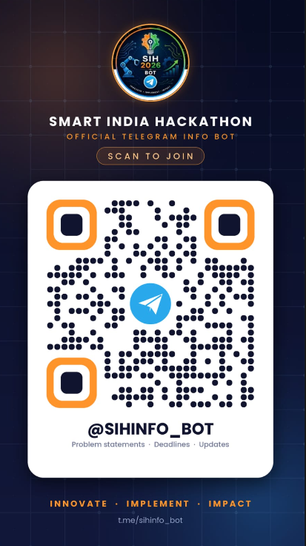

WHERE DO I GO FROM HERE?
STAY CONNECTED
SIH QUERY BOT
Rules
Registration
Deadlines
General queries
BOT UNLOCKS AT 4:07 PM
JOIN. STAY UPDATED. ASK.
SMART INDIA HACKATHON 2026
7

Slide 7
READY TO TAKE THE CHALLENGE?
LEARN SOMETHING NEW.
BUILD SOMETHING YOU'RE PROUD OF.
SEE HOW FAR YOU CAN GO.
SMART INDIA HACKATHON 2026
SIH Coordinator • Faculty • Student Organizer Details
SMART INDIA HACKATHON 2026
8

