Slide 1
FarmAssist
Sophie • your digital agriculture officer
An algorithm-based agricultural knowledge search system
Review 1 | DSA-3 (25CS2103E) | Team 20
Nimma Lokesh Reddy (2520030366) Ramagiri Rishik Rao (2520030333) Manne Yashwanth Manoj (2520030369)

Slide 2
Problem statement
▪ A farmer's question is messy, not a database query
It carries typos, joined words and local names: “my tomatoe has yelow leaves”, “lateblight”, “paddy” for rice, “bhindi” for okra.
▪ Agricultural advice online assumes connectivity and literacy
A village user may have neither, and a general search engine cannot rank agronomic records it does not hold.
▪ The useful answers are computations, not lookups
Which fertilizers fit a budget, which bag goes to which crop, which disease matches the symptoms actually seen — each is a classic algorithmic problem.
FarmAssist • Sophie | DSA-3 (25CS2103E) | Team 20
2

Slide 3
Objectives
▪ Answer farming questions offline, with no AI and no network call
Every answer is computed from a local agricultural database.
▪ Implement eight classical algorithms from first principles
No String.contains(), no Collections.sort() — the string searching, spelling repair, ranking, budgeting and assignment are all our own.
▪ Make the algorithm usage visible while it runs
The program prints a live trace naming the algorithm behind every step.
▪ Tolerate the way people actually type
Spelling repair, joined-word splitting and local-name rewriting before the question is ever interpreted.
FarmAssist • Sophie | DSA-3 (25CS2103E) | Team 20
3

Slide 4
Proposed system
Question
raw text, exactly as the farmer types it, typos and all
↓
Repair
Edit Distance fixes the spelling; a word-segmentation DP unsticks joined words, so lateblight becomes late blight
↓
Normalise
a second Aho-Corasick automaton rewrites local and Hindi names: paddy, dhan and chawal all become rice
↓
Extract
one Aho-Corasick pass over 285 patterns finds every crop, disease, pest, fertilizer and symptom in the sentence at once
↓
Route
the entities found, and the shape of the question, decide which of the nine features answers it
↓
Answer
Knapsack for a budget, Bipartite Matching for many crops, KMP with QuickSort for a diagnosis, or Rabin-Karp search with Suffix Array related reading
FarmAssist • Sophie | DSA-3 (25CS2103E) | Team 20
4

Slide 5
The eight algorithms
# | Algorithm | What it does in the system
1 | KMP | Matches a symptom or damage keyword inside a disease or pest record
2 | Rabin-Karp | Rolling-hash scan of 271 documents to score relevance
3 | Aho-Corasick | Finds every crop, disease, pest and fertilizer in one pass over 285 patterns
4 | Edit Distance | Spelling repair, and the “closest match” fallback
5 | Suffix Array + LCP | Related articles, by longest common substring (Kasai)
6 | 0/1 Knapsack | Best basket of fertilizer within a budget
7 | Bipartite Matching | One different fertilizer for each crop (Kuhn's method)
8 | Randomized QuickSort | Ranks results, diseases, pests and related articles
FarmAssist • Sophie | DSA-3 (25CS2103E) | Team 20
5

Slide 6
Modules and knowledge base
Module | Lines
algo — the eight algorithms | 691
engine — search, diagnosis, routing | 1530
ui — chat loop and screens | 1735
model — the records | 126
util — algorithm trace | 98
Total, 30 source files | 4180
Knowledge base | Rows
Crops | 63
Diseases | 64
Pests | 44
Fertilizers | 38
Articles | 62
Local-name synonyms | 396
Plain text data files. Rows added to any of them are picked up on the next run with no code change.
FarmAssist • Sophie | DSA-3 (25CS2103E) | Team 20
6

Slide 7
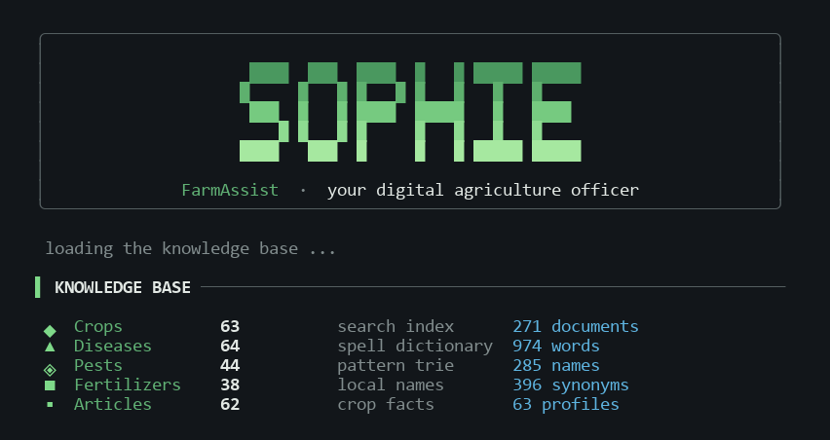
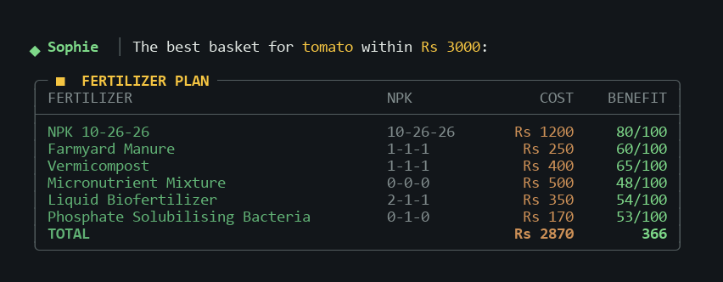
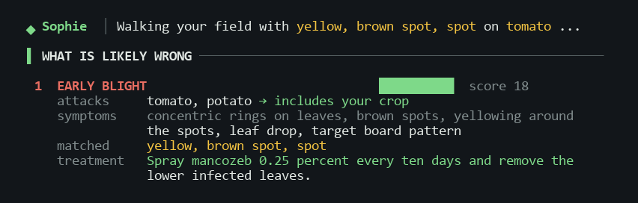
Working prototype
Runs today, end to end.
Left: what is loaded at start up. Right: 0/1 Knapsack choosing a fertilizer basket, and KMP + QuickSort ranking a diagnosis.
FarmAssist • Sophie | DSA-3 (25CS2103E) | Team 20
7

Slide 8
Status and next steps
Done
Next
▪ All eight algorithms implemented and in use
▪ Nine question types answered end to end
▪ Live algorithm trace for demonstration
▪ Console interface on a single layout grid
▪ Widen the article set beyond 62 documents
▪ Measure diagnosis accuracy against a test set
▪ Regional language input beyond the synonym table
▪ Package as a single runnable jar
Demonstration: algo demo • my tomatoe has yelow leaves • suggest fertilizer for tomato under 3000 • compare rice and wheat
FarmAssist • Sophie | DSA-3 (25CS2103E) | Team 20
8

