Slide 1
Data Structures and Algorithms -3 (25CS2103E)
Farm Assist Advanced Search System
Team Members
Nimma Lokesh Reddy 2520030366
Ramagiri Rishik Rao 2520030333
Yashwanth Manoj 2520030369
Under the Esteemed Guidance of
Dr. V. Sireesha
Assistant Professor

Slide 2
Contents
Abstract
Introduction
Literature survey
Problem Statement and Objectives
Hardware and Software requirements
Results
Conclusion
Future Scope

Slide 3
Abstract
FarmAssist is an agricultural knowledge search system designed to help farmers quickly access information about crops, diseases, symptoms, fertilizers, and cultivation methods. The system uses advanced data structures and algorithms to improve search accuracy and speed. KMP supports exact crop and disease searches, while Rabin-Karp searches across multiple agricultural documents. Aho-Corasick identifies several symptoms in a single query, and Edit Distance corrects spelling mistakes. Suffix Array and LCP are used to recommend related articles. Bipartite Matching connects crops with suitable fertilizers, and the Knapsack algorithm selects the best fertilizer combination within a given budget. Randomized QuickSort ranks the search results according to relevance. The system stores verified agricultural records and presents matching information in a simple and understandable format. FarmAssist aims to reduce the time required to find useful farming information and support better crop-management decisions.

Slide 4
Introduction
Farmers need quick, reliable answers about crop diseases; expert advice is not always reachable
A farmer's question is not a database query — it is a sentence, with the disease and symptom buried inside it
Finding many keywords in one sentence, and matching them against many records, is a string-matching problem
Classical pattern-matching algorithms solve it exactly, quickly, and without any training data
The project is built in core Java — no libraries, no build tool, no String.contains()
Review 1 is a working three-algorithm build; the full system extends it further

Slide 5
Literature Survey
Paper | Author(s) | Year | Contribution to our work
Fast Pattern Matching in Strings, SIAM J. Computing | Knuth, Morris, Pratt | 1977 | Linear-time exact search using the LPS/failure table — used to match symptoms to disease records
Efficient String Matching: An Aid to Bibliographic Search, CACM | Aho, Corasick | 1975 | Trie with failure links; finds all patterns in one pass — used to extract crops/symptoms from the question
Efficient Randomized Pattern-Matching Algorithms, IBM J. R&D | Karp, Rabin | 1987 | Rolling-hash matching in expected linear time — used to score article relevance
Findings: naïve search costs O(n×m) per pattern and repeats work for every keyword. KMP removes the backtracking, Aho–Corasick removes the per-pattern repetition, and Rabin–Karp makes repeated scanning cheap through hashing.

Slide 6
Problem Statement and Objectives
Problem Statement
Farming advice is hard to reach offline, and a general search engine cannot rank agricultural records it does not hold
A farmer's sentence mixes crop names, symptoms and disease names in no fixed order
Scanning every keyword against every record separately is too slow and repeats work
Objectives
Detect every crop, symptom and disease named in a question in a single pass
Match the reported symptoms exactly against stored disease records
Rank the articles by how often the search terms actually occur
Implement all three algorithms from first principles, no built-in search
Make the algorithm usage visible on screen while it runs

Slide 7
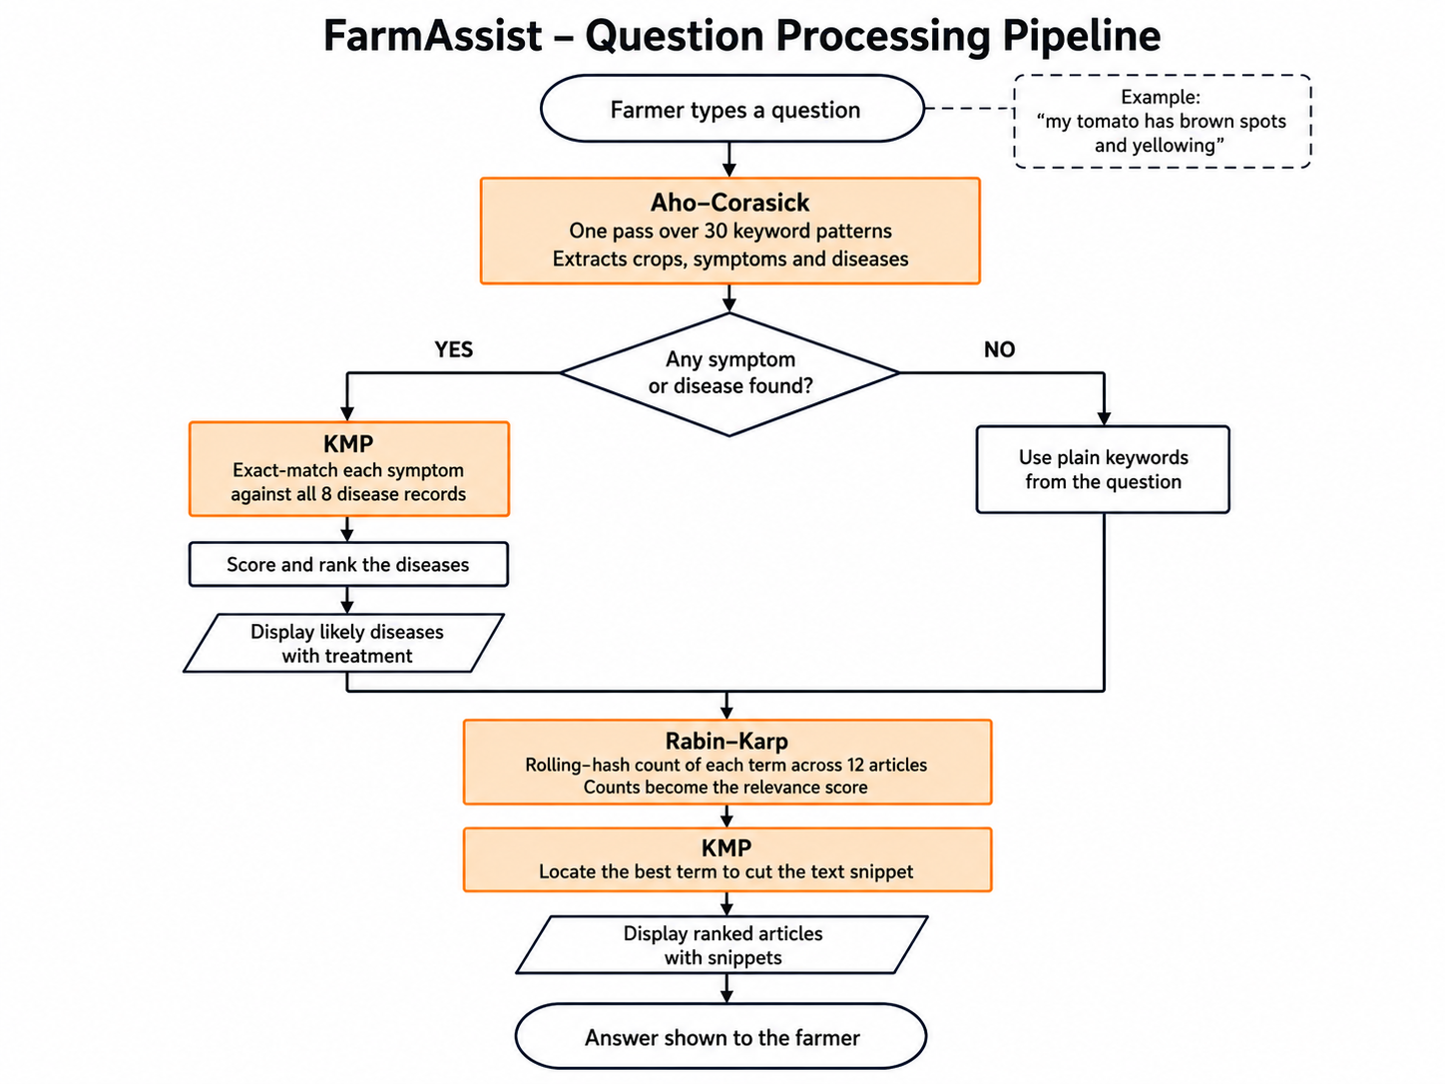
Flow Chart

Slide 8
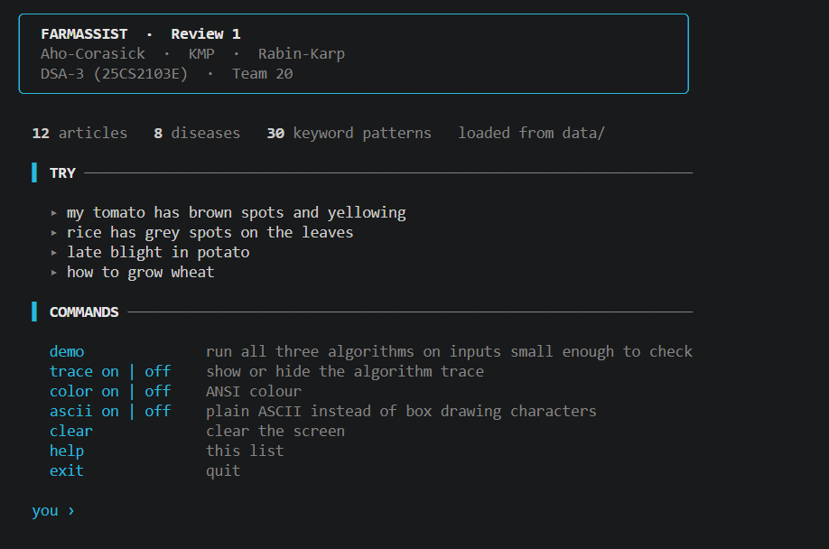
Results
Working console application — 12 articles, 8 disease records, 30 keyword patterns
Input: my tomato has brown spots and yellowing
Aho–Corasick → crops=[tomato] symptoms=[brown spots, yellowing] in one pass
KMP → 16 exact symptom searches over 8 records → Early Blight ranked first (score 8)
Rabin–Karp → 36 scans over 12 articles → 4 matched, top article returned with snippet
Word-boundary rule verified: "rice" is not matched inside "price", "spot" not inside "spots"
Validation
All three cross-checked against Java's String.indexOf over 4,000 randomised test cases — 100% agreement
Edge cases passed: empty pattern, pattern longer than text, overlapping matches (aaa in aaaa), LPS of ababaca = [0,0,1,2,3,0,1]

Slide 9
Hardware and Software requirements
Hardware
Processor: any dual-core, 1 GHz or above
RAM: 2 GB minimum (4 GB recommended)
Disk: under 5 MB for source, data and compiled classes
Display: standard terminal / command prompt
No internet connection required
Software
OS: Windows 10/11 (also runs on Linux and macOS)
JDK 21 or above — developed and tested on JDK 25
Any text editor or IDE (VS Code / IntelliJ / Notepad++)
No external libraries, no frameworks, no build tool
Data stored as plain .txt files, pipe-separated

Slide 10
Conclusion
A farming question in plain English is answered correctly using only classical string algorithms
Aho–Corasick makes keyword extraction independent of the number of patterns — one pass, always
KMP gives exact symptom matching with no backtracking over the text
Rabin–Karp makes relevance scoring cheap through rolling hashes
The system runs fully offline, in core Java, with no library doing the searching
Demonstrates that classical DSA solves a real problem without any AI

Slide 11
Future Scope
Edit Distance — repair spelling ("tomatoe" → "tomato")
Suffix Array + LCP — related articles by longest common substring
0/1 Knapsack — best fertilizer basket within a budget
Bipartite Matching — one distinct fertilizer per crop
Randomized QuickSort — replace the insertion sort used for ranking
Expand the knowledge base beyond 12 articles and 8 diseases
Regional language support (Hindi/Telugu crop names)
Package as a single runnable JAR, and later a mobile or web front end

Slide 12
Thank you

