Slide 1

machine learning
Clustering II: Hierarchical Clustering (Agglomerative, Divisive)
Session-14
CO-4

Slide 2



AIM
To familiarize students with the concept of Clustering II: Hierarchical Clustering (Agglomerative, Divisive) in Machine Learning.
INSTRUCTIONAL OBJECTIVES
This unit is designed to:
Introduce hierarchical clustering as a connectivity-based approach for grouping data at multiple levels.
Explain the agglomerative and divisive methods of building hierarchical structures.
Demonstrate the interpretation and visualization of hierarchical clustering using dendrograms.
LEARNING OUTCOMES
At the end of this unit, you should be able to:
Define hierarchical clustering and differentiate it from partition-based methods like K-Means.
Describe the steps involved in agglomerative hierarchical clustering and the role of linkage criteria.
Interpret a dendrogram to determine appropriate clusters and understand cluster hierarchy.

Slide 3
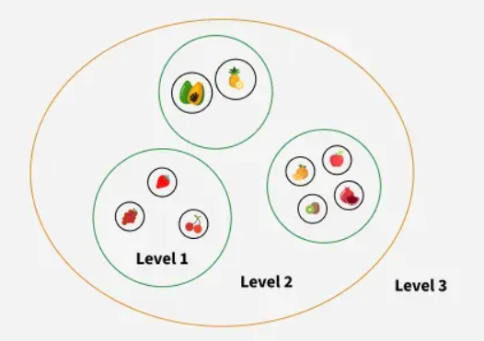
Hierarchical Clustering
Hierarchical clustering is used to group similar data points together based on their similarity creating a hierarchy or tree-like structure.
The key idea is to begin with each data point as its own separate cluster and then progressively merge or split them based on their similarity.
Let’s understand this with the help of an example
Imagine you have four fruits with different weights: an apple (100g), a banana (120g), a cherry (50g) and a grape (30g). Hierarchical clustering starts by treating each fruit as its own group.
It then merges the closest groups based on their weights.
First the cherry and grape are grouped together because they are the lightest.
Next the apple and banana are grouped together.

Slide 4
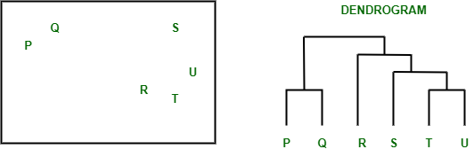
Dendrogram
A dendrogram is like a family tree for clusters. It shows how individual data points or groups of data merge together. The bottom shows each data point as its own group, and as you move up, similar groups are combined.
The lower the merge point, the more similar the groups are. It helps you see how things are grouped step by step. The working of the dendrogram can be explained using the below diagram:
In the above image on the left side there are five points labeled P, Q, R, S and T. These represent individual data points that are being clustered. On the right side there’s a dendrogram which show how these points are grouped together step by step.

Slide 5

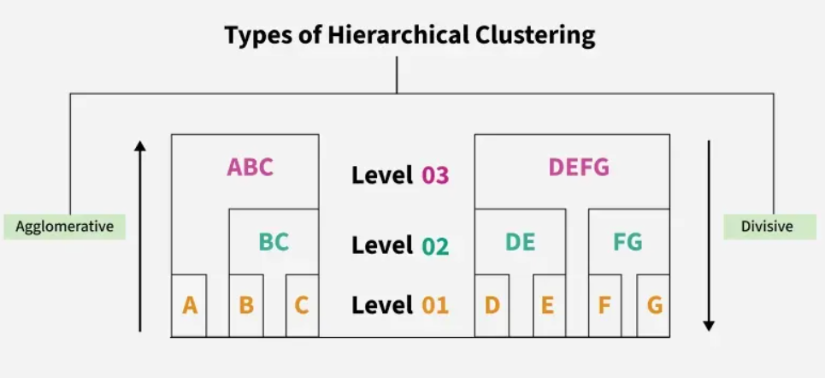
At the bottom of the dendrogram the points P, Q, R, S and T are all separate.
As you move up, the closest points are merged into a single group.
The lines connecting the points show how they are progressively merged based on similarity.
The height at which they are connected shows how similar the points are to each other; the shorter the line the more similar they are
Types of Hierarchical Clustering
There are two main types of hierarchical clustering.
Agglomerative Clustering
Divisive clustering

Slide 6
Types of hierarchical clustering
Agglomerative (bottom up) clustering: It builds the dendrogram (tree) from the bottom level, and
  merges the most similar (or nearest) pair of clusters
  stops when all the data points are merged into a single cluster (i.e., the root cluster).
Divisive (top down) clustering: It starts with all data points in one cluster, the root.
  Splits the root into a set of child clusters. Each child cluster is recursively divided further
  stops when only singleton clusters of individual data points remain, i.e., each cluster with only a single point

Slide 7
Agglomerative clustering
It is more popular than divisive methods.
  At the beginning, each data point forms a cluster (also called a node).
  Merge nodes/clusters that have the least distance.
  Go on merging
  Eventually all nodes belong to one cluster

Slide 8
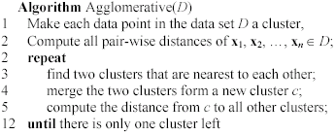
Agglomerative clustering algorithm

Slide 9
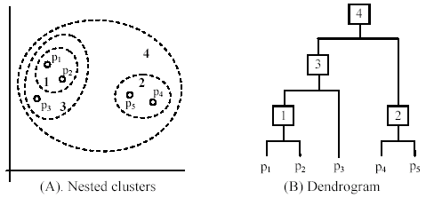
An example: working of the algorithm

Slide 10
Measuring the distance of two clusters
A few ways to measure distances of two clusters.
Results in different variations of the algorithm.
  Single link
  Complete link
  Average link
  Centroids
  …

Slide 11
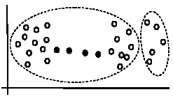
Single link method
The distance between two clusters is the distance between two closest data points in the two clusters, one data point from each cluster.
It can find arbitrarily shaped clusters, but
  It may cause the undesirable “chain effect” by noisy points
  Two natural clusters are split into two

Slide 12
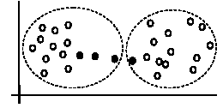
Complete link method
The distance between two clusters is the distance of two furthest data points in the two clusters.
It is sensitive to outliers because they are far away

Slide 13
Average link and centroid methods
Average link: A compromise between
  the sensitivity of complete-link clustering to outliers and
  the tendency of single-link clustering to form long chains that do not correspond to the intuitive notion of clusters as compact, spherical objects.
  In this method, the distance between two clusters is the average distance of all pair-wise distances between the data points in two clusters.
Centroid method: In this method, the distance between two clusters is the distance between their centroids

Slide 14
The complexity
All the algorithms are at least O(n²). n is the number of data points.
Single link can be done in O(n²).
Complete and average links can be done in O(n²logn).
Due the complexity, hard to use for large data sets.
  Sampling
  Scale-up methods (e.g., BIRCH).

Slide 15
Distance functions
Key to clustering. “similarity” and “dissimilarity” can also commonly used terms.
There are numerous distance functions for
  Different types of data
    Numeric data
    Nominal data
  Different specific applications

Slide 16
Distance functions for numeric attributes
Most commonly used functions are
  Euclidean distance and
  Manhattan (city block) distance
We denote distance with: dist(x_{i}, x_{j}), where x_{i} and x_{j} are data points (vectors)
They are special cases of Minkowski distance. h is positive integer.

Slide 17
Euclidean distance and Manhattan distance
If h = 2, it is the Euclidean distance
If h = 1, it is the Manhattan distance
Weighted Euclidean distance

Slide 18
Squared distance and Chebychev distance
Squared Euclidean distance: to place progressively greater weight on data points that are further apart.
Chebychev distance: one wants to define two data points as "different" if they are different on any one of the attributes.

Slide 19
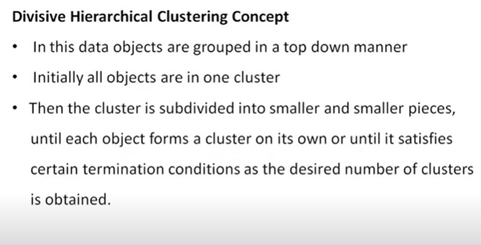

Slide 20
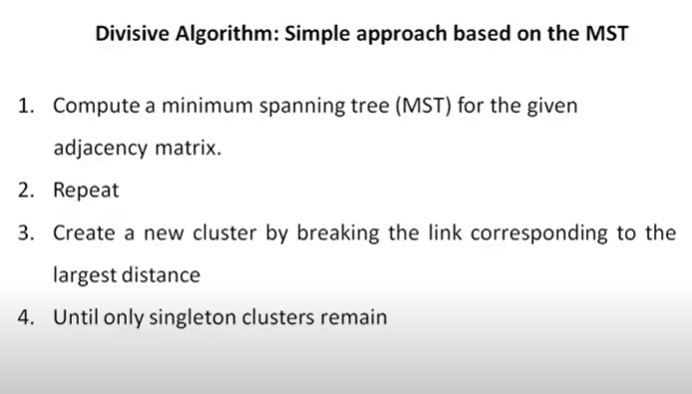

Slide 21
Self-Assessment Questions
Agglomerative Hierarchical Clustering is best described as a:
Top-down approach
Bottom-up approach
Side-to-side approach
Random approach
What is the name of the tree-like diagram used to show the hierarchy of clusters?
A bar chart
A scatter plot
A dendrogram
A histogram

Slide 22

TERMINAL QUESTIONS
What is the fundamental difference between Agglomerative and Divisive Hierarchical Clustering in terms of their approach?
Describe the initial state of data points when starting the Agglomerative Hierarchical Clustering algorithm.
What is the name of the graphical representation that illustrates the hierarchical relationships and merging/splitting of clusters?
List any two proximity measures used to calculate the distance between two clusters during the merging process.
State one major advantage of Hierarchical Clustering over K-Means Clustering regarding the number of clusters.

Slide 23
References
Text Books:
1) Pattern Recognition and Machine Learning, C. M. Bishop, 1st ed. Springer, 2006.
2) Machine Learning: A Probabilistic Perspective, K. P. Murphy, 1st ed. The MIT Press, 2012.
Reference Books :
1) Machine Learning, Mitchell Tom, Second Edition, McGraw-Hill.
2) Stephen Marsland, “Machine Learning an Algorithmic Perspective”, CRC Press, 2009.

Slide 24
THANK YOU
Team – MACHINE LEARNING

