Slide 1






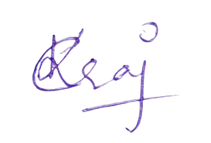

PARTICIPATION
Certificate
This certificate is awarded to
for participating in internal Smart India Hackathon 2026 organized by ED Cell, Koneru Lakshmaiah Education Foundation, Bachupally, Hyderabad Telengana held on 24-08-2026 and 25-08-2026
Dr. G Kalpana
Dr. L.Koteshwara Rao
CO-ORDINATOR
EDC-Cell & IIC KLHB
PRINCIPAL
KLH University
Bachupally

