Slide 1
Project 1
The importance of EDA and Data Cleaning

Slide 2
The Problem Definition
In this project we will take anonymized transactional data to see if there is any relationship between those behaviors and the target outcome. Which in this case is make an additional transaction.

Slide 3
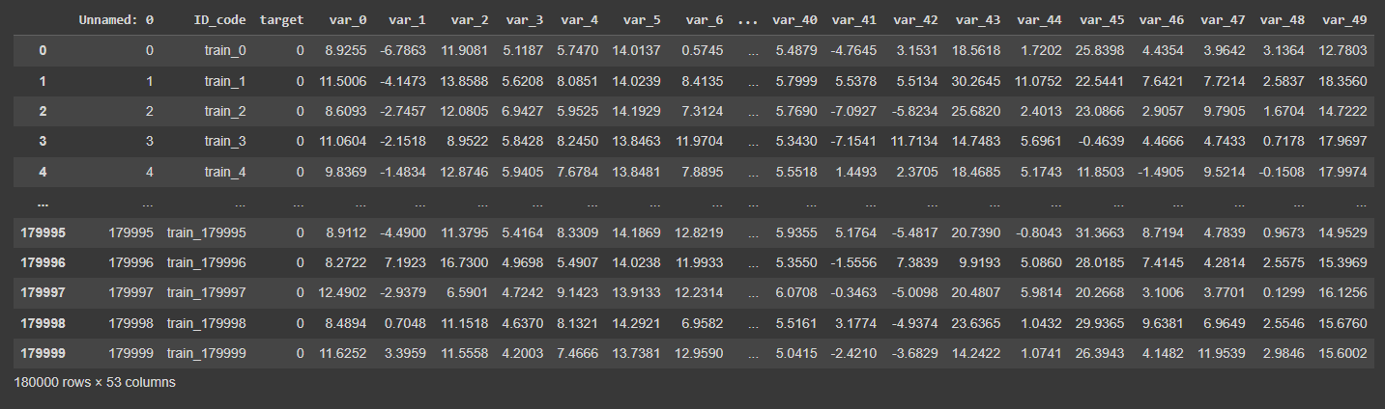
The Data - Overview

Slide 4

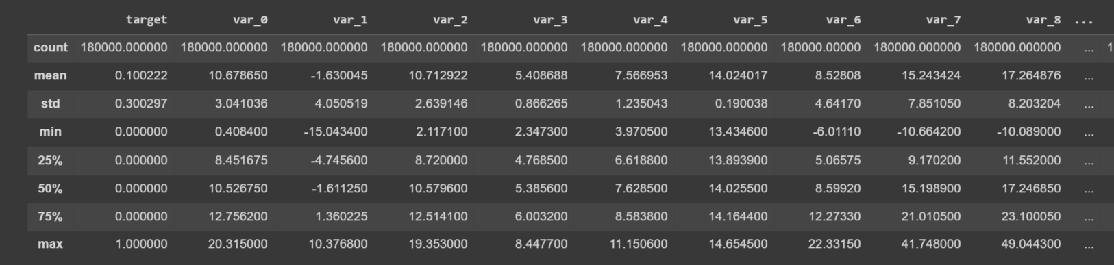
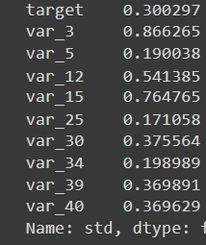
The Data Description

Slide 5
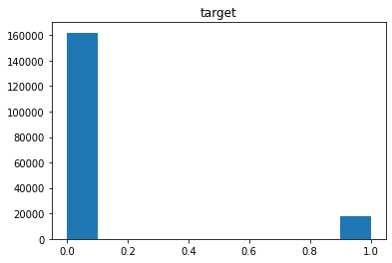
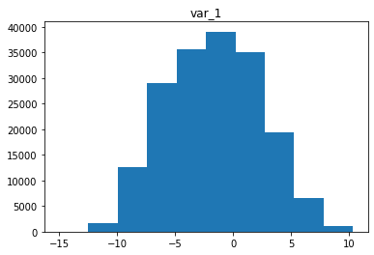
The Data Distribution

Slide 6
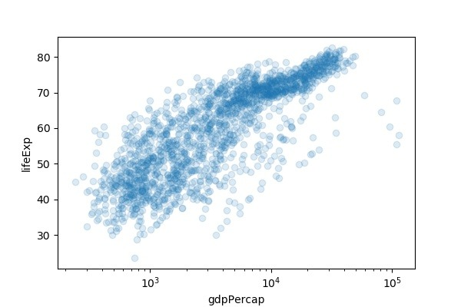
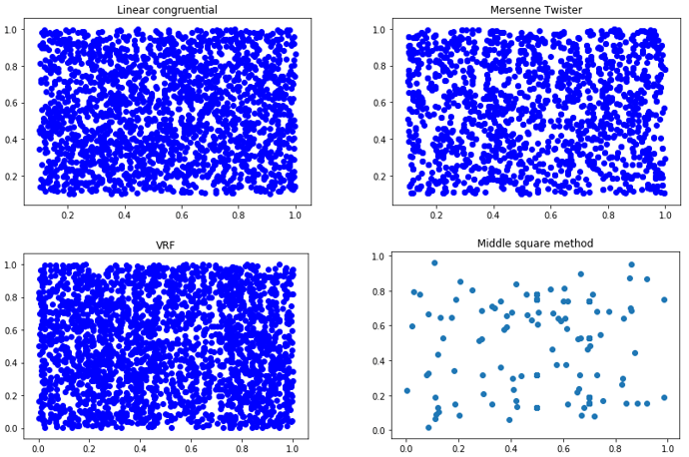
What to expect from a scatterplot

Slide 7
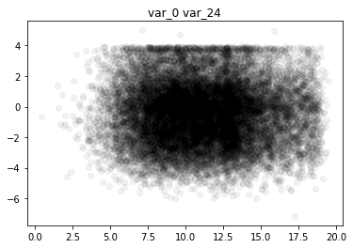
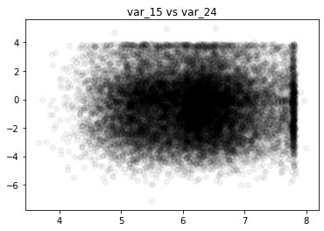
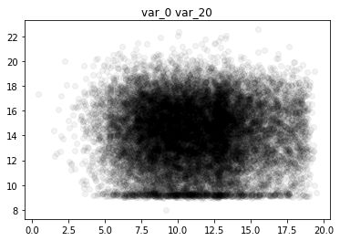
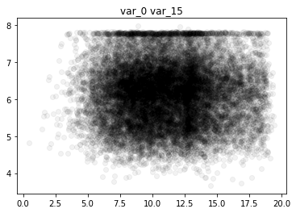
What we got

Slide 8
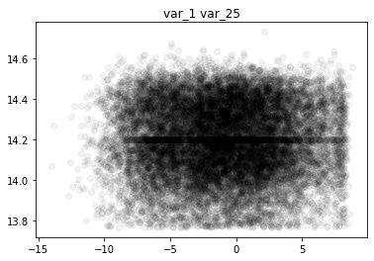
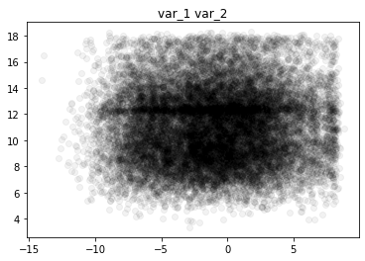
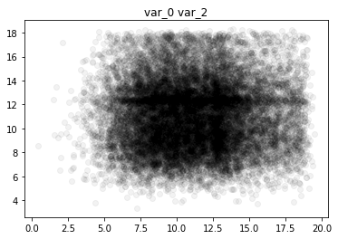
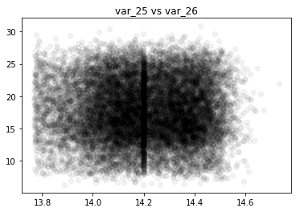
What we got

Slide 9
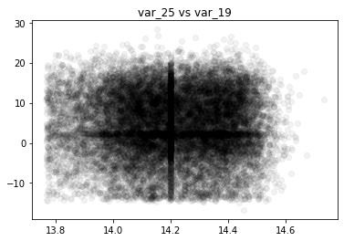
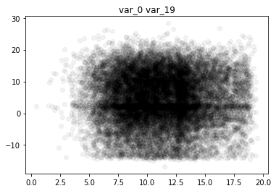
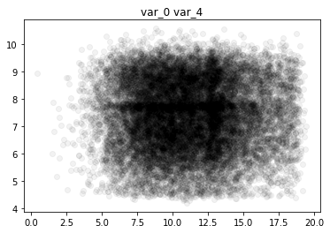
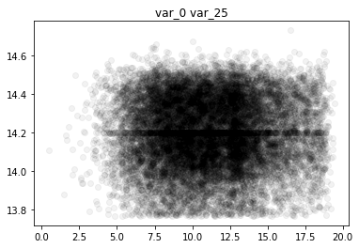
What we got

Slide 10
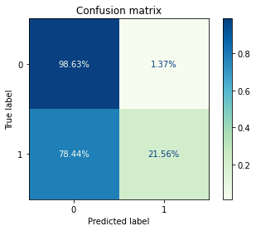
Gaussian Naïve Bayes

Slide 11
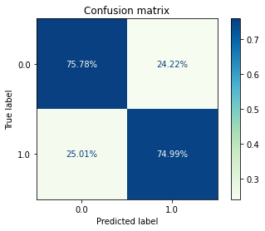
Gaussian Naïve Bayes 2.0

Slide 12
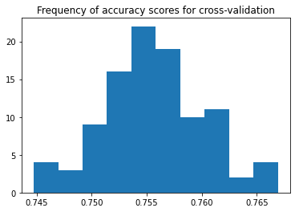
Accuracy Scores

Slide 13
Conclusion & Future Directions
Even if a data set looks clean, that does not mean that meaning information can be taken from it. It might be mostly noise.
It’s okay to modify data as a part of cleaning if you are able to get more meaningful information and models out of it. Be sure to be transparent about that modification.
If you are going to generate random data use a trigonometric function.
In the future we could look at what the lines in the scatter plot correlations are or exam our data collection methods.

Slide 14
Sources
Scatter plot of random Numbers. | Download Scientific Diagram (researchgate.net)
How To Make Scatter Plot in Python with Seaborn? - Python and R Tips (cmdlinetips.com)

