Slide 1
Project 2
More data, more problems

Slide 2
The Problem Definition
In this project I will take information about home features and compare them to the sales price of the home to see if there is any relationship between them. Any relationships derived should help me develop a model to better predict the price at which a house will sell for based on the features it has.

Slide 3

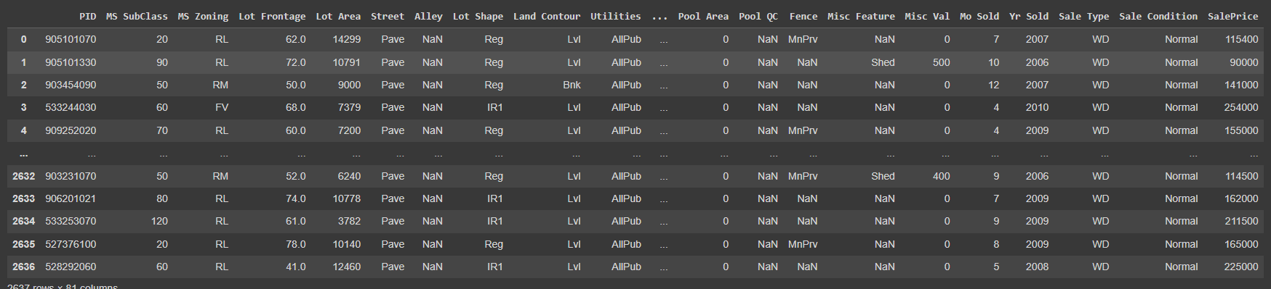
The Data - Overview

Slide 4
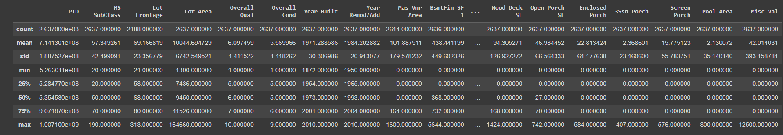
The Data Description

Slide 5
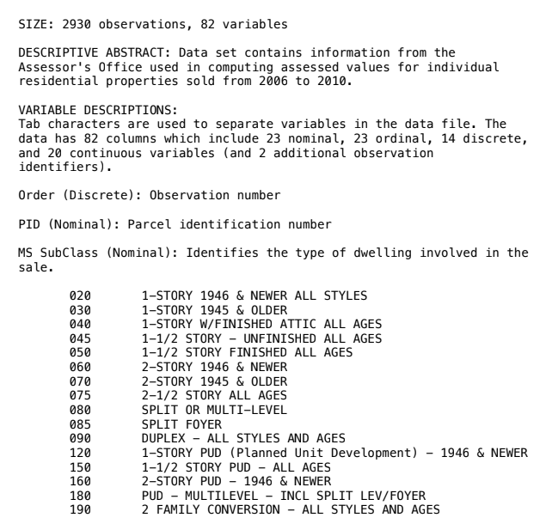
The Data Description

Slide 6
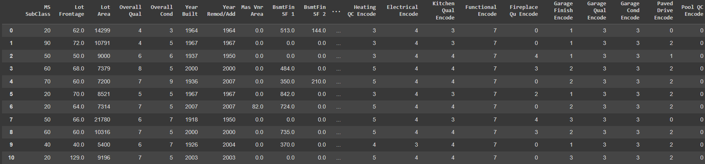
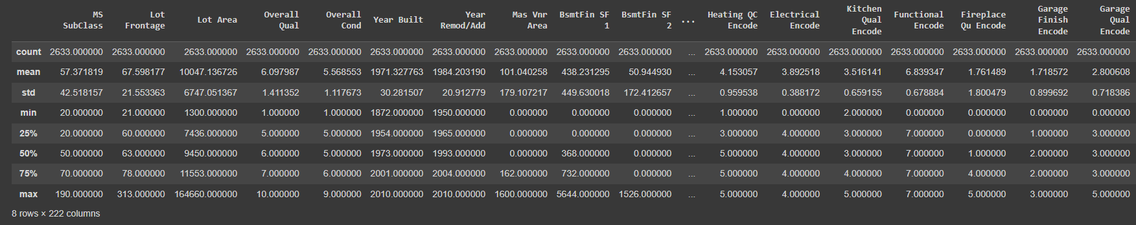
The Data Description – After Cleaning & Encoding

Slide 7
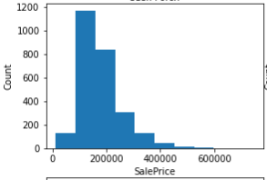
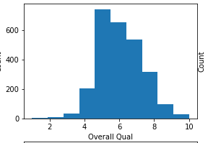
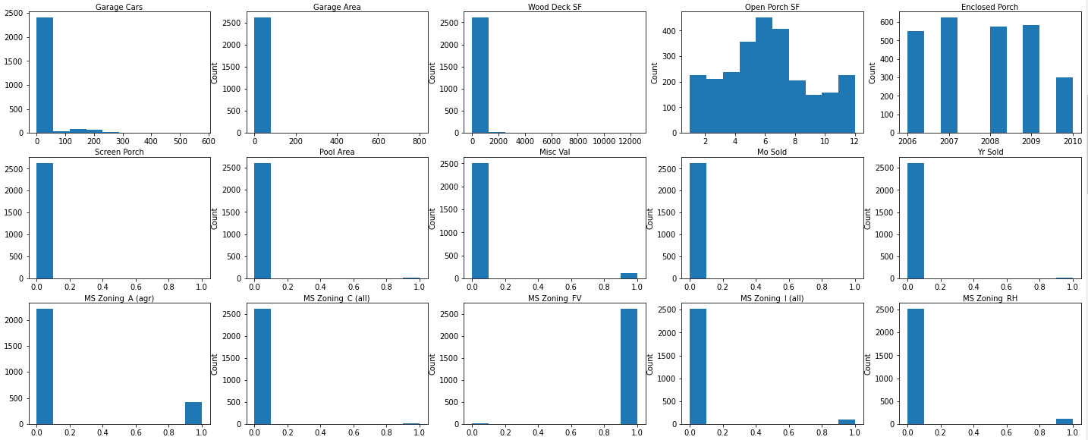
The Data Distribution

Slide 8
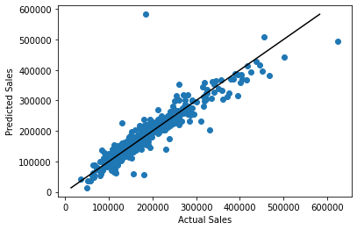

Regression of predicted sales

Slide 9
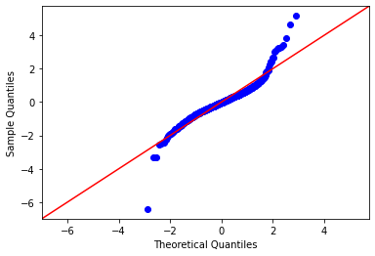
How accurate is the model

Slide 10
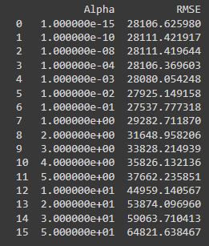
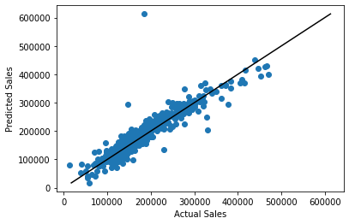
Regularization

Slide 11
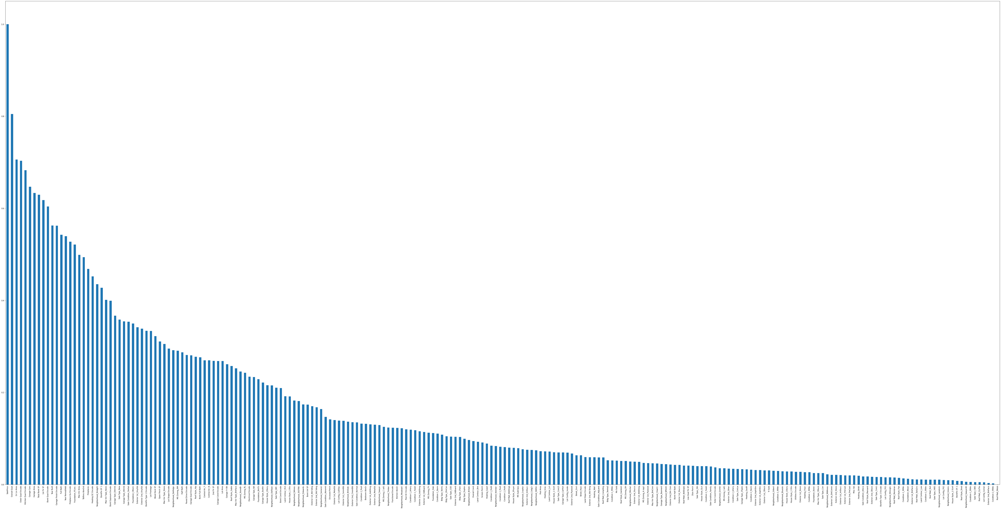
How many variables?!

Slide 12
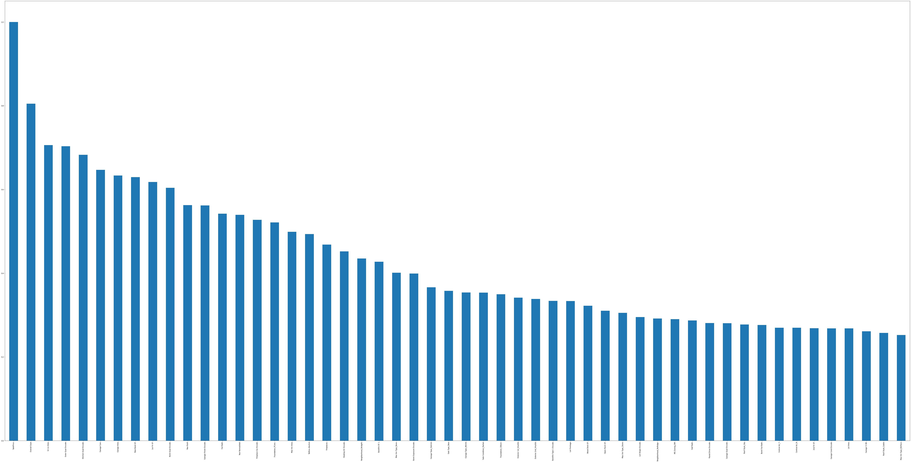
Feature Selection

Slide 13
Conclusion & Future Directions
Cleaning and encoding data is an important aspect to data that could drastically change data outputs. Checking how that can change your output can be labor intensive, so choose wisely.
Model’s are great, but they can be subject to the random sample. AKA overfitting.
Sometimes it is worth it to forgo cross validation accuracy in order to reduce the amount of variables.
In the future we could try to find the perfect intersection between feature selection and lowest error or use the model for other things such as a decision tree.

Slide 14
Sources
Data Science Cohort 8 shared google drive.

