Slide 2

Nick Turner
nickleviturner@gmail.com
505.944.6361
Scientist, Coder, Educator

Slide 3
What I learned at Data Camp

Slide 4
Technical Coding Skills

Slide 5

Technical Coding Skills

Slide 6

Technical Coding Skills

Slide 7

Technical Coding Skills

Slide 8

Technical Coding Skills

Slide 9

Technical Coding Skills

Slide 10

Technical Coding Skills

Slide 11
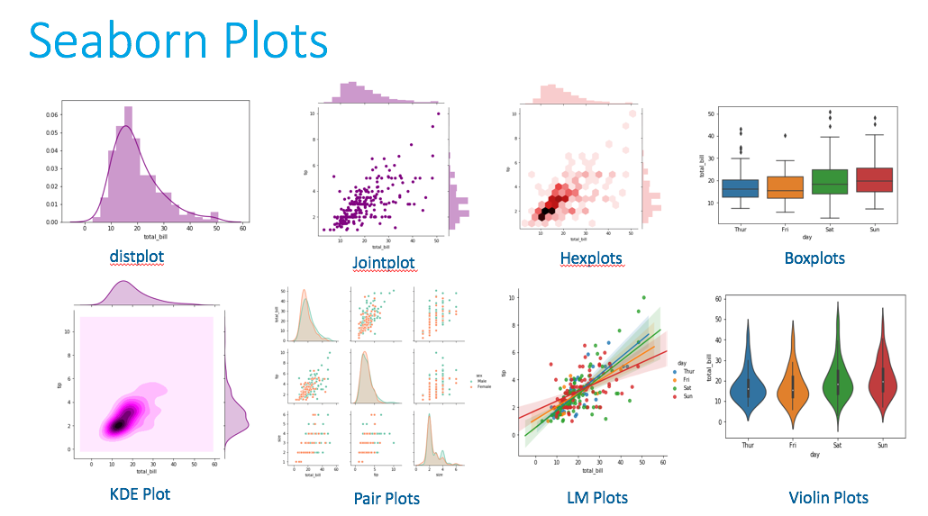
Technical Coding Skills

Slide 12
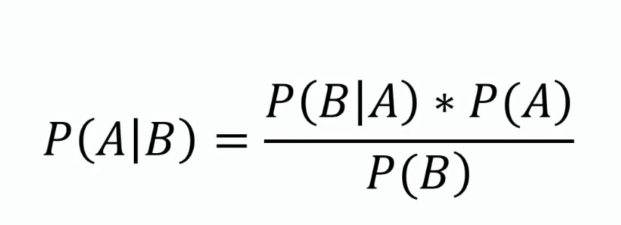
Technical Coding Skills

Slide 13
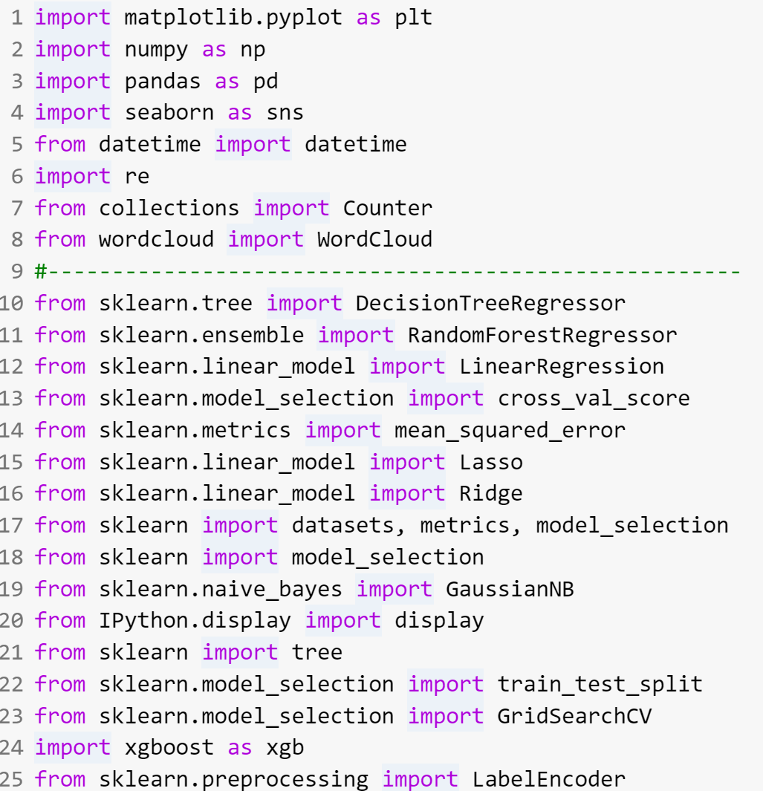
Technical Coding Skills

Slide 14
Good Data Tells a Story

Slide 15

Good Data Tells a Story

Slide 16
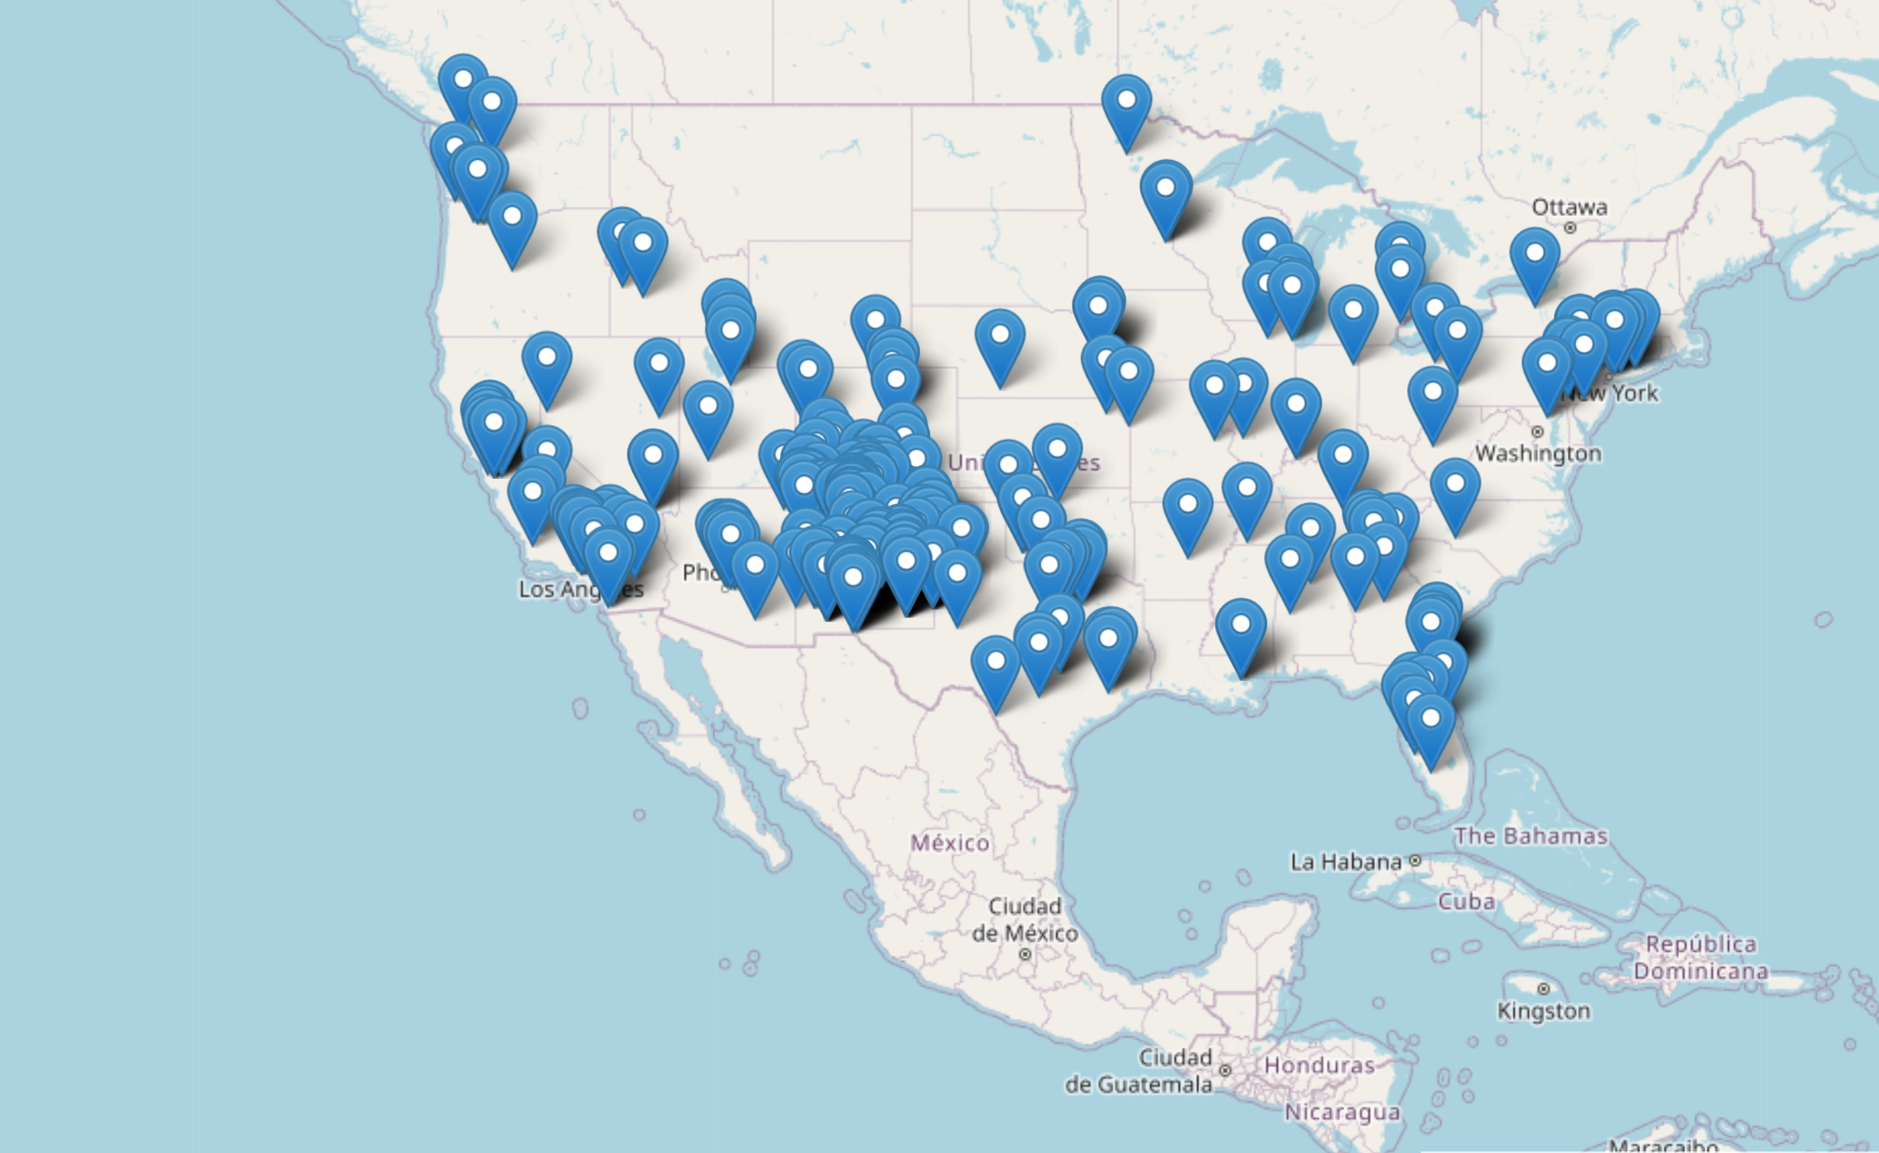


Slide 17
56076 USA
709 Outside USA
82276 Unknown

Slide 18
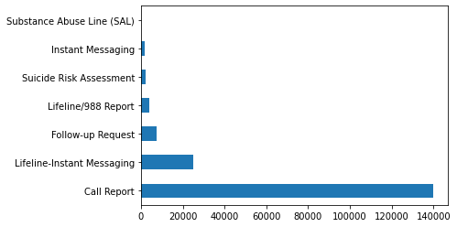

Slide 19
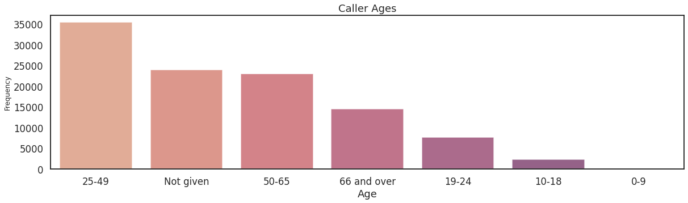

Slide 20
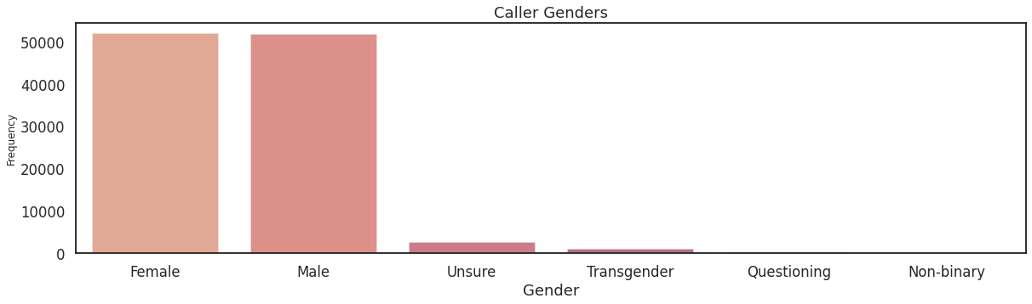

Slide 21
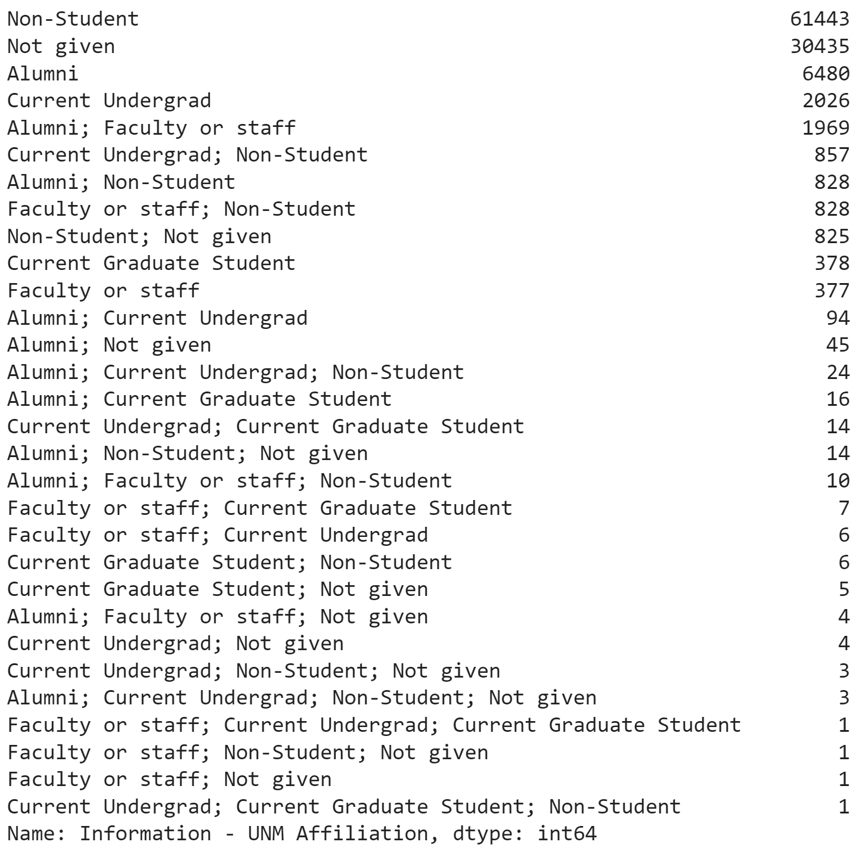

Slide 22
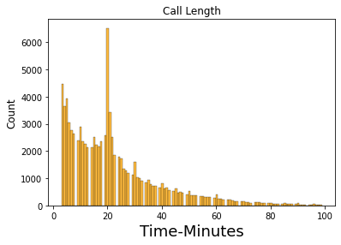

Slide 23
41509 < 3min
499 > 100 min

Slide 24
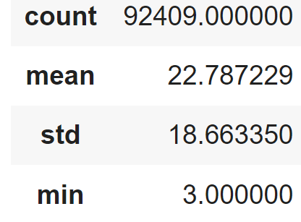
41509 < 3min
499 > 100 min

Slide 25
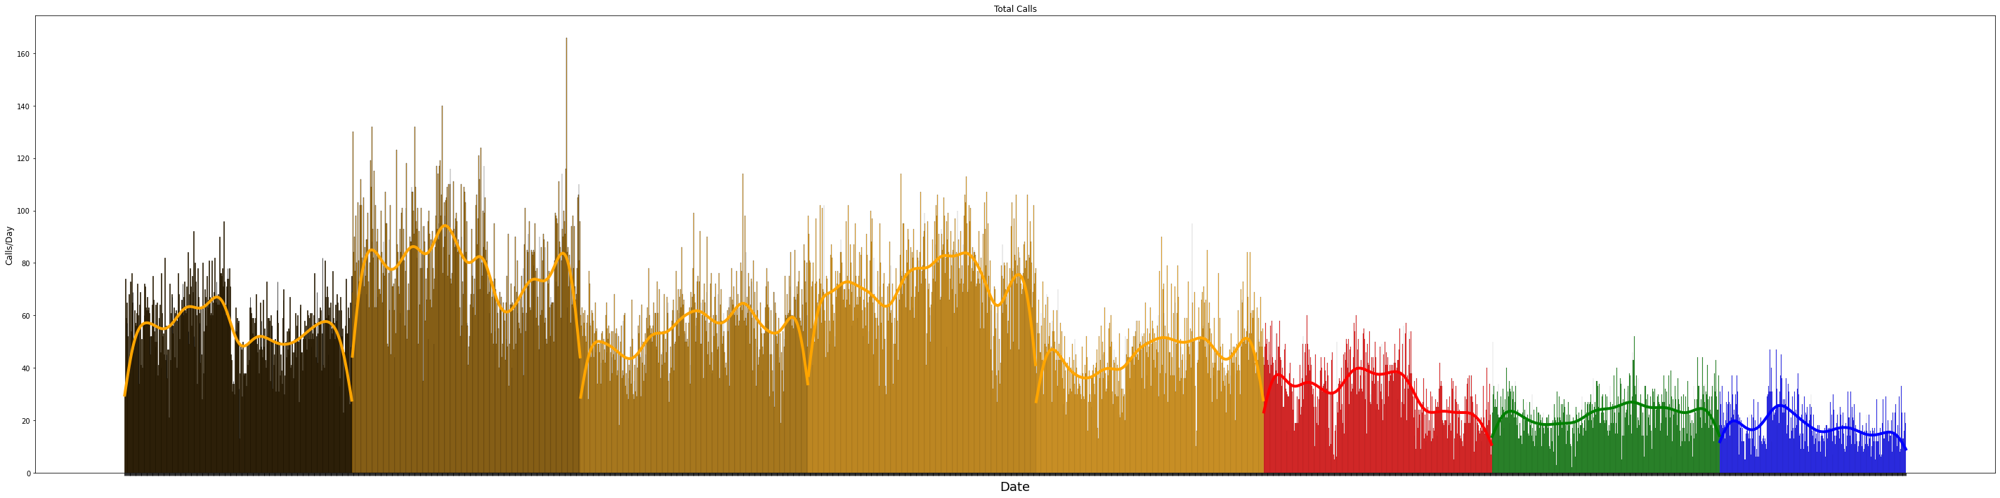

Slide 26
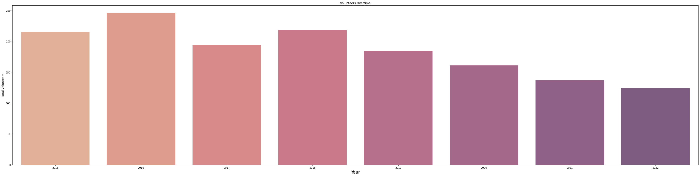

Slide 27
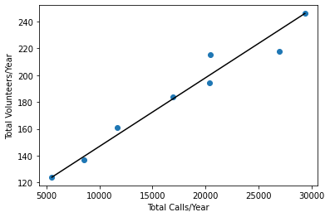

Slide 28
Lifeline Instant Messaging
  Post-Chat Survey
    Agitated
    Alone
    Confident and in control
    Depressed
    Hopeful
    Overwhelmed
    Suicidal
  Evaluated Features
    Center Information - Chat Answered
    Center Information - Type of Chat
    IM Demographics - Do you have thoughts of suicide?
    IM Demographics - Has a family member served in the military - past or present?
    IM Demographics - Have you served in the military - past or present?
    IM Demographics - How upset are you? [Scale of 1-5]
    IM Demographics – Race/Ethnicity
    IM Demographics - What is your gender identity (how you define yourself)?
    IM Demographics - What is your main concern?
    Post-Chat Survey - I didnt have anyone else I could trust with my problem
    Post-Chat Survey - I don't have access to a professional counselor
    Post-Chat Survey - I have used the chat service before
    Post-Chat Survey - I wanted help from someone who doesn't know me personally
    Post-Chat Survey - I'm more comfortable chatting online than talking to someone in person or on the phone
    Post-Chat Survey - The people I talk to about problems are not currently available
    Post-Chat Survey - What is your sexual orientation?
    Suicidal/Homicidal Risk Assessment - Was emergency rescue dispatched?
    Suicidal/Homicidal Risk Assessment - Was homicidal ideation (any desire or threat of violence to others) present?
    Suicidal/Homicidal Risk Assessment - Was suicidal ideation present?
    Suicidal/Homicidal Risk Assessment - Was user at imminent risk for suicide?"

Slide 29
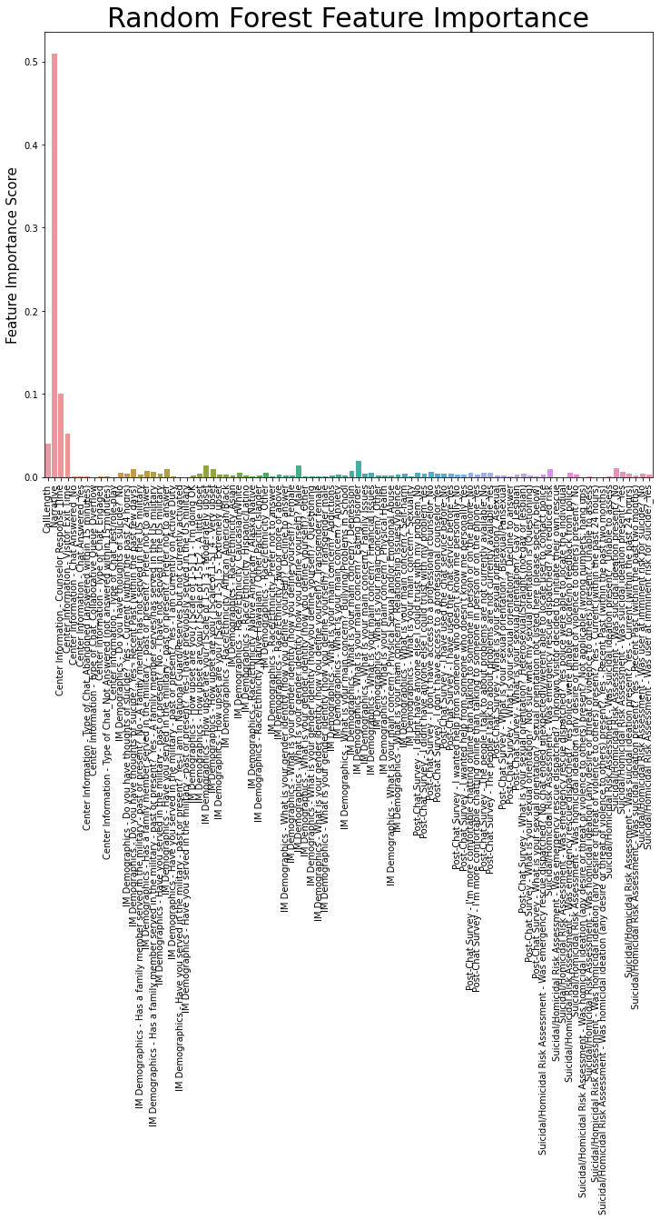
Agitated

Slide 30
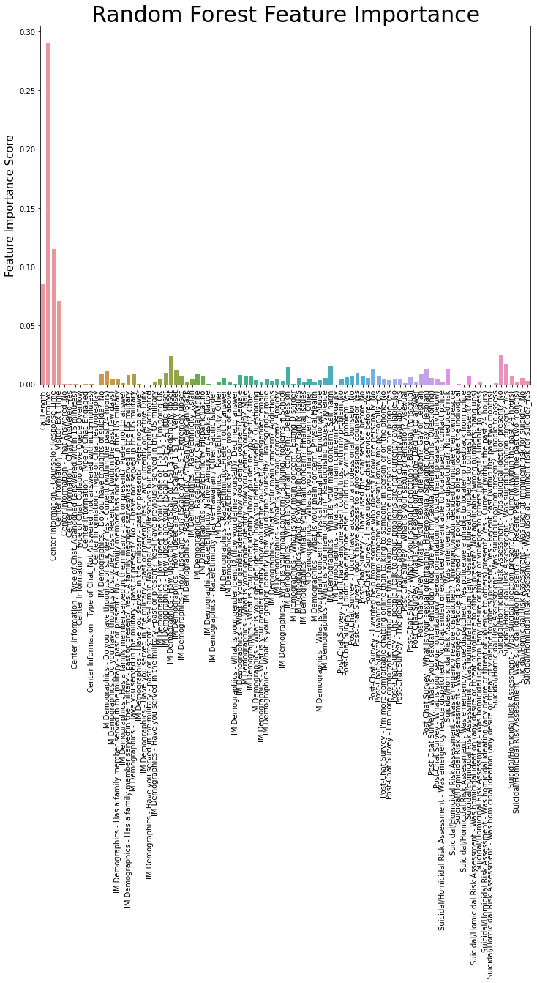
Alone

Slide 31

Confident

Slide 32
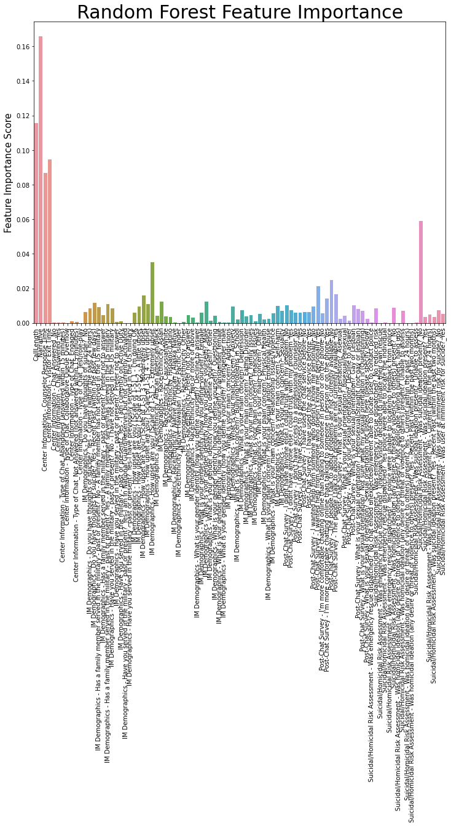
Depressed

Slide 33

Hopeful

Slide 34
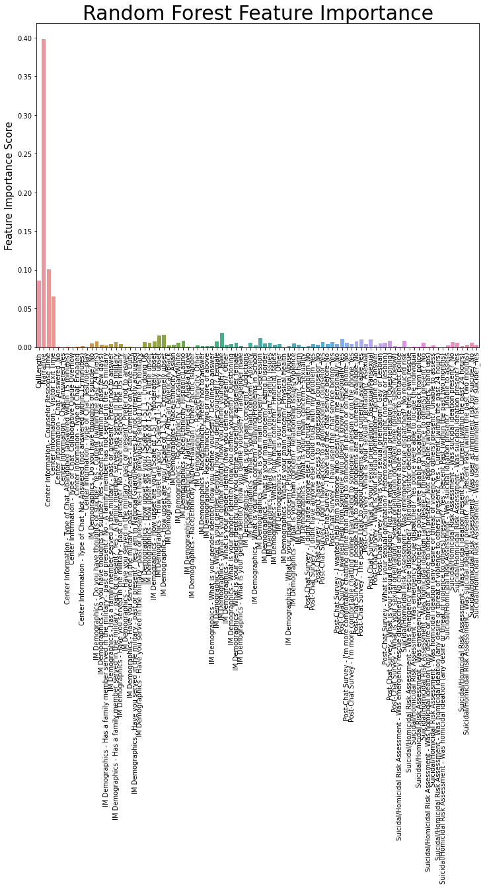
Overwhelmed

Slide 35

Suicidal

Slide 36
Conclusion
Agora is a fantastic organization.
This information affirms some of Agora’s key philosophies.
Additional exploration could be crucial for future grant funding.
Future Directions
Continue to clean, and organize the data.
Evaluate relationships in caller data
Monitor volunteer behavior
Natural Language Processing

Slide 37
Image Sources
http://www.agoracares.org/
https://en.wikipedia.org/wiki/Python_(programming_language)
https://en.wikipedia.org/wiki/Project_Jupyter
https://en.wikipedia.org/wiki/Docker_(software)
https//commons.wikimedia.org/wiki/File:Sql_data_base_with_logo.png
https://en.wikipedia.org/wiki/TensorFlow
https://seaborn.pydata.org/

Slide 39
Mistakes are Mandatory

Slide 40
Mistakes are Mandatory
iterate, iterate, iterate

Slide 41
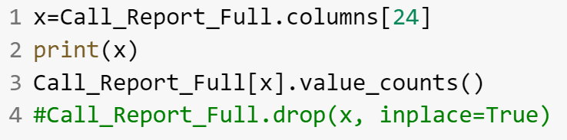
Mistakes are Mandatory
iterate, iterate, iterate

Slide 42
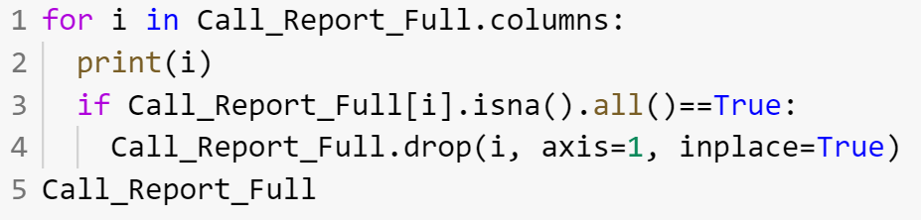
Mistakes are Mandatory
iterate, iterate, iterate

Slide 43
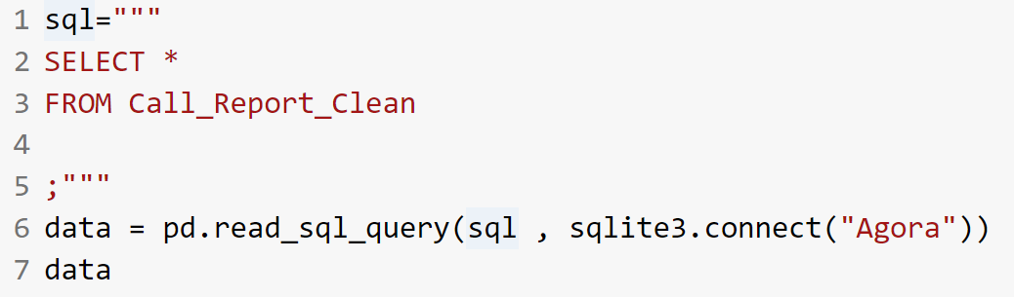
Mistakes are Mandatory

Slide 44
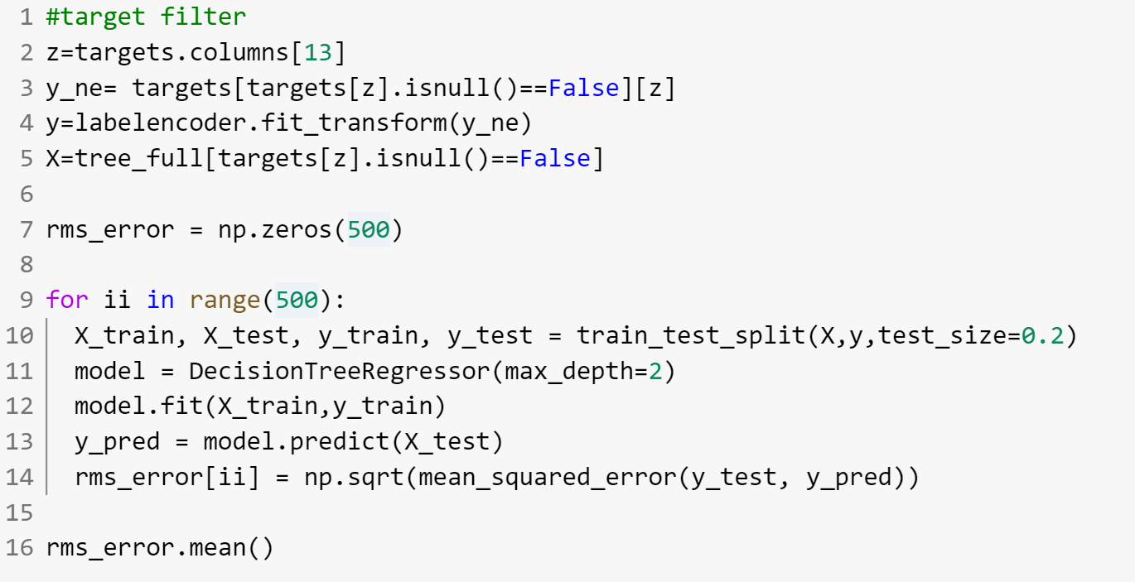
Mistakes are Mandatory

Slide 46
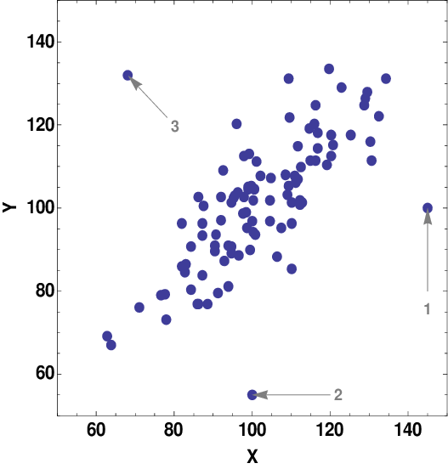
Outliers get the most attention

Slide 47


Slide 48
DruID© is capable of accurately predicting the structures of the identified natural products, comparing the predicted structures with known ones and excluding non-novel structures from further analyses.
For novel entities, the analysis pipeline continues by predicting the 3D structure. A relatively small library of several thousand compounds is generated, which in turn can be used to screen drug targets in silico by identifying and ranking potential binders of a particular drug target.

Slide 49
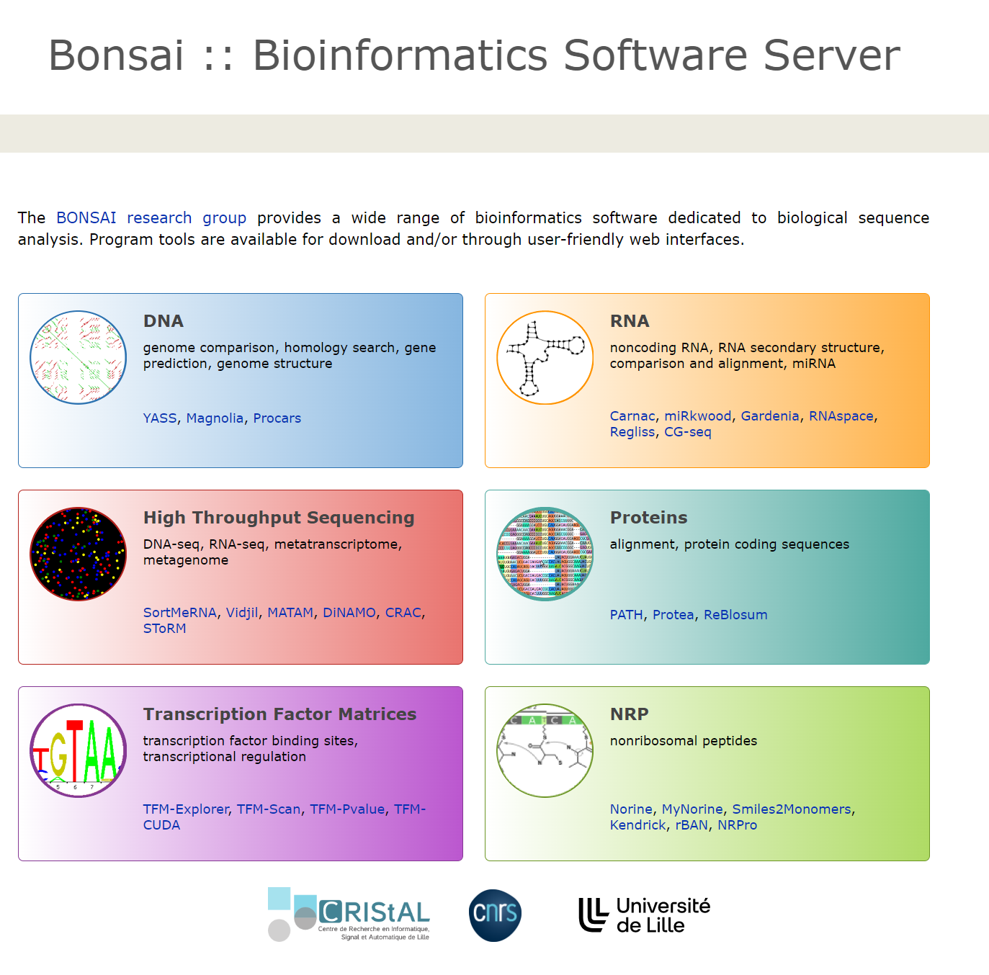

Slide 50
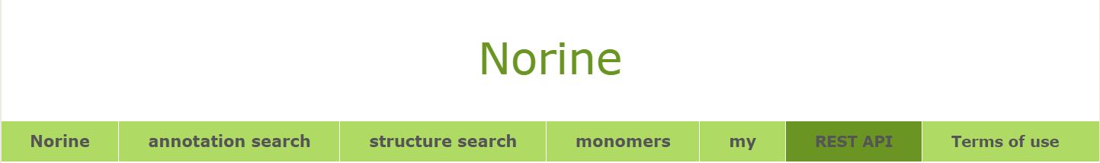

Slide 51
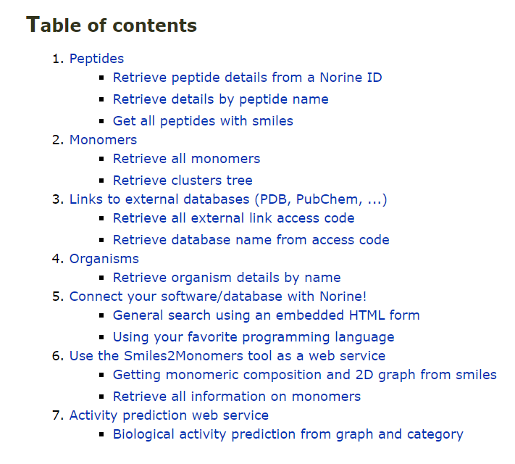

Slide 52
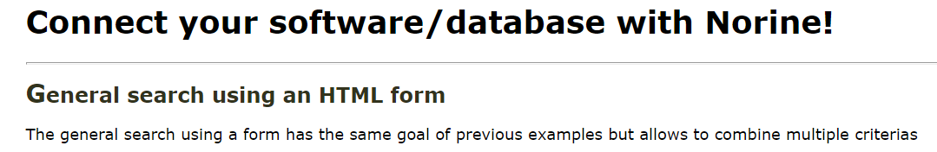
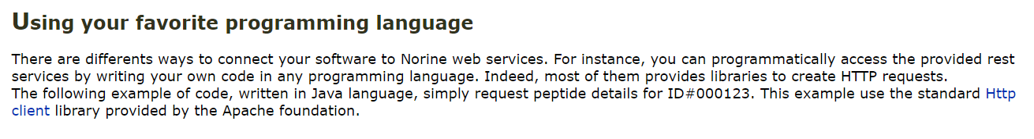

Slide 53


Slide 54
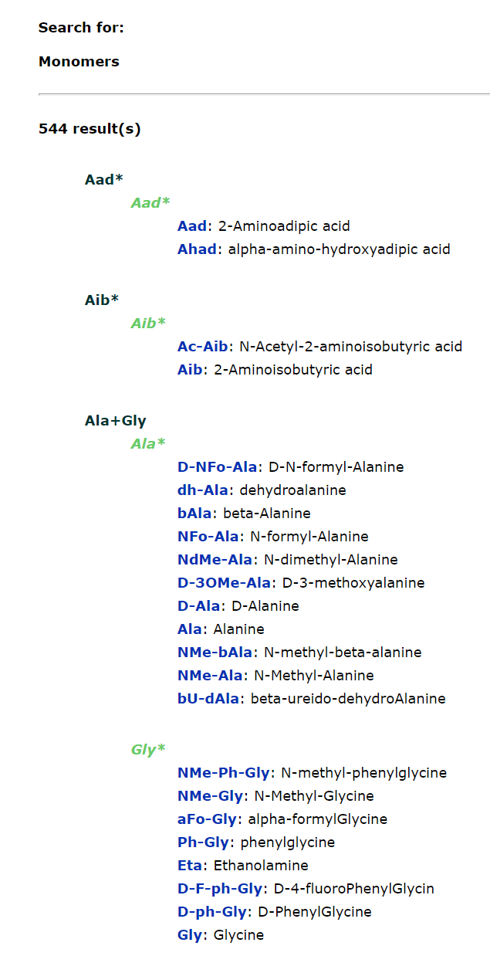

Slide 55
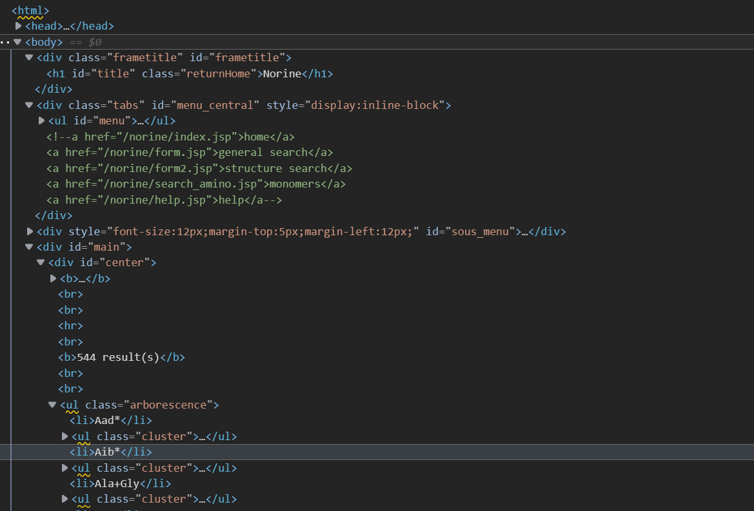

Slide 56
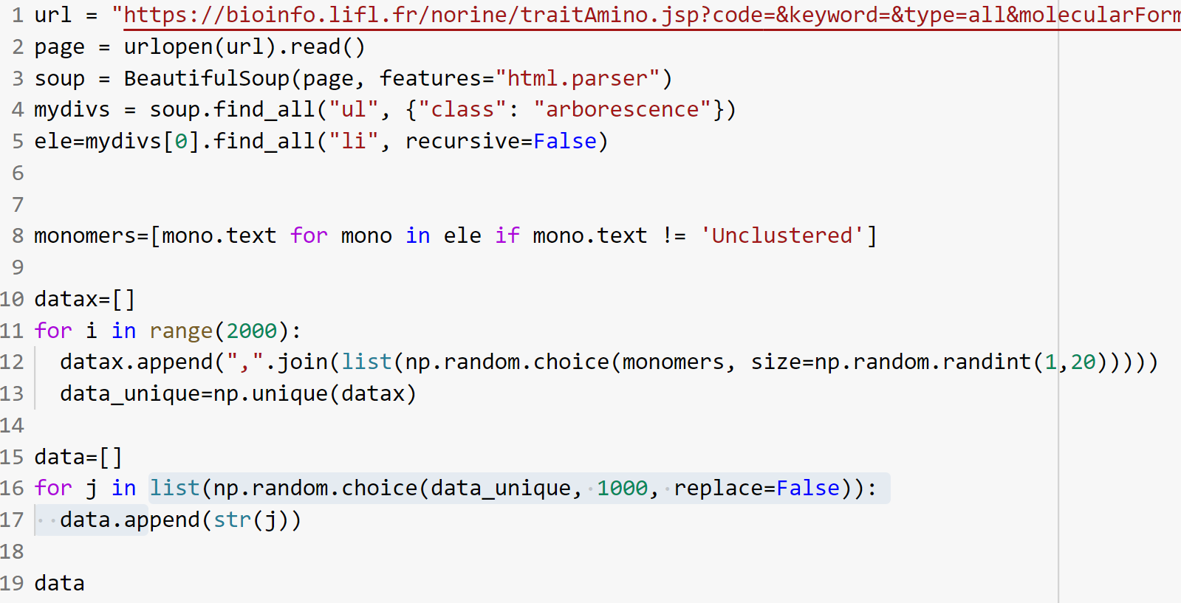

Slide 57
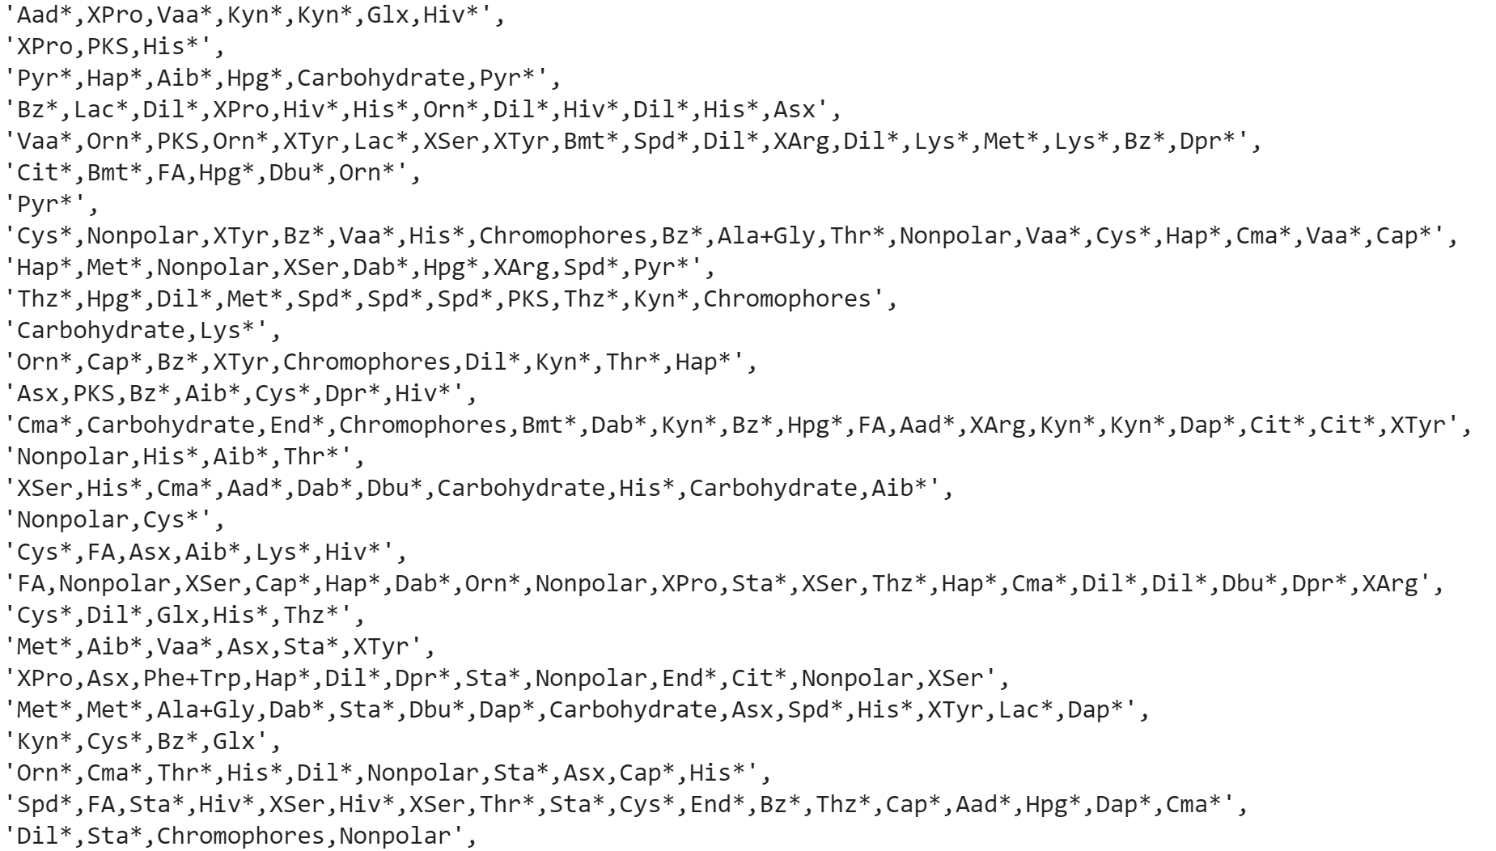

Slide 58
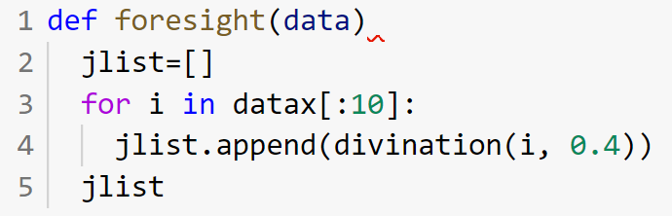

Slide 59
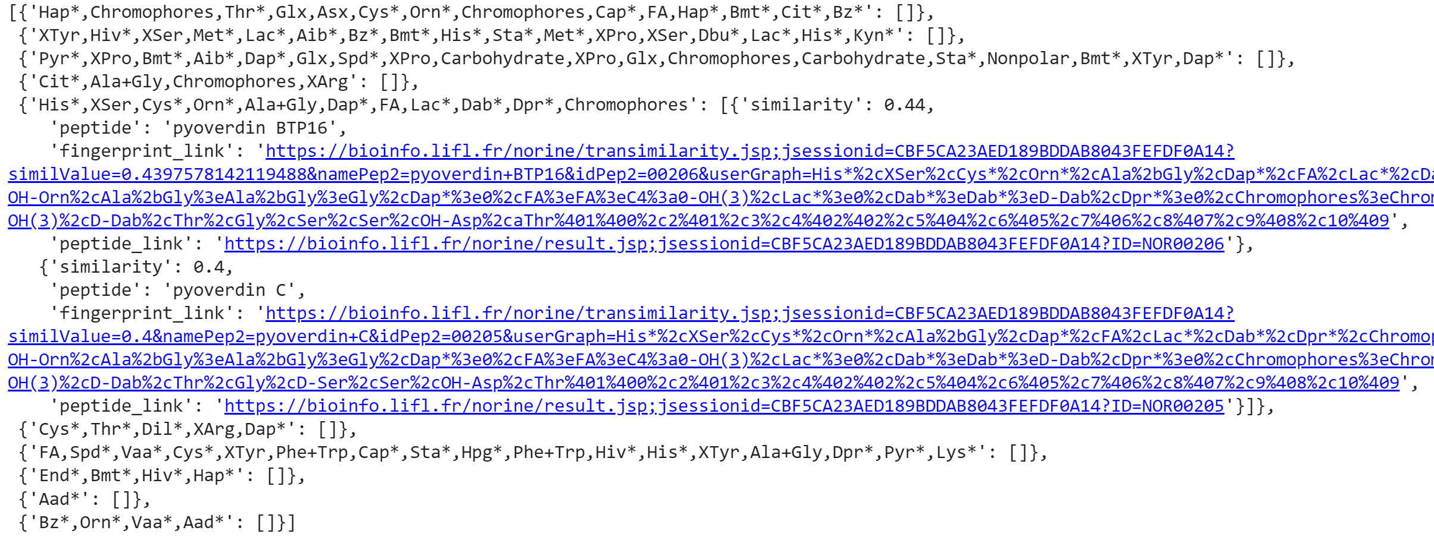

Slide 60


Slide 61
Take every opportunity to network

Slide 62
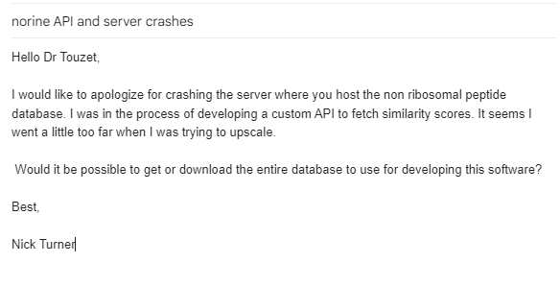
Take every opportunity to network

Slide 63

Challenge #1: Python
Not everyone has Python installed
Or the right modules installed
Or the right version of Python

Slide 64

Solution: Docker
Container with code bundled
Distribute as a single tar file
Launch container
Exec into container to scripts run

Slide 65
Challenge #2: Docker
not everyone has Docker installed

Slide 66

Solution: Cloud Functions
Place code in a cloud function
REST API with URL
No server to run

Slide 67
Challenge #3: Cloud Functions
Payload too big

Slide 68

Solution: Raspberry Pi + Docker
Install Docker on RPi
Load image
Launch container at boot
SSH into Raspbery Pi
Exec into container to scripts run

Slide 69
Challenge #4: 32-bit Raspberry Pi 3B+
ARM32 not AMD64
Image is for AMD64

Slide 70

Solution: AWS
EC-2 Graviton 64-bit
Build with '--platform=linux/arm/v7'

Slide 71
Solution: Raspberry Pi + Docker
Download ARM32 image from AWS
Launch container
SSH into Raspberry Pi
Exec into container to run scripts

Slide 72

Solution: Raspberry Pi + Docker + Flask
REST API
Launch container at boot
Plug and curl

Slide 73
Test #1
$ curl -s -X GET http://192.168.0.44:5000/
{
"email": "alice@outlook.com",
"name": "alice"
}

Slide 74
Test #2
$ curl -s \
-X POST \
-H "Content-Type: application/json" \
-d '{"peptide":"Ala+Gly"}' \
http://192.168.0.44:5000/peptide

Slide 75
Test #2
{
"Ala+Gly": [
{
"fingerprint_link": "https://bioinfo.lifl.fr/norine/transimilarity.jsp;jsessionid=56681E504E1AEE641BB328B22C3488EB?similValue=0.5469181606780271&namePep2=phosphinothricin+tripeptide&idPep2=00670&userGraph=Ala%2bGly&choices=Ala%2bGly%3eAla%2bGly%3eAla&matchGraph=PT%2cAla%2cAla%401%400%2c2%401",
"peptide": "phosphinothricin tripeptide",
"peptide_link": "https://bioinfo.lifl.fr/norine/result.jsp;jsessionid=56681E504E1AEE641BB328B22C3488EB?ID=NOR00670",
"similarity": 0.547
},
{
"fingerprint_link": "https://bioinfo.lifl.fr/norine/transimilarity.jsp;jsessionid=56681E504E1AEE641BB328B22C3488EB?similValue=0.5&namePep2=bacilysin&idPep2=00209&userGraph=Ala%2bGly&choices=Ala%2bGly%3eAla%2bGly%3eAla&matchGraph=Ala%2cAca%401%400",
"peptide": "bacilysin",
"peptide_link": "https://bioinfo.lifl.fr/norine/result.jsp;jsessionid=56681E504E1AEE641BB328B22C3488EB?ID=NOR00209",
"similarity": 0.5
}
]
}

Slide 76
Future Directions
Cloud functions: AWS, GCP, DO(?)
Real data
Clean up code
Talk with Norine maintainers about scaling

Slide 77
Image Sources
https://en.wikipedia.org/wiki/Docker_(software)#/media/File:Docker_logo.svg
https://upload.wikimedia.org/wikipedia/commons/c/c3/Python-logo-notext.svg
https://en.wikipedia.org/wiki/DigitalOcean#/media/File:DigitalOcean_logo.svg
https://en.wikipedia.org/wiki/Raspberry_Pi#/media/File:Raspberry_Pi_Logo.svg
https://en.wikipedia.org/wiki/Amazon_Web_Services#/media/File:Amazon_Web_Services_Logo.svg
https://en.wikipedia.org/wiki/Flask_(web_framework)#/media/File:Flask_logo.svg

Slide 78
Thank you!

