Slide 1
Project 3
Missing the Random Forest for the Decision Tree

Slide 2
Problem Definition
The purpose of this project is to predict new song popularity (target) based on data features (variables) collected for songs that have been on the top 200 Weekly Global charts of Spotify in 2020 and 2021.
This is a supervised regression problem.
Goals
  To minimize the cross-validated root mean squared error (RMSE) around 10.
  To determine the importance of the features in driving the regression result.
  To choose parameters that will avoid over-fitting in the result.
  Explore the features included in the analyses
Methodology
  The project will be done using tree-based regression techniques.

Slide 3
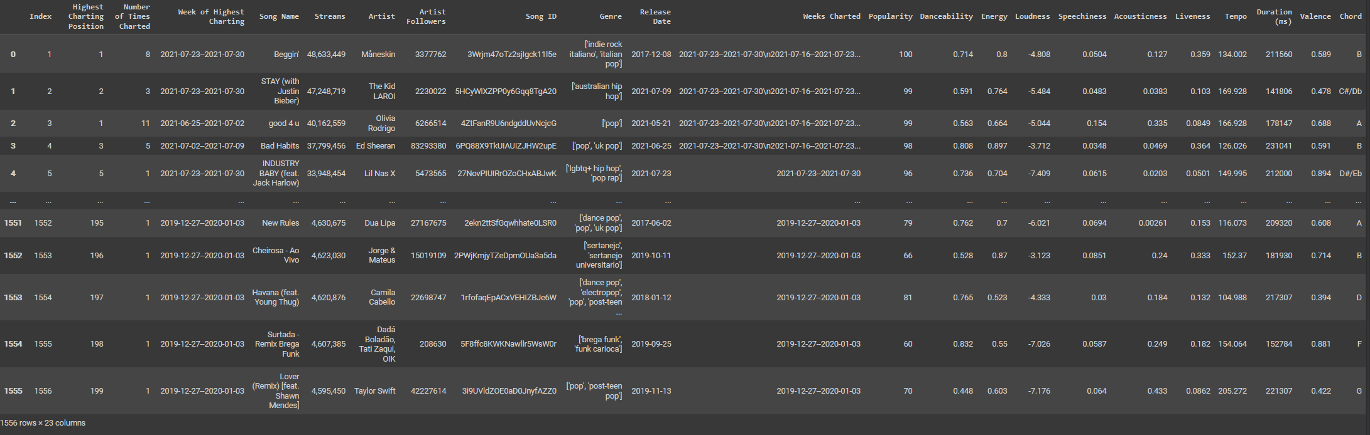
The Data

Slide 4
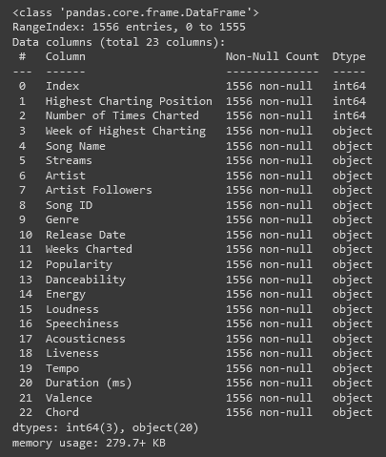
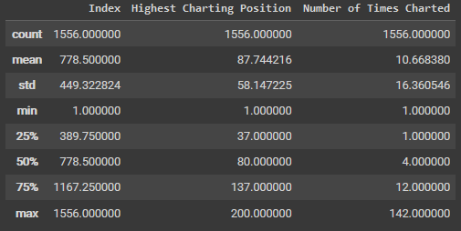
Data Description

Slide 5
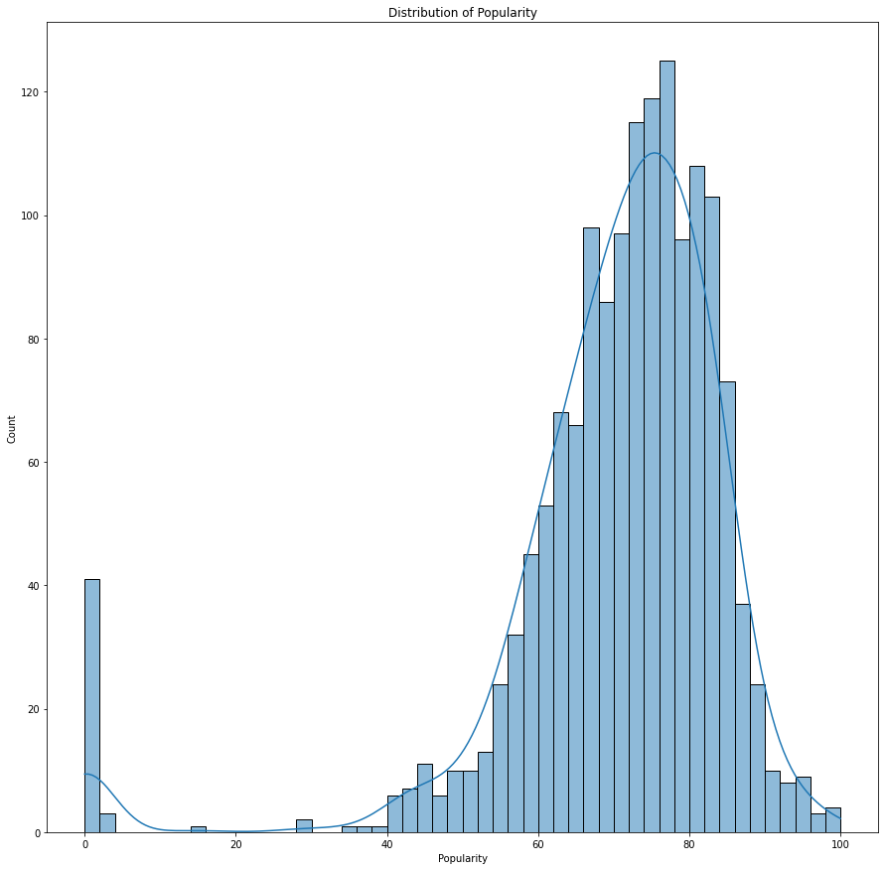
Distribution of Target Variable

Slide 6
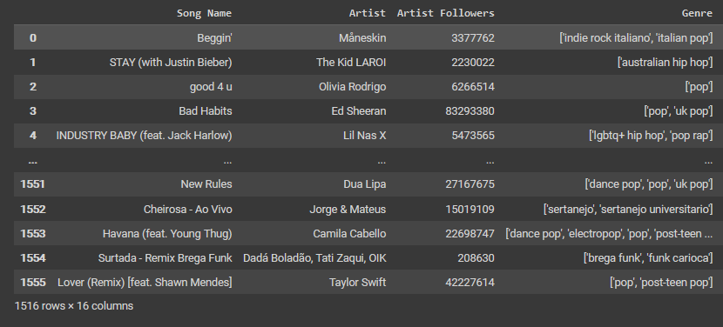
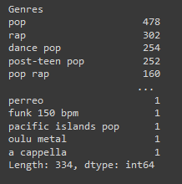
Dealing with Complicated Variables

Slide 7
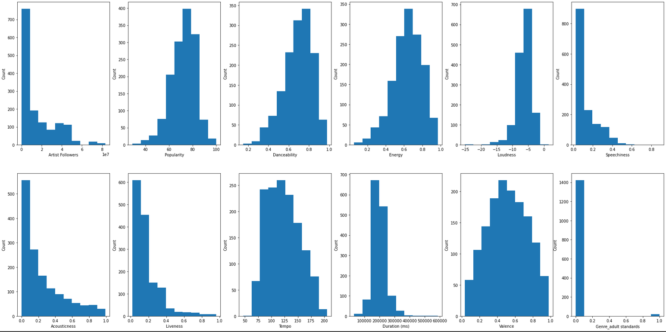
Data Representation

Slide 8
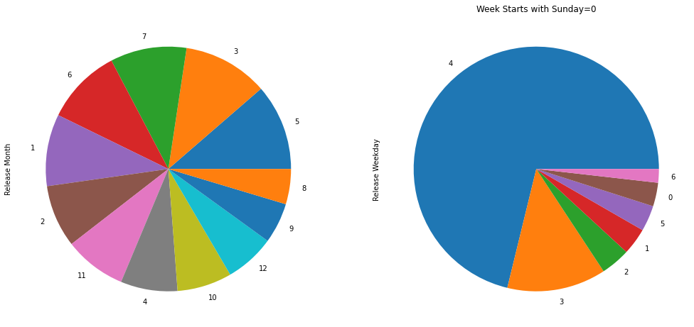
Data Representation

Slide 9
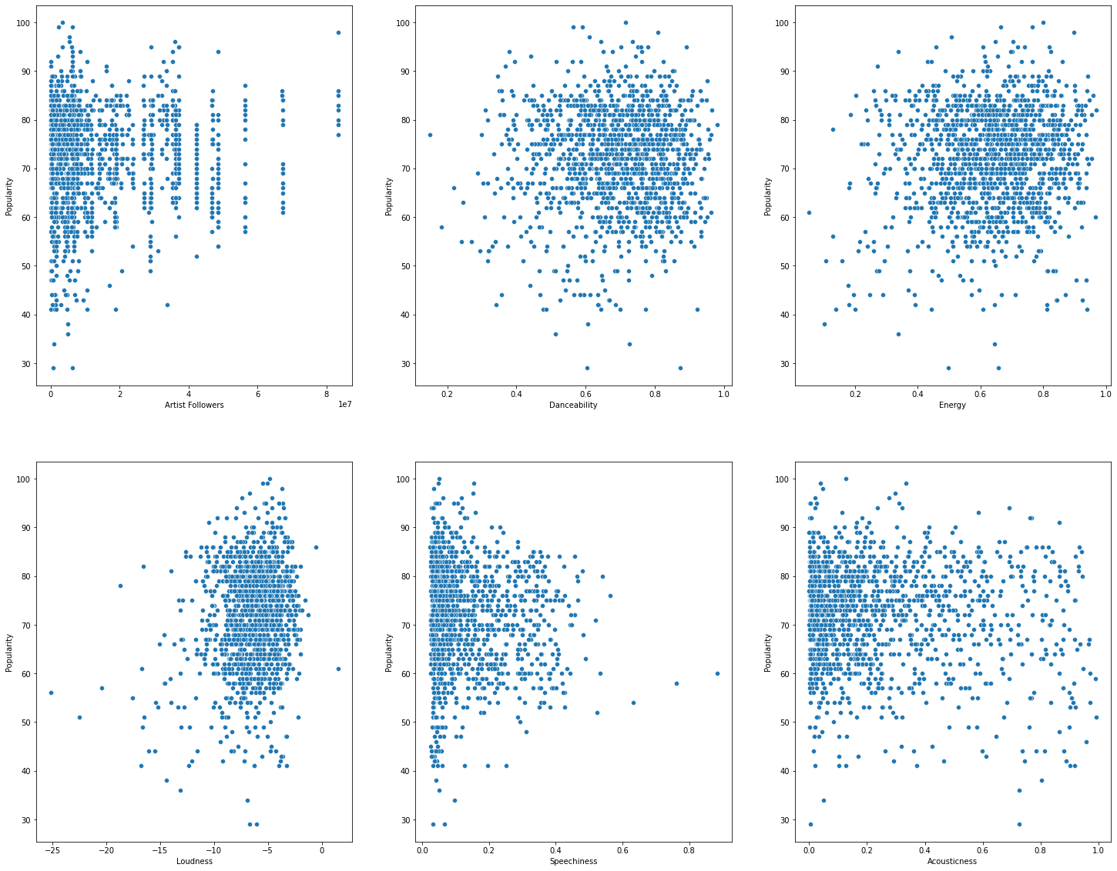
Data Representation

Slide 10
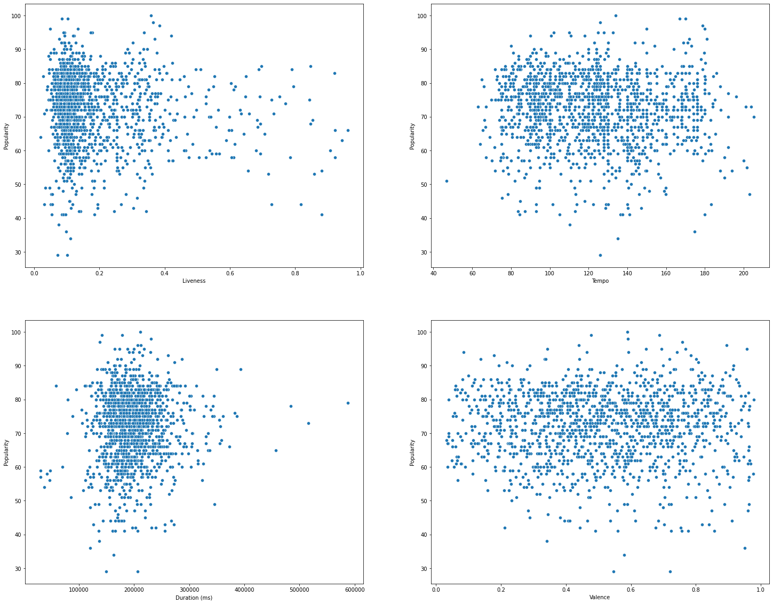
Data Representation

Slide 11
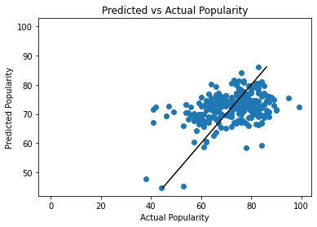
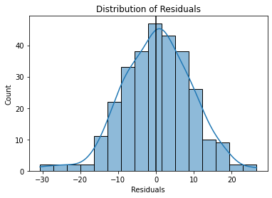
Linear Regression

Slide 12
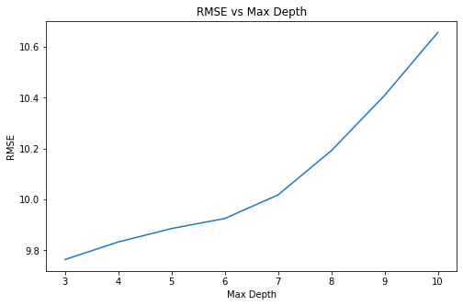
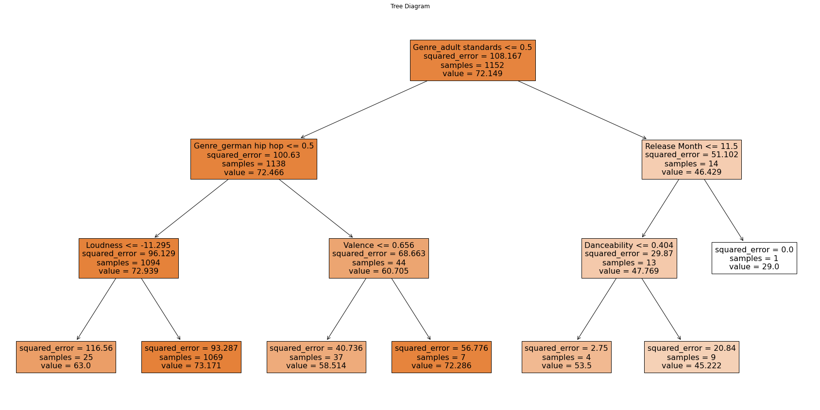
Decision Tree

Slide 13
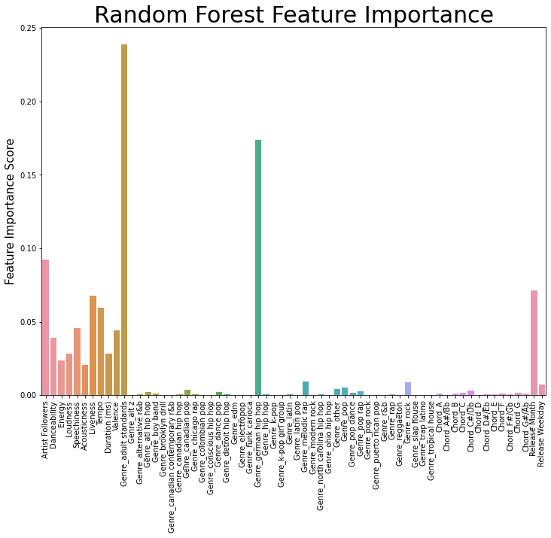

Slide 14
XGBoost

Slide 15
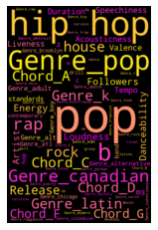
Ref
(https://www.kaggle.com/datasets/sashankpillai/spotify-top-200-charts-20202021)

