Slide 1
Project 4 Natural Language Processing & Cluster Analysis
Turning tabloids into data

Slide 2
Problem Definition
The goal of this project is to take text data (wiki articles) and perform meaningful analysis with it. To do this I will:
  Make estimations with existing data
  Collect data from Wikipedia's API
  Clean and vectorize text data
  Perform clustering analysis

Slide 3
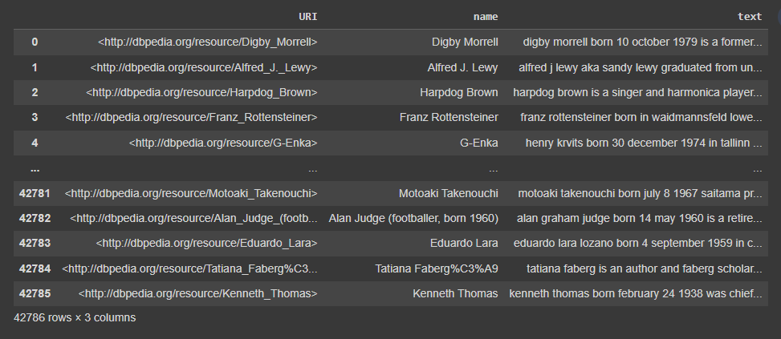
Existing Data

Slide 4
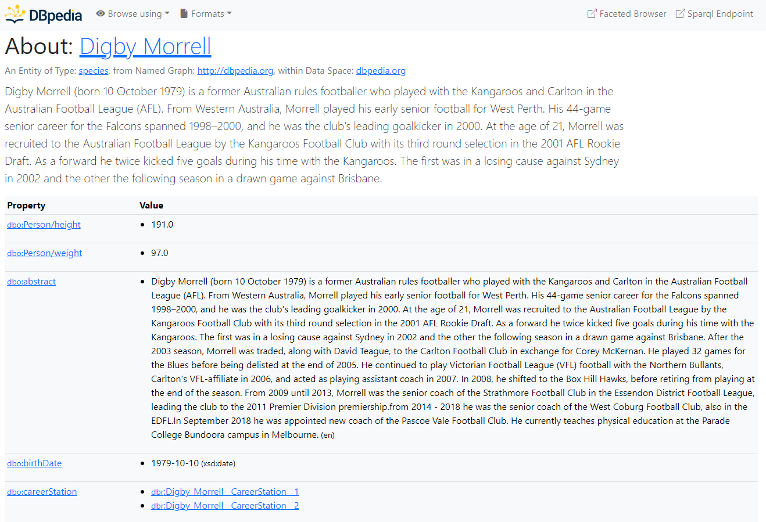
Existing Data

Slide 5
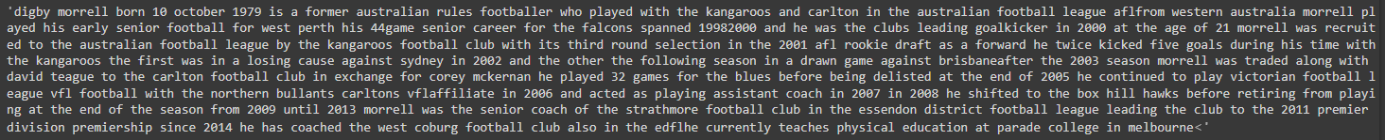
Existing Data

Slide 6
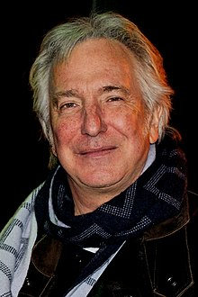
Selecting a Celebrity

Slide 7
Checking Rickman’s Data

Slide 8
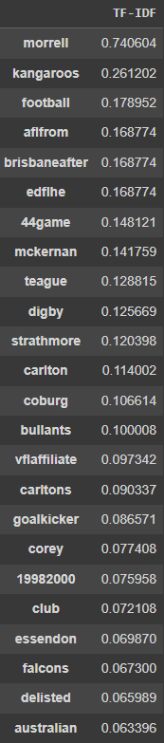
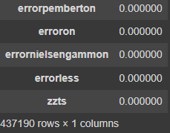
Turning words into numbers

Slide 9
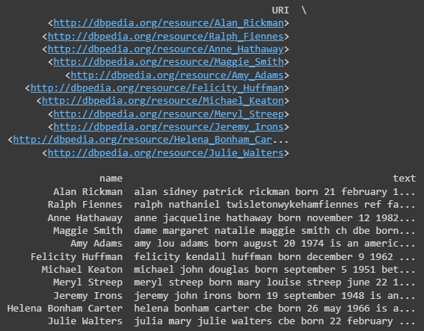
Alan Rickman’s Nearest Neighbor’s

Slide 10
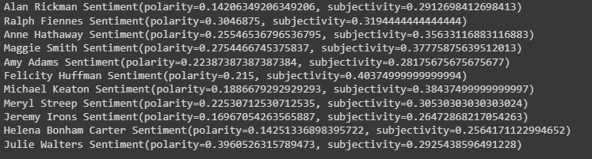
Sentiment Analysis

Slide 11
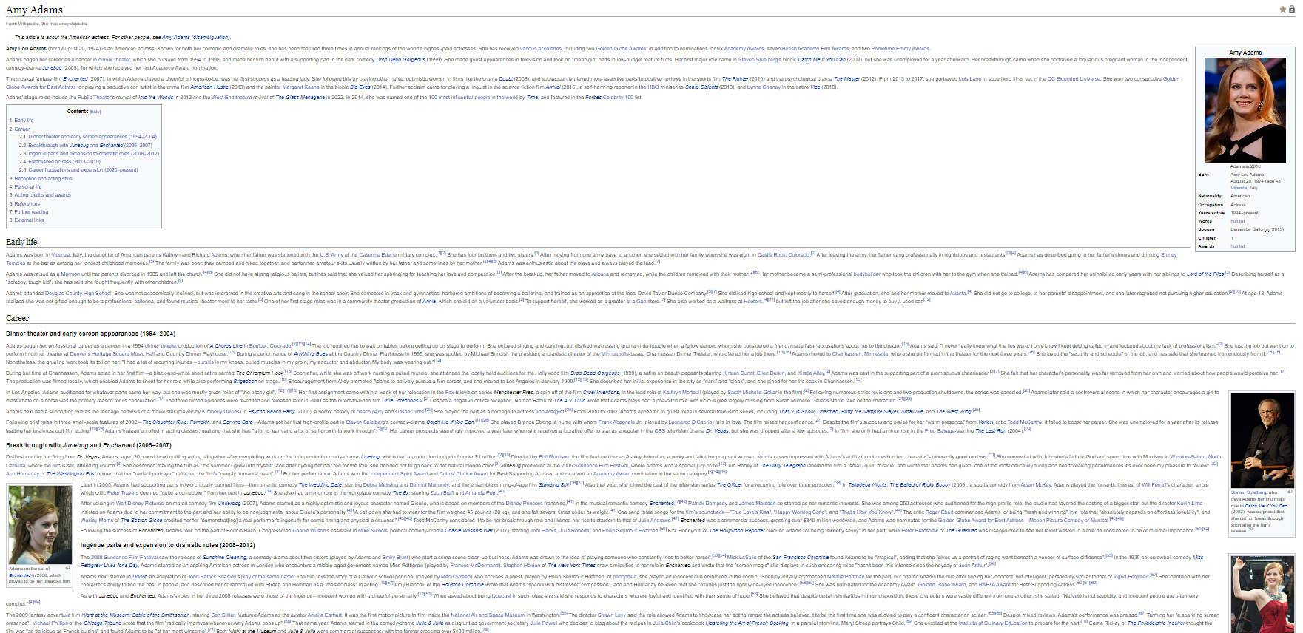
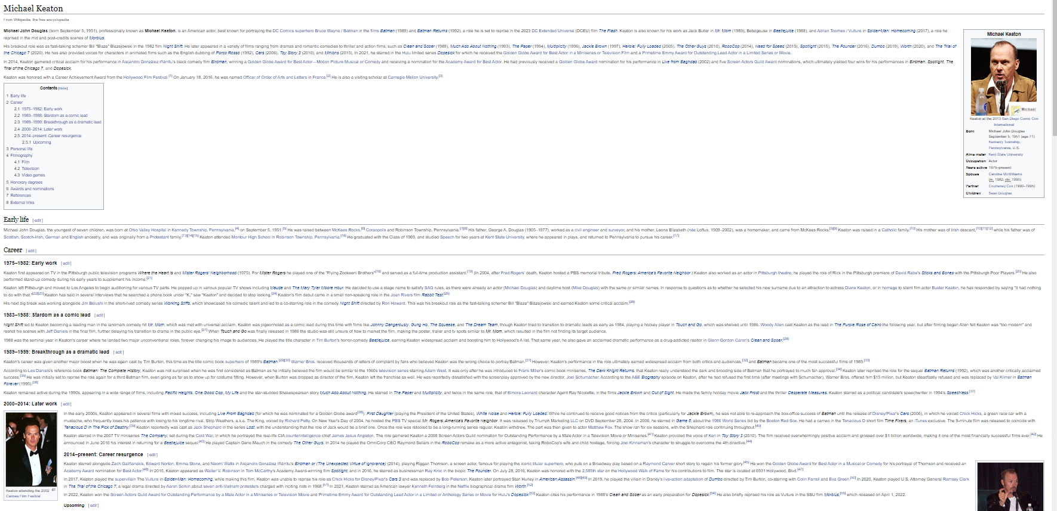
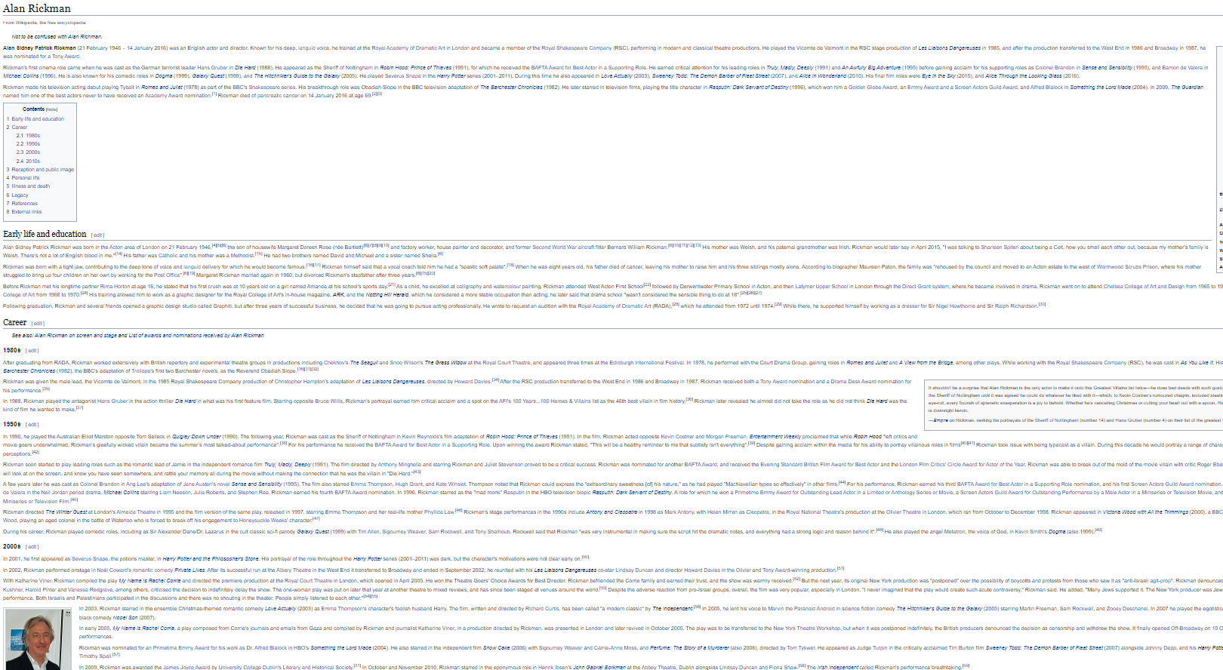
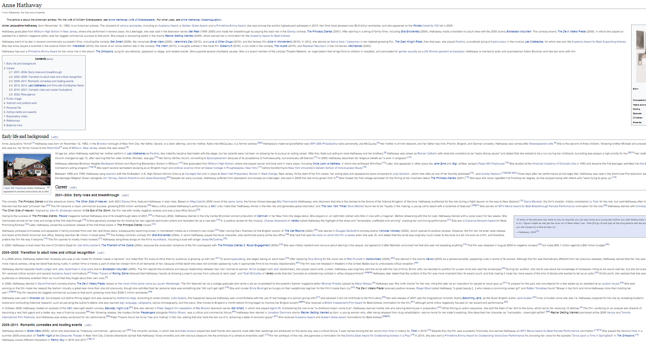
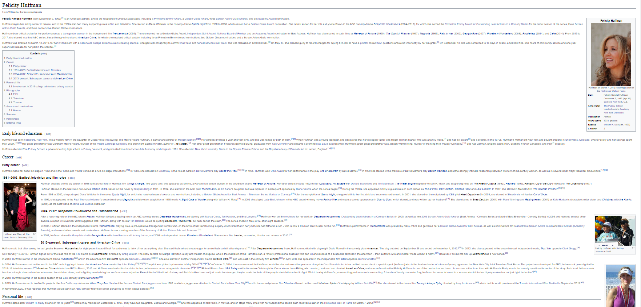
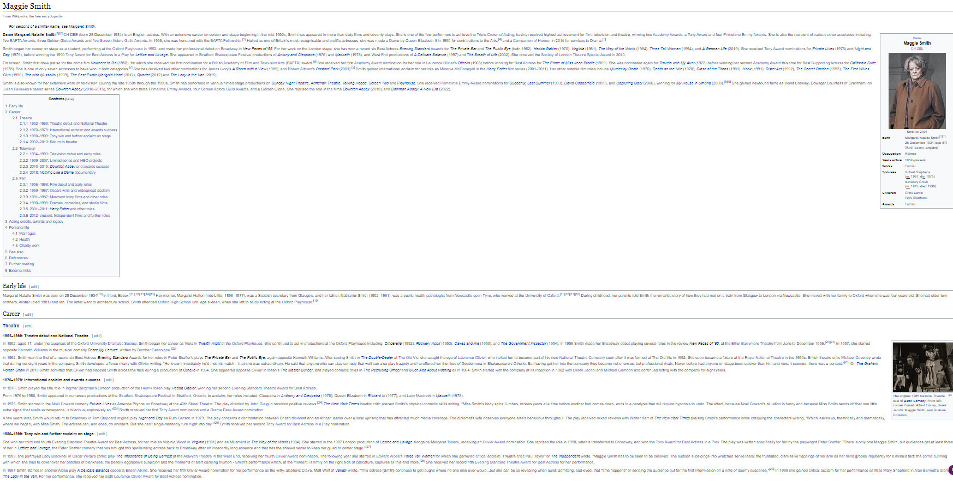
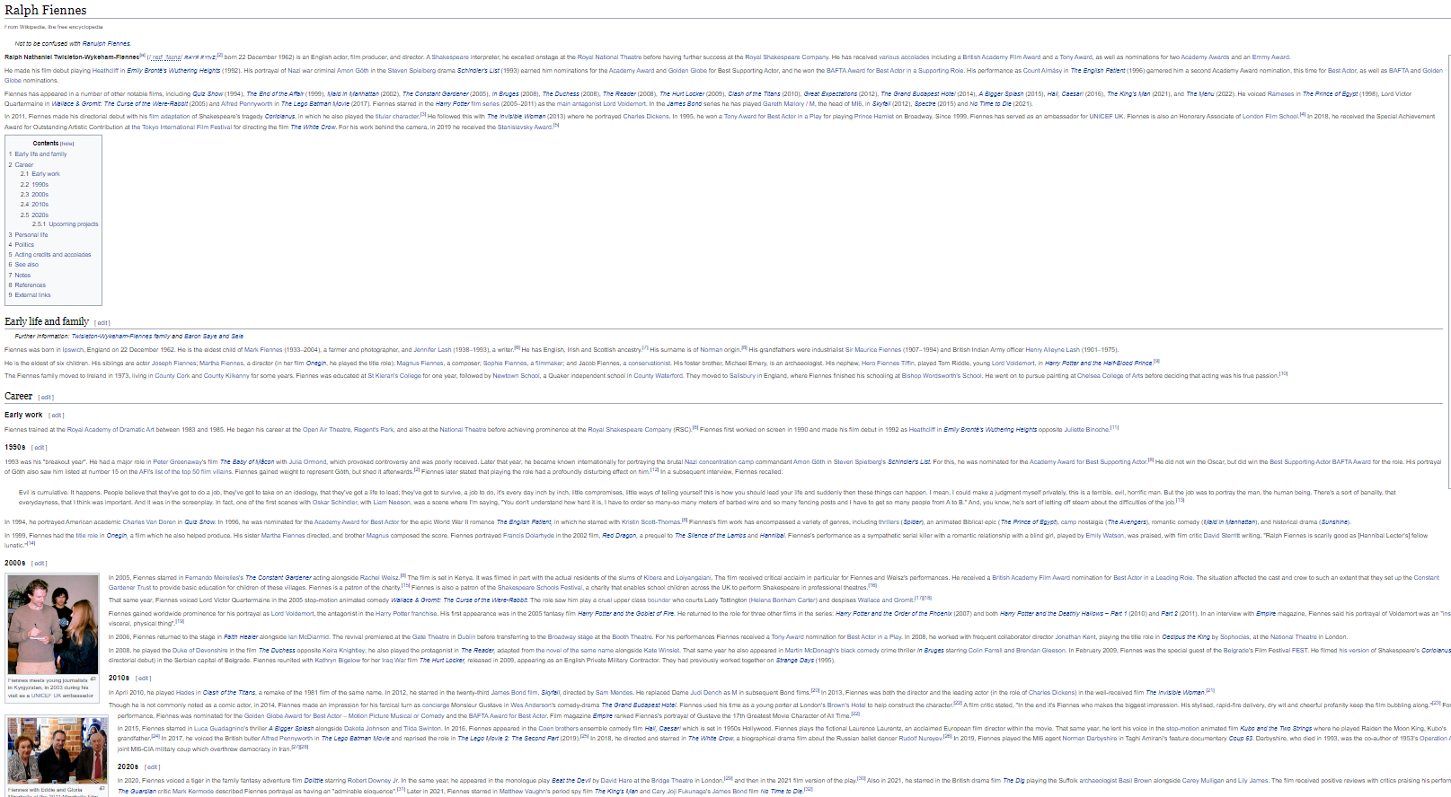
Wiki API Data Collection

Slide 12
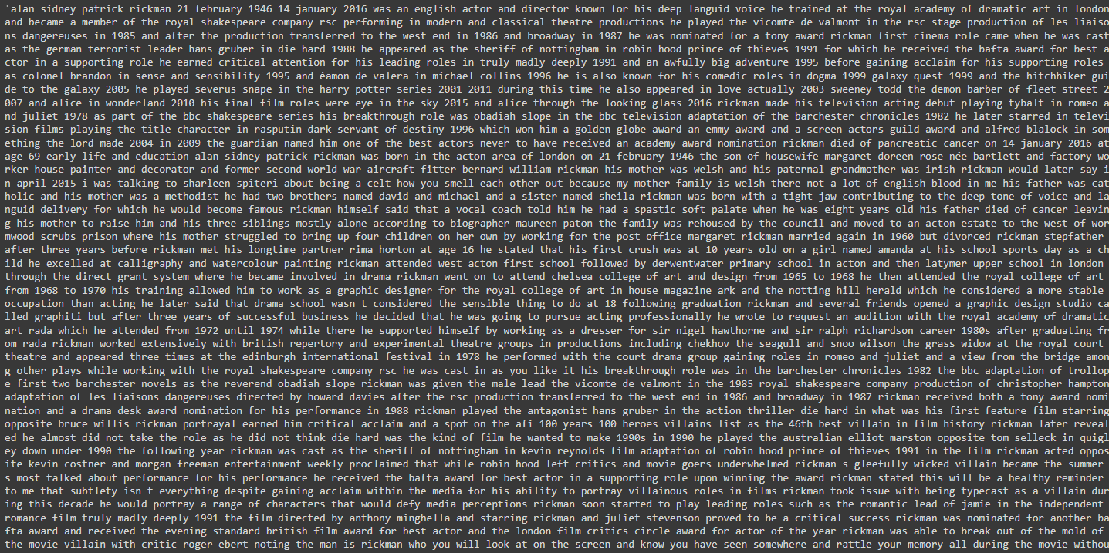
Wiki Pages

Slide 13
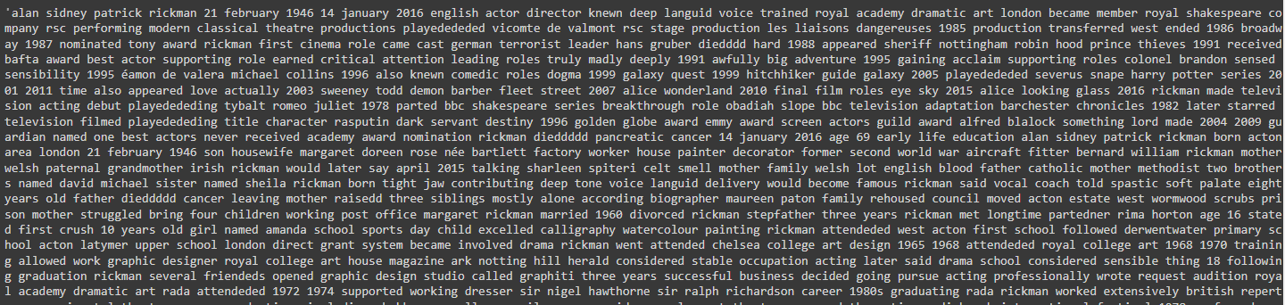
Cleaned Wiki Pages

Slide 14
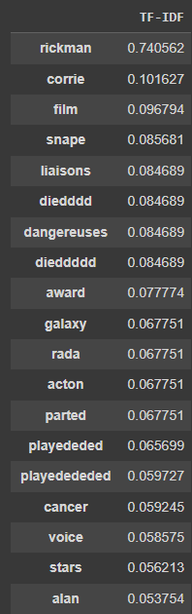
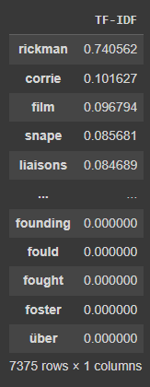
Most meaningful words

Slide 15
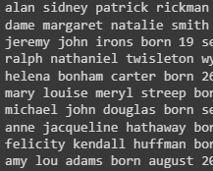



What changed
Full Page
Original Data

Slide 16
Conclusion
The distance of between Rickman and his nearest neightbors went up just a tiny when I expanded the comparison to the full wiki-pages. However, I believe that this distance would've been much greater had I not improved the word processing.
The people most similar to Rickman seem to be people that he has worked with in the past.
Future Directions:
  Create a function that will do all of this with just the input of a celebrities name.
  Improve word processing.
  Update original data descriptions with the new, cleaner descriptions.

