Slide 1
Project 5
The Sequel We Have All Been Waiting For

Slide 2
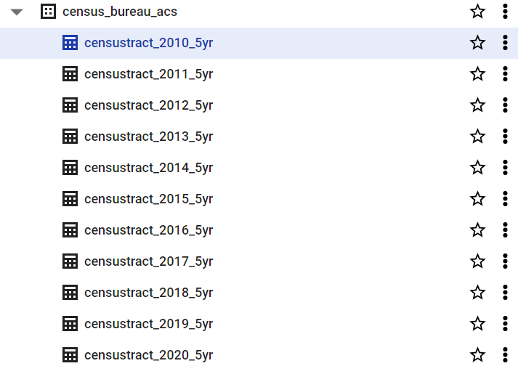
Census Data
Geological data
Household data
Income and Rent
Demographics

Slide 3
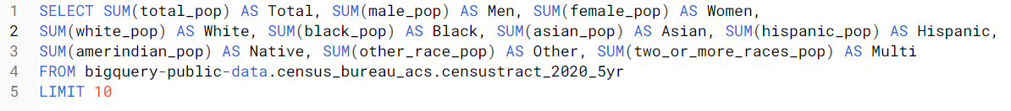
Population Counts

Slide 4

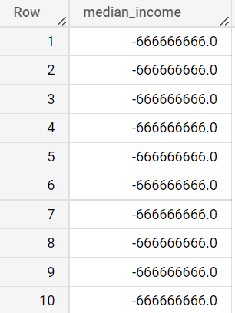
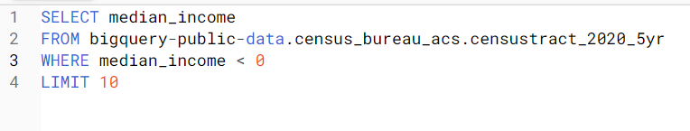
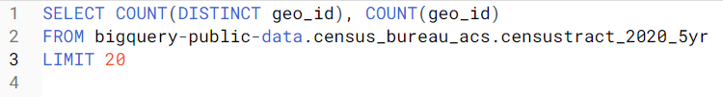


This data smells funny
-10963616.634004479
21980 out of 85395

Slide 5
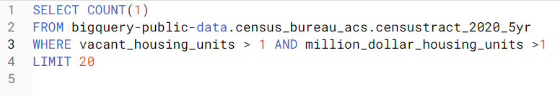
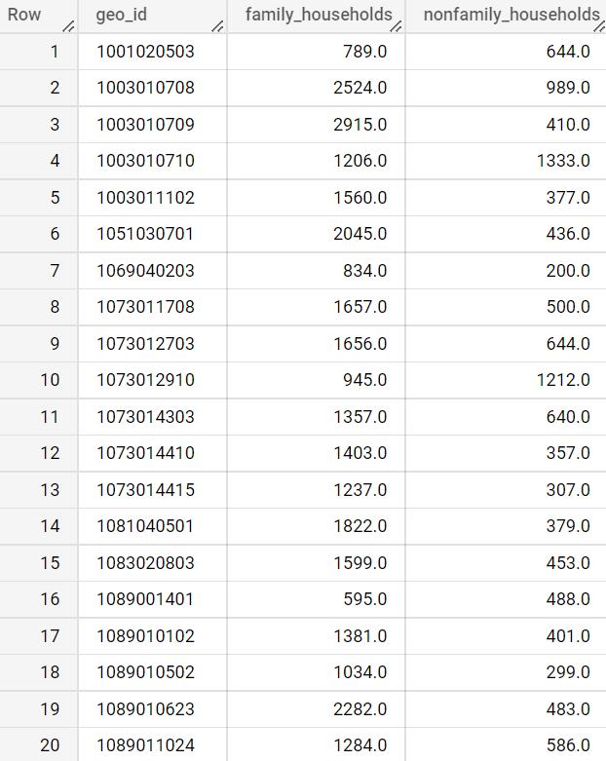



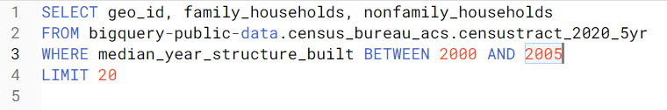
Utilizing Query Tools
23131

Slide 6
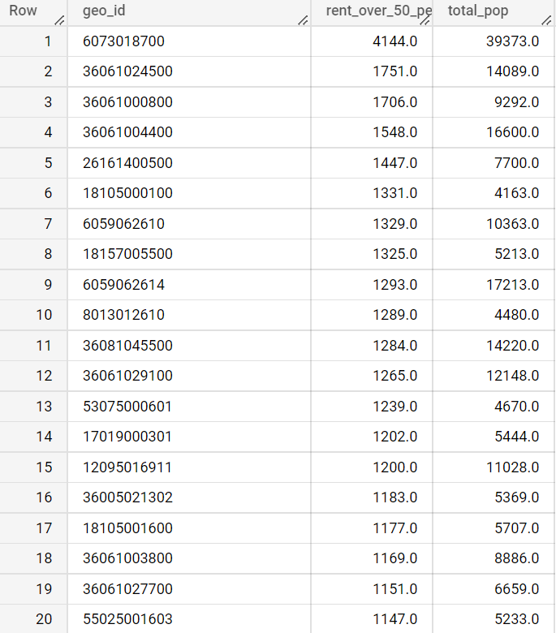
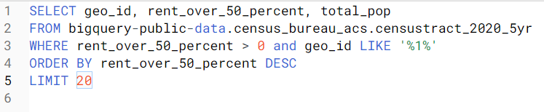
Proportions of Expensive Rent

Slide 7
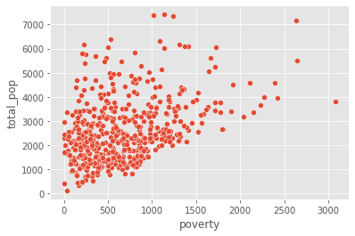
Poverty vs Total Population

Slide 8
Conclusion
SQL can be useful for IDA
This data is very dirty and would need to be cleaned up before any meaningful analysis could be done.
Comparison’s across time.

