Slide 1
Project 6: Deep Learning
Neural Networks are like onions.

Slide 2
Project 6: Deep Learning
Neural Networks are like onions.
Nobody likes onions.

Slide 3
Problem Definition
Develop a Neural Network with Deep Learning that can tell the difference between a dog and a cat.
Practice with Neural Networks
Being able to tell the difference between cats and dogs is important.

Slide 4


Data Collection
Pickled files of Images and Text

Slide 5
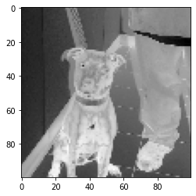
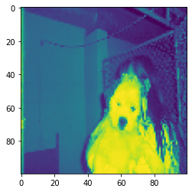
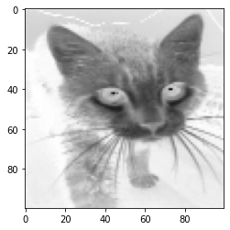
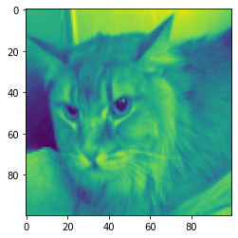
Data

Slide 6
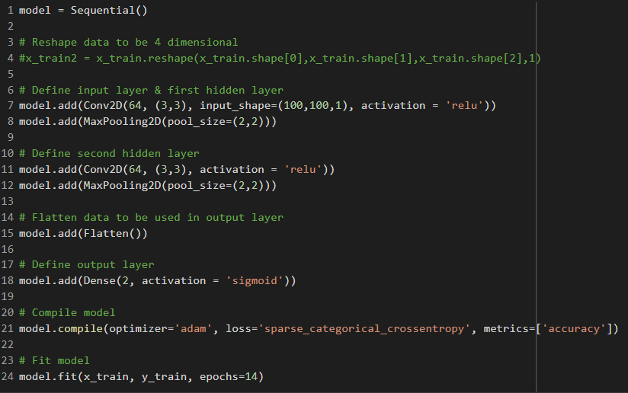
Training a Model

Slide 7
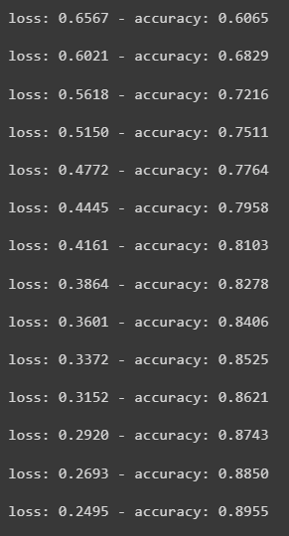
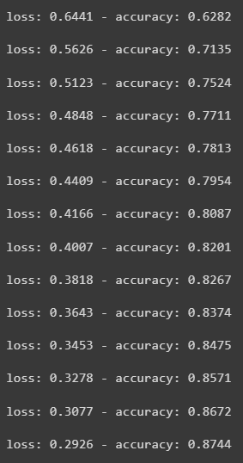
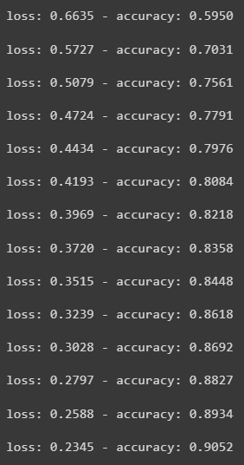
Model Performance

Slide 8
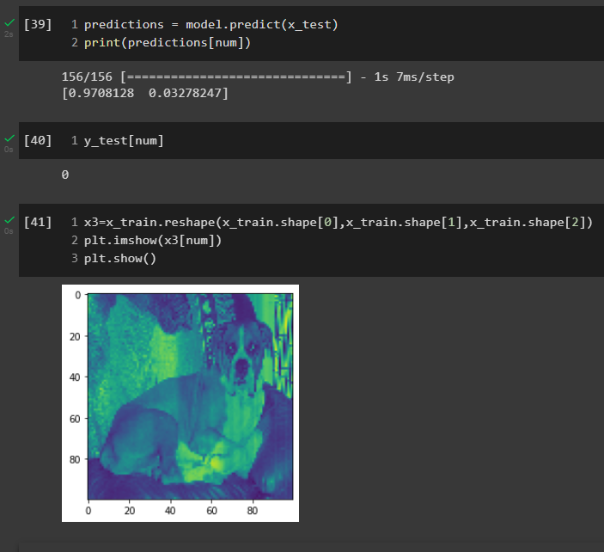
Model Predictions – Test Sample

Slide 9
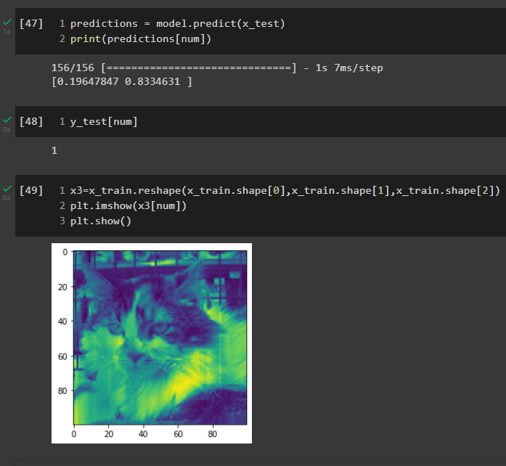
Model Predictions – Test Sample

Slide 10
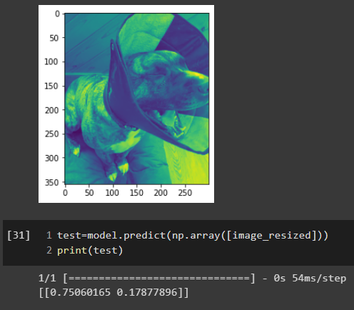
Model Predictions – Unlabeled Sample

Slide 11
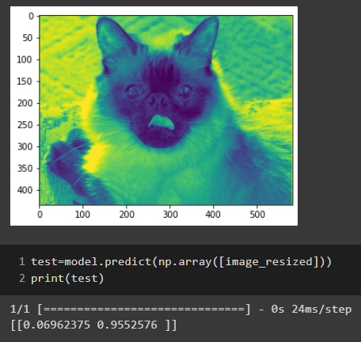
Model Predictions – Unlabeled Sample

Slide 12
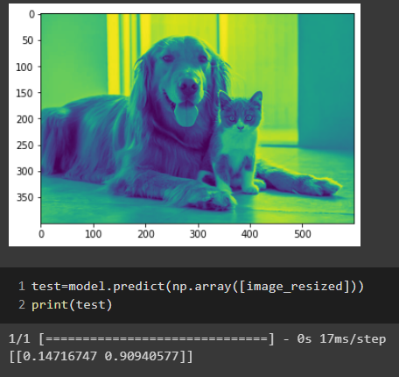
Model Predictions – Unlabeled Sample

Slide 13
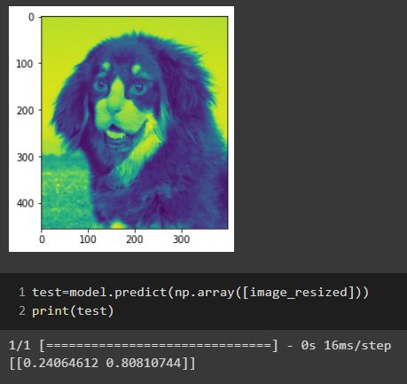
Model Predictions – Unlabeled Sample

Slide 14
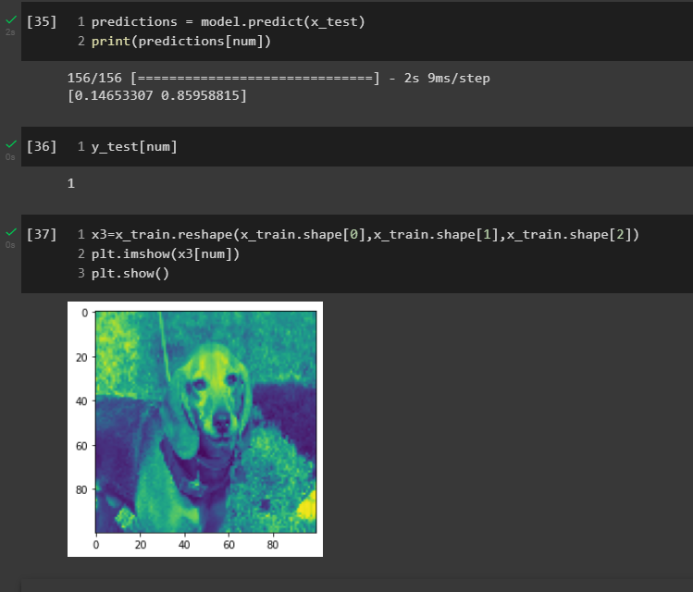
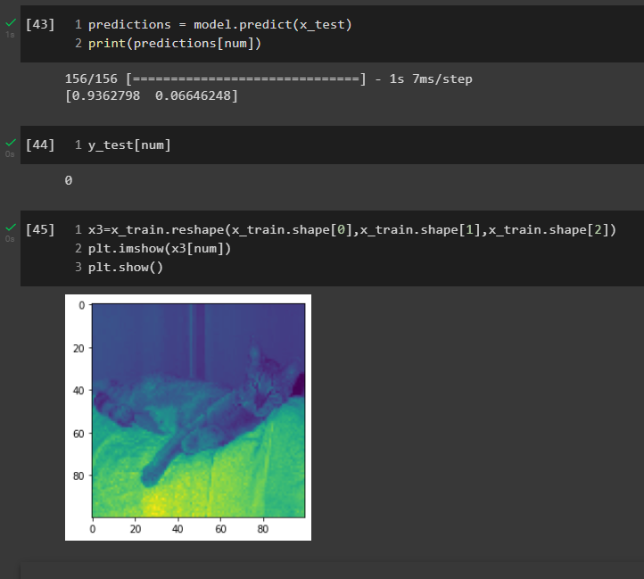
Bad Data, Bad Model

Slide 15
Conclusion
Neural Nets can be used to make sophisticated conclusions or identify objects within large data sets.
The accuracy is only as good as the data you give it.
How the program comes to its conclusions can be a black box.
Interpreting the conclusions of the neural net is highly dependent on understanding the context in which your model applies.
Future Direction
– Evaluate mislabeled data.
– Expand the features and contexts the neural net can identify.

