Slide 1
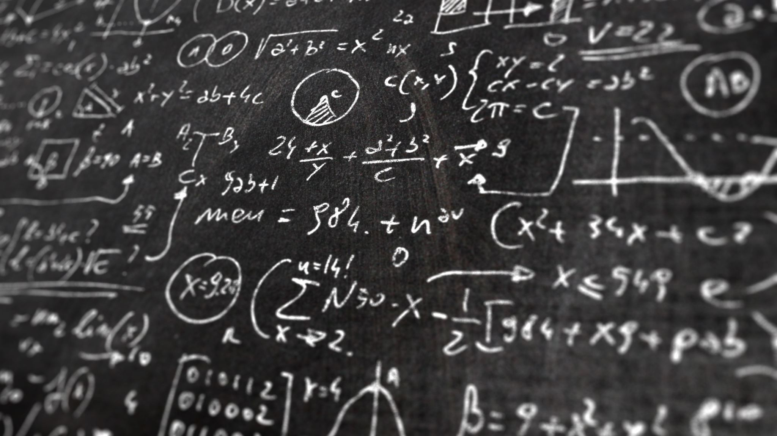
Mathematics
Yeah mostly linear algebra

Slide 2
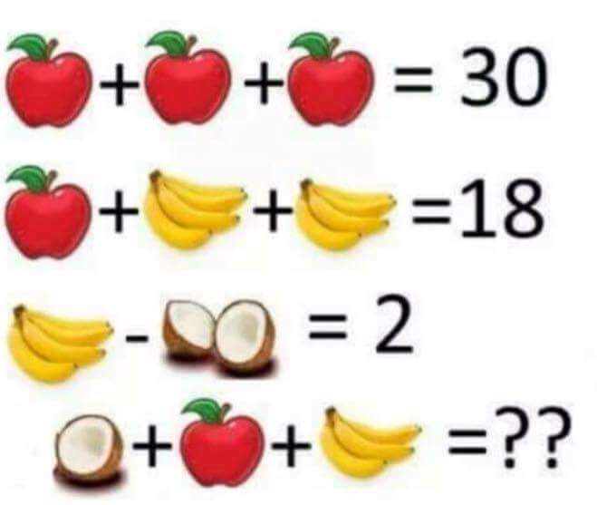
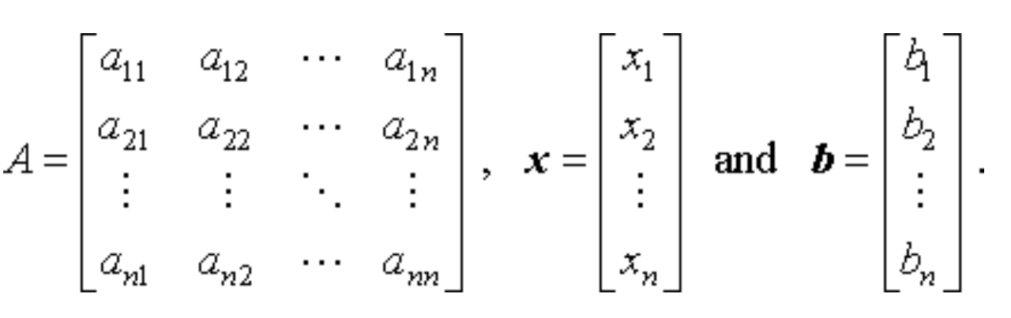
Ax=b

Slide 3
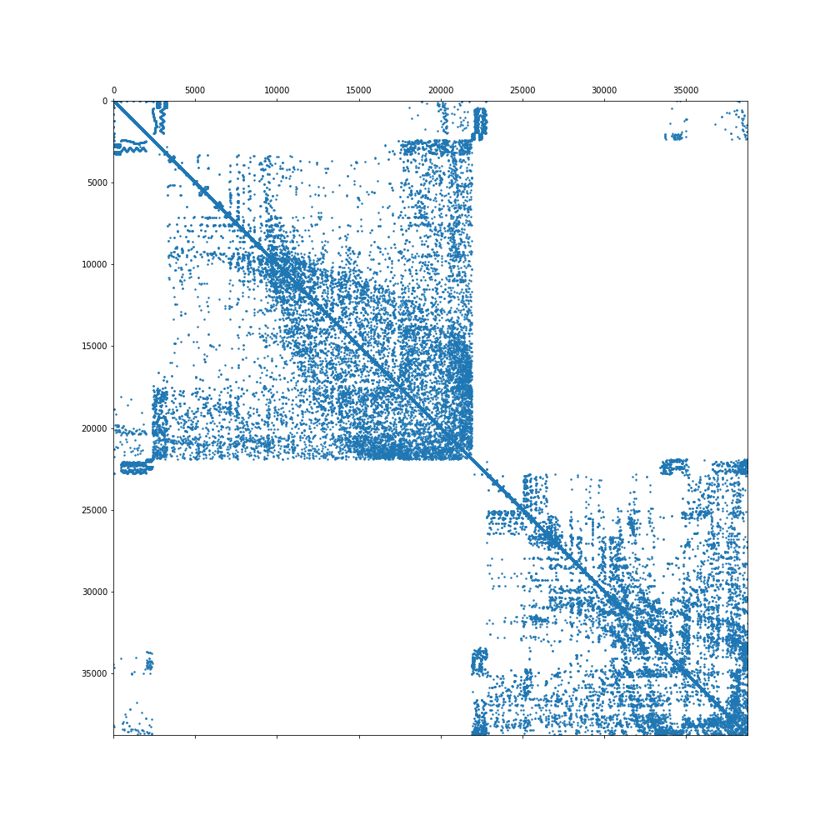
Iterative Solvers Ax=b
Guess an x₀
Calculate r=Ax₀-b
Calculate x₁ from r
Repeat till r is really small

Slide 4
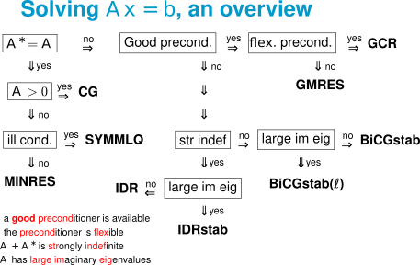
GMRES Yousef Saad, Martin H. Schultz (1986)
BiCGStab Van der Horst (1992)
BiCGStab(L) G.L.G. Sleijpen, D.R. Fokkema. (1993)
IDR(s) Martin B. van Gijzen and Peter Sonneveld (2011)
What happened in Dutch Mathematics in the last 30 years and why do we not find it in software packages/applications?

Slide 5
We talked to some mathematicians
Topics:
Sparse Systems
Preconditioners
Iterative Solvers
Hierachial structures
Direct methods
Model order reduction
Eigenvalue solvers
Graph/subdomain methods
Multigrid
Deflation techniques
Accelerator aware algorithms
Companies exist which pick these methods up and commercialize them (Vortech & Mathware)
eScience is known but not well!
Large scale scientific computing is on the National Agenda
Not much intent to maintain own packages, "throwing it over the fence

Slide 6
What can we do?
Talk to more mathematicians
Reach out at math conferences/Sponsorship and inform them about eScience
Join Dutch Flemish Scientific Computing society
NA-digest
Siam Conference in Amsterdam 2023
Find applied partners who would be interested
Determine a pool of engineers who want to push this
Think about libraries which could take up these developments (i.e. establish connections)
Talk to DT (Joris likes the idea)
Maybe organize a Small Scale initiative
Full grand call
And your ideas

