Slide 1
NumTech SIG : Introduction
Amsterdam, 2018

Slide 2
Why a new SIG
The NumTech SIG should be a market place to study, develop and implement dedicated numerical techniques for eScience projects
Eigenvalue problems and SVD
Linear systems
Differential equations
Optimizations
Numerical integration
Interpolation, regression, …
Notes:
Full brand statement
The Netherlands eScience Center is the Dutch national center of excellence for the development and application of research software to advance academic research.
We are convinced that research in every academic discipline can be improved by taking advantage of available digital technology.
We take a multidisciplinary approach, combining our deep knowledge of both academic research and software development to help define and solve research challenges.
We share our ideas and the tools we develop.
Together with a wide range of partner organizations, we advance not just our research projects, but the state of academic research in general.

Slide 3



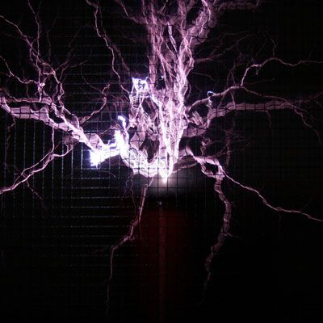



Interaction within the center
Efficient
Computing SIG
Energy
Projects
GPU
SIG
Physics &
Beyond
MLCV
SIG
Climate
Projects
Statistics
SIG
Notes:
Full brand statement
The Netherlands eScience Center is the Dutch national center of excellence for the development and application of research software to advance academic research.
We are convinced that research in every academic discipline can be improved by taking advantage of available digital technology.
We take a multidisciplinary approach, combining our deep knowledge of both academic research and software development to help define and solve research challenges.
We share our ideas and the tools we develop.
Together with a wide range of partner organizations, we advance not just our research projects, but the state of academic research in general.

Slide 4



Organization of the SIG SIG
Meeting once a +/- month.
Could increase/decrease frequency depending on interest.
Each session should either be:
- presentation of specific issue related to a project
- presentation of a dedicated techniques used in a project
- hands on presentation of a library that we could reuse
Organization of the SIG through its Github page :
https://github.com/NLeSC/NumTech-sig
Email : numtech-sig@esciencecenter.nl
Office Group : https://nlesc.sharepoint.com/sites/numtech-sig
Notes:
Explanation
The eScience Center’s conviction. The dream is socially relevant and inspires some, but not everyone.

Slide 5


Organization of the SIG
Need volunteers to present what they are doing !
We shouldn’t have to force presentation (but we will)
Are you the next NumTech SIG leader ?

