Slide 1
Raw data
BACKGROUND
SITES
PC
(LAS)
PC
(LAS)
MESH
(OBJ)
PICS
(PNG,JPEG)
viaappiadb
OSG Converter
POTREE Converter
Converted data (OSG)
MSA->PSQL
Converter
OSGB
META
Converted data (POTREE)
Converted data (POTREE)
PC
(LAS)
META
SITES
footprints & altitude range
SITES
Attribute Microsoft Access

Slide 2
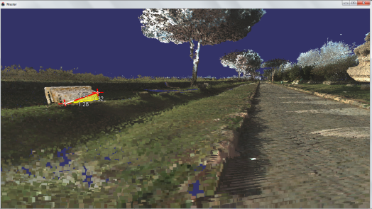

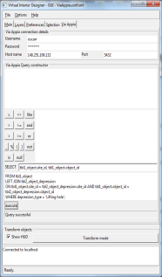
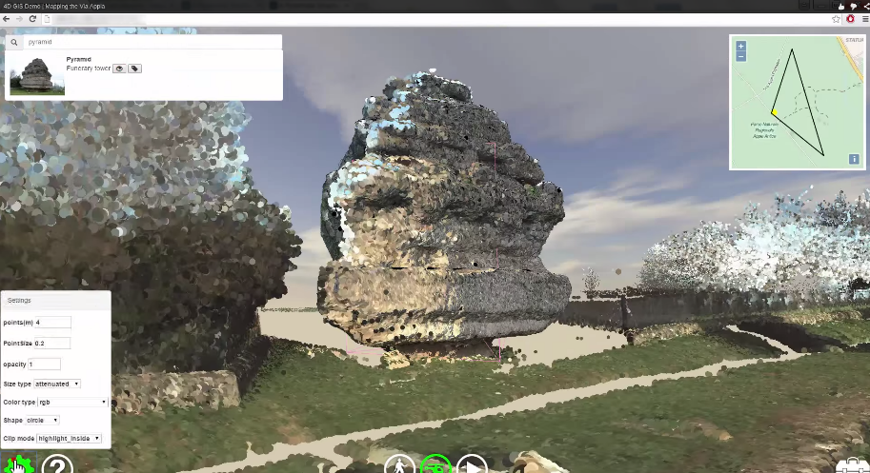

Client
Converted data (OSG)
Windows desktop application
Via Appia Linux server
OSGB
META
viaappiadb
XML viewer configuration
file
Converted data (OSG)
OSGB
META
Converted data (POTREE)
WEB application
PC
JSON viewer configuration
file
META
WEB server
Converted data (POTREE)

Slide 3
PC
(LAS)
PC
(LAS)
Automatic image-based modeling
Automatic alignment
PICS
(PNG,JPEG)
MESH
(OBJ)
MESH
(OBJ)

