Slide 1
Acquisition data
BACKGROUND
SITES
PC
(LAS)
PC
(LAS)
MESH
(OBJ)
PICS
(PNG,JPEG)
viaappiadb
OSG Converter
POTREE Converter
Converted data (OSG)
MSA->PSQL
Converter
OSGB
META
Converted data (POTREE)
Converted data (POTREE)
PC
(LAS)
META
SITES
footprints & altitude range
SITES
Attribute Microsoft Access

Slide 2
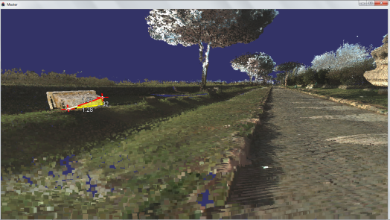

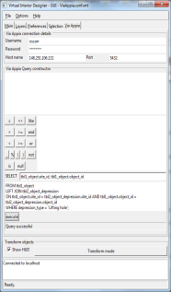
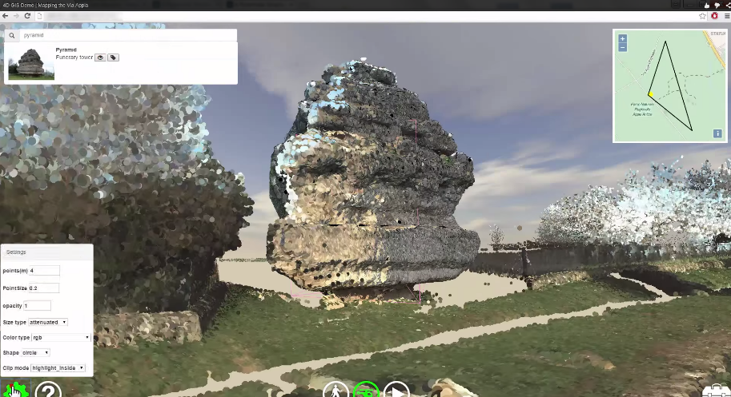
Client (launcher tool)
Converted data (OSG)
Windows machine
OSGB
META
Via Appia Linux server
viaappiadb
XML viewer configuration
file
Converted data (OSG)
OSGB
META
Converted data (POTREE)
WEB browser
PC
META
Converted data (POTREE)
JSON viewer configuration
file

