Slide 1
RAW
BACKGROUND (Low-Resolution)
SITES (High-Resolution)
viaappiadb
PC
LAS
PC
LAS
MESH
OBJ
PICS
PNG,JPEG
Management Data
Attribute Data
OSG Converter
MSA->PSQL
Converter
OSGB
META
SITES
2D footprints
SQL
SITES
Attribute Microsoft Access
Converted data (OSG)

Slide 2


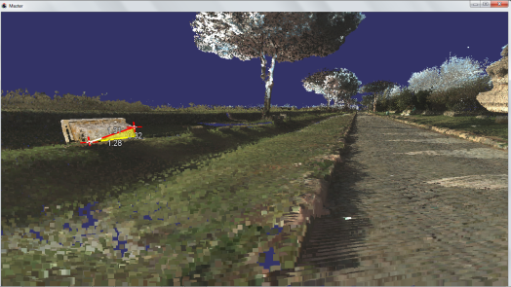
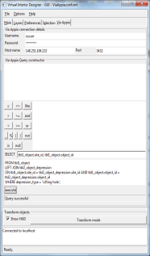
Via Appia Linux server
viaappiadb
Management Data
OSGB
META
Attribute Data
Converted data (OSG)
Windows user laptop/desktop (launcher tool)
OSGB
META
Converted data (OSG)
XML viewer configuration file

