Slide 1
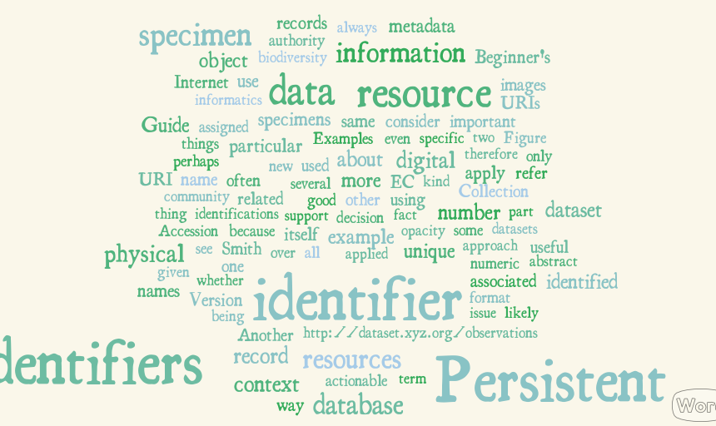
Persistent Identifiers (PIDs)
Persistent Identifiers (PIDs)
Persistent Identifiers (PIDs)
Persistent Identifiers (PIDs)
Workshop 28th/29th April 2015
Workshop 28th/29th April 2015
Workshop 28th/29th April 2015
Christine Staiger

Slide 2
What do we want from data?
Findable – Easy to find by both humans and computer systems
→ Metadata
Accessible – Stored for long term, accessed and/or downloaded with well-defined license and access
Interoperable – Ready to be combined with other datasets by humans as well as computer systems;
Reusable – Ready to be used for future research and to be processed further using computational methods.
Reference data and identify data
Infrastructure should take care of some aspects

Slide 3
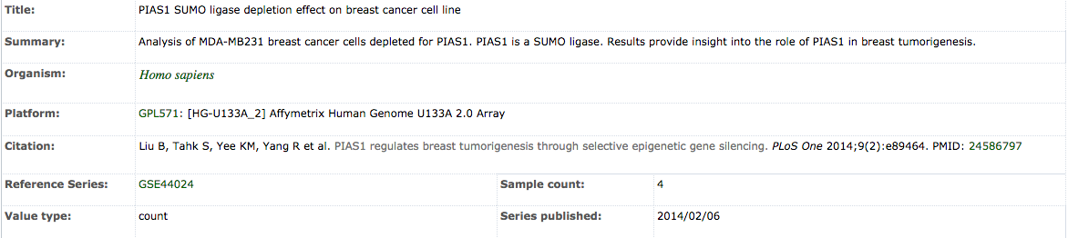
Digital Object (DO)
PID
Data
Metadata
Persistent Identifier: reference and identify object, either metadata or data object
Synchronise PID, Data and Metadata during creation, maintenance, update and deletion of a digital object!
Notes:
Tie data objects and metadata together

Slide 4
Persistent Identifiers (PIDs)
Pointers to data resources
Digital Resources:
Data, metadata, documents
Real world objects:
Species, patient, cell line
Globally unique
Exist infinitely long
Used to identify and retrieve resources
Resolvable
Examples: ISBNs, DOIs, Handles, URIs

Slide 5

Pro: PIDs are static
PID 1
PID 2
PID 3
PID 4
Data2
Data1
World of data infrastructure
Data4
Data3

Slide 6
Downside: Change storage environment
PID1
PID2
Storage site A
Storage site B

Slide 7
Advantages and Disadvantages
Pro:
Static reference,
even if data moves or
changes
Network of persistent links
Data – metadata relations
Provenance chains
Con:
Extra effort
What to identify?
Coordination across organisations and people
Organisational discipline to ensure persistence

Slide 8
Persistent Identifier Systems
Handle
PID: 11304/cf8956a2-39d3-11e5-8a18-f31aa6f4d448
Resolver: http://hdl.handle.net/
Doi
PID: 10.3389/fgene.2013.00289
Resolver: http://dx.doi.org/
Ark
PID: ark:/13030/tf5p30086k
Resolver: https://nbn-resolving.org/
→ Opaque string pointing to resource + resolver

Slide 9
Use Case 1: Digital repositories
PIDs point to landing page of the digital repository
showing metadata
“Real” data can be downloaded from this page with another link
E.g. B2SHARE, 3.TU Datacentrum
PID
http://hdl.handle.net/11304/3265434c-4b34-11e4-81ac-dcbd1b51435e
resolves to landing page https://b2share.eudat.eu/record/139

Slide 10
Use Case 1: Digital repositories
Create PIDs for submitted data, papers …
Ask or extract some metadata to generate PID
Usually metadata is public
Author information is needed
Publishing
→ (nearly) final data

Slide 11
Use Case 2: Keeping track of own data
Share data with your working group, many people
Share data over generations of group members, PhD/master students
Allow for data relocation
→ Create an own data registry
→ Clear separation between data users and data admins
Notes:
Use data from data carpentry – pandas module which is located on figshare
Without extra information: context – Pandas module
Show how to create PID and link it to figshare data,

Slide 12
Example: Modeling Relationships
PID: prefix2/suffix2
Use tightly coupled metadata
Part of/has part relationships
Model cohort-patient relationship
Model patient-samples relationship
Metadata:
key1: …
key2: prefix1/suffix1
PID: prefix1/suffix1
Metadata:
key1: …
key2: prefix2/suffix2
key3: prefix3/suffix3
PID: prefix3/suffix3
Metadata:
key1: … key2: prefix1/suffix1
Which metadata to store with the PID
and which in en extra catalogue ?

Slide 13
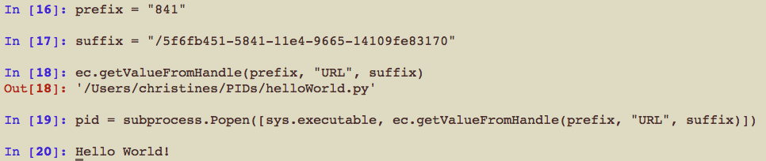
Use Case 2c: Enabling workflows
Execute program hidden behind a PID
Way to refer to workflows → reproducibility
Notes:
Label hello_world.py
Execute

Slide 14
Thank you!

