Slide 1
Paper Outline
Show experimental set-up/timeline
Show microbiome profile of human source communities
Chose communities with varying levels of Proteobacteria, Bacteroidetes, Firmicutes
Different source communities resulted in varying levels of colonization resistance
Profiles range from little to no colonization to persistent colonization to death
What are the structures of the communities across Day 0
How do they correlate with subsequent levels of C. difficile?
Over the entire time course how does the structure of the microbiome correlate with C. difficile levels
Is microbiome structure different between mice that died and mice highly colonized? → Microbiome ~ CDI severity?
Overall, this project will show what bacteria on Day 0 are present that allow or prevent C. difficile colonization. Moreover I can look at the relationship between the microbiome and CDI severity.

Slide 2
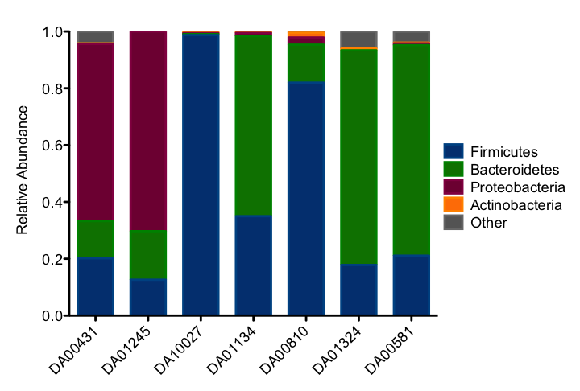
Experimental Design
Day
-14
0
Monitor colonization
and CR levels
10
Gavage Human
Stool Slurry
Challenge with
10² C. difficile
431 spores
Euthanize
Mice
n=3

Slide 3
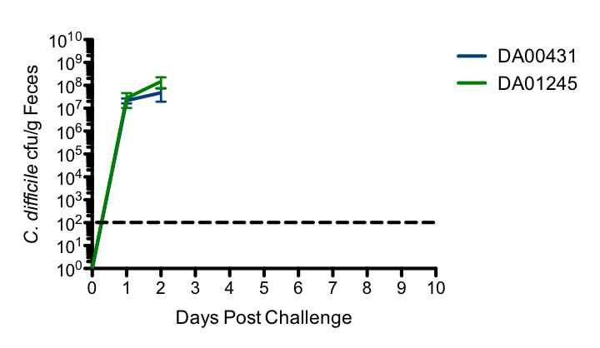
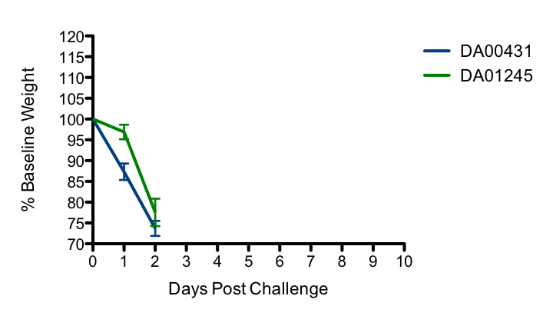
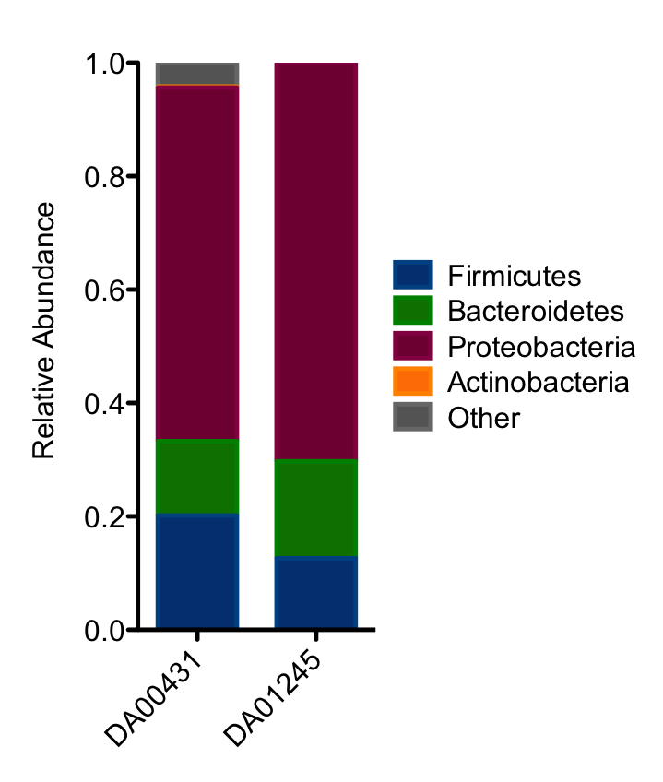
Severe CDI in Humanized Germ-free Mice
Notes:
-so first looking at the original control community I tested earlier and one of my experimental communities, these communities are rich in proteobacteria
-the first is that control community you’ve already seen where the mice die by two days post infection
-the second bar graph is one of my experimental communities, and when challenged with cdiff strain 431, you can see that these mice also die by 2dpc
-and we can see this furthermore in the weight loss graph
---we know from a number of other studies looking at community data that proteobacteria are often found in disease states, including in IBD or CRC

Slide 4
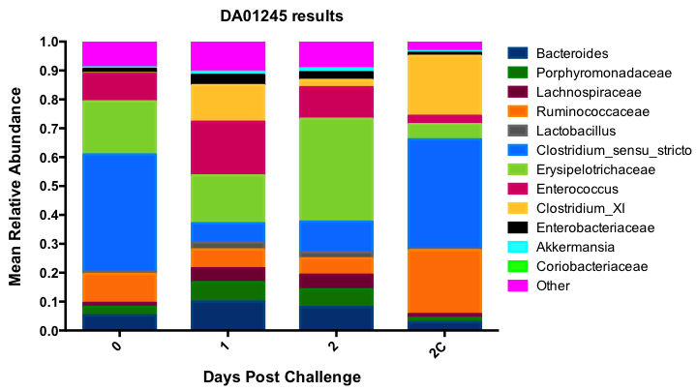
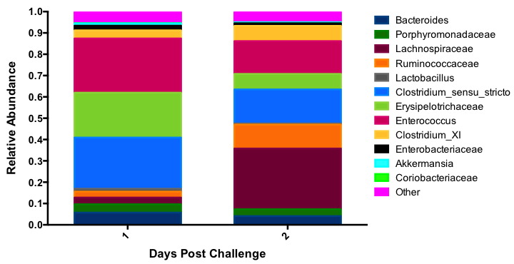
Enteroccocus, Clostridium sensu stricto, and Erysipelotrichaeceae Found in Moribund Mice
DA00431
DA001245
Phylotypes, Family Level
Notes:
change

Slide 5
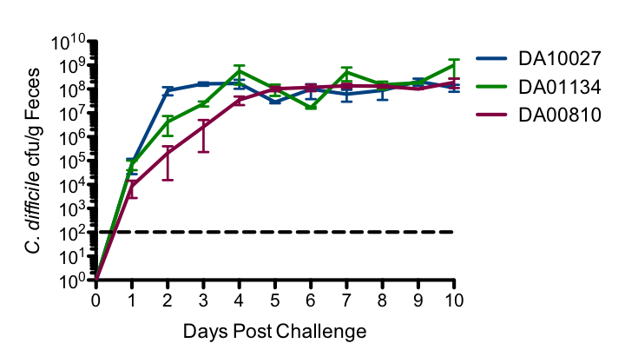
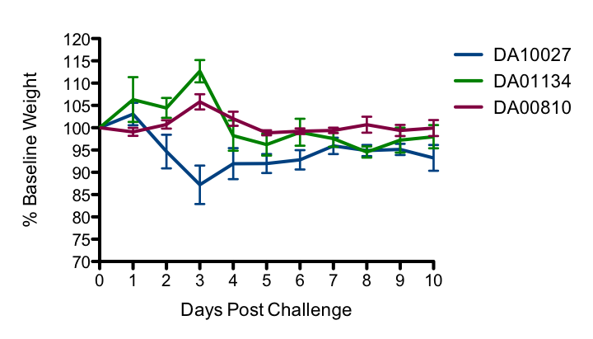
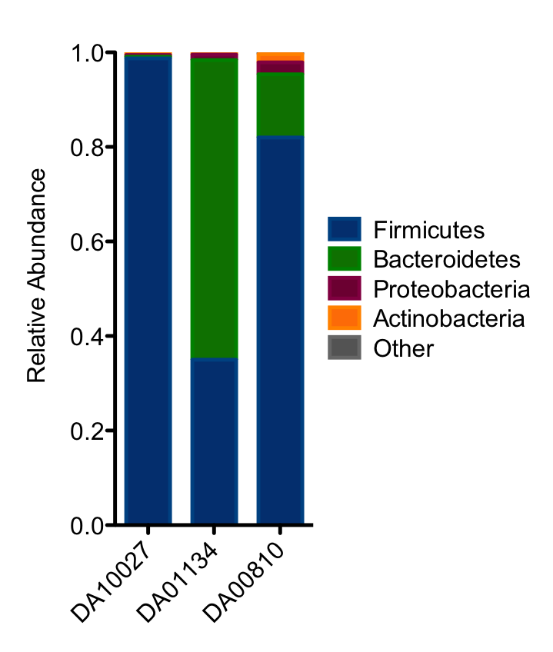
Persistent Colonization in Humanized Germ-free Mice
Notes:
Next looking at these three communities, in all of these there are high firmicute levels, although to a less degree in the second case.
-however each of these three had rapidly increasing levels of cdiff
-while showing minimal signs of severe cdi

Slide 6
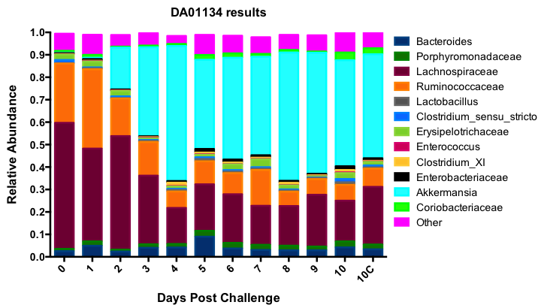
Akkermansia Positively Correlates with C. difficile CFU
DA01134
Phylotypes, Family Level

Slide 7
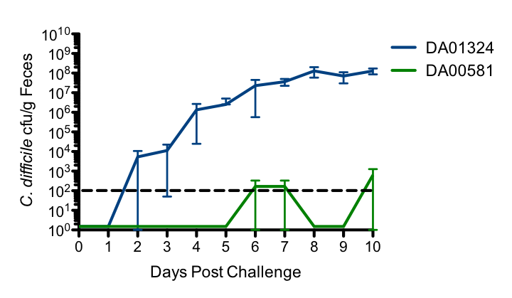
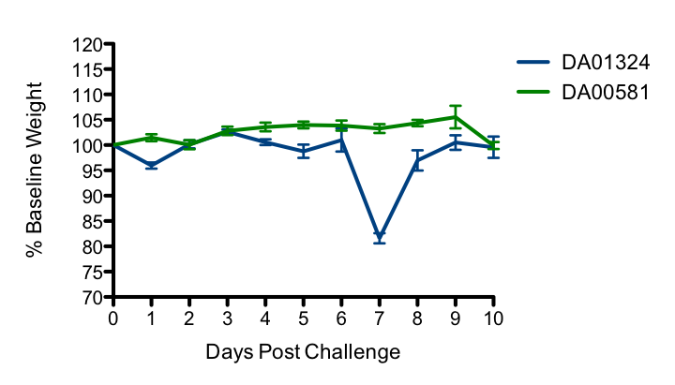
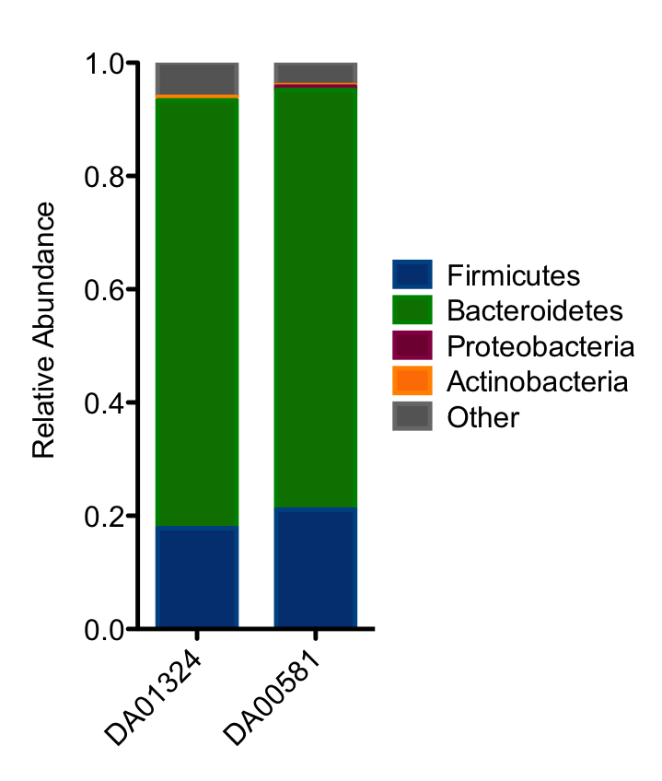
Delayed/Low Colonization in Humanized Germ-free Mice
Notes:
Lastly looking at these two communities which are dominated by bacteroidetes, these communities also had higher levels of resistance against cdifficile.
-in the first case cdifficile colonization is low and there is a delay in its bloom, occurring as early as day 2 post challenge, but as late as day 7 in one mouse.
0-in the second

