Slide 1
DNS privacy in theory and practice

Slide 2
Goal of this talk
Become familiar with the privacy implication in DNS
Understand how recent developments can reduce these privacy implications
Learn how to configure DNS software to make use of these recent developments

Slide 3
Privacy in DNS
DNS data is public
Until recently no privacy considerations in the DNS protocol
  30+ year old protocol
Transactions should not be public
  Almost every Internet activity starts with a DNS query

Slide 4
DNS data disclosure
.
stub
185.49.140.10
stub
185.49.140.20
resolver
178.62.200.226
nl.
stub
185.49.140.225
nlnetlabs.nl.

Slide 5
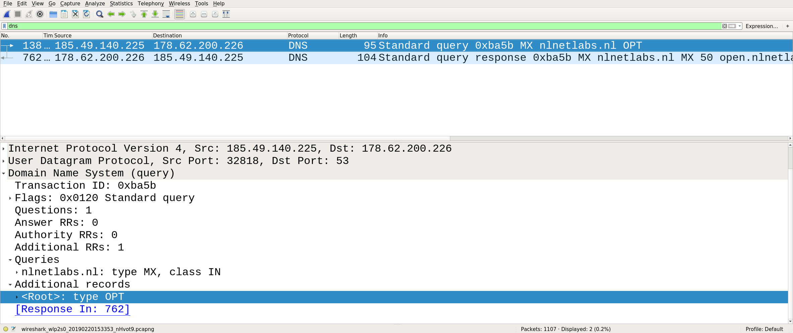
Stub → resolver

Slide 6
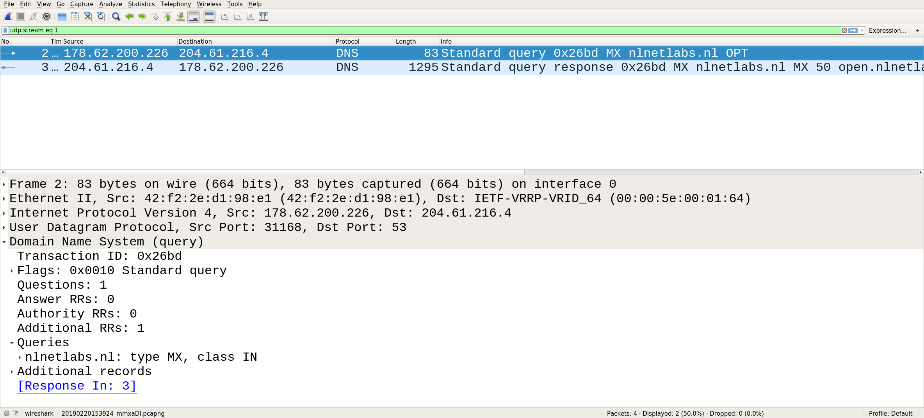
Resolver → authoritative name server

Slide 7

We will use the Unbound resolver in our examples
  https://nlnetlabs.nl/unbound/
Can be installed from distribution package:
  apt install unbound
  brew install unbound
  Windows installer available

Slide 8
Unbound: minimal installation - 1/2
Configure DNSSEC root key (if not already done by distribution package)
  Get key:
  Add key to Unbound config:
$ unbound-anchor -a /usr/local/etc/unbound/root.key
auto-trust-anchor-file: /usr/local/etc/unbound/root.key

Slide 9
Unbound: minimal installation - 2/2
Set access control list:
access-control:127.0.0.0/8 allow
access-contol: ::1 allow

Slide 10

/ Stubby
We will use the Stubby DNS privacy stub resolver in our examples
  getdns proxy daemon
Installation:
  brew install stubby
  Install using windows installer
  Compile from source for Linux

Slide 11
Stubby as minimal proxy
Listen on local address and send queries to upstream resolver
Configure OS to send all queries to stubby
  Set DNS server to stubby listen address in Network settings
  /etc/resolv.conf
listen_addresses:
- 127.0.0.1
- 0::1
upstream_recursive_servers:
- address_data: 178.62.200.226

Slide 12
Privacy and the IETF
July 2013: RFC6973 - Privacy Considerations for Internet Protocols
May 2014: RFC7258 - Pervasive Monitoring Is an Attack
  Pervasive monitoring is a technical attack that should be mitigated in the design of IETF protocols, where possible.

Slide 13
Privacy Threat Mitigation
Privacy Considerations for Internet Protocols, RFC6973
  6.1 Data Minimization
    “Reducing the amount of data exchanged reduces the amount of data that can be misused or leaked.”
  6.3 Security
    “Confidentiality: Keeping data secret from unintended listeners.”

Slide 14
Privacy Threat Mitigation
Data minimisation
  → Limit the number of DNS queries
  Minimise the data disclosed in DNS transactions
Security
  Hide transaction by using encryption
  Limit data disclosure to authenticated parties

Slide 15
Limit the number of DNS queries
At stub: not much that can be done
At recursive resolver: multiple (non-exclusive) options
  Local root
  Aggressive NSEC

Slide 16
RFC7706 – root zone in resolver
Get complete root zone locally
No need to expose privacy sensitive data to the root anymore

Slide 17
Unbound: root zone in resolver
Auth-zone functionality in Unbound since version 1.7.0
AXFR/IXFR and HTTP zone transfer
  NOTIFY support
Reading from and writing to file

Slide 18
Unbound: root zone in resolver
auth-zone:
name: "."
master: 199.9.14.201 # b.root-servers.net
master: 192.33.4.12 # c.root-servers.net
master: 199.7.91.13 # d.root-servers.net
master: 192.5.5.241 # f.root-servers.net
master: 192.112.36.4 # g.root-servers.net
master: 193.0.14.129 # k.root-servers.net
master: 192.0.47.132 # xfr.cjr.dns.icann.org
master: 192.0.32.132 # xfr.lax.dns.icann.org
master: 2001:500:200::b # b.root-servers.net
master: 2001:500:2::c # c.root-servers.net
master: 2001:500:2d::d # d.root-servers.net
master: 2001:500:2f::f # f.root-servers.net
master: 2001:500:12::d0d # g.root-servers.net
master: 2001:7fd::1 # k.root-servers.net
master: 2620:0:2830:202::132 # xfr.cjr.dns.icann.org
master: 2620:0:2d0:202::132 # xfr.lax.dns.icann.org
fallback-enabled: yes
for-downstream: no
for-upstream: yes

Slide 19
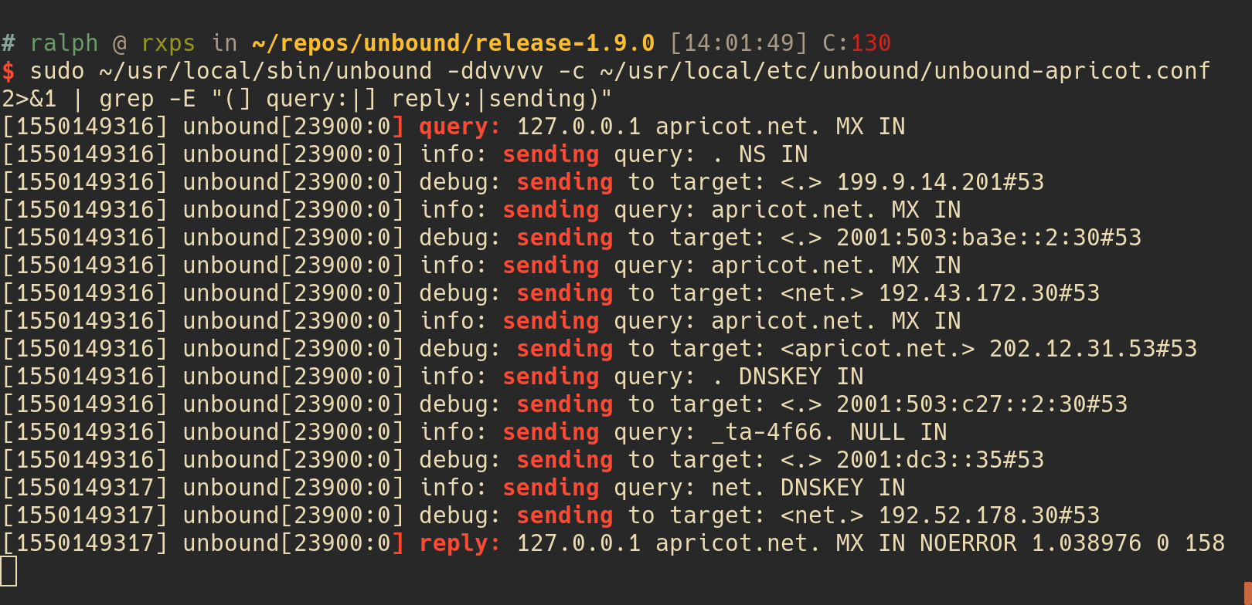

Slide 20
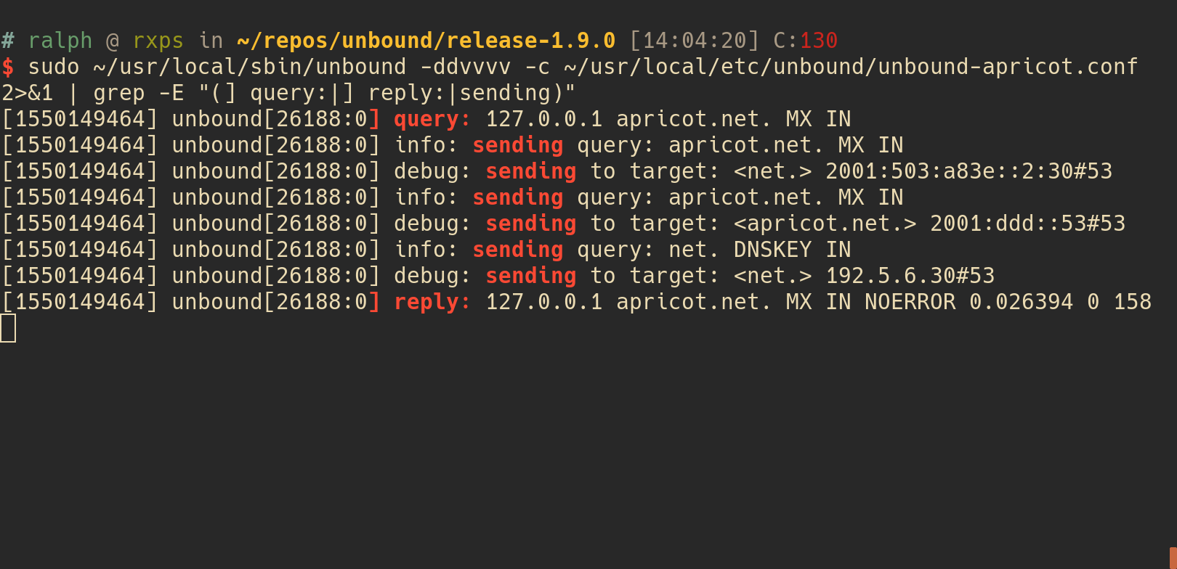

Slide 21
Unbound: local TLD
Not limited to the root zone
auth-zone:
name: "se"
fallback-enabled: yes
for-downstream: no
master: zonedata.iis.se
zonefile: “se.zone”

Slide 22
RFC8198 - Aggressive NSEC
Use cached NSEC and NSEC3 records to synthesise answers
  Negative answers (NODATA and NXDOMAIN)
  Wildcard answers
Does not work for NSEC3 opt-out

Slide 23
NSEC
Unsigned zone:
apricot-demo.nlnetlabs.nl. SOA [..]
NS albatross
albatross.apricot-demo.nlnetlabs.nl. A 185.49.140.60
zebra.apricot-demo.nlnetlabs.nl. A 185.49.140.70
NSEC records generated after zone signing:
apricot-demo.nlnetlabs.nl. NSEC albatross.apricot-demo.nlnetlabs.nl. [..]
albatross.apricot-demo.nlnetlabs.nl. NSEC zebra.apricot-demo.nlnetlabs.nl. [..]
zebra.apricot-demo.nlnetlabs.nl. NSEC apricot-demo.nlnetlabs.nl. [..]

Slide 24
NSEC proof of non existence
$ dig tiger.apricot-demo.nlnetlabs.nl +dnssec
; <<>> DiG 9.11.3-1ubuntu1.3-Ubuntu <<>> tiger.apricot-demo.nlnetlabs.nl +dnssec
;; global options: +cmd
;; Got answer:
;; ->>HEADER<<- opcode: QUERY, status: NXDOMAIN, id: 58617
;; flags: qr rd ra ad; QUERY: 1, ANSWER: 0, AUTHORITY: 6, ADDITIONAL: 1
;; OPT PSEUDOSECTION:
; EDNS: version: 0, flags: do; udp: 4096
;; QUESTION SECTION:
;tiger.apricot-demo.nlnetlabs.nl. IN A
;; AUTHORITY SECTION:
albatross.apricot-demo.nlnetlabs.nl. 3600 IN NSEC zebra.apricot-demo.nlnetlabs.nl. A RRSIG NSEC
albatross.apricot-demo.nlnetlabs.nl. 3600 IN RRSIG NSEC [..]
apricot-demo.nlnetlabs.nl. 3600 IN NSEC albatross.apricot-demo.nlnetlabs.nl. NS SOA RRSIG NSEC DNSKEY
apricot-demo.nlnetlabs.nl. 3600 IN RRSIG NSEC [..]
apricot-demo.nlnetlabs.nl. 3600 IN SOA ns.nlnetlabs.nl. ralph.nlnetlabs.nl. 1550139530 14400 3600 604800 3600
apricot-demo.nlnetlabs.nl. 3600 IN RRSIG SOA [..]

Slide 25
NSEC proof of non existence
$ dig elephant.apricot-demo.nlnetlabs.nl +dnssec
; <<>> DiG 9.11.3-1ubuntu1.3-Ubuntu <<>> elephant.apricot-demo.nlnetlabs.nl +dnssec
;; global options: +cmd
;; Got answer:
;; ->>HEADER<<- opcode: QUERY, status: NXDOMAIN, id: 13618
;; flags: qr rd ra ad; QUERY: 1, ANSWER: 0, AUTHORITY: 6, ADDITIONAL: 1
;; OPT PSEUDOSECTION:
; EDNS: version: 0, flags: do; udp: 4096
;; QUESTION SECTION:
;elephant.apricot-demo.nlnetlabs.nl. IN A
;; AUTHORITY SECTION:
albatross.apricot-demo.nlnetlabs.nl. 3600 IN NSEC zebra.apricot-demo.nlnetlabs.nl. A RRSIG NSEC
albatross.apricot-demo.nlnetlabs.nl. 3600 IN RRSIG NSEC [..]
apricot-demo.nlnetlabs.nl. 3600 IN NSEC albatross.apricot-demo.nlnetlabs.nl. NS SOA RRSIG NSEC DNSKEY
apricot-demo.nlnetlabs.nl. 3600 IN RRSIG NSEC [..]
apricot-demo.nlnetlabs.nl. 3600 IN SOA ns.nlnetlabs.nl. ralph.nlnetlabs.nl. 1550139530 14400 3600 604800 3600
apricot-demo.nlnetlabs.nl. 3600 IN RRSIG SOA [..]

Slide 26
Using cached NSEC records
NSEC records in cache after tiger.apricot-demo.nlnetlabs.nl query:
These records can be used to return an NXDOMAIN answer for elephant.apricot-demo.nlnetlabs.nl → Aggressive use of NSEC
  Less upstream queries
albatross.apricot-demo.nlnetlabs.nl. 3600 IN NSEC zebra.apricot-demo.nlnetlabs.nl. A RRSIG NSEC
apricot-demo.nlnetlabs.nl. 3600 IN NSEC albatross.apricot-demo.nlnetlabs.nl. NS SOA RRSIG NSEC DNSKEY

Slide 27
Unbound: Aggressive NSEC
Disabled by default (for now)
Limited to NSEC (for now)
aggressive-nsec: yes

Slide 28
Aggressive NSEC – NODATA
Cached NSEC records can also be used to synthesise NODATA answers
MX query for albatross.apricot-demo.nlnetlabs.nl can be answered without upstream query
albatross.apricot-demo.nlnetlabs.nl. 3600 IN NSEC zebra.apricot-demo.nlnetlabs.nl. A RRSIG NSEC

Slide 29
Aggressive NSEC – Wildcard records
Cached wildcard + NSEC records can also be used to synthesise wildcard answers
TXT query for camel.apricot-demo.nlnetlabs.nl can be answered without upstream query
  camel.apricot-demo.nlnetlabs.nl provably non existent
  TXT record in cache → camel.apricot-demo.nlnetlabs.nl TXT “wildcard record”
albatross.apricot-demo.nlnetlabs.nl. 3600 IN NSEC zebra.apricot-demo.nlnetlabs.nl. A RRSIG NSEC
*.apricot-demo.nlnetlabs.nl. 3600 IN TXT “wildcard record”

Slide 30
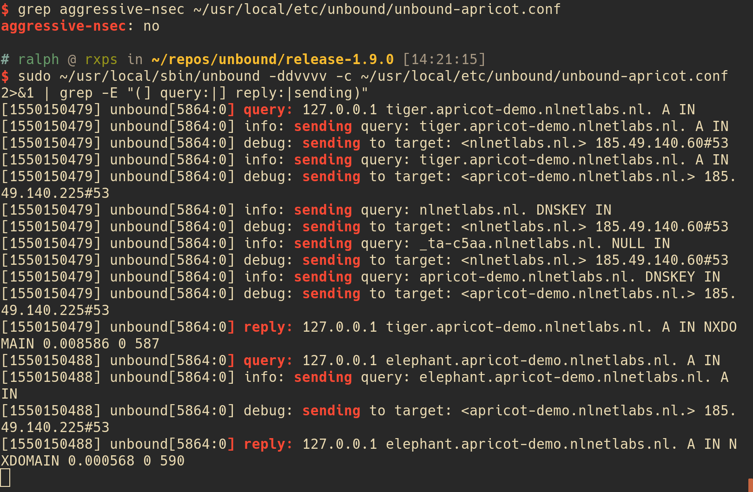

Slide 31
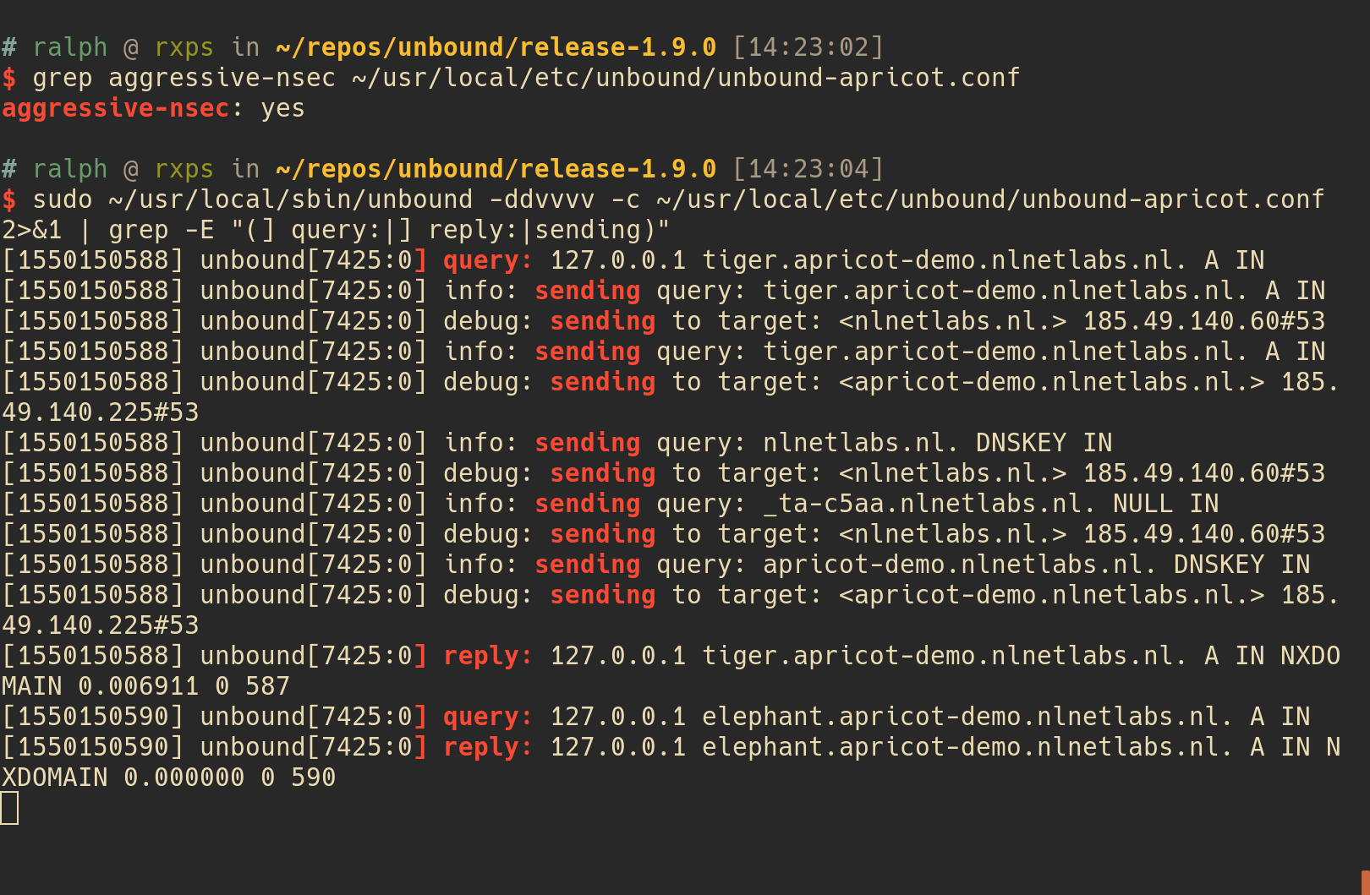

Slide 32
Privacy Threat Mitigation
Data minimisation
  Limit the number of DNS queries
  → Minimise the data disclosed in DNS transactions
Security
  Hide transaction by using encryption
  Limit data disclosure to authenticated parties

Slide 33
DNS data disclosure with ECS
.
stub
185.49.140.10
resolver
178.62.200.226
nl.
nlnetlabs.nl.

Slide 34
ECS - 0 source prefix length
RFC7871, section 7.1.2:
  “A SOURCE PREFIX-LENGTH value of 0 means that the Recursive Resolver MUST NOT add the client's address information to its queries.”
Not honored by OpenDNS :(

Slide 35
EDNS Client Subnet
From stub
  Set EDNS Client Subnet prefix to /0
From resolver
  Do not use EDNS Client Subnet
  (set ECS prefix to /0 when forwarding)

Slide 36
DNS data disclosure with ECS
(/0 source prefix)
.
stub
185.49.140.10
resolver
178.62.200.226
nl.
nlnetlabs.nl.

Slide 37
Unbound: EDNS Client Subnet
Default off, no need to change for privacy aware resolver
Forwarding /0 not implemented yet

Slide 38
Stubby: ECS /0
Always send ECS 0 source prefix option:
edns_client_subnet_private : 1

Slide 39
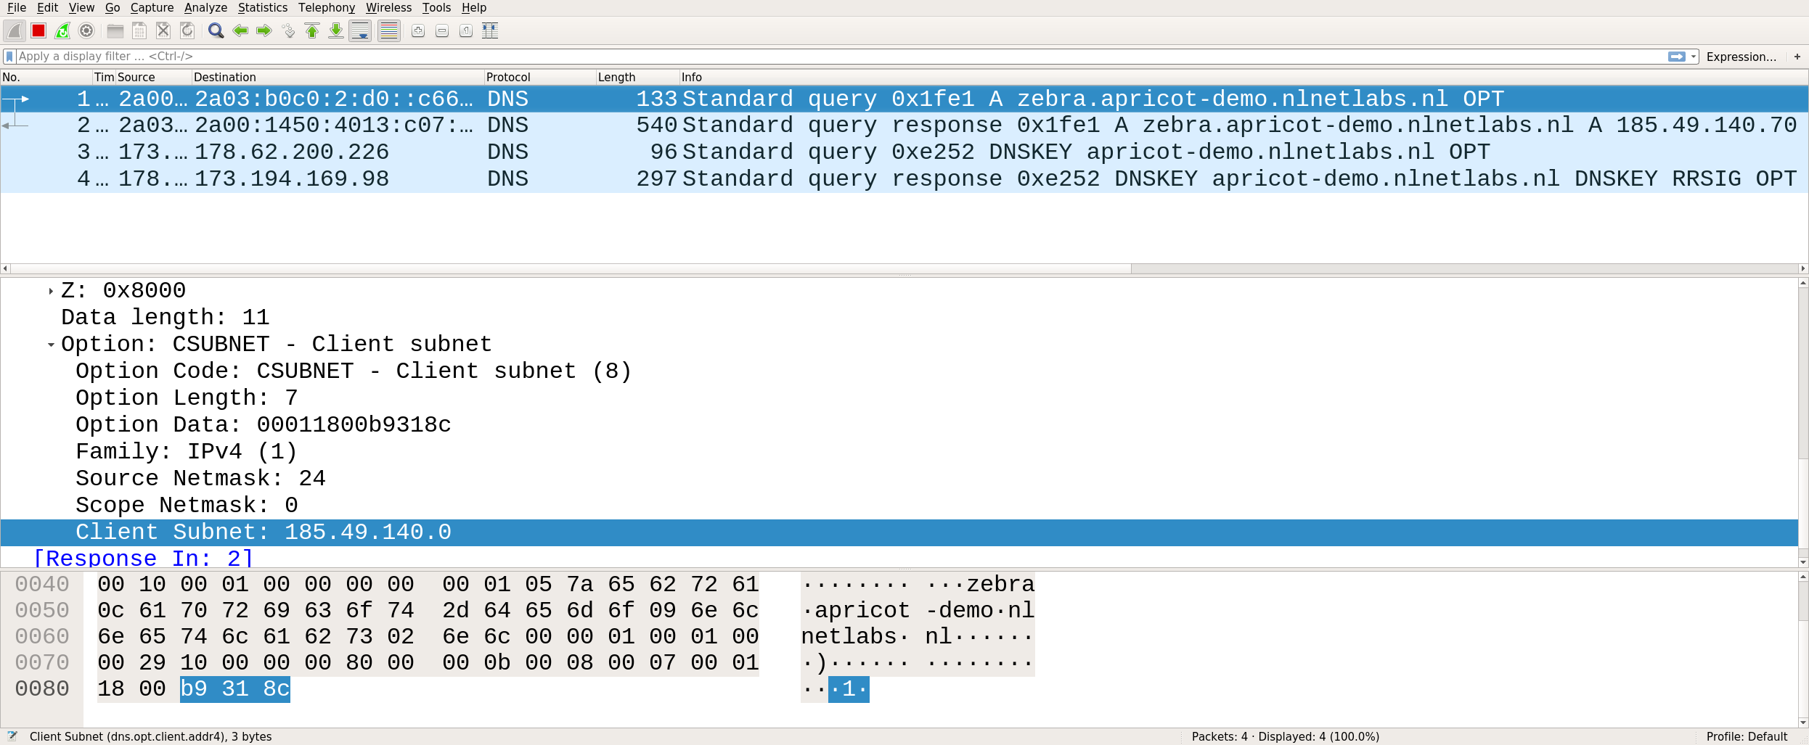
dig zebra.apricot-demo.nlnetlabs.nl @8.8.8.8

Slide 40
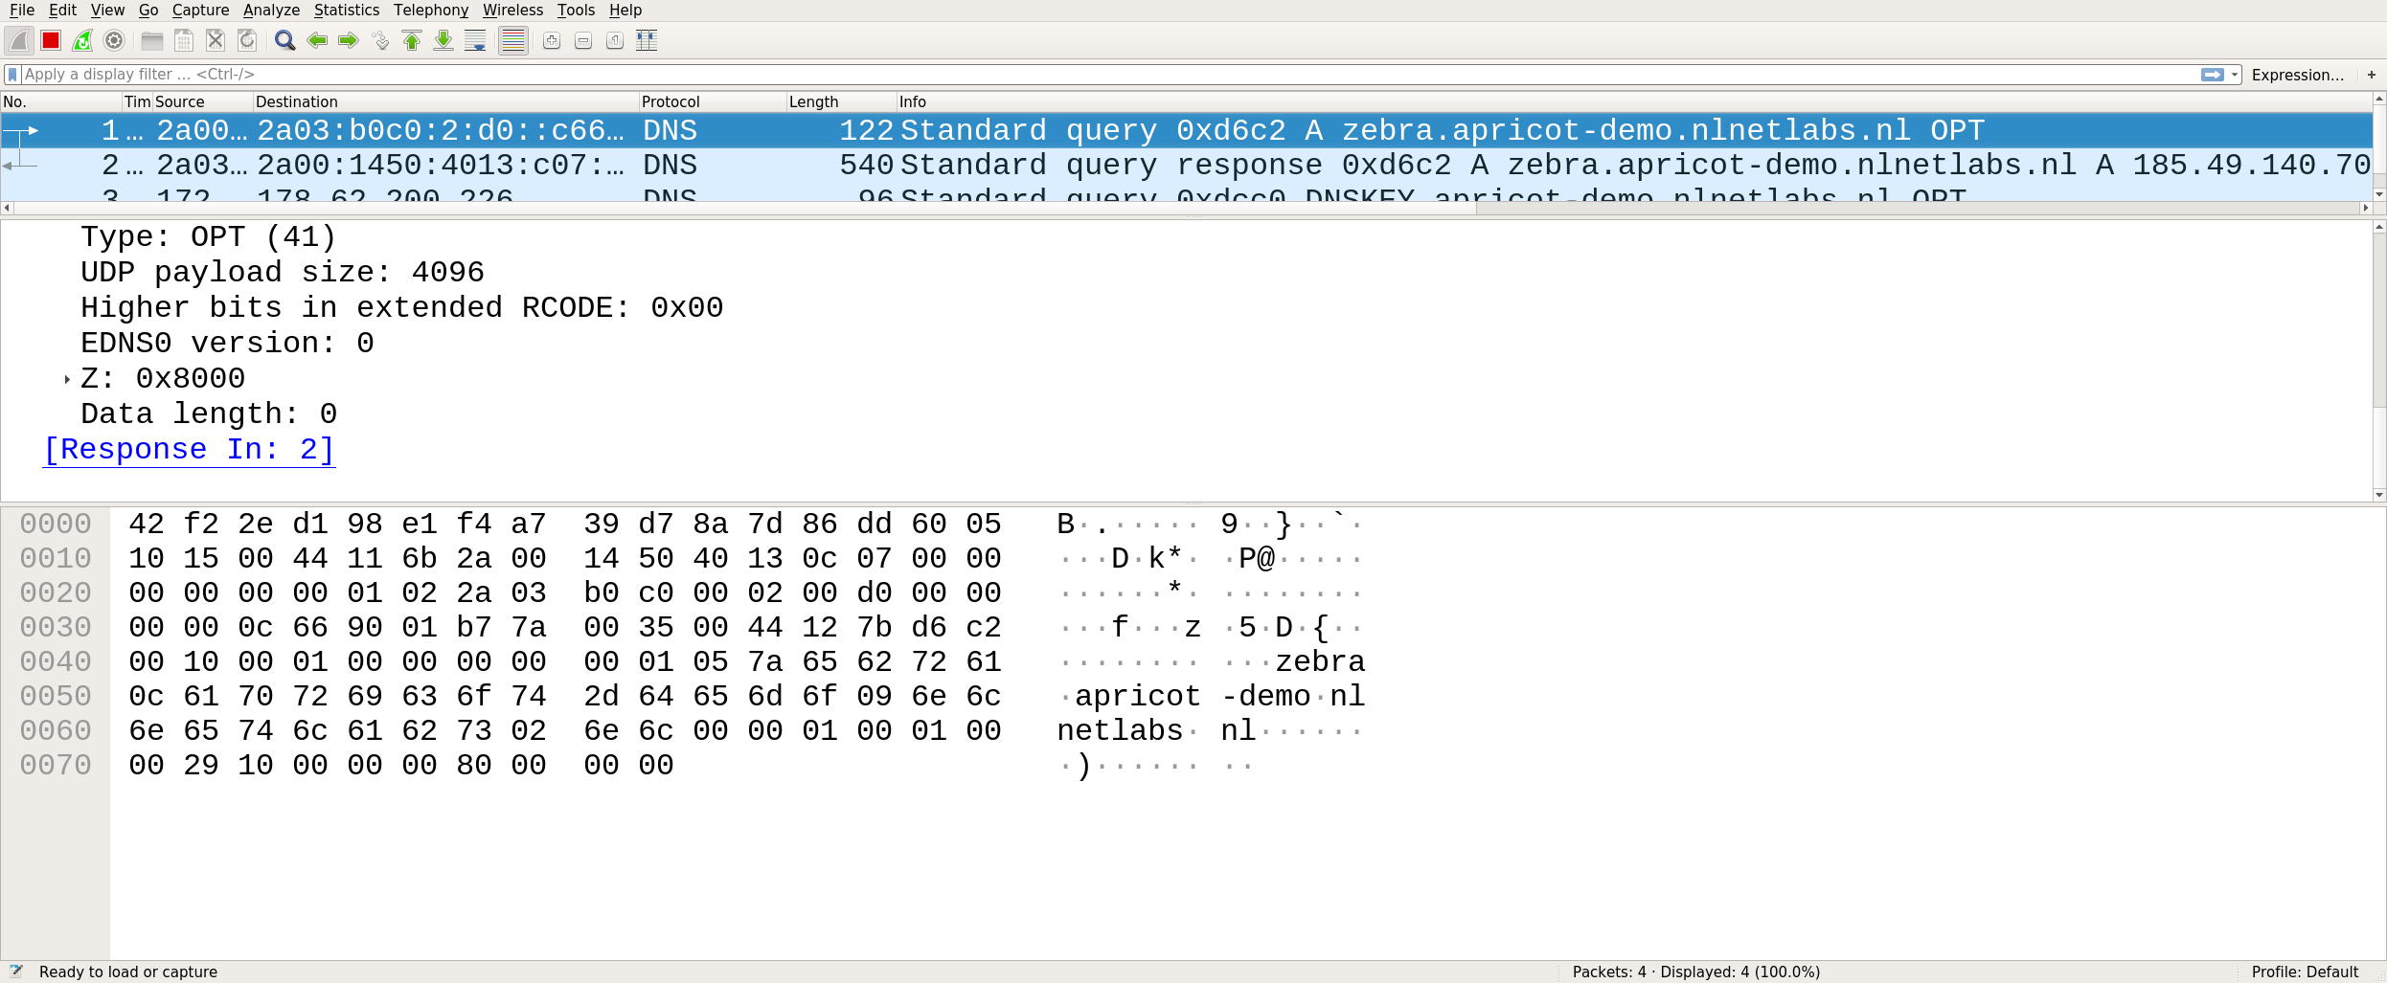
dig zebra.apricot-demo.nlnetlabs.nl @8.8.8.8 +subnet=0.0.0.0/0

Slide 41
QNAME minimisation
DNS Query Name Minimisation to Improve Privacy, RFC7816:
  “The request is done with:
    the QTYPE NS,
    the QNAME which is the original QNAME, stripped to just one label more than the zone for which the server is authoritative.”

Slide 42
Without QNAME minimisation
.
nl.
stub
resolver
nlnetlabs.nl.
hello.nlnetlabs.nl.

Slide 43
With QNAME minimisation
.
nl.
stub
resolver
nlnetlabs.nl.
hello.nlnetlabs.nl.

Slide 44
QNAME minimisation issues
Lot of queries for some domains, e.g. 0.1.0.0.0.0.0.0.0.0.0.0.1.0.0.0.0.0.0.0.0.0.0.0.0.0.9.b.4.0.a.2.ip6.arpa.
Queries for NS QTYPE not always (correctly) answered
Unclear when to stop resolving
  RFC8020- NXDOMAIN: There Really Is Nothing Underneath

Slide 45
Empty-non-terminals
Existing name without records
Example zone with records for nlnetlabs.nl, www.nlnetlabs.nl and a.b.nlnetlabs.nl
b.nlnetlabs.nl is an empty-non-terminal
nlnetlabs.nl
www.nlnetlabs.nl
b.nlnetlabs.nl
a.b.nlnetlabs.nl

Slide 46
QNAME minimisation in Unbound
Do QNAME minimisation with QTYPE=A
Limit number of queries
  Limit QNAME minimisation iterations to 10
  Always append one label for the first 4 queries
Continue without minimisation when RCODE != NOERROR
  Exception for DNSSEC signed domains
  Not in strict mode

Slide 47
QNAME minimisation in Unbound
Enable QNAME minimisation (default):
QNAME minimisation in strict mode (not recommended):
qname-minimisation: yes
qname-minimisation-strict: yes

Slide 48
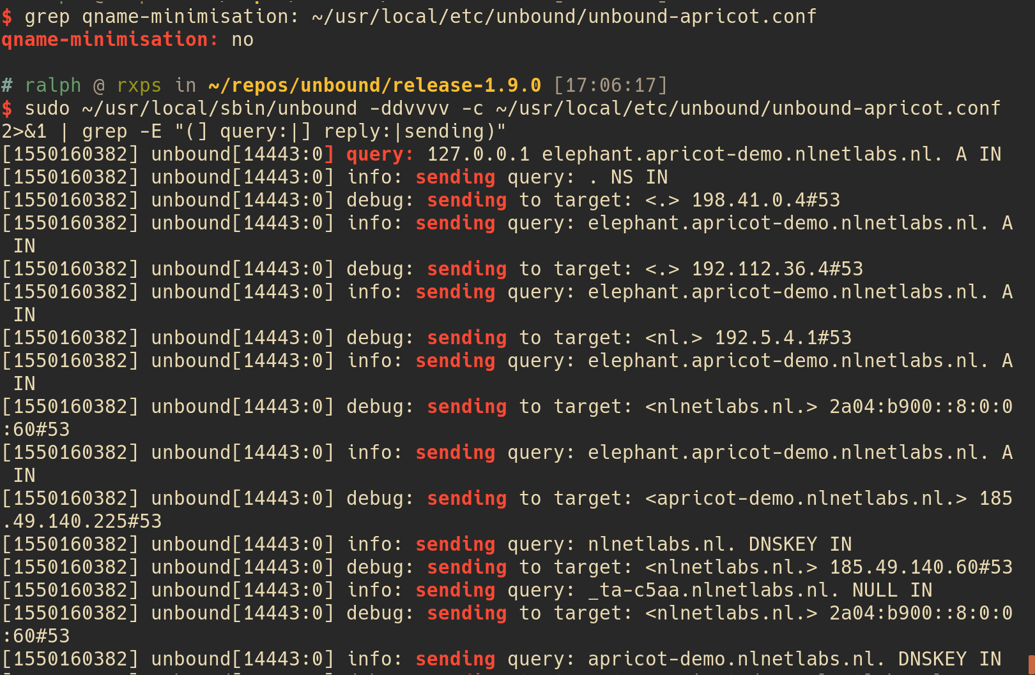

Slide 49
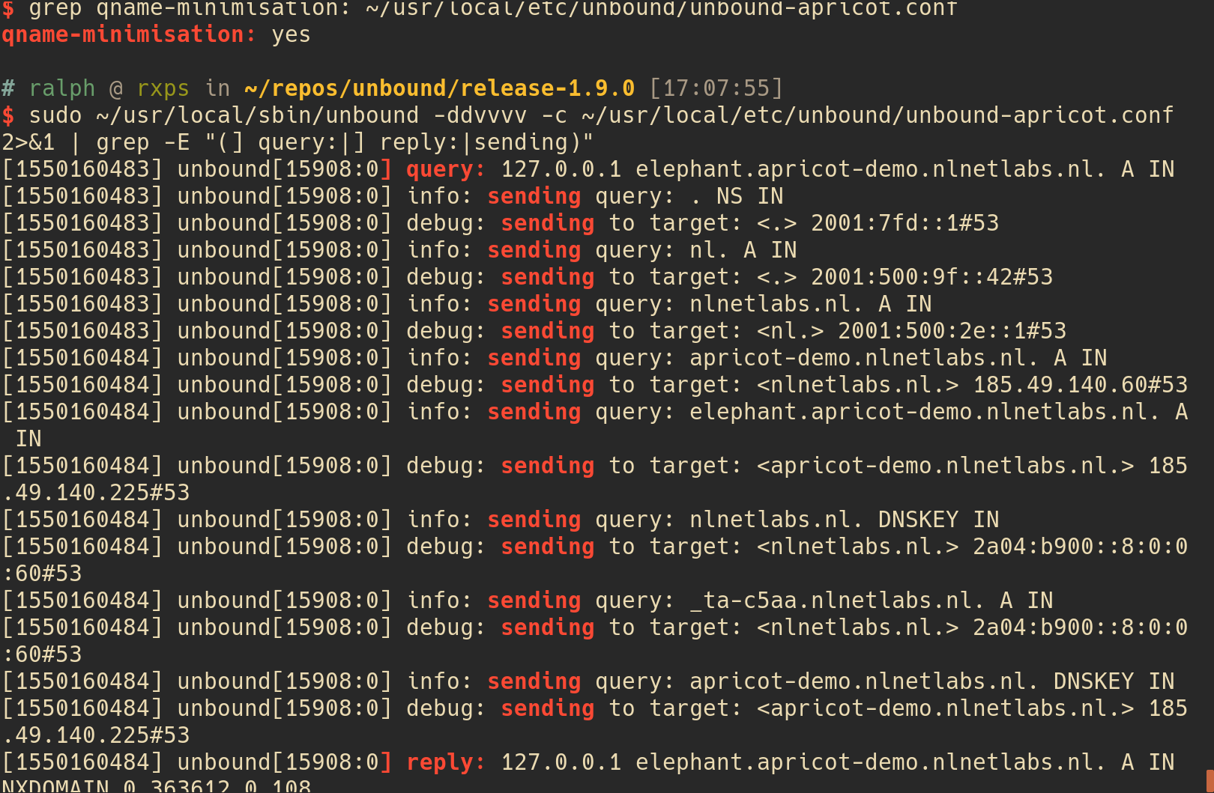

Slide 50
Privacy Threat Mitigation
Data minimisation
  Limit the number of DNS queries
  Minimise the data disclosed in DNS transactions
Security
  → Hide transaction by using encryption
  → Limit data disclosure to authenticated parties

Slide 51
DPRIVE
DNS Privacy Considerations (RFC7626)
Initial focus on stub –> resolver
DNS-over-TLS
  Needs TCP
  Own port (853)

Slide 52
DNS over TCP
Most DNS traffic currently UDP
Changes are needed in DNS software to better handle the increased TCP load
RFC7766
    Query pipelining / out of order processing
    Connection reuse
    TCP fast open

Slide 53
Connection reuse
Limit the TCP connection setup latency
SYN
TCP handshake
SYN + ACK
ACK + DNS Query
DNS response
DNS query
DNS response

Slide 54
Query pipelining
Do not wait for a reply before sending the next query
SYN
TCP handshake
SYN + ACK
ACK + DNS QUERY
DNS query
DNS query
DNS response
DNS response
DNS response

Slide 55
In order processing
STUB
RESOLVER
AUTH
Q1
Q2
Q1
Q3
R1
R1
Q2
R2
R2
Q3
R3
R3

Slide 56
Out of order processing
STUB
RESOLVER
AUTH
Q1
Q2
Q1
Q3
Q2
R2
R2
Q3
R3
R3
R1
R1

Slide 57
Stubby: Connection reuse
Connection reuse and query pipelining by default
Keep idle TCP connections open:
idle_timeout: 10000

Slide 58
Unbound: Query pipelining / OOOP
Downstream persistent connections in Unbound for many years
Downstream out of order processing since Unbound 1.9.0
  No configuration change needed
Upstream connection reuse not yet in Unbound

Slide 59
Unbound – handling persistent client connections
Number of incoming tcp connections:
TCP idle timeout (in msec):
Incoming-num-tcp: ??
incoming-num-tcp: 128
tcp-idle-timeout: 30000

Slide 60
TCP fast open
Save one RTT by putting application data in SYN and SYN-ACK packets
  Server-side generated security cookie to authenticate client
SYN
1st TCP handshake
(no cookie at client)
SYN + ACK + Cookie
ACK + DNS QUERY
DNS response
SYN + Cookie + DNS Query
2nd TCP handshake
(cookie at client)
SYN + ACK + DNS response

Slide 61
TCP fast open on OS
Linux: net.ipv4.tcp_fastopen=N*
OSX: net.inet.tcp.fastopen=N*
FreeBSD: net.inet.tcp.fastopen.server_enabled=1
* 1 = client, 2 = server, 3 = client+server

Slide 62
Unbound/getdns: TCP fast open
Unbound
  --enable-tfo-client
  --enable-tfo-server
getdns
  Enabled by default if available

Slide 63
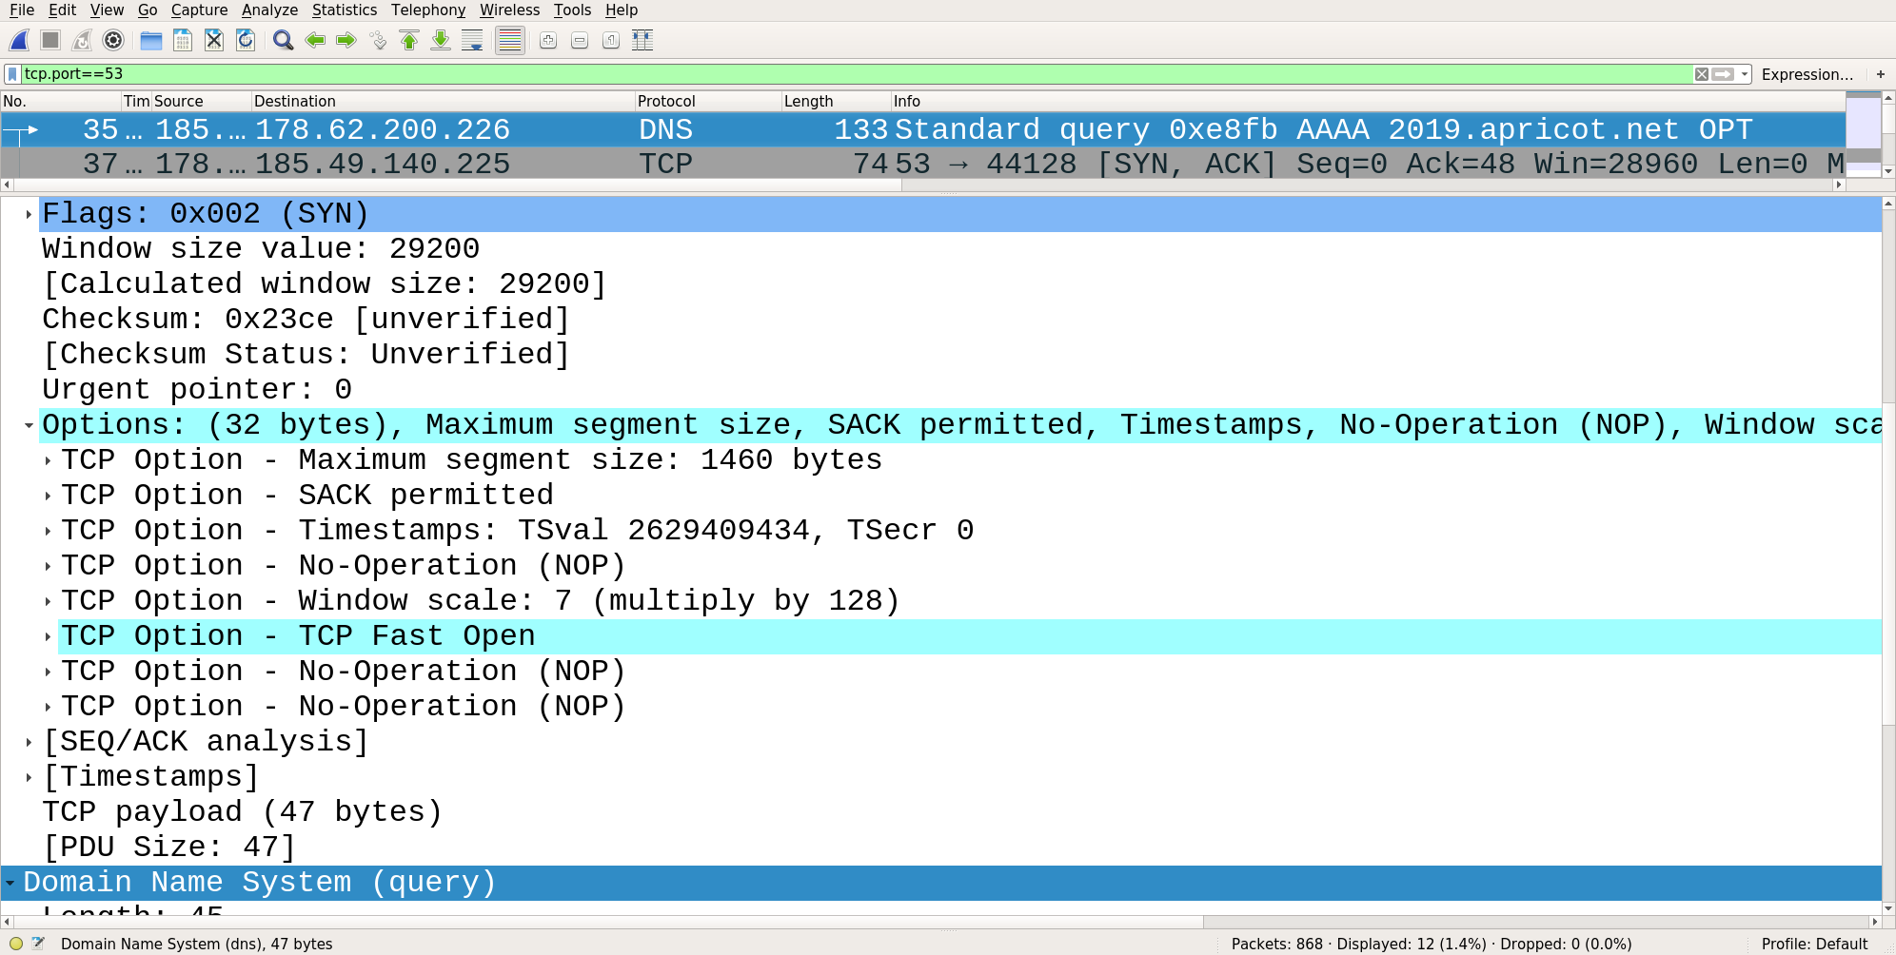

Slide 64
TLS recap
Provides secure application layer communication channel
  Encryption of data
  Authentication of server
Identification using digital certificate
  Containing public key which is used to generate session key
Dedicated port or connection upgrade using STARTTLS

Slide 65
DNS-over-TLS
Uses dedicated port: 853
Strict privacy vs opportunistic privacy (RFC8310)
  Mitigate against passive or active attacks
Authentication
  Authentication domain name or SPKI pin set needed at client
  Trusted CA bundle or TLSA record may be needed at client
    Chicken/egg problem for TLSA: solution DNSSEC chain extension

Slide 66
Setup DNS-over-TLS server
Generate key and certificate
  Self signed
  CA (letsencrypt) signed
openssl req -newkey rsa:2048 -nodes -keyout privkey.pem -x509 -days 365 -out certificate.pem
./certbot-auto certonly --standalone -d albatross.apricot-demo.nlnetlabs.nl

Slide 67
Unbound: DNS-over-TLS server
TLS for client
server:
interface: 0.0.0.0@853
interface: ::0@853
tls-service-key: "/etc/letsencrypt/live/albatross.apricot-demo.nlnetlabs.nl/privkey.pem"
tls-service-pem: "/etc/letsencrypt/live/albatross.apricot-demo.nlnetlabs.nl/fullchain.pem"
do-udp: no
udp-upstream-without-downstream: yes

Slide 68
getdns_query
Test our DoT resolver using getdns_query:
getdns_query -L -m @178.62.200.226~albatross.apricot-demo.nlnetlabs.nl 2019.apricot.net

Slide 69
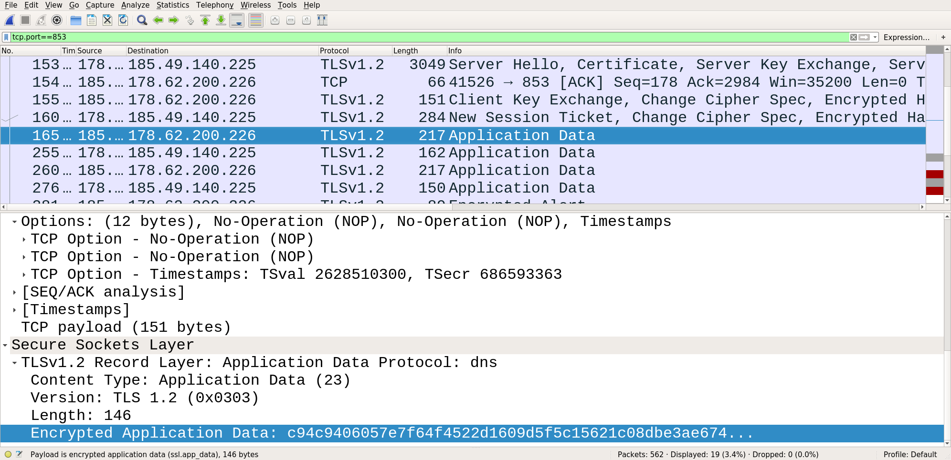

Slide 70
Stubby DNS-over-TLS
Opportunistic privacy by default
Configure strict privacy with CA authentication:
dns_transport_list:
- GETDNS_TRANSPORT_TLS
tls_authentication: GETDNS_AUTHENTICATION_REQUIRED
tls_ca_path: "/etc/ssl/certs/"
upstream_recursive_servers:
- address_data: 178.62.200.226
tls_auth_name: "albatross.apricot-demo.nlnetlabs.nl"

Slide 71
Get SPKI pin set
Get SPKI pinset (Base64 encoded sha256 hash of public key fingerprint):
openssl s_client -connect 178.62.200.226:853 -servername albatross.apricot-demo.nlnetlabs.nl 1>&/dev/null |
openssl x509 -pubkey -noout | openssl pkey -pubin -outform der | openssl dgst -sha256 -binary |
openssl enc -base64

Slide 72
Stubby – SPKI pin set authentication
No ca_path required for SPKI pin set authentication
Configure strict SPKI authentication in stubby:
dns_transport_list:
- GETDNS_TRANSPORT_TLS
tls_authentication: GETDNS_AUTHENTICATION_REQUIRED
upstream_recursive_servers:
- address_data: 178.62.200.226
tls_auth_name: "albatross.apricot-demo.nlnetlabs.nl"
tls_pubkey_pinset:
- digest: "sha256"
value: aZgr7RhoLDAvug16/FeebD02E2s5+Y5LJKG1jcBVNCA=

Slide 73
Unbound: DNS-over-TLS client
Forward all data to DoT resolver using Unbound
server:
tls-cert-bundle: "/etc/ssl/certs/ca-certificates.crt"
forward-zone:
name: "."
forward-tls-upstream: yes
forward-addr: 178.62.200.226@853#albatross.apricot-demo.nlnetlabs.nl

Slide 74
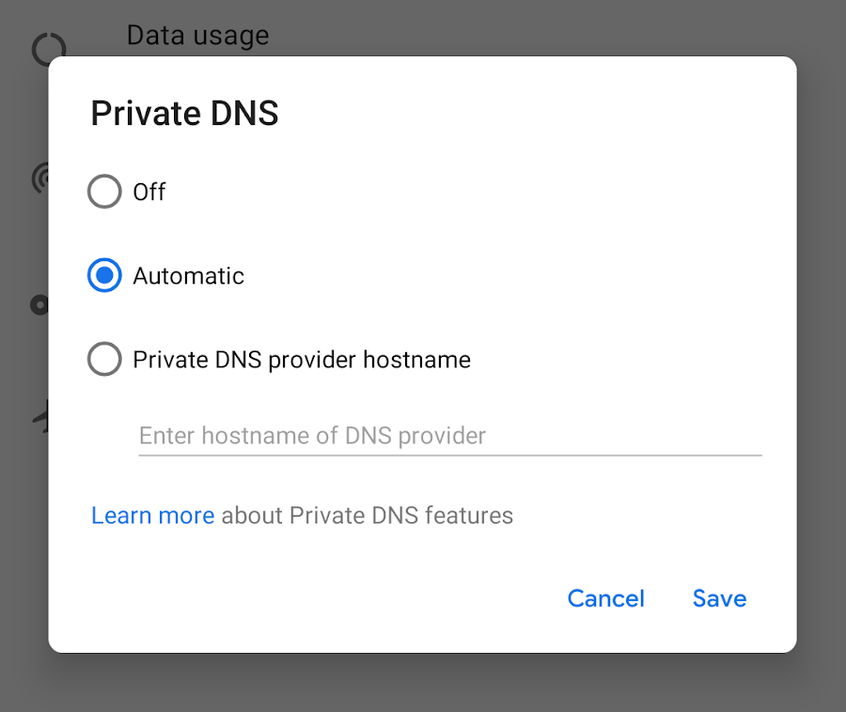
Android Pie
Opportunistic DoT by default
  Probing queries to port 853 to detect DoT support
Strict privacy possible after providing authentication domain name
  Device’s CA store used to authenticate the certificate
Image from: android-developers.googleblog.com

Slide 75
DNS-over-TLS server monitoring
Monitor for certificate expiration!
  It’s just TLS, existing TLS monitoring tools should work
  View certificate (including expiration date):
openssl s_client -connect 178.62.200.226:853 -servername albatross.apricot-demo.nlnetlabs.nl |
openssl x509 -noout -text

Slide 76
Cert renewal
You might want to reuse the private key (when using public key for authentication), in that case:
  Generate certificate signing request using existing key
  Get self signed certificate using CSR
  , or get Let’s encrypt certificate using CSR
openssl req -key privkey.pem -new -out request.csr
openssl x509 -req -days 365 -in request.csr -signkey privkey.pem -out certificate.pem
./certbot-auto certonly --standalone -d albatross.apricot-demo.nlnetlabs.nl --csr request.csr

Slide 77
DNS-over-HTTPS
DNS payload wrapped in HTTP transactions
HTTP 2 with TLS
Port 443, hides DNS transactions

Slide 78
DoT vs DoH
DNS-over-HTTP
  Easier for browser apps
  Hides DNS traffic in regular HTTP traffic
  Mature transport ecosystem
DNS-over-TLS
  DNS as we know it

Slide 79
Trusted Recursive Resolver
List of DoH resolvers in browser
Used instead of configured system resolver
  Bypass local policies
Guaranteed to work, no middleboxes hampering lookups
Privacy impact depends on used resolver

Slide 80
Privacy at the resolver
Be aware of information logged on your machines
  Limit privacy sensitive data in your logs
    Do you really need to store the client addresses?
  Limit data to personnel who need it for operational purposes
  Store data for shortest operationally feasible period
  Consider encrypting and/or anonymising the data

Slide 81
Encryption resolver → auth
DPRIVE rechartered in May 2018
Security between resolver and authoritative is next
Need to authenticate many servers, manual configuration is not going to work here
  Magic NS names to detect SPKI fingerprint (DNSCurve style)
  TLSA at _853._tcp.ns.example.net
  ..?

Slide 82
“best” set-up
Multiple scenarios possible
  Local resolver
  Public resolver
  Local with forwarding to public
    Randomise forwards selection, or not?

Slide 83
Questions?

Slide 84
Lab time!
Hands on: http://bangkok.lol/
  9. DNS Privacy

