Slide 1


ยินดีต้อนรับสู่
Cyber Security Workshop
DNS Focused
Bangkok
8-9 May 2019

Slide 2

Who are we?
Willem Toorop
Developer @
Loves doing Hackathons
Internet measurements with RIPE Atlas
All-rounder (but does not skate the 10km)

Slide 3
Who are we?
Ralph Dolmans
Also a Developer & Researcher @
In Program Committee of DNS-OARC
Architect of internet.nl
Advises Dutch Goverment on Open Standards (COE list)
Also an all-rounder (and actually can skate the 10km)

Slide 4

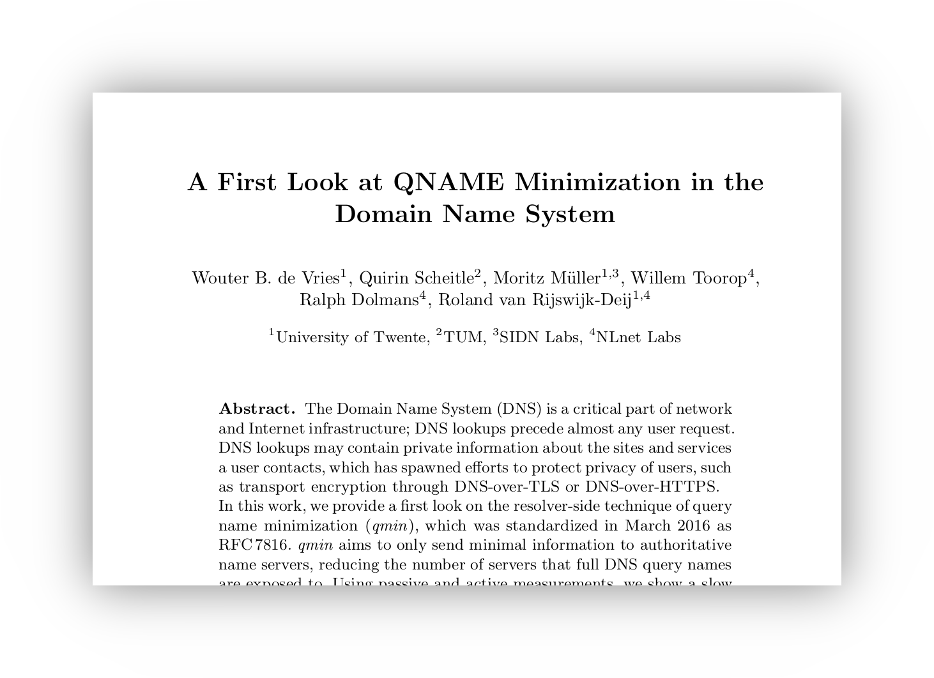
Who are we?
Willem & Ralph – Researching activities
Root KSK roll effects, DNS Flagday effects,
NTP vulnerabilities on DNS
Best Dataset
Award

Slide 5




















What is/What does
Not-for-profit foundation – since 1999 – subsidies & donations

Slide 6
What is/What does
Mission:
  To provide globally recognized innovations and expertise for those technologies that turn a network of networks into an Open Internet for All.
Objective:
  To develop Open Source software and Open Standards for the benefit of the Internet,

Slide 7


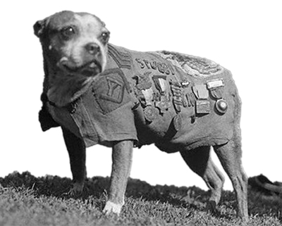




What is/What does
Objective:
  To develop Open Source Software and
  Open Standards for the benefit of the Internet,
ldns
Net::DNS
Net::DNS::SEC

Slide 8
What is/What does
Objective:
  To develop Open Source Software and
  Open Standards for the benefit of the Internet,
  and furthermore do all that is directly or indirectly connected in the broadest sense.
Research – Internet measurements – Student projects –
Participate in Program Committees – Hackathons – Workgroup Chair – Governance – and…
… incidentally do Workshops ☺

Slide 9
Who are you?
Experience? Day job?
  Unix prompt: huh prompt?
  make: make what, a pie everyday?
  unbound: Sorry, I’m married.
  zones and domains: stay out of my personal space
Expectations?
  Is there anything we should pay special attention to?

Slide 10
About the workshop
Hand-on:
  Interleave lectures and Do It Yourself
Start basic DNS and basic DNS services
  Resolver → Authoritative → Registering zones → Resilience → DNSSEC Validation → Signing → etc.
Bit of improvisation on our side, and on yours

Slide 11
Lab environment
Teams of two or three persons
Each team has two cloud provided Linux (Ubuntu 19.04) machines (access with ssh)
bangkok.lol domain for hands-on practice

Slide 12

Lab time!
Hands on: http://bangkok.lol/
0. Make Teams &
access to machines
Photo by Alex Kondratiev on Unsplash

