Slide 1


ยินดีต้อนรับสู่
Cyber Security Workshop
DNS Basics
Bangkok
8-9 May 2019

Slide 2
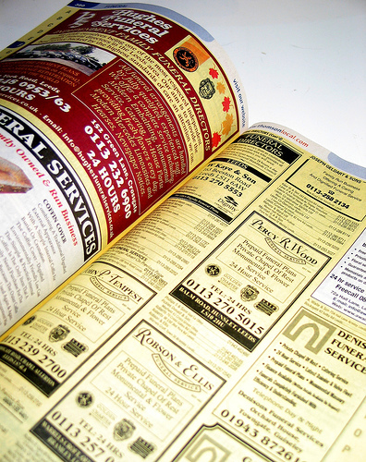
Name Space on the Internet
Finding IP addresses
  Start with a domain name
  (human form)
  Translating to an IP address
  (machine form)
What is the IP address of
www.bangkok.lol?
  Client asks server
  Server responds with answer
  … case closed?

Slide 3
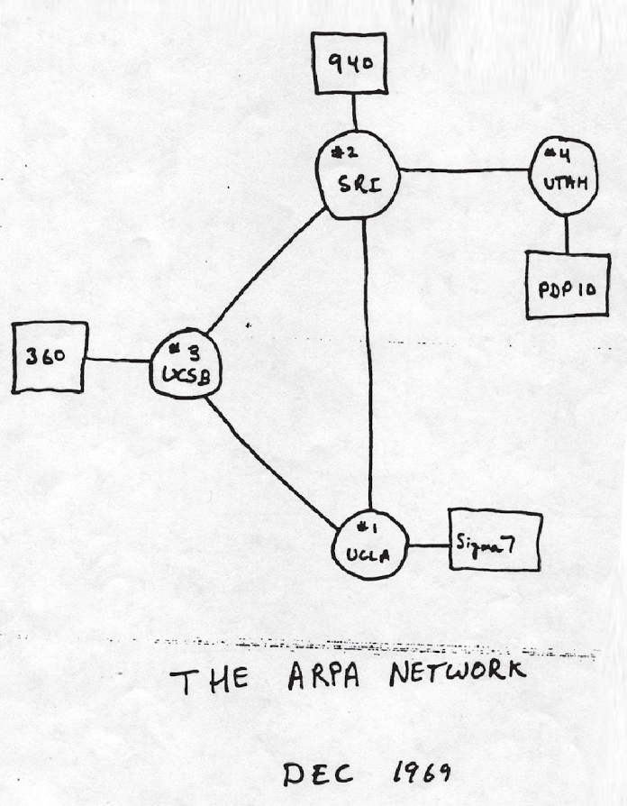
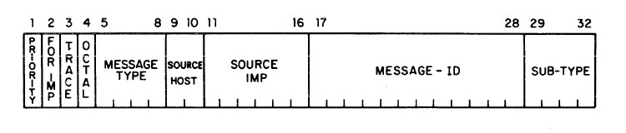
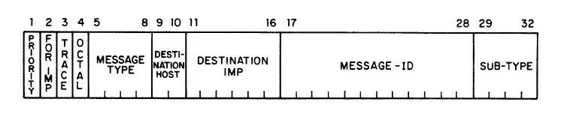
Name Space on the Internet
NCP (Network Control Program)
December 1973
HOSTS.TXT (RFC 606)

Slide 4
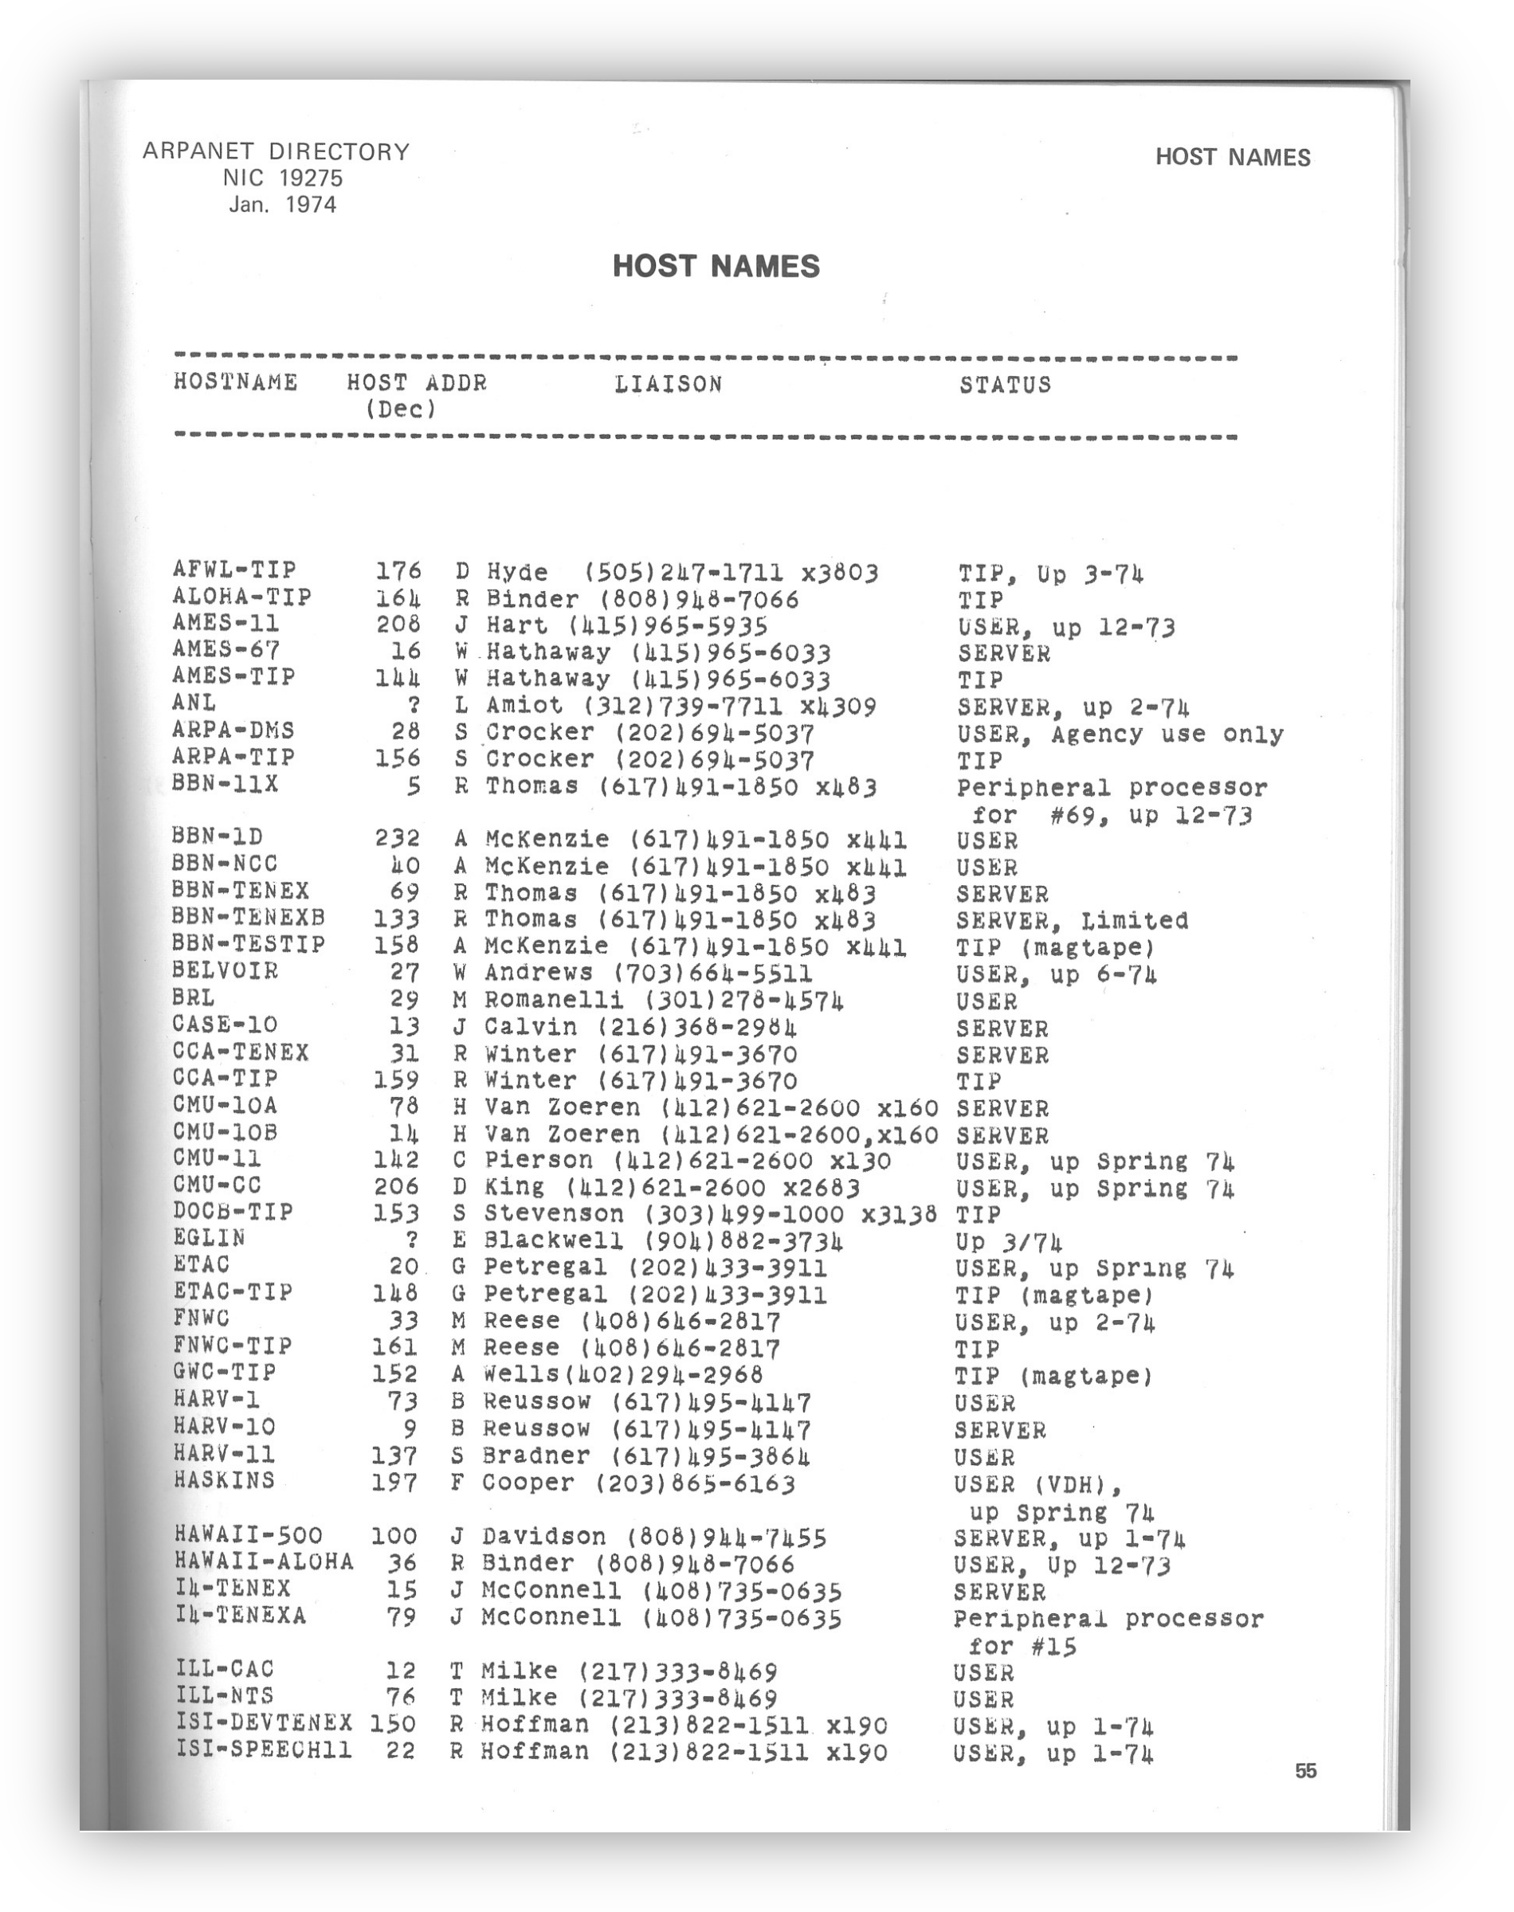
Namespace on the Internet
NCP (Network Control Program)
December 1973
HOSTS.TXT (RFC 606)

Slide 5
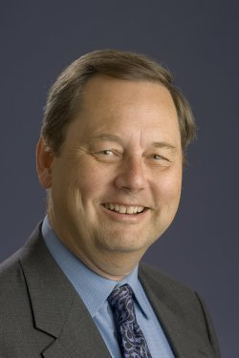
Name Spaces on the Internet
1 January 1983 NCP→IP/TCP
flagday
max 256→max 4.294.967.296 hosts
November 1983 DNS (RFC 882)
Domain Name System
November 1987 STD13
(RFC 1034 & RFC 1035)
Elder of the Internet
Paul Mockapetris - © CC BY-SA 4.0 by Oscured
First implementation: https://www.hactrn.net/hacks/jeeves/

Slide 6
Domain Name Space – scale
.
13 root servers
.th
.org
.lol
ait.ac.th
dns-school.org
ietf.org
bangkok.lol

Slide 7
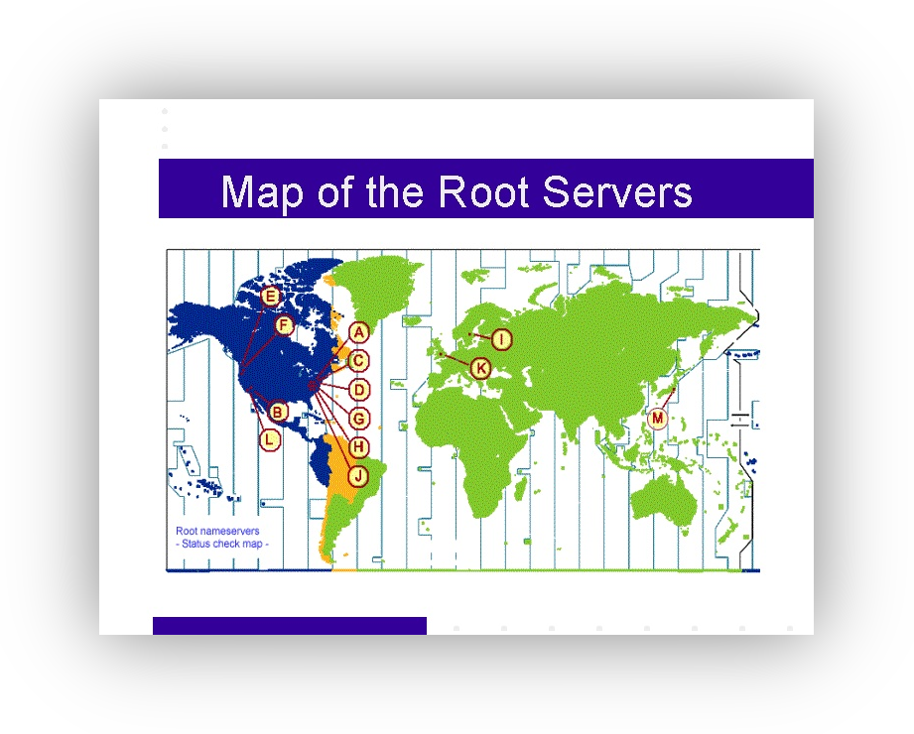
Domain Name Space – scale
.
13 root servers
.th
.org
.lol
ait.ac.th
dns-school.org
ietf.org
bangkok.lol
Map from 2001

Slide 8
Domain Name Space – scale
A | VeriSign | 198.41.0.4 2001:503:BA3E::2:30 | H | US Army | 128.63.2.53 2001:500:1::803f:235
B | USC-ISI | 192.228.79.201 2001:478:65::53 | I | Netnod | 192.36.148.17 2001:7fe::53
C | Cogent | 192.33.4.12 2001:500:2::c | J | VeriSign | 192.58.128.30 2001:503:C27::2:30
D | Uni Maryland | 199.7.91.13 2001:500:2d::d | K | RIPE NCC | 193.0.14.129 2001:7fd::1
E | NASA | 192.203.230.10 2001:500:a8::e | L | ICANN | 199.7.83.42 2001:500:3::42
F | ISC | 192.5.5.241 2001:500:2f::f | M | WIDE Project | 202.12.27.33 2001:dc3::35
G | DoD | 192.112.36.4 2001:500:12::d0d

Slide 9
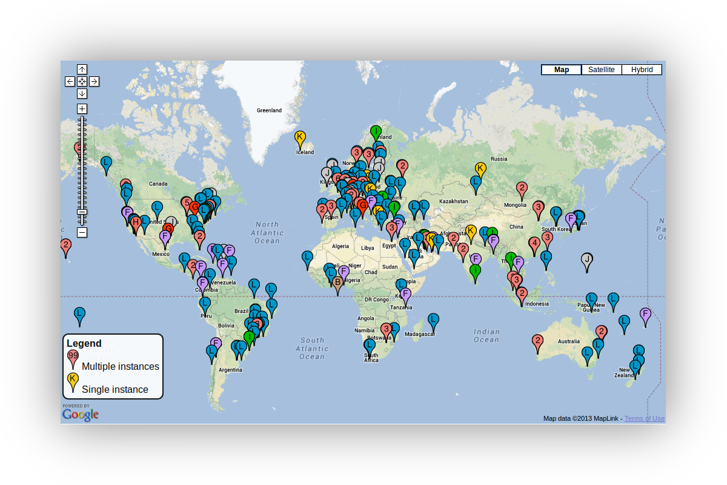
Domain Name Space – scale
.
13 root servers
.th
.org
.lol
ait.ac.th
dns-school.org
ietf.org
bangkok.lol

Slide 10
Domain Name Space – scale
.
RFC920 (1984)
generic Top Level Domains
(gTLDs)
    Categories
      .gov .edu .com
      .mil .org .net
.th
.org
.lol
ait.ac.th
dns-school.org
ietf.org
bangkok.lol

Slide 11
Domain Name Space – scale
.
country code TLD (ccTLD)
    .US (15 Feb 1985)
    .UK, GB (24 Jul ‘85)
    .AU ( 5 Mar 1986)
    .NL (25 Apr 1986)
    .JP ( 5 Aug 1986)
        .TH (1988)
.th
.org
.lol
ait.ac.th
dns-school.org
ietf.org
bangkok.lol

Slide 12
Domain Name Space – scale
.
2000 – 2012
    Internationalized
    Domain Names
      .ไทย
    more gTLDs, including
      .name .pro .biz
      (restricted)
.th
.org
.lol
ait.ac.th
dns-school.org
ietf.org
bangkok.lol

Slide 13
Domain Name Space – scale
.
Now: Unlimited
$186,000
1532 TLDs
.com 141,600,000
.tk 23,700,000
.de 14,600,000
.nl 5,500,000
.th ?
.th
.org
.lol
ait.ac.th
dns-school.org
ietf.org
bangkok.lol

Slide 14
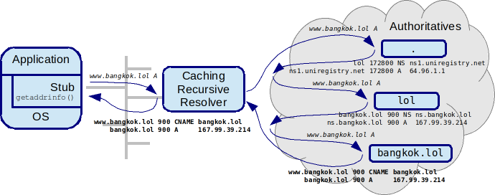
Domain Name System - scale

Slide 15
Domain Name System - scale
UDP = No State on authoritatives
Caching Recursive Resolvers:
  Reduce load to authoritatives
  Reduce latency to stub

Slide 16

Lab time!
Hands on: http://bangkok.lol/
1. Setup a Caching
Recursive Resolver
Photo by Alex Kondratiev on Unsplash

