Slide 1


ยินดีต้อนรับสู่
Cyber Security Workshop
DNS Vulnerabilities
Bangkok
8-9 May 2019

Slide 2
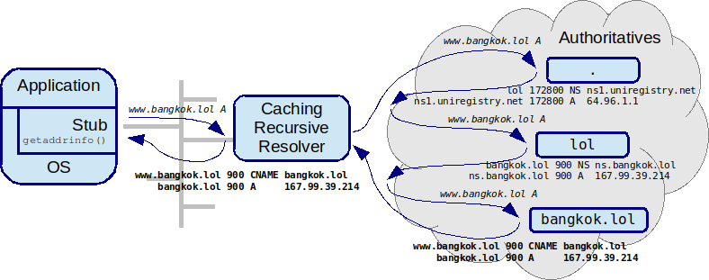

Domain Name System - security
Random bits (65.536 query ID * source ports) &
Caching as security mechanism
DNS Security Extensions (DNSSEC)
1997 (RFC 2065) … 2008 (RFC 5155)
www.bangkok.lol 666666 A 1.6.6.6

Slide 3

Domain Name System - security
TTL saves you?!?
I don’t think so...
Random bits (65.536 query ID * 64.512 source ports) & Caching als security mechanisme
DNS Security Extensions (DNSSEC)
1997 (RFC 2065) … 2008 (RFC 5155)
Security Popstar
www.bangkok.lol 666666 A 1.6.6.6

Slide 4
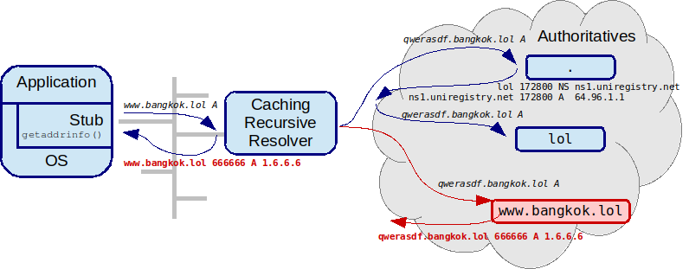
Domain Name System - security
qwerasdf.bangkok.lol A
bangkok.lol 666666 NS www.bangkok.lol
www.bangkok.lol 666666 A 1.6.6.6

Slide 5
Domain Name System - security
# Bits | 50% chance | 5% chance | Method
16 | 10 seconds | 1 second | Query ID
26 | 2.8 hours | 17 minute | 1024 source ports
34 | 28 days | 2.8 days | All source ports + 2 bits server selection
44 | 288444 days | 2844.4 days | 0x20 hack

Slide 6

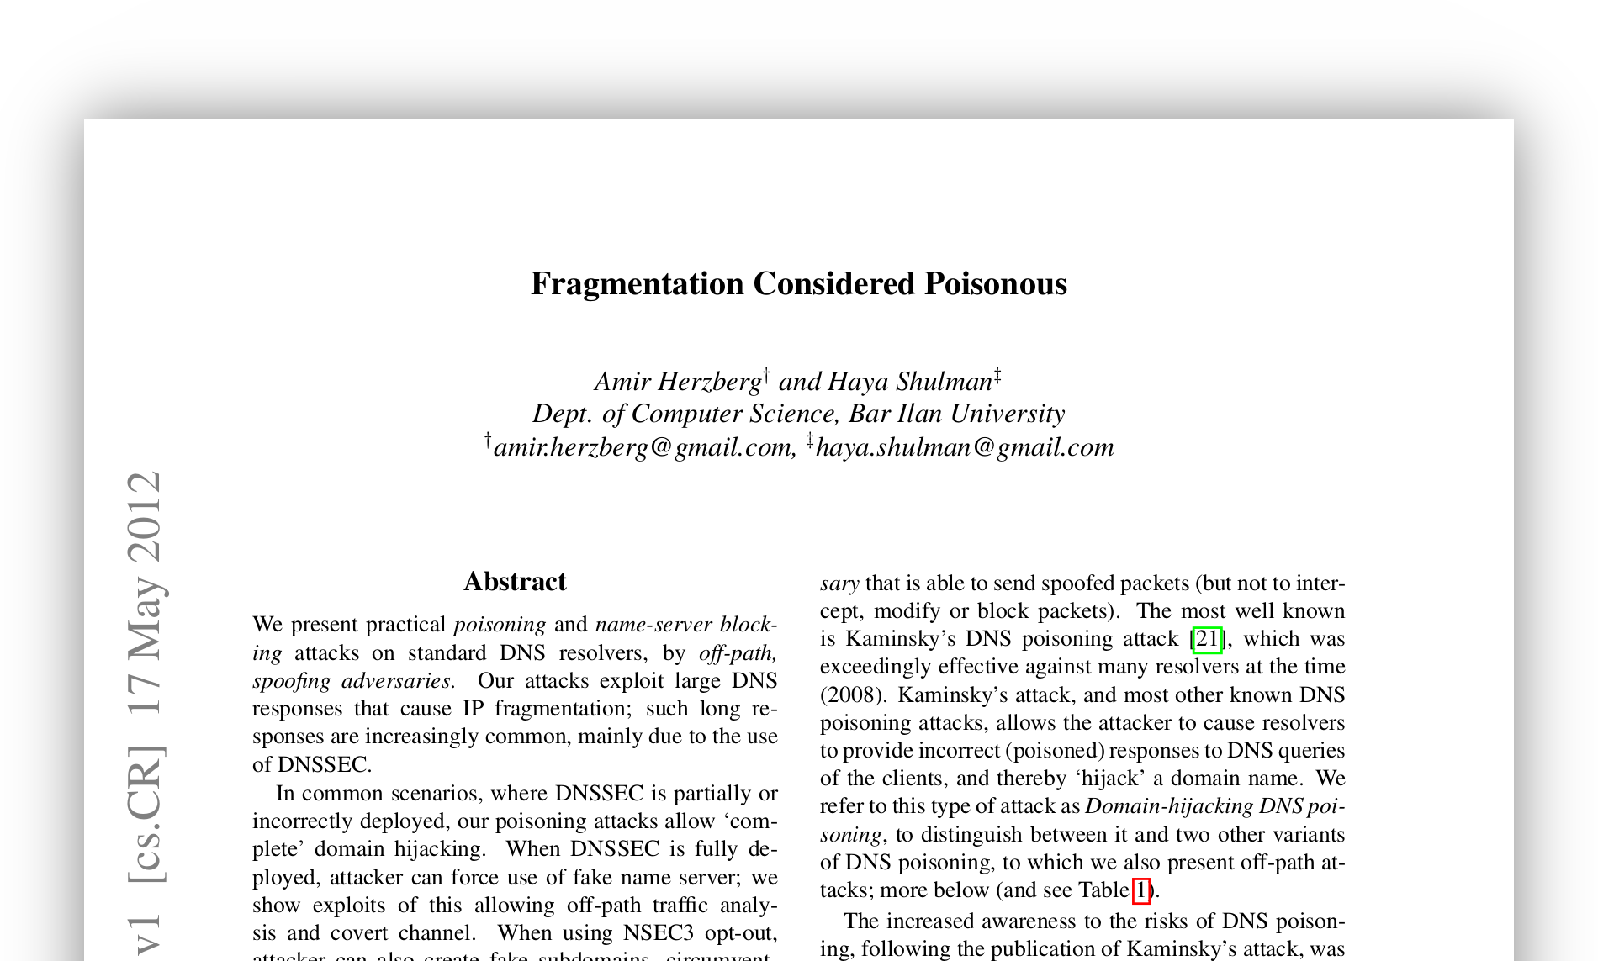
Domain Name System - security
Help with spoofing DNS responses
Security Rockstar

Slide 7
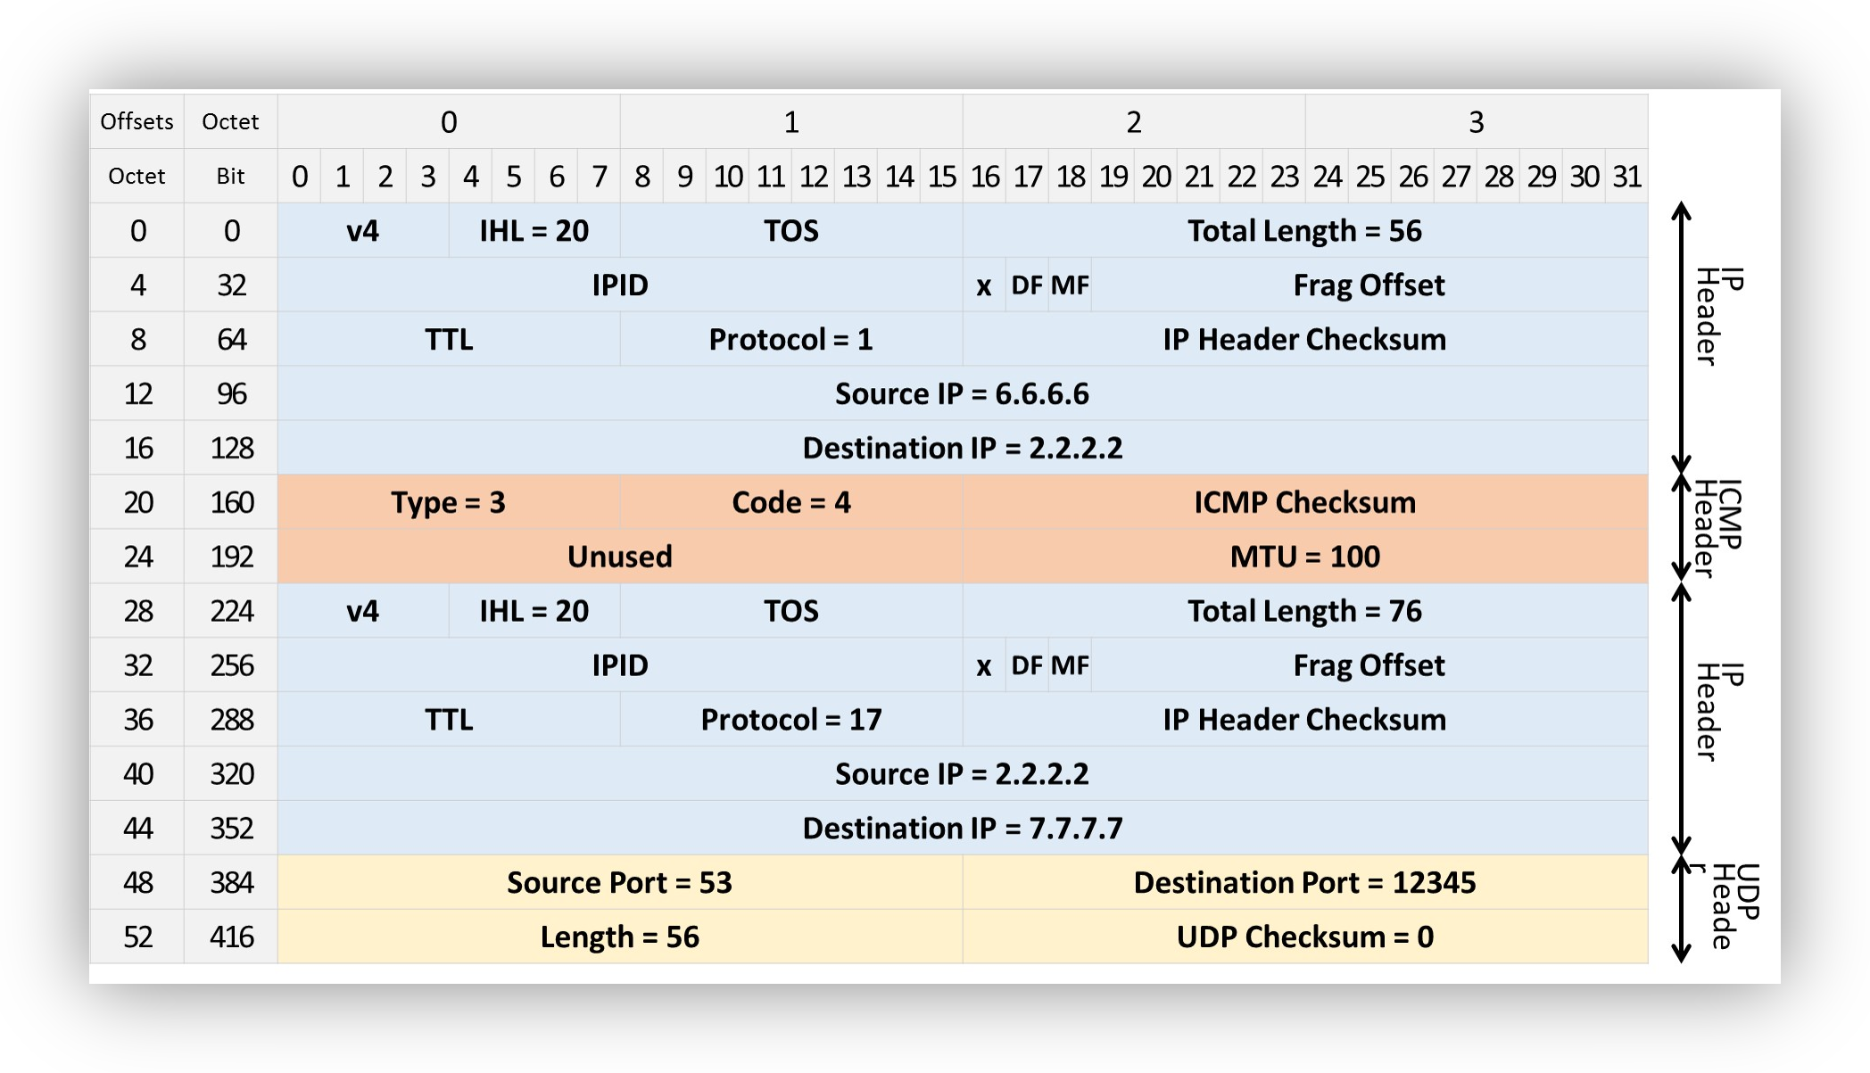
Domain Name System - security
Help with spoofing DNS responses
attacker ICMP frag needed→ authoritative
Security Rockstar

Slide 8
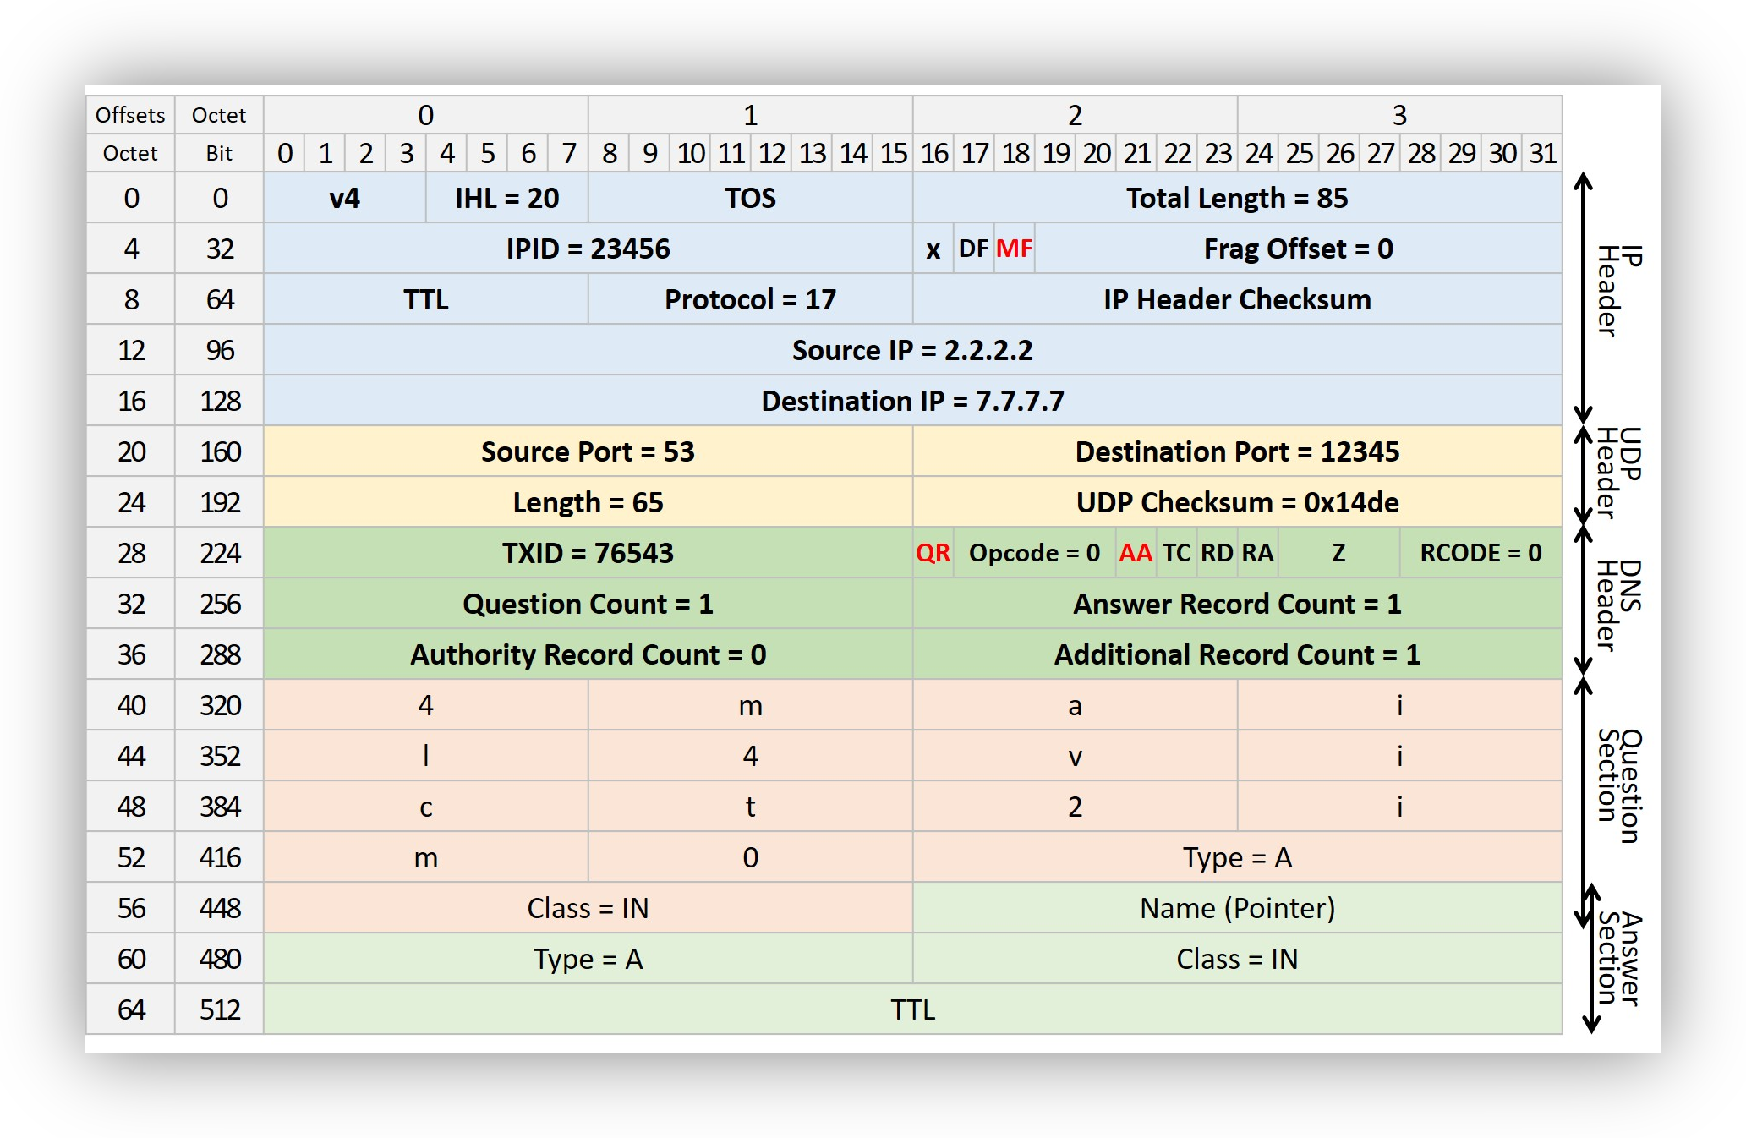
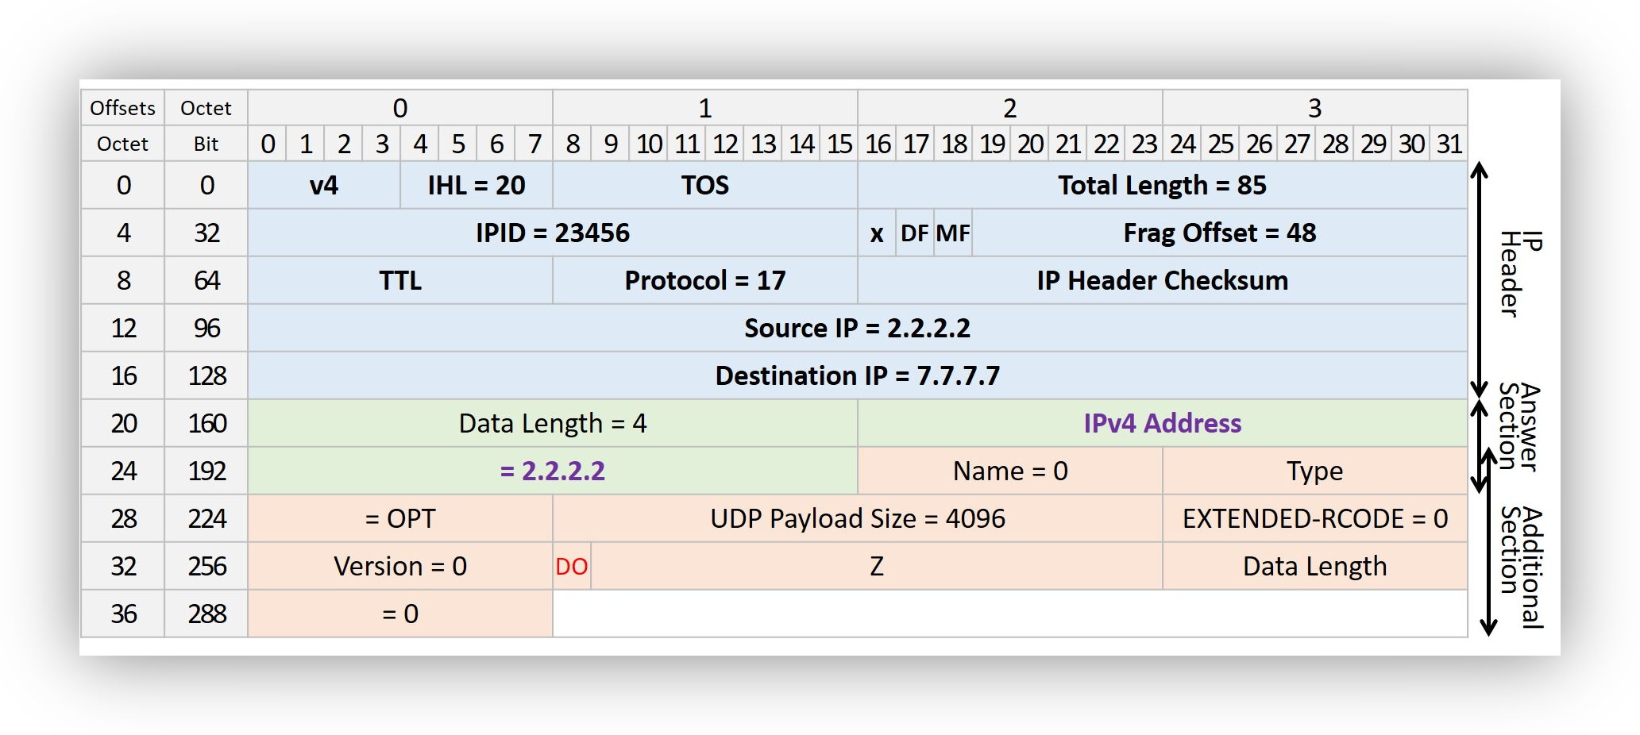
Domain Name System - security
Help with spoofing DNS responses
1e fragment
authoritative → resolver
^{2e} fragment
attacker → resolver
Security Rockstar

Slide 9
Domain Name System - security
bits | 50% chance | 5% chance | Method
16 | 10 seconds | 1 seconde | Query ID
26 | 2,8 uur | 17 minutes | 1024 source ports
2 | 0 seconds | 0 seconds | All source ports 2 bits server selection
44 | 288444 days | 2844.4 days | 0x20 hack
5 | 0 seconds | 0 seconds | IP ID

Slide 10
Domain Name System - security
bits | 50% chance | 5% chance | Method
16 | 10 seconds | 1 seconde | Query ID
26 | 2,8 uur | 17 minutes | 1024 source ports
2 | 0 seconds | 0 seconds | All source ports 2 bits server selection
44 | 288444 days | 2844.4 days | 0x20 hack
5 | 0 seconds | 0 seconds | IP ID
69 | 2,928,370,544 year | 292,837,054 year | IPv6 /64 source address

Slide 11
Domain Name System - security
It’s not just spoofing
Spoofing& MITM
Server
Vulnerability
Spoofing & MITM
Server vulnerabilities

Slide 12

DNS Security Extensions (DNSSEC)
end-to-end security on top of DNS
Metaphor

Slide 13
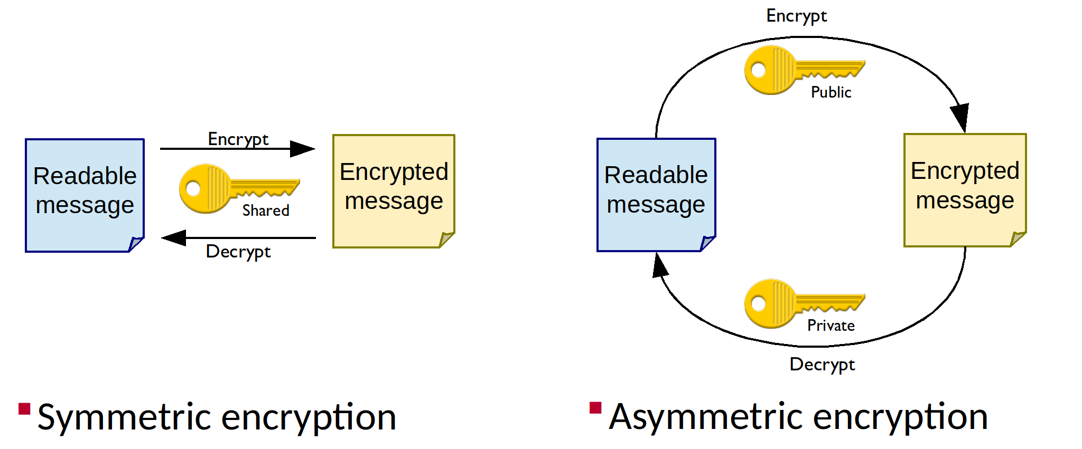
DNS Security Extensions (DNSSEC)
Refresher Public Key Crypto

Slide 14
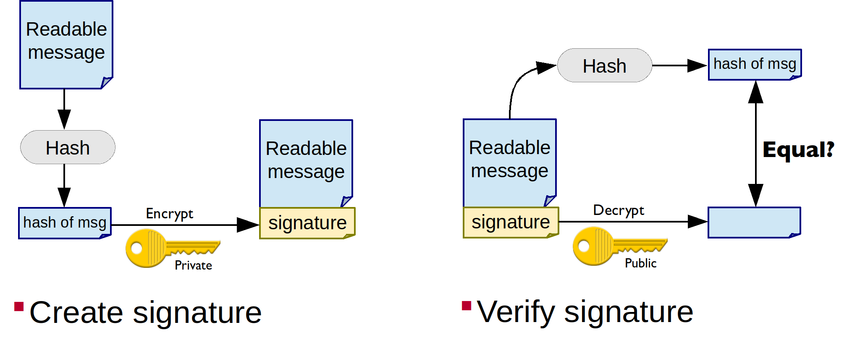
DNS Security Extensions (DNSSEC)
Public Key Crypto – Signing

Slide 15
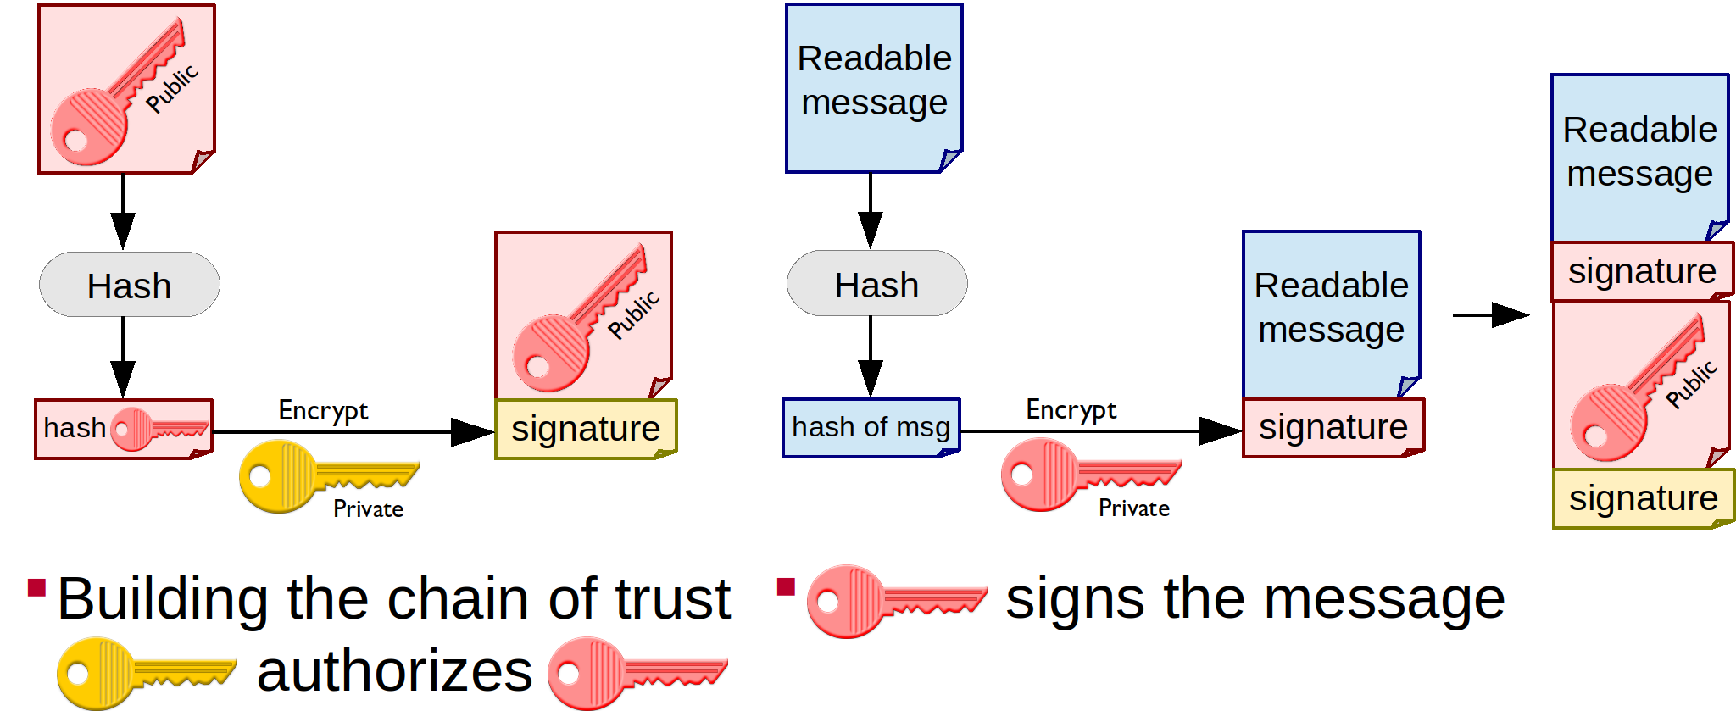
DNS Security Extensions (DNSSEC)
Public Key Crypto – Delegating Authority

Slide 16
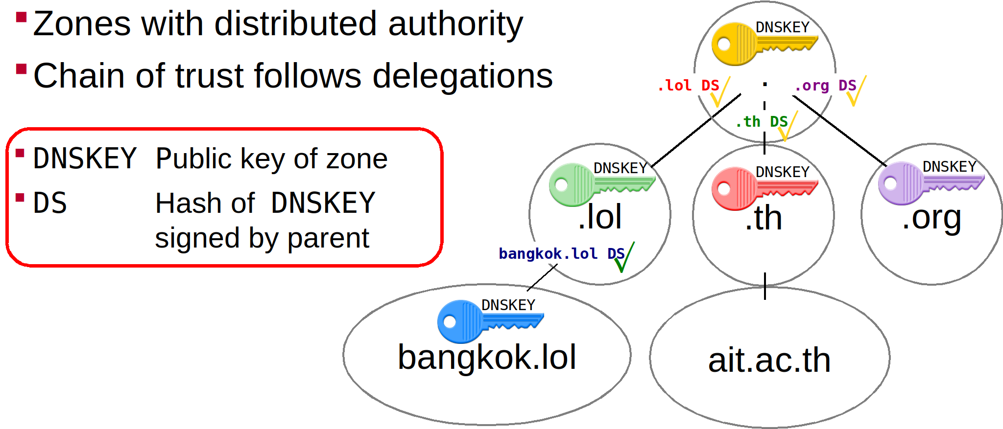
DNS Security Extensions (DNSSEC)
Chain of Trust

Slide 17
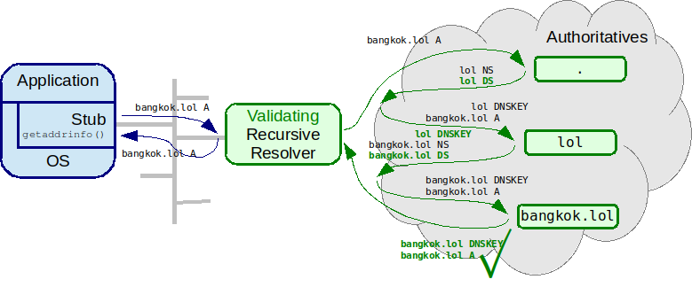
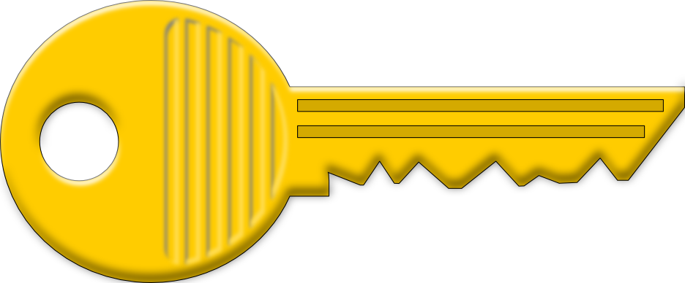
DNS Security Extensions (DNSSEC)
Validation
Server
Vulnerability
Spoofing & MITM

Slide 18
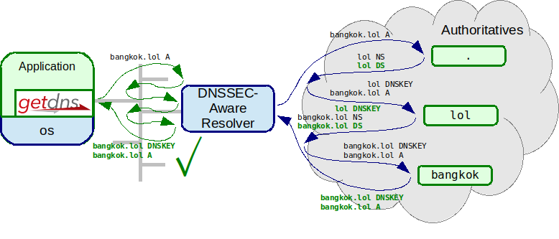
DNS Security Extensions (DNSSEC) end-to-end validation

Slide 19
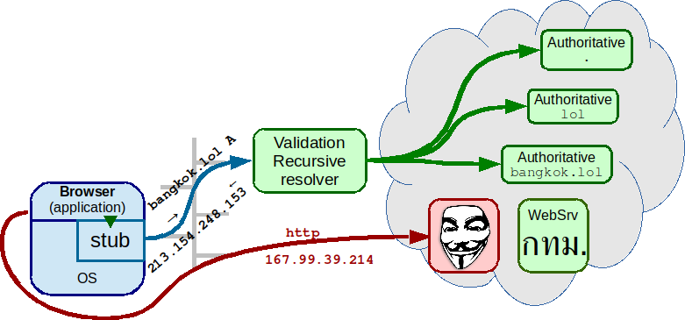
DNS Security Extensions (DNSSEC) does not protect against MITM

Slide 20
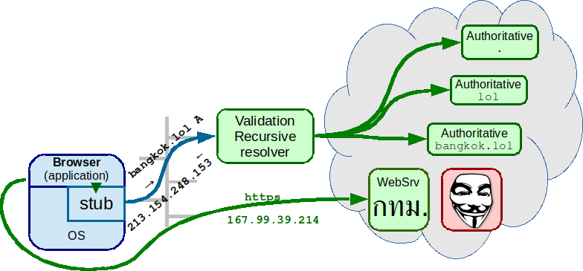
DNS Security Extensions (DNSSEC) does not protect against MITM – TLS does!

Slide 21
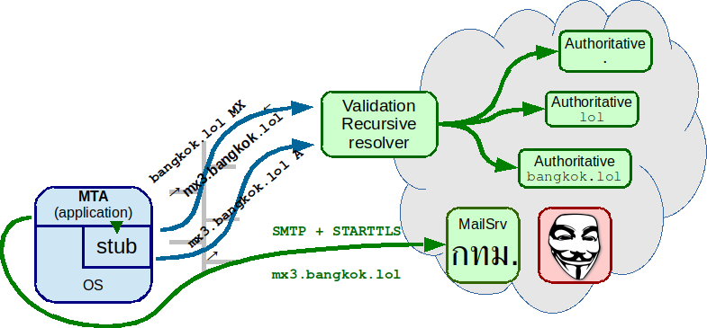
DNS Security Extensions (DNSSEC) still needed for referrals

Slide 22
DNSSEC for Applications voor TLS
Transport Layer Security (TLS) uses
both asymmetric and symmetric encryption
A symmetric key is sent encrypted with remote public key
How is the remote public key authenticated?

Slide 23
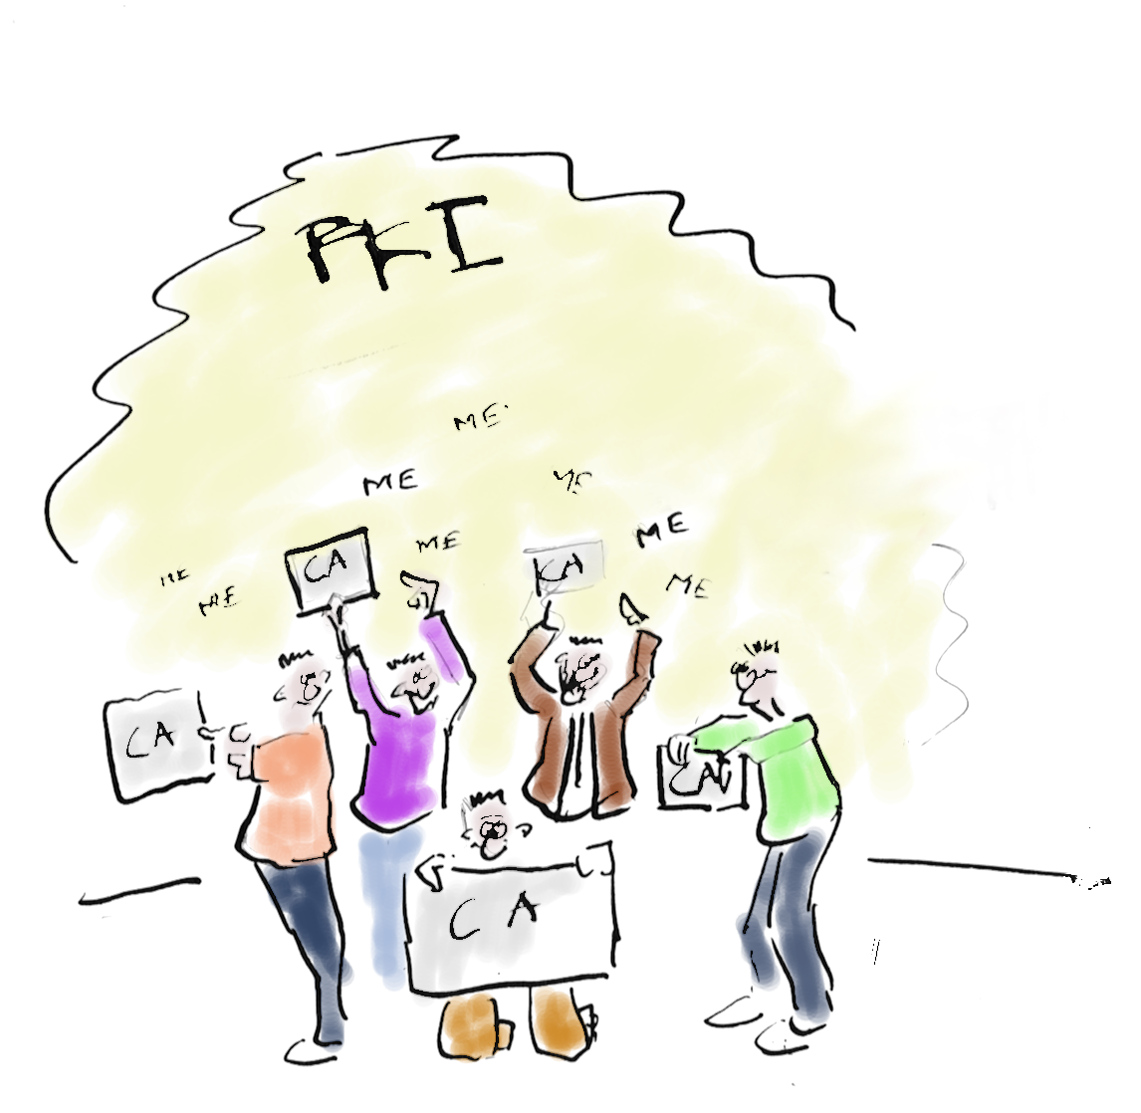
TLS without DNSSEC
By the Certificate Authorities
in OS and/or browser
Each CA is authorized to authenticate for any name
(weakest link problem)
There are more than 1500 CAs
(in 2010, see https://www.eff.org/observatory)
Cartoon by Kloot

Slide 24
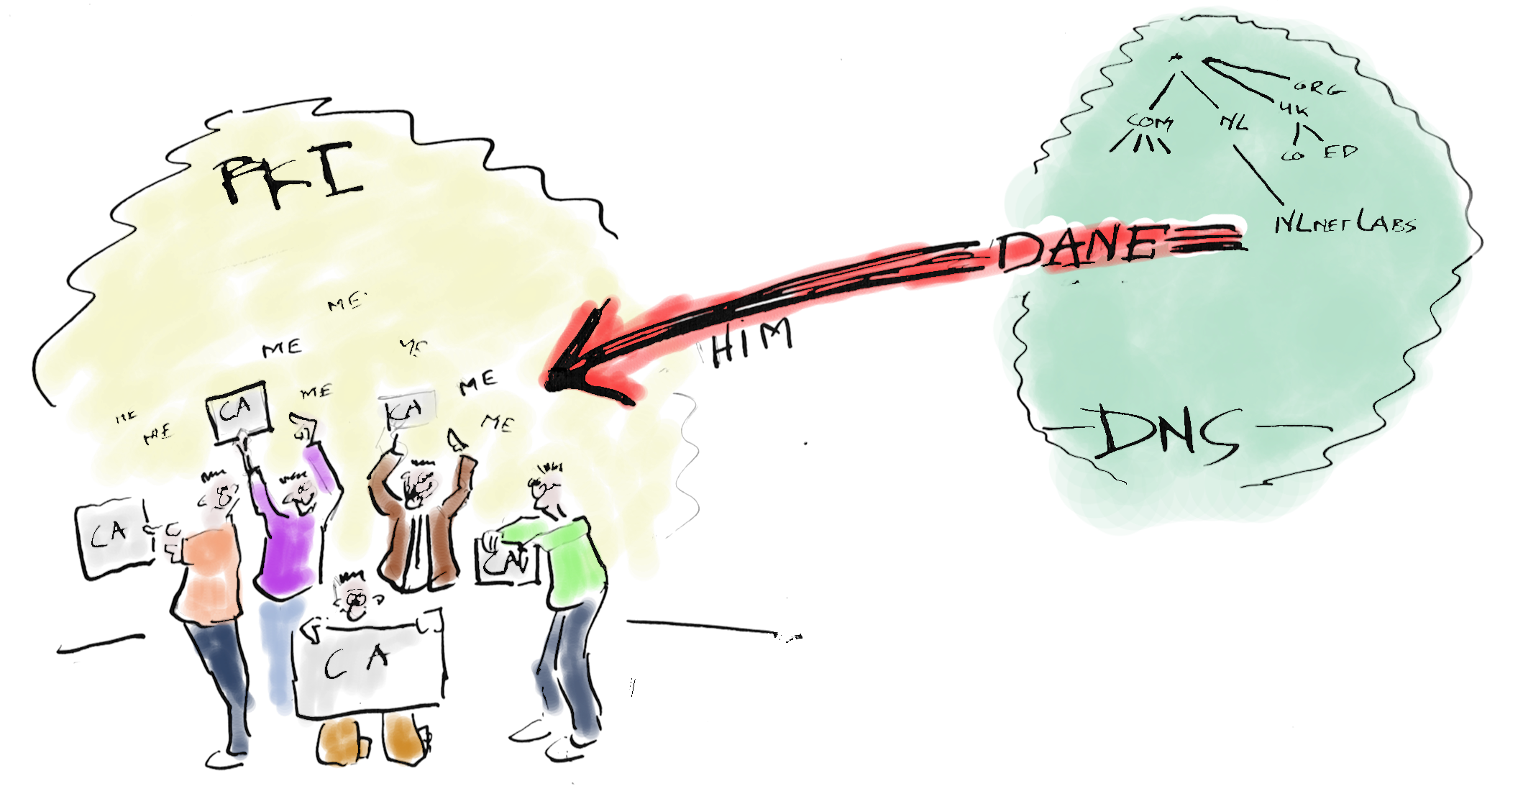
Enter DANE-TLS
DNS-based
Authentication of
Named
Entities (RFC 6698)
Cartoon by Kloot

Slide 25

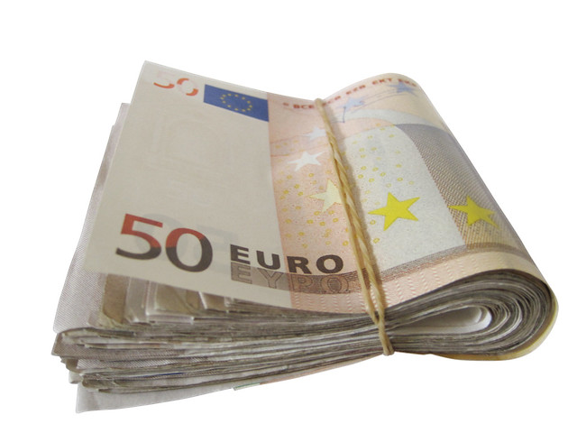
DNS Security Extensions (DNSSEC) consequence of UDP, worse with DNSSEC
BCP38?

Slide 26

Lab time!
Hands on: http://bangkok.lol/
5. Turning your recursive resolver
into a validating resolver
Photo by Alex Kondratiev on Unsplash

