Slide 1


ยินดีต้อนรับสู่
Cyber Security Workshop
DNS Resilience
Bangkok
8-9 May 2019
The material in these slides is based on Karst Koymans’ CIA
course material, see: https://www.os3.nl/2020-2021/courses/cia/start

Slide 2
Required!
RFC2182:
  “The DNS requires that multiple servers exist
  for every zone”
Why?
  Resilience
  Spread the Load
How?

Slide 3
Zone transfers
Pull
  When Secondary starts without data
  Query Type AXFR (Authoritative Transfer)
Primary
ns.bangkok.lol.
Secondary
ns.nlnetlabs.nl.
bangkok.lol. AXFR
ns AAAA 2001:
ns A 167.99.3
www CNAME @
@ SOA ns.bangk
@ SOA ns.bangk
@ NS ns.bangk
ns.nlnet
@ A 167.99.3

Slide 4
Zone transfers
Pull
  When data changed
    Slave checks after SOA refresh time
  Query Type IXFR (Incremental Transfer)
    Include known SOA in authority section
Primary
ns.bangkok.lol.
Secondary
ns.nlnetlabs.nl.
bangkok.lol. IXFR
bangkok.lol. SOA ...
Deleted and
Added RRs
Since SOA
Serial

Slide 5
Zone transfers
Push
  Special opcode (4) NOTIFY
Slave behaves as if SOA refresh timed out
Primary
ns.bangkok.lol.
Secondary
ns.nlnetlabs.nl.
opcode: NOTIFY
bangkok.lol IN SOA

Slide 6
Zone transfers
Zone transfers are often limited to slave servers
  DNS data: public or semipublic?
  IP level ACL… safe enough?
bangkok.lol.
@ SOA ns.bangk
@ NS ns.bangk
ns.nlnet
@ A 167.99.3
Primary
ns.bangkok.lol.
Secondary
ns.nlnetlabs.nl.

Slide 7
Zone transfers
Zone transfers are often limited to secondaries
  DNS data: public or semipublic?
  IP level ACL… safe enough?
Server
Vulnerability
Server
Vulnerability
Address
Hijacking & MITM
Address
Hijacking & MITM
bangkok.lol.
@ SOA ns.bangk
@ NS ns.bangk
ns.nlnet
@ A 167.99.3
Primary
ns.bangkok.lol.
Secondary
ns.nlnetlabs.nl.

Slide 8
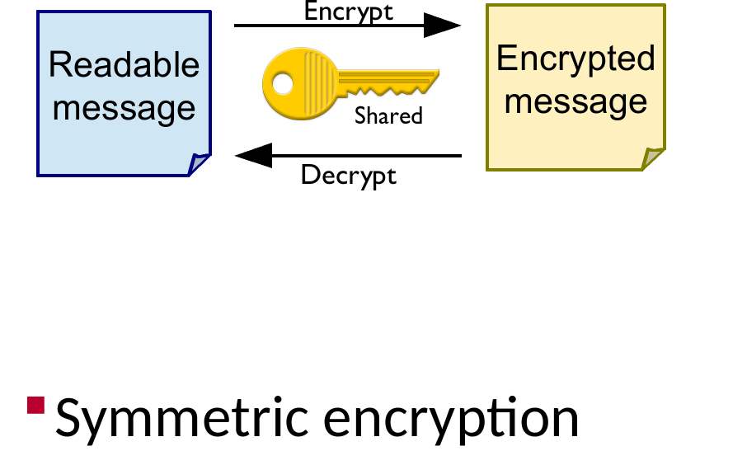
Transaction Signature: TSIG
TSIG (RFC2845)
Shared secret

Slide 9
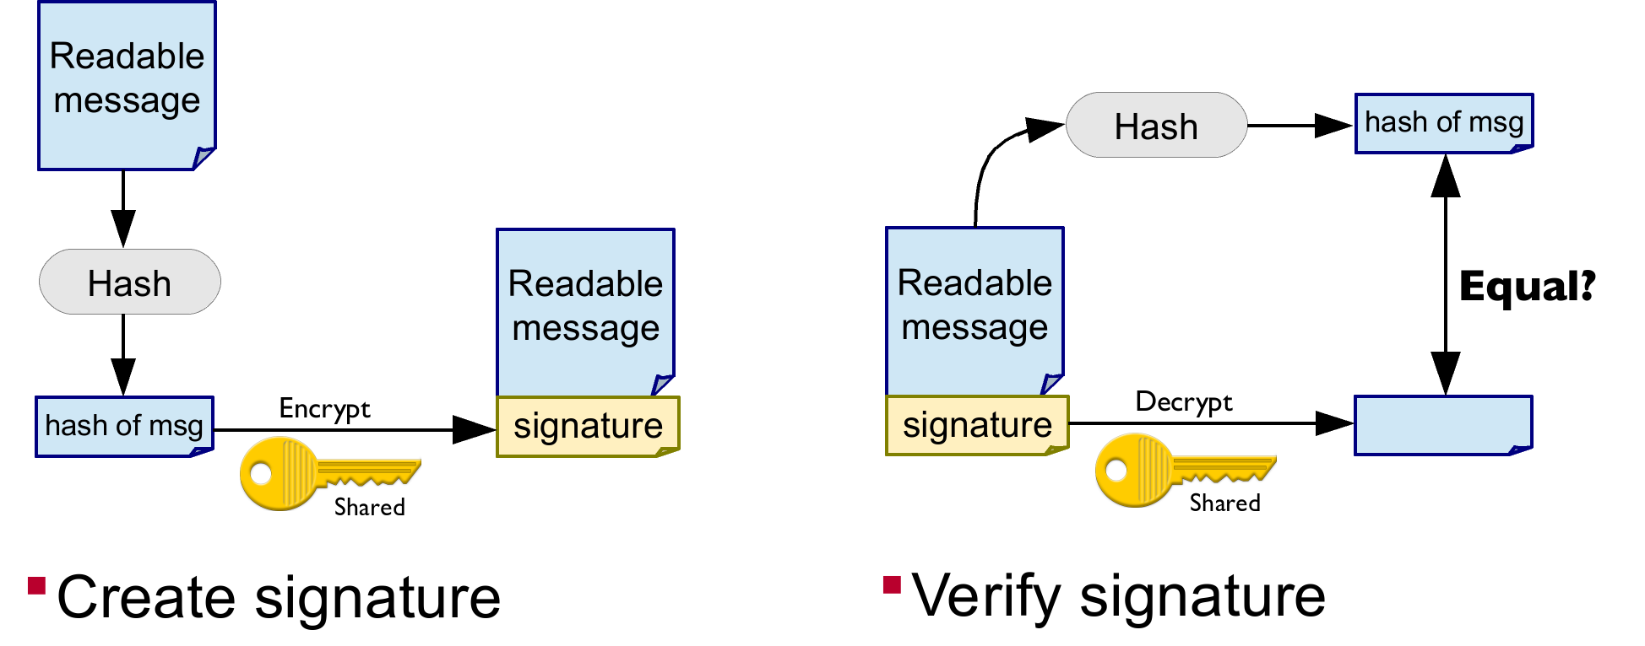
Transaction security with TSIG
Hash based Message Authentication Code (HMAC)

Slide 10
Transaction security with TSIG
TSIG (RFC2845)
Shared secret
  Communicated out of band
  Secret in configuration, NOT in zone data!
Hash based Message Authentication Code (HMAC)
  Provides mutual Authenticity & Integrity
  Does not provide confidentiality

Slide 11

Lab time!
Hands on: http://bangkok.lol/
4. Setup a redundant
authoritative name server
for your domain
Photo by Alex Kondratiev on Unsplash

