Slide 1

ยินดีต้อนรับสู่
Cyber Security Workshop
OpenDNSSEC
Bangkok
8-9 May 2019
The material in these slides is based on
OpenDNSSEC course material from Berry van Halderen

Slide 2
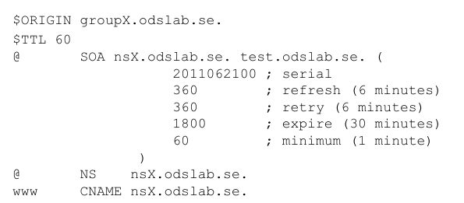
Unsigned zone file

Slide 3
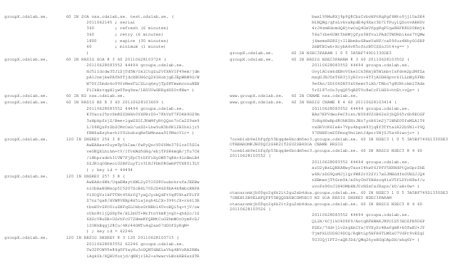
Signed zone file

Slide 4
DNSSEC extra requirements
Procedure to make changes to key infrastructure
Add, remove, swap key usage
Signatures expire, and need refreshing

Slide 5
DNSSEC extra status
Insecure
Secure
BOGUS
...

Slide 6
A whole new dimension
Signatures expire !
Past: Goofing up -> your slaves would keep you up
DNSSEC: not doing in means going out of existence
Past: static
DNSSEC: constant maintaining the zone.

Slide 7
OpenDNSSEC

Slide 8
OpenDNSSEC Whay, Why, Who
OpenDNSSEC is a zone signer that automates the process of keeping trackof DNSSEC keys and the signing of zones
Many DNSSEC Tools missing
  key management
  policy handling
  hardware acceleration
DNSSEC should be easy to deploy
Increase DNSSEC users and add experience from previous deployments

Slide 9

OpenDNSSEC - Who

Slide 10
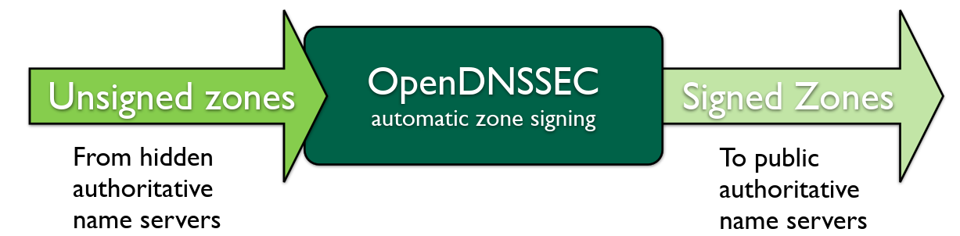
OpenDNSSEC goals
Open Source software with BSD license
Simple to integrate into existing infrastructure
Key storage and hardware acceleration using PKCS#11
Anticipate OpenDNSSEC deployed between hidden and public master invisible as bump-in-the-wire.

Slide 11
Components of OpenDNSSEC
Key and Signing Policy (KASP)
Enforcer (handling policy, key handling)
Signing (signing the zone based on enforcer instructions)
HSM (hardware accelerated PKCS#11 crypto, or SoftHSM)

Slide 12
Key and Signing Policy (KASP)
How to sign a zone is described by a policy
Allows choice of key strengths, algorithm, key and signature lifetimes, NSEC/NSEC3, etc.
One policy per zone, or some zones sharing policies

Slide 13
Enforcer
Management of Keys (manages creation, disposal)
Keeps track of timing and key rolling
Select which keys need to sign
Handles changes in policy

Slide 14
Signer
Automatic signing of the zones
  can re-use signatures that are not too old
  can spread signature expiration over time (jitter)
Maintains NSEC/NSEC3 chain
Updates SOA serial number

Slide 15
Hardware Security Module
Performs actual crypto
Therefor keys only live inside HSM
Often security must, but also a good abstraction
Everything can be rebuild - except your keys

Slide 16
Input and Output adapters
Acts as nameserver
Both incoming and outgoing:
  AXFR
  IXFR
  Notify
Any nameserver can be used (BIND, NSD, ...))
Automation to reload zone

Slide 17
Configuration
And Parameters

Slide 18
Configuration of OpenDNSSEC
Very configurable
conf.xml -- used for overall configuration of the system
kasp.xml -- defines the various policies for signing zones
addns.xml -- defines In- and Output adapter parameters (e.g. TSIG).

Slide 19
Time definition in OpenDNSSEC
“P1M3DT1H30M10S”
P[n]Y[n]M[n]DT[n]H[n]M[n]S
Configuration of OpenDNSSEC about durations (periods) not absolute times.
No clue about Gregorian Calendar (P1Y == P365D)
Pitfall: P5M PT5M
A world of difference (actually 13391700s).
ISO8601

Slide 20
conf.xml
Configuration contains
RepositoryList (which HSMs)
Common
Enforcer
Signer
<Configuration>
<RepositoryList>
…
</RepositoryList>
<Common> … </Common>
<Enforcer> … </Enforcer>
<Signer> … </Signer>
</Configuration>

Slide 21
Repository List
Defines where private keys live
You need at least one but can have more (separate ZSK/KSK)
HSM interface available
Each private key repository is listed as an <repository> element
SoftHSM if you do not have the money
hardware
<RepositoryList>
<Repository name="SoftHSM">
<Module>/usr/lib/libsofthsm2.so</Module>
<TokenLabel>OpenDNSSEC</TokenLabel>
<PIN>1234</PIN>
<Repository>
<RepositoryList>

Slide 22
Sideline: SoftHSM
PKCS#11 is the industry API to HSMs;
Private keys are assumed to be stored in HSM;
The SoftHSM is distributed separately and independently from OpenDNSSEC (but in co-operation);
for those who do not have HSM (most users);
HSMs can be tricky, read documentation about capacity, backups, sessions;

Slide 23
Hands-on
Part 7: SoftHSM
http://bangkok.lol/

