Slide 1

ยินดีต้อนรับสู่
Cyber Security Workshop
OpenDNSSEC
part 2
Bangkok
8-9 May 2019
The material in these slides is based on
OpenDNSSEC course material from Berry van Halderen

Slide 2
conf.xml
Configuration contains
RepositoryList (which HSMs)
Common
Enforcer
Signer
<Configuration>
<RepositoryList>
…
</RepositoryList>
<Common> … </Common>
<Enforcer> … </Enforcer>
<Signer> … </Signer>
</Configuration>

Slide 3
Repository List
Defines where private keys live
You need at least one but can have more (separate ZSK/KSK)
HSM interface available
Each private key repository is listed as an <repository> element
SoftHSM if you do not have the money
hardware
<RepositoryList>
<Repository name="SoftHSM">
<Module>/usr/lib/libsofthsm2.so</Module>
<TokenLabel>OpenDNSSEC</TokenLabel>
<PIN>1234</PIN>
<Repository>
<RepositoryList>

Slide 4
Having multiple Repositories
Off-line KSK when not needed
Place signing of keyset (using KSK)
And regular zone signing (ZSK) in different locations
Long validity period signatures keyset
Zone needs updating -> short period remainder

Slide 5
Choice of algorithm
Crypto improves over time
also matter of preference
RSAMD5, DSA, RSASHA1, DSA-NSEC3-SHA1,.. -- legacy
RSASHA256 -- the current
RSASHA512 -- future?
ECC-GOST -- Russia?
ECDSAP256SHA256, ECDSAP384SHA384 -- upcoming
ED25519,ED448 – emerging

Slide 6
Key rollover
Crypto improves over time
Keys may still be stolen
When to roll over
Crypto works better when rolling keys
When keys stolen or better crypto
Just as a procedure regulary

Slide 7
Key states
TTL of data in DNS caches need to be taken into account.
Why?
Other propagation delays and timings.

Slide 8
Key states
Generate
Publish
Ready
Active
Retired
Revoked

Slide 9
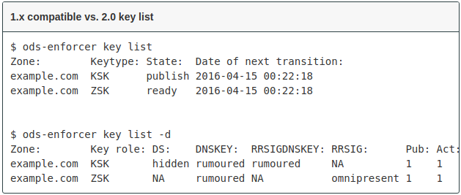
Key Rollover methods
Know the state of your keys and signatures
Hidden
Rumoured
Omnipresent
Retentive

Slide 10
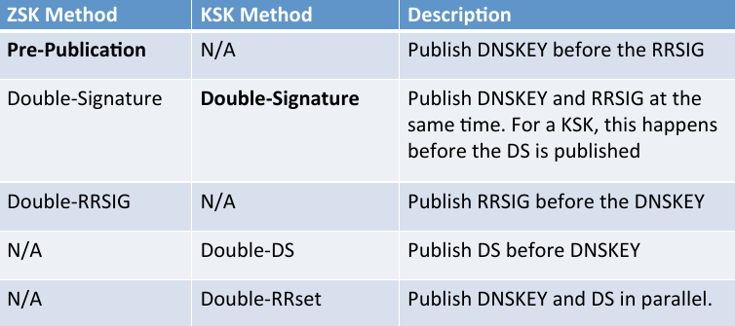
Rollover methods

Slide 11
Hands-on
Part 8: Using OpenDNSSEC
http://bangkok.lol/

Slide 12
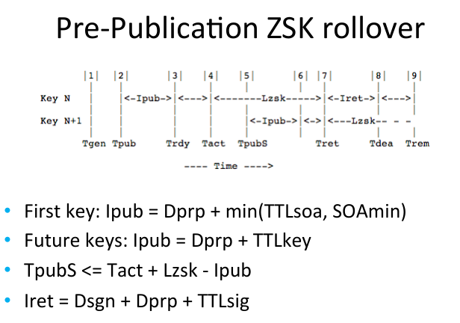

Slide 13
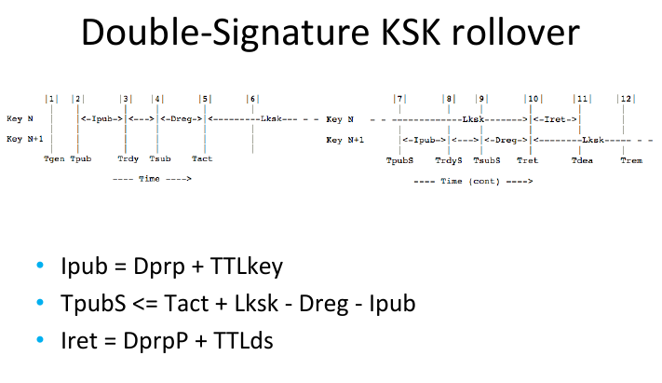

Slide 14
Configration conf.xml highlights
Enforcer/Datastore
Enforcer/ManualKeyGeneration
Enforcer/AutomaticKeyGenerationPeriod
Enforcer/RolloverNotificationPeriod
Enforcer/DelegationSignerSubmitCommand
Signer/Threads
Signer/NotifyCommand

Slide 15
KASP
Values in default policies are sane starting values
Signatures/Resign
Signatures/Refresh
Signatures/Validity/Default
Signatures/Validity/Denial
Signatures/Jitter
Signatures/InceptionOffset
Signatures/MaxZoneTTL
Denial/NSEC3/OptOut
Denial/NSEC3/Resalt
Denial/NSEC3/Hash
Keys/TTL
Keys/RetireSafety
Keys/PublishSafety
Keys/Purge
Keys/KSK/Lifetime
Zone/PropagationDelay
Zone/SOA/TTL
Zone/SOA/Minimum
Zone/SOA/Serial
Zone/PropagationDelay
Zone/SOA/TTL
Zone/SOA/Minimum
Zone/SOA/Serial
Parent/PropagationDelay
Parent/DS/TTL
Parent/SOA/TTL
Parent/SOA/Minimum

Slide 16
SOA
Always have valid signatures in zone
Zone should expire before signatures expire
SOA Expire < signature refresh period
ods-kaspcheck

Slide 17
Rollover specials
Emergency roll-over (rollover when in rollover procedure)
Algorithm rollover
  Requires signatures to be published before DNSKEY

Slide 18
Features
Combined signing keys

Slide 19
Migrating
Exporting keys and importing them
Publish DNSKEY in old sign environment
Go insecure

Slide 20
Updating DS
Manually
Use delegationSignerSubmitCommand
Future CDS / CDNSKEY RFC7344
Never give ds-seen without verifying.

Slide 21
Monitoring
OpenDNSSEC, NSD, Bind, all are stable, but integration will break:
Signer up and running
Signature expiration nearing unexpectedly
Zone updates get through
Prepare for when things to wrong
Backup not just keys, also var/lib/opendnssec and kasp.conf

Slide 22
Recommendations
Roll KSK at least yearly (or not at all and prepare to go unsigned)
Roll ZSK every 3 months
SHA256, RSASHA256 not yet ECDSA
Key size 1024 / 2048
NSEC / NSEC3 ? OptOut when number of DS is low.

