Slide 1

Why radio?
Immediacy
Lack of infrastructure
Group communication
Notes:
3/9/2026
1
1

Slide 2
Why NOT radio?
Some radios “need” licensing
Range
Not secure (usually)
Can have ‘add on’ legal penalties
Notes:
3/9/2026
2
2

Slide 3
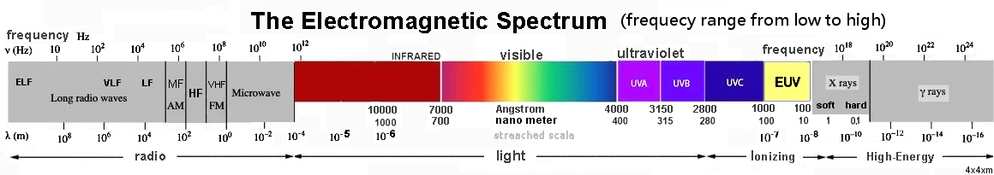
Radio Basics - EM Spectrum
Notes:
3/9/2026
3
3

Slide 4
Radio Basics - What is a radio wave?
Notes:
3/9/2026
4
4

Slide 5
Radio Basics - Frequency vs. Wavelength
Wavelength = speed of light divided by frequency
λ = c/f f = c/λ
Wavelength in meters
Frequency in MHz
Speed in MM/S (300)
Notes:
3/9/2026
5
5

Slide 6
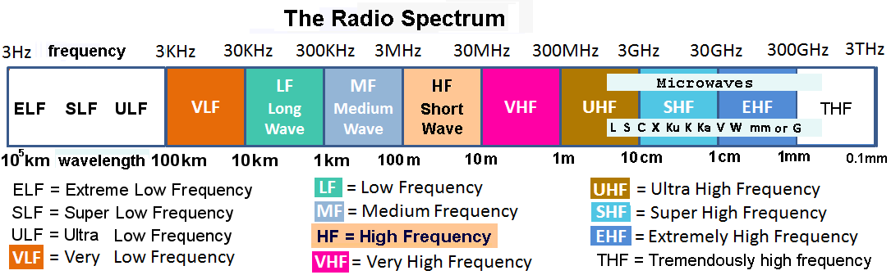
Radio Basics - Radio Spectrum (Bands)
Notes:
3/9/2026
6
6

Slide 7
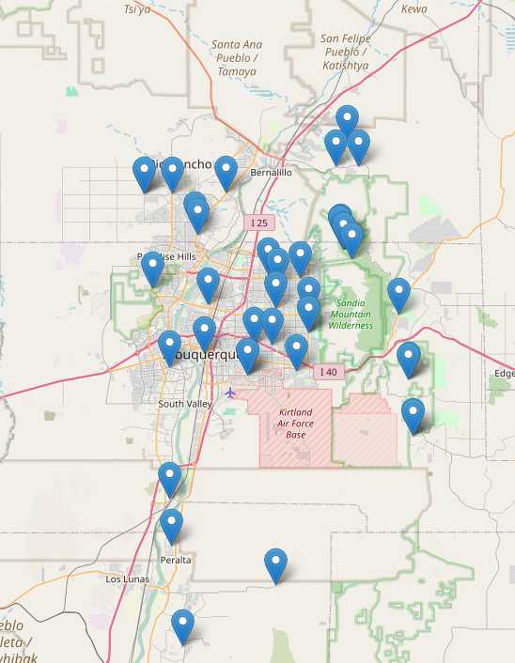
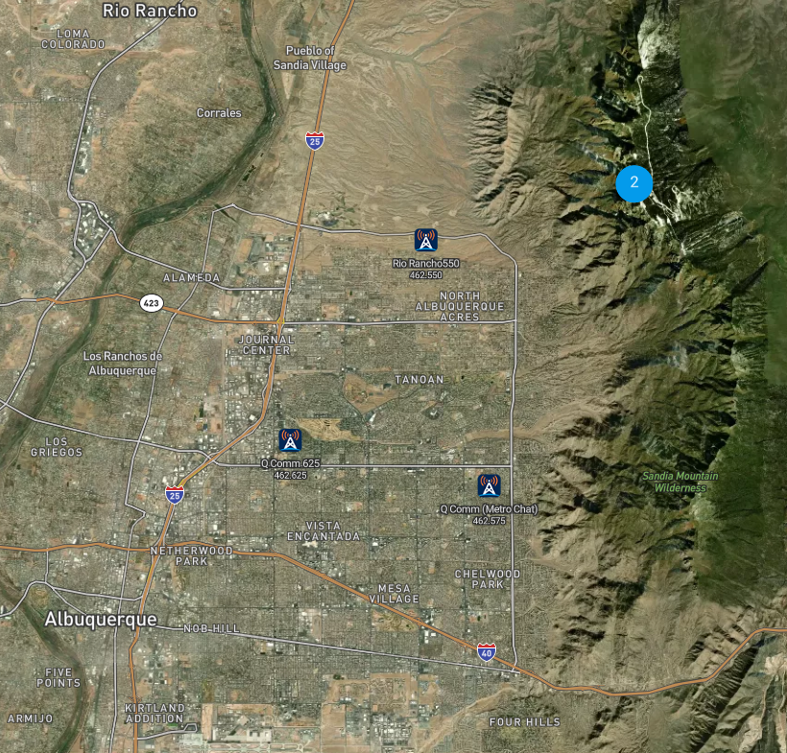
Repeaters
Notes:
3/9/2026
7
7

Slide 8
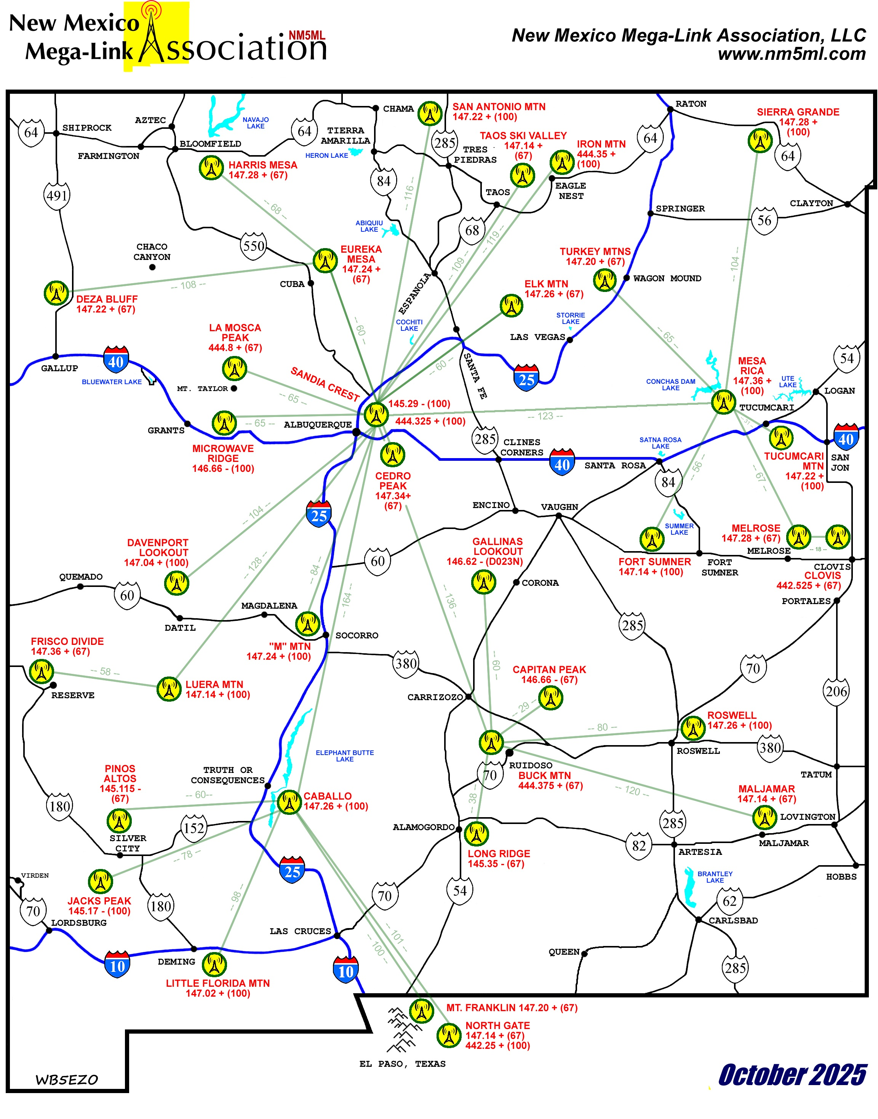
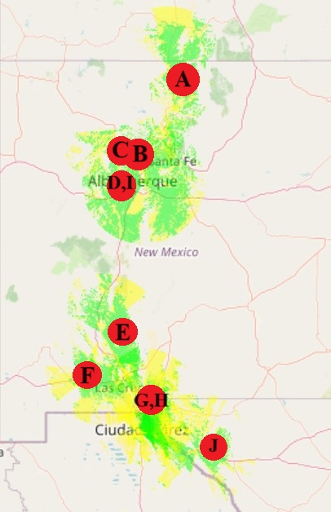
Repeaters
Notes:
3/9/2026
8
8

Slide 9
Cross-Band Repeat
“Poor man’s repeater”
Transmits on one band, repeats on the other
Can extend range
More private than a repeater
Notes:
3/9/2026
9
9

Slide 10
Radio Options
Ham
Needs license, with test
Ties real name and address to call sign
FRS
No license
Limited to ½ watt
GMRS
Needs license, no test
Ties real name and address to call sign
½ watt, 5 watt, and 50 watt limits
Notes:
3/9/2026
10
10

