Slide 1

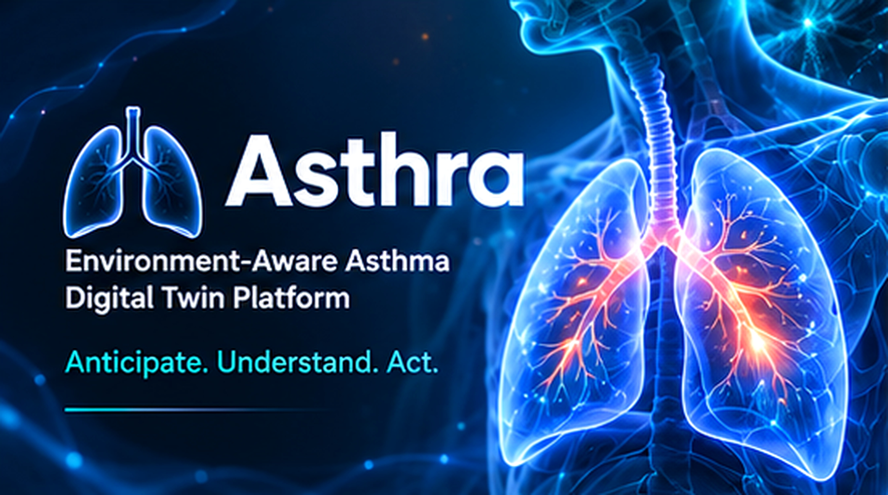
ENVIRONMENT-AWARE ASTHMA
Asthra
Digital Twin Platform
Anticipate. Understand. Act.
A personalized respiratory-health platform combining clinical history, sensor telemetry and environmental context.
CLINICAL DECISION-SUPPORT RESEARCH PROTOTYPE

Slide 2

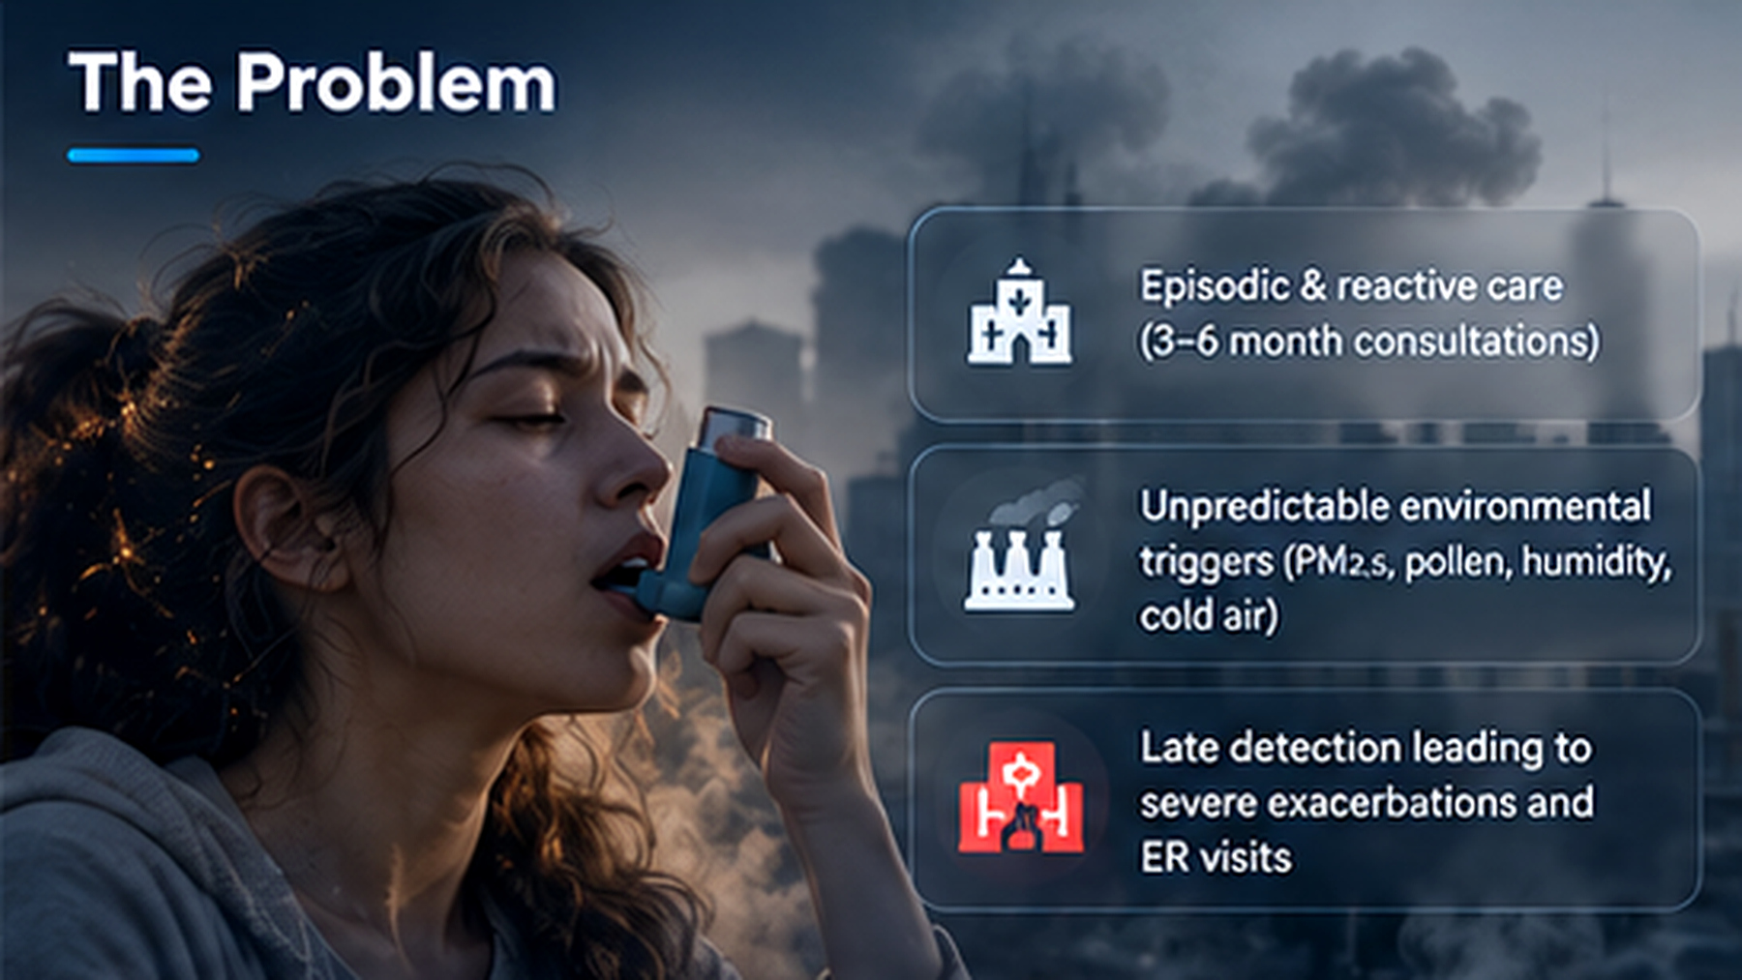




01 / THE CHALLENGE
Asthma care is often reactive
Routine consultations provide only periodic snapshots of a changing condition.
Triggers such as PM₂.₅, pollen, humidity and cold air can vary throughout the day.
Wearables and spirometers can generate data without enough personalized context.
Late recognition of deterioration may mean action begins after symptoms worsen.
Design goal: move from episodic observation toward earlier, contextual awareness.

Slide 3

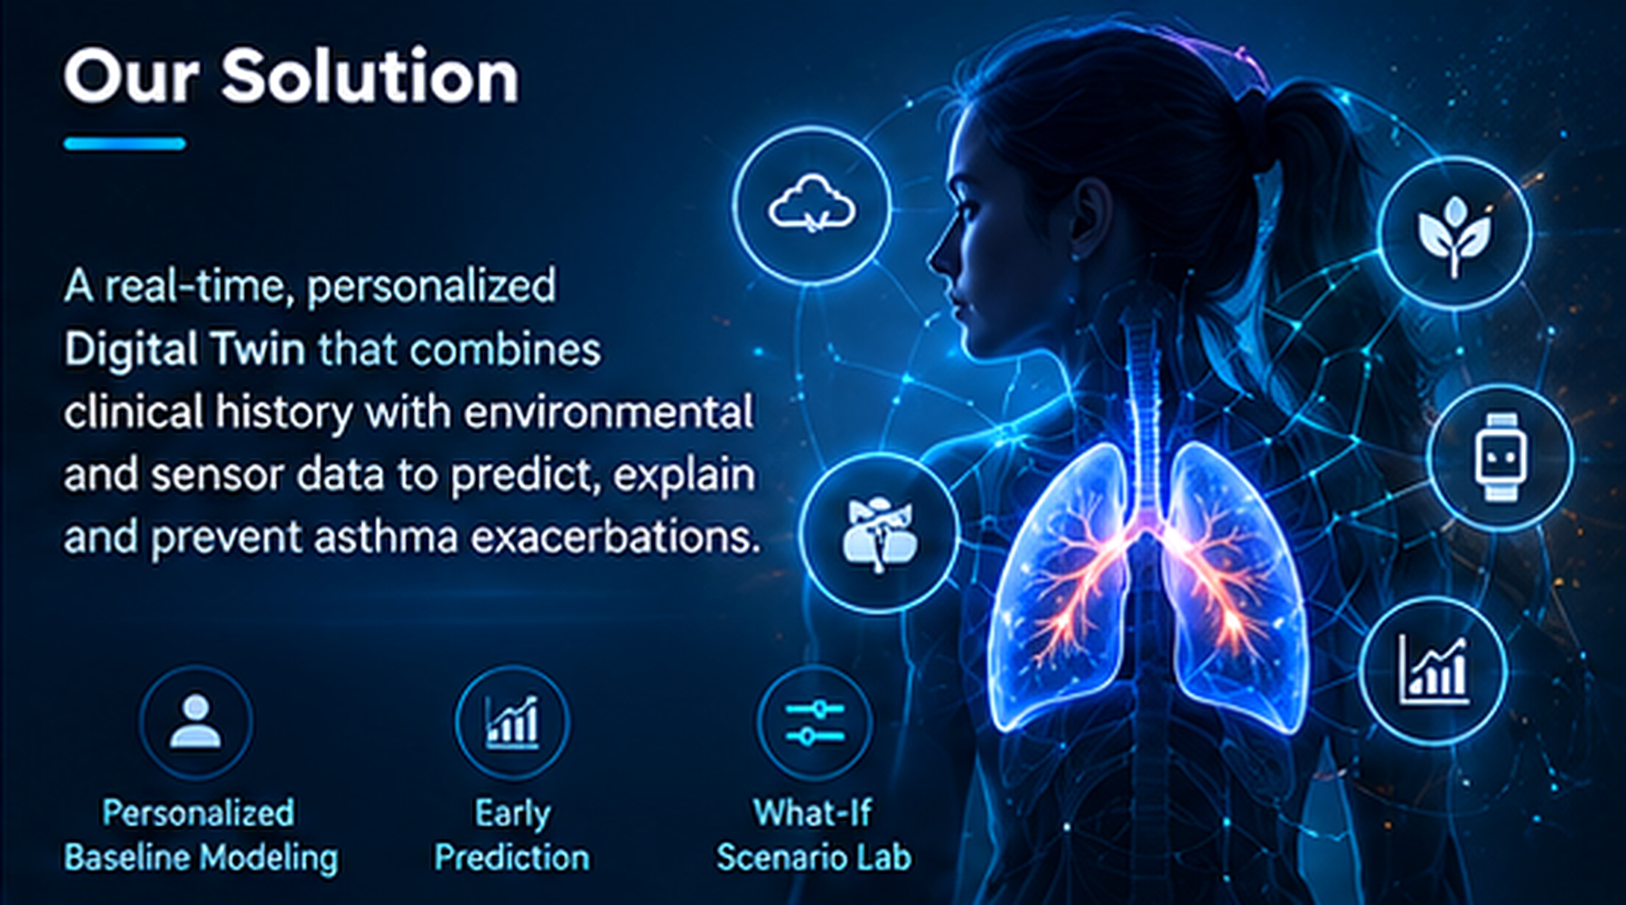



02 / THE SOLUTION
A personalized digital twin for respiratory health
Combines historical clinical context with continuous physiological and environmental observations.
Builds patient-specific baselines rather than relying only on population thresholds.
Estimates near-term deterioration risk and highlights potentially relevant contributors.
Lets clinicians explore hypothetical scenarios in an isolated simulation.
Asthra is a research prototype—not a replacement for clinical judgement or emergency care.

Slide 4

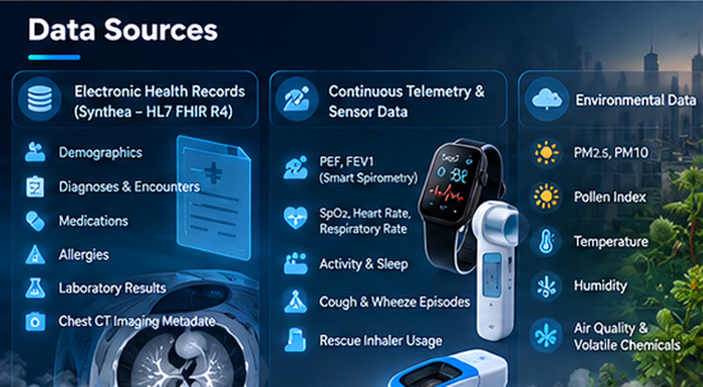

03 / INPUTS
Two data streams. One patient context.
HISTORICAL EHR
Synthetic Synthea records in HL7 FHIR R4 format
Diagnoses, encounters and medications
Allergies, laboratory results and CT metadata
CONTINUOUS TELEMETRY
PEF, FEV₁, SpO₂, pulse and respiratory rate
Cough/wheeze, activity, sleep and inhaler use
PM₂.₅, PM₁₀, pollen, temperature and humidity
The report describes a synthetic five-patient cohort; these are not real patient records.

Slide 5

04 / SYSTEM ARCHITECTURE
Asthra system architecture
EHR DATA
Synthetic Synthea records
HL7 FHIR R4
5. DASHBOARD
React UI • patient metrics • 2D/3D respiratory twin
1
2
INGEST
FHIR + telemetry normalization
VALIDATE
Range, freshness and quality checks
SENSOR TELEMETRY
PEF, FEV₁, SpO₂, pulse
Activity and sleep
6. WHAT-IF LAB
Isolated scenario simulation and comparison
3
4
ENVIRONMENT
PM₂.₅ / PM₁₀, pollen
Temperature, humidity
PERSONALIZE
Patient baseline and features
ANALYZE
Risk forecast + trigger associations
7. AUDIT & SAFEGUARDS
Data quality gates • prediction history • human review
Stack: React 19 + Vite • FastAPI • scikit-learn • Three.js • SQLite/SQLAlchemy

Slide 6

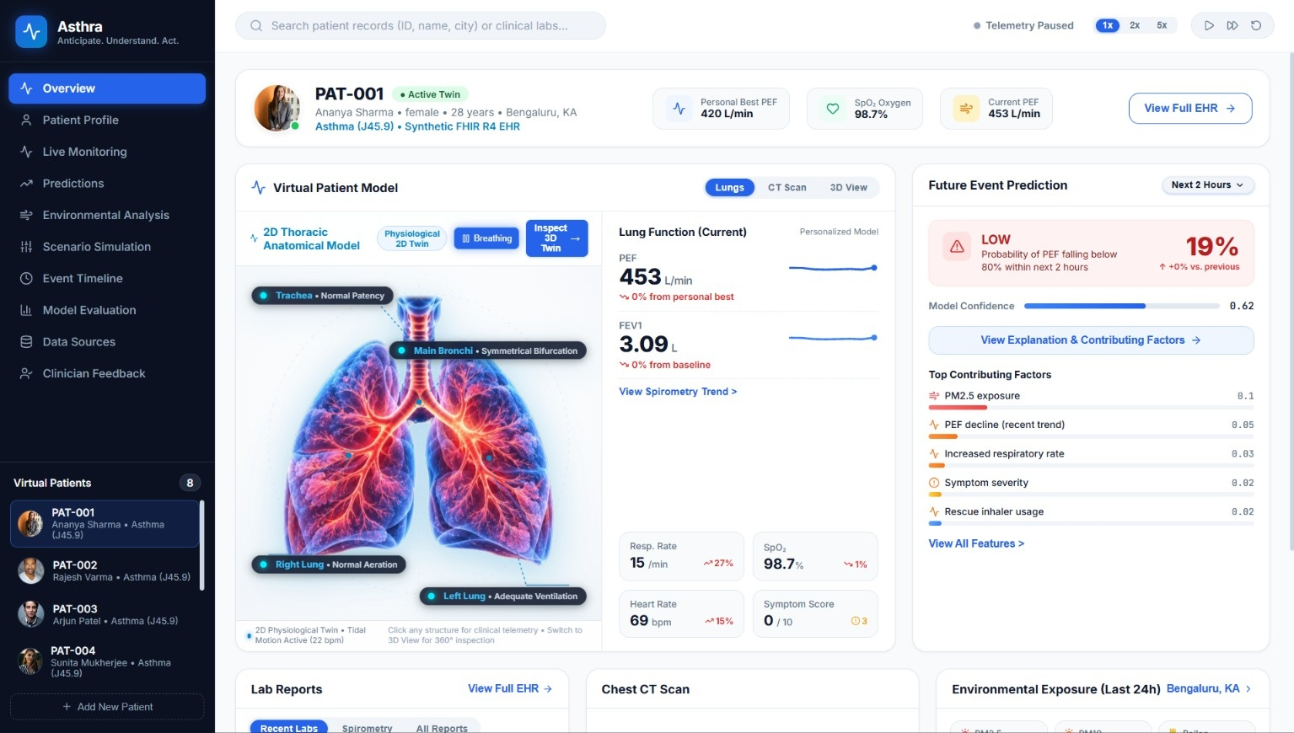



05 / VISUALIZATION
The living respiratory twin
2D physiological view: airway branches, breathing motion and constriction indicators.
3D WebGL model: interactive anatomy with rotation, zoom and view presets.
Vital cards: PEF, SpO₂, pulse and respiratory rate relative to the patient context.
Simulation controls advance, pause or reset the synthetic timeline.
Visual changes should reflect the selected synthetic twin state—not be treated as diagnostic imaging.

Slide 7

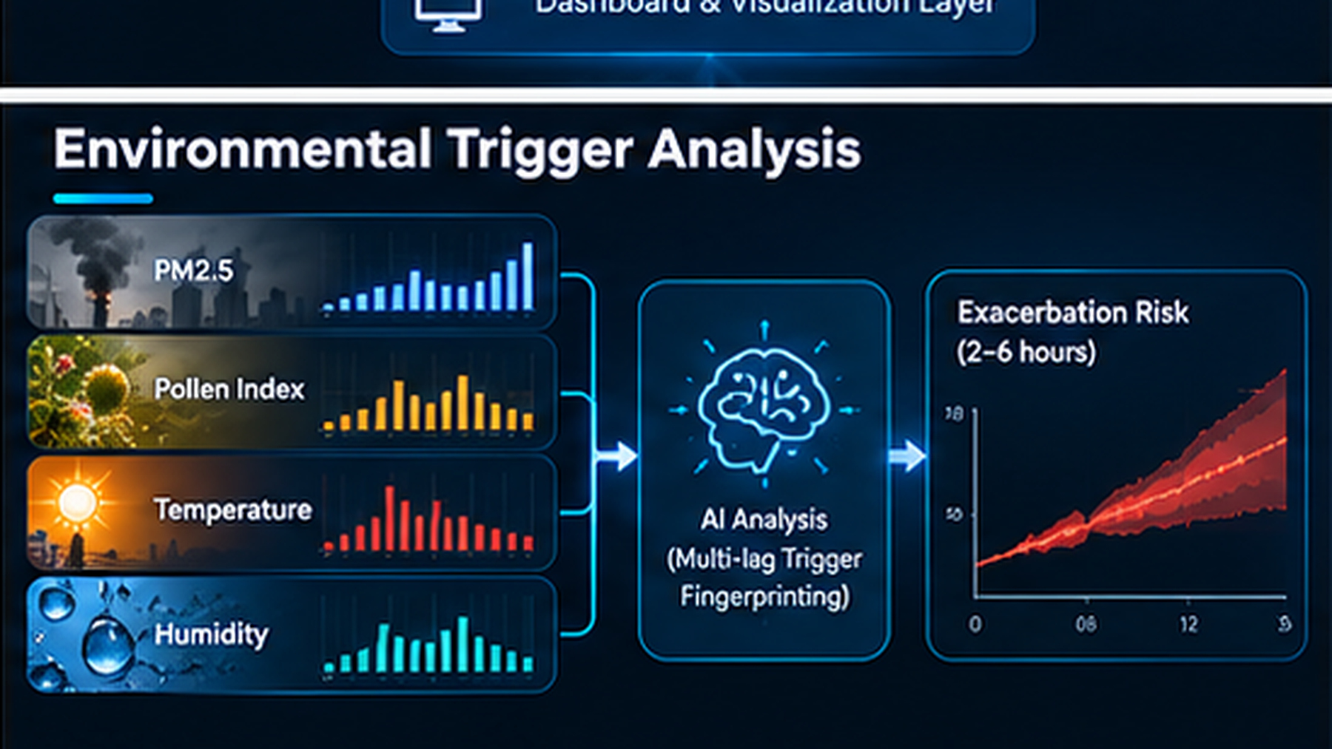



07 / ENVIRONMENTAL INTELLIGENCE
Environmental trigger analysis
Combine PM₂.₅, pollen, temperature and humidity observations with respiratory signals.
Compare configurable lag windows: 30 minutes, 1 hour, 2 hours and 6 hours.
Surface patient-specific associations to help investigate possible triggers.
Associations are exploratory; correlation alone does not establish causation.
Interpret results alongside data quality, timing and individual variability.

Slide 8

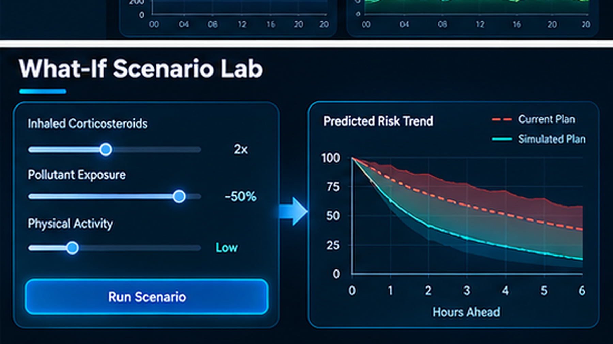



08 / WHAT-IF SCENARIO LAB
Explore scenarios without changing the live twin
Clone the selected synthetic patient state into an isolated simulation.
Vary exposure and other scenario assumptions to compare hypothetical trajectories.
Keep simulated outputs separate from observed patient data.
Scenario outputs are exploratory and are not medication instructions.
Use scenario comparisons to support discussion—not to replace clinical judgement.

Slide 9



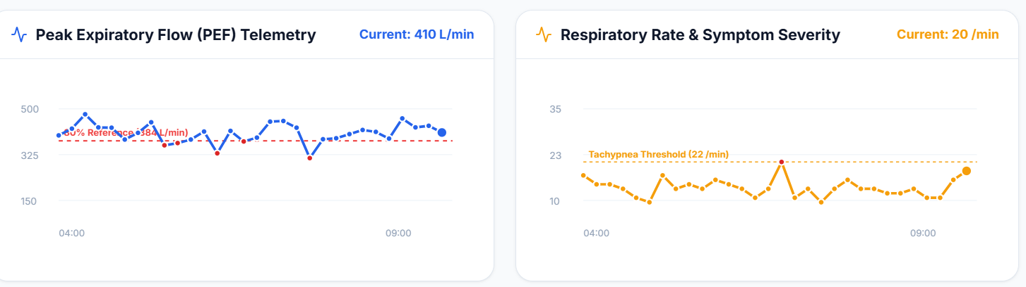
09 / RESPONSIBLE DEVELOPMENT
Evaluation, safeguards & next steps
TEMPORAL VALIDATION
MODEL METRICS
SAFE ABSTENTION
Use chronological train/test separation to reduce temporal leakage.
Review ROC-AUC, PR-AUC, calibration, sensitivity and specificity.
Reduce confidence or withhold predictions when data is stale or unreliable.
Next steps
Validate on independent, representative clinical data.
Review calibration, false alarms and missed deterioration.
Conduct clinician-led usability and safety evaluation.
Keep a clear human-in-the-loop decision process.
ASTHRA • Anticipate. Understand. Act.

Slide 10









10 / OUTCOME & IMPACT
Project outcome & impact
PROJECT OUTCOME
PROJECT IMPACT
Personalized Digital Twin
Clinical history + live respiratory and environmental data
Earlier awareness
Spot concerning trends before they worsen
Predictive early warning
ML risk estimate over a configurable horizon
Personalized insights
Patient-specific exposure patterns
Trigger analysis & what-if
PM₂.₅, PM₁₀, pollen links and isolated scenarios
Safer AI-assisted decisions
Explanations, uncertainty indicators, audit trails
Dashboard & traceability
Explanations, data-quality checks, prediction history
Remote monitoring foundation
Ready for wearables and connected spirometers
Overall: a proactive, explainable Digital Twin pathway for asthma care. A functional research prototype — clinical effectiveness needs real-world validation.

