Slide 1

Thanks for using AMPL Toolpath software!
To get you started, let’s first define what these toolpath algorithms are designed to form by defining One-Stage forming and Single-Feature parts.
Z
One-Stage Forming
The cross-section of a truncated cone is shown with the arrows denoting the region where the tool will be in contact with the sheet. In One-Stage forming, the final part is made with the material being locally deformed only once.
Z
Multi-Stage Forming
In Multi-Stage forming, material will be deformed by the tools multiple times. While there is not a well-defined method to determine the intermediate shapes in Multi-Stage forming, this process is required to achieve parts with high wall angles. To do this, you must design all of the profiles manually and run this One-Stage algorithm for each profile.
X
X
Z
X
Notes to the User
Incremental forming is still under constant research, including the implementation of toolpath algorithms. It’s not possible to catch every potential error/bug during toolpath generation, so it is critical that the user take the time to understand the limitations of the software. To help increase your chances of a successful forming operation, please read each “Information” dialog while providing your toolpath inputs. Also, consider doing dry-runs of your toolpaths on the machine (i.e. do not use a metal sheet) to ensure that there are no potential issues. AMPL Toolpath does not provide any guarantees and is not responsible for unexpected errors during forming.
Translated XY-Plane
Single-Feature Part
When intersecting the part with any translated XY-plane, the result should be ONE closed contour. If multi-featured parts must be manufactured, the user must separate each feature out manually and repeatedly use this Single-Feature algorithm.
Result from the intersection of the plane and the part is a closed contour.
Y
X
Centroid

Slide 2
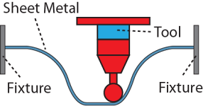
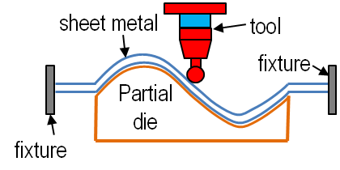
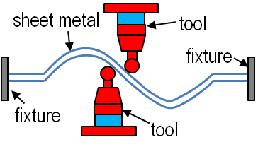
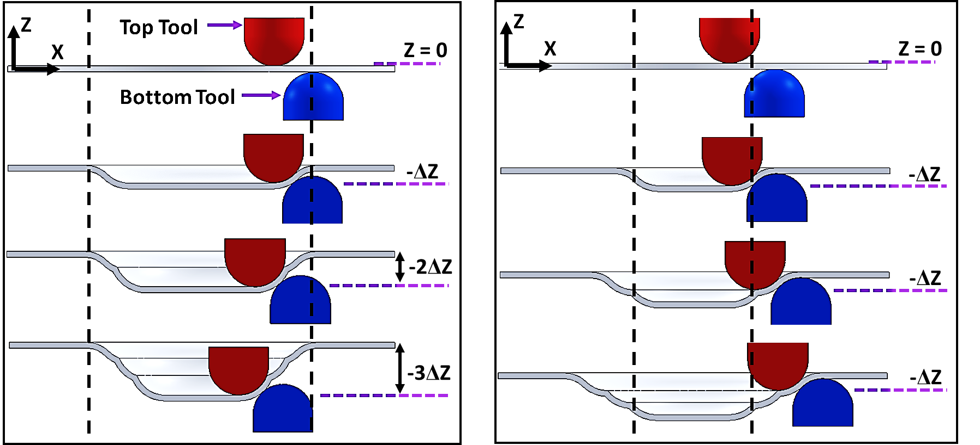
SPIF:
Single-Point Incremental Forming (SPIF) uses one tool to deform the sheet metal. Sometimes a backing plate is included to help decrease the global bending that occurs between the feature and fixture.
TPIF:
Two-Point Incremental Forming (TPIF) uses one tool and a partial die for better support during forming.
DSIF:
Double-Sided Incremental Forming (DSIF) consists of two forming tools; one on the top and one on the bottom of the sheet.
Accumulated-DSIF (ADSIF) is a special variant of DSIF that remains in the same plane of the sheet metal during forming. ADSIF is commonly nicknamed an “In-to-Out” DSIF method whereas traditional DSIF is an “Out-to-In” method. It is the accumulation of rigid body motion that creates the final part in ADSIF. ADSIF does deform only virgin material as the toolpath progresses outward, but the process is often limited by the maximum achievable wall angle which is much lower than that of DSIF.
DSIF…………..versus…………..ADSIF

Slide 3
Sheet Thickness [mm]: Provide the original thickness of the virgin sheet metal.
Top Tool Diameter [mm]: Enter the diameter of the top hemispherical tool. The top tool is defined as the tool that is in the positive Z-direction with respect to the sheet. This parameter is unused in SPIF and TPIF if the toolpath is progressing in the positive Z-direction because only the bottom tool is required.
Bottom Tool Diameter [mm]: Enter the diameter of the bottom hemispherical tool. The bottom tool is defined as the tool that is in the negative Z-direction with respect to the sheet. This parameter is unused in SPIF and TPIF if the toolpath is progressing in the negative Z-direction because only the top tool is required.
TPIF Example:
Z
DSIF Example:
X
Top Tool
Z
X
Female Die
Bottom Tool
Toolpath progresses in the negative Z-direction (purple arrow).
The tool is in the positive Z-direction with respect to the sheet and is therefore denoted as the Top Tool.
The toolpath algorithm expects the DIE surface (green lines) in TPIF. In order to ensure that the origin of the toolpath is on the top surface of the initial blank, the input surface must be translated downward by the sheet’s original thickness. The Sine Law is used when calculating the tool gap.
Toolpath progresses in the positive Z-direction (purple arrows).
In SPIF and DSIF, toolpath algorithms expect the TOP surface of the desired part (green lines). If this part were formed using SPIF, then only the Bottom Tool would be active. Notice that the input surface should be offset in the positive Z-direction by the original thickness in order to place the toolpath’s origin on the bottom surface of the initial blank. The Sine Law is used when calculating the tool gap.
Advanced Tool Gap and Compensation Techniques: If the user desires to utilize custom tool compliance compensation techniques or something other than the Sine Law, then one must do this manually with the outputted contact points and associated surface normal vectors.

Slide 4
Z-Level Contour Slicing: The toolpath is composed of multiple discrete contours which are then discretized into toolpath points. These contours are the result of intersections between a translated XY-plane and the input surface.
Spiral Toolpath: The toolpath is composed of a single, approximate helix that lies on the input surface which is then discretized into toolpath points. Techniques used in Z-Level Contour Slicing are still used in this method to help determine where the start and end points of the helix should be.
Toolpath Algorithm Start/End Height [mm]: These parameters control the start and end heights of the toolpath. Use these parameters to start a toolpath halfway into the part or end a toolpath early. Also, these features are commonly used when the input surface is translated in the Z-direction as is often the case in TPIF. Choose these parameters carefully as invalid parameters can cause the algorithms to crash (e.g. heights above/below the part).
Incremental Depth [mm]: Defines the distance between subsequent contours in Z-Level Contour Slicing, or in the case of Spiral Toolpaths, defines the pitch of the helix. Caution is advised with large increments (greater than 2.0 mm) when using the spiral algorithms as this can cause challenges in projecting the spiral onto the surface. Additionally, small increments (less than 0.1 mm) often lead to rather large toolpaths and long computing times.
Squeeze Factor: This is a scalar factor multiplied to the resultant thickness as predicted by the Sine Law. For example, a squeeze factor of 0.9 will shrink the tool gap (i.e. add more squeeze) by 10% of the thickness predicted by the Sine Law.
Resolution Along Toolpath Curve [mm]: Change this parameter to affect the distance between subsequent toolpath points. Note, however, that the algorithm will try to maintain the desired resolution but it cannot be guaranteed in all situations, especially for spiral toolpaths.

Slide 5
Column Number:
1 | 2 | 3 | 4 | 5 | 6 | 7 | 8 | 9 | 10 | 11 | 12 | 13 | 14 | 15 | 16 | 17
Column Formatting:
%f,%f,%f,%f,%f,%f,%f,%f,%f,%f,%f,%f,%f,%f,%f,%f,%i
NOTE: Columns are separated by commas with NO spaces
%f – Will be converted to a real number (i.e. float)
%i – Will be converted to an integer
Columns 1 – 3: X-, Y-, and Z-coordinate of the contact point [mm]
Columns 4 – 6: X-, Y-, and Z-components of the local surface normal (must be unit vector) at the contact point
Column 7: Maximum principal curvature on the surface at the contact point
Columns 8 – 10: X-, Y-, and Z-direction of the maximum curvature at the contact point
Column 11: Minimum principal curvature on the surface at the contact point
Column 12 – 14: X-, Y-, and Z-direction of the minimum curvature at the contact point
Column 15: Mean curvature (i.e. 0.5 * [min. + max. curvatures]) at the contact point
Column 16: Gaussian curvature (i.e. min. curvature * max. curvature) at the contact point
Column 17: Set to 1 if the contact point signifies the end of the current contour/revolution, otherwise set to 0

Slide 6
Assumed Orientation of the Surface Normal (See the User Guide for More Information on Input Surfaces and Contact Points)
SPIF:
Forming Direction is Along Negative Z-Axis (Downward)
Only Top Contact Points required.
Surface normal assumes a positive Z-component
Forming Direction is Along Positive Z-Axis (Upward)
Only Bottom Contact Points required.
Surface normal assumes a negative Z-component.
TPIF:
Forming Direction is Along Negative Z-Axis (Downward)
Bottom Contact Points correspond to the die contact points
Top Contact Points correspond to the tool contact points
Surface normal assumes a positive Z-component
Curvature and surface normal measurements are assumed to be equal for both the bottom and top contact points
Forming Direction is Along Positive Z-Axis (Upward)
Bottom Contact Points correspond to the tool contact points
Top Contact Points correspond to the die contact points
Surface normal assumes a negative Z-component
Curvature and surface normal measurements are assumed to be equal for both the bottom and top contact points
DSIF & ADSIF:
Forming Direction is Along Negative Z-Axis (Downward)
Top and bottom tool contact points are required
Surface normal assumes a positive Z-component
Curvature and surface normal measurements do not have to be equal for both the bottom and top contact points
Forming Direction is Along Positive Z-Axis (Upward)
Top and bottom tool contact points are required
Surface normal assumes a negative Z-component
Curvature and surface normal measurements do not have to be equal for both the bottom and top contact points

