Slide 1
IBM Applied Data Science Capstone

Slide 2
Business Problem
Where to open an Asian Restaurant in UK?

Slide 3
Data Preparation & Tools used
List of UK Area Code extracted from:
https://en.wikipedia.org/wiki/List_of_postcode_areas_in_the_United_Kingdom'
Tools Used for Data Preperations:
BeautifulSoup
Geocoder package
Foursquare API
Json data extraction

Slide 4
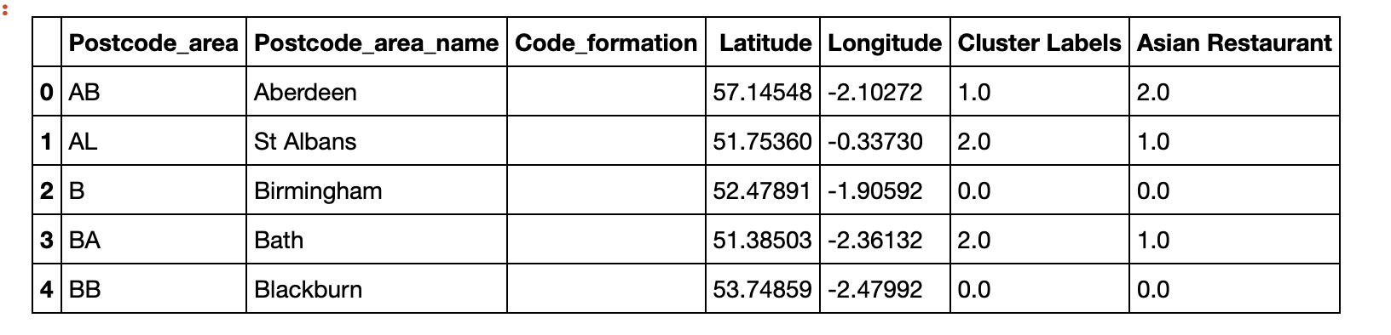
Methods used
K-Means Clustering
1. UK area code
Clustered Data table view:
Parameters used
UK Area Code
Asian Restaurant Count
Latitude
Longitude

Slide 5
UK neighborhood before clustering

Slide 6
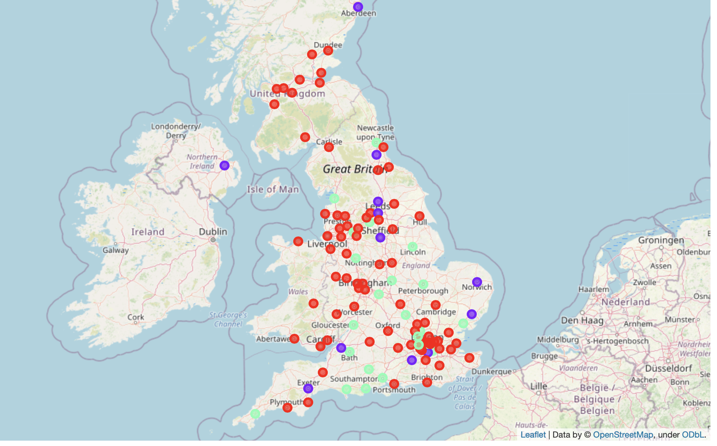
UK neighborhood After clustering
Cluster 1 : 83 areas with no Asian restaurant
Cluster 2 : 12 areas with 23 Asian restaurant
Cluster 3 : 25 areas with 26 Asian restaurant

Slide 7
Recommendation
To target cluster 1 and 2 where there
are no/very less number of
Asian restaurant
for further analysis

