Slide 1









UNIVERSITY OF CONSTANTINE 2 – ABDELHAMID MEHRI
FACULTY OF NEW TECHNOLOGIES OF INFORMATION AND COMMUNICATION (NTIC)
DEPARTMENT OF SOFTWARE TECHNOLOGIES AND INFORMATION SYSTEMS (TLSI)
DEPARTMENT OF FUNDAMENTAL COMPUTER SCIENCE AND ITS APPLICATIONS (IFA)
RequAI
A Smart Recruitment Assistant —
Chatbot Extension for Wassit Online
PRESENTED BY
SUPERVISED BY
Benameur Khaoula
Dr. Telghamti Samira
Nedjem Mohamed Anis
June 2026
1
1

Slide 2

Presentation Outline
01
Introduction
05
Evaluation & Results
02
State of the Art
06
Implementation & Stack
03
Proposed Solution
07
Startup aspect​ 1275
04
Two-Approach Methodology
08
Conclusion & Future Work
2

Slide 3
INTRODUCTION
3

Slide 4

INTROCUTION
Context & Motivation
Digital Transformation
Algerian Employment Context
24/7
Wassit Online: ANEM’s web platform connecting job seekers, employers, and employment services.
Guidance gap
Employment services are increasingly online.
No conversational help to
interpret needs or answer
ANEM questions.
4

Slide 5
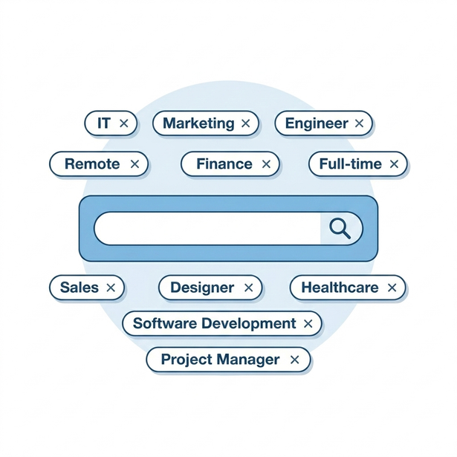
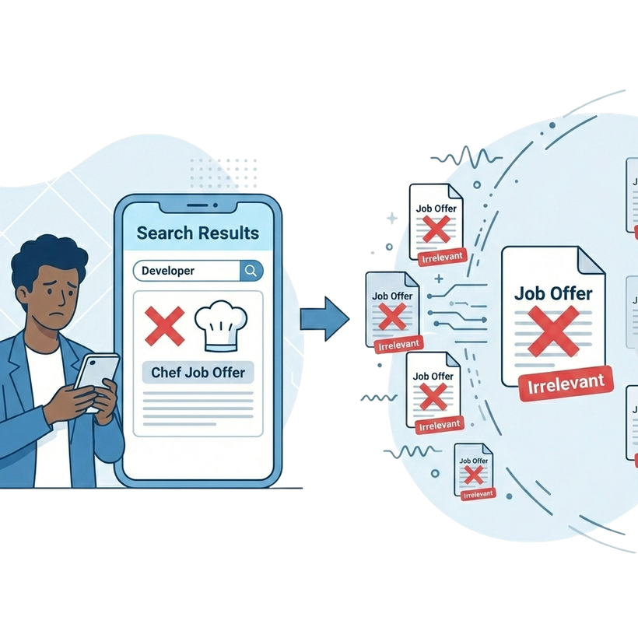
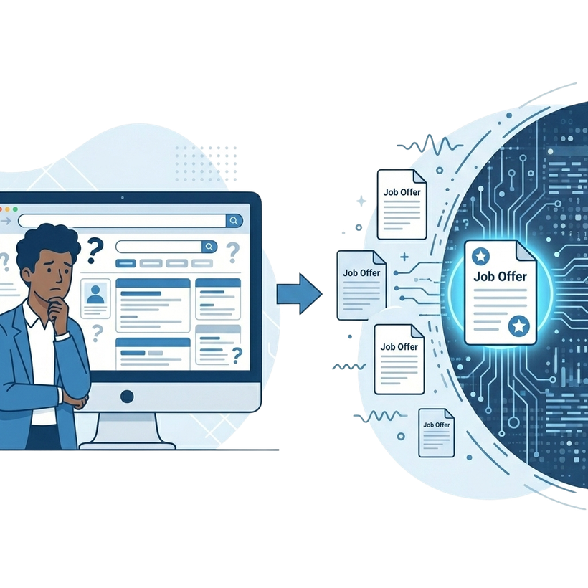

INTROCUTION
Problem Statement
Manual input
and
Keyword-based search
Inaccurate results
and
Weak profile-job matching
Limited understanding of user needs
missed opportunities
5

Slide 6
INTROCUTION
Objectives
Provide a more interactive and personalized recruitment experience.
Allow users to ask questions in natural language.
Clear guidance about employment procedures.
Support CV/profile analysis.
Job recommendations through profile-job matching.
Deployable extension
6

Slide 7
State of the Art
7

Slide 8




State of the Art
Recruitment & E-Recruitment
Traditional Recruitment
E-Recruitment
Direct human interaction
Physical verification of documents
Personalized contact
access to opportunities
reduces time and administrative effort
Faster Connection between job seekers and employers
Paper-based CVs and documents
Geographic constraints
Manual screening and administrative workload
forms
fixed filters
manual processing
8

Slide 9

State of the Art
Wassit Online
The national platform of ANEM, Algeria's
public employment agency
CURRENT LIMITATIONS
No semantic search
Provides access to job offers and services
Synonyms and related skills are not recognized.
Connects job seekers, employers, and agencies
No multilingual handling
Darija and Arabizi queries are unsupported.
Job posting and application management
No conversational guidance
Candidate and recruiter profiles
Users navigate alone without assistance.
Keyword-based offer search
9

Slide 10
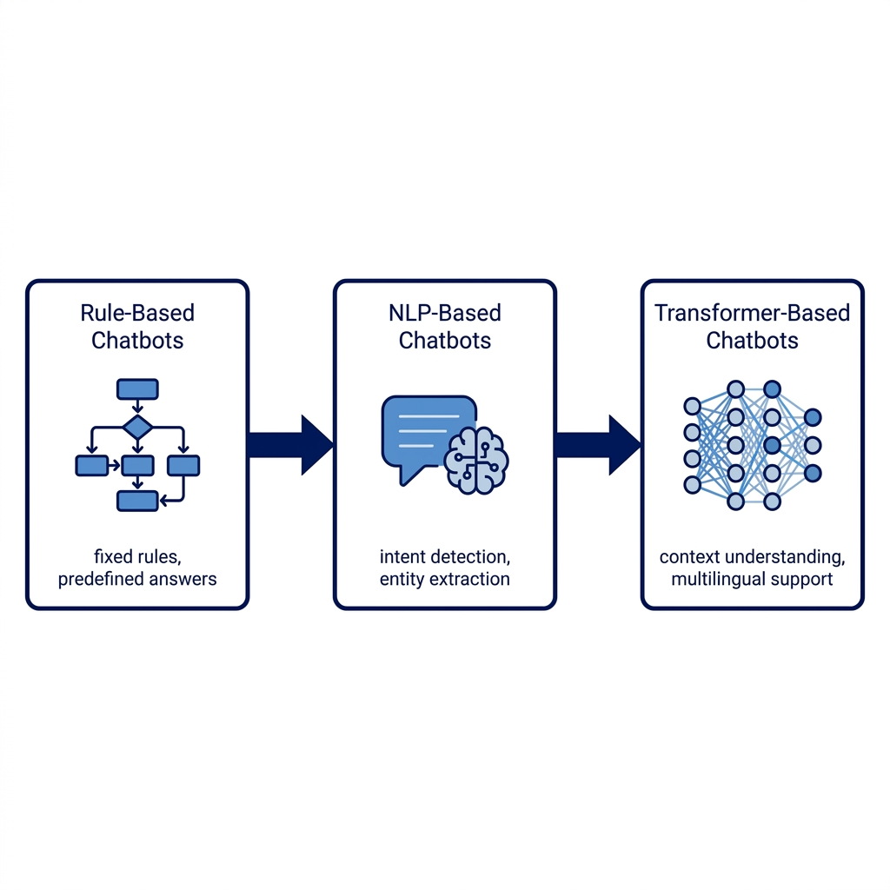
State of the Art
Chatbots Evolution
A conversational system that allows users to interact with a digital service through natural language
10

Slide 11
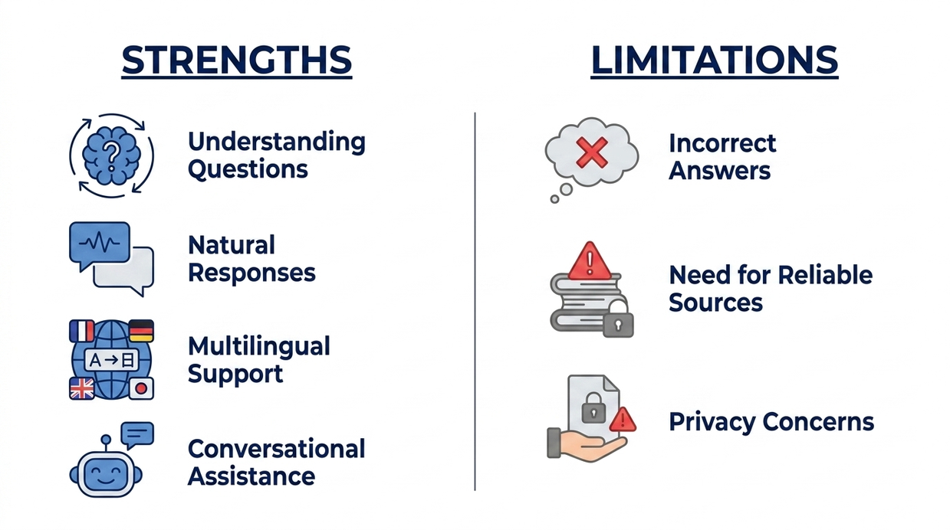
State of the Art
Large Language Models (LLMs)
advanced AI models trained on large amounts of text to understand and generate natural language.
11

Slide 12
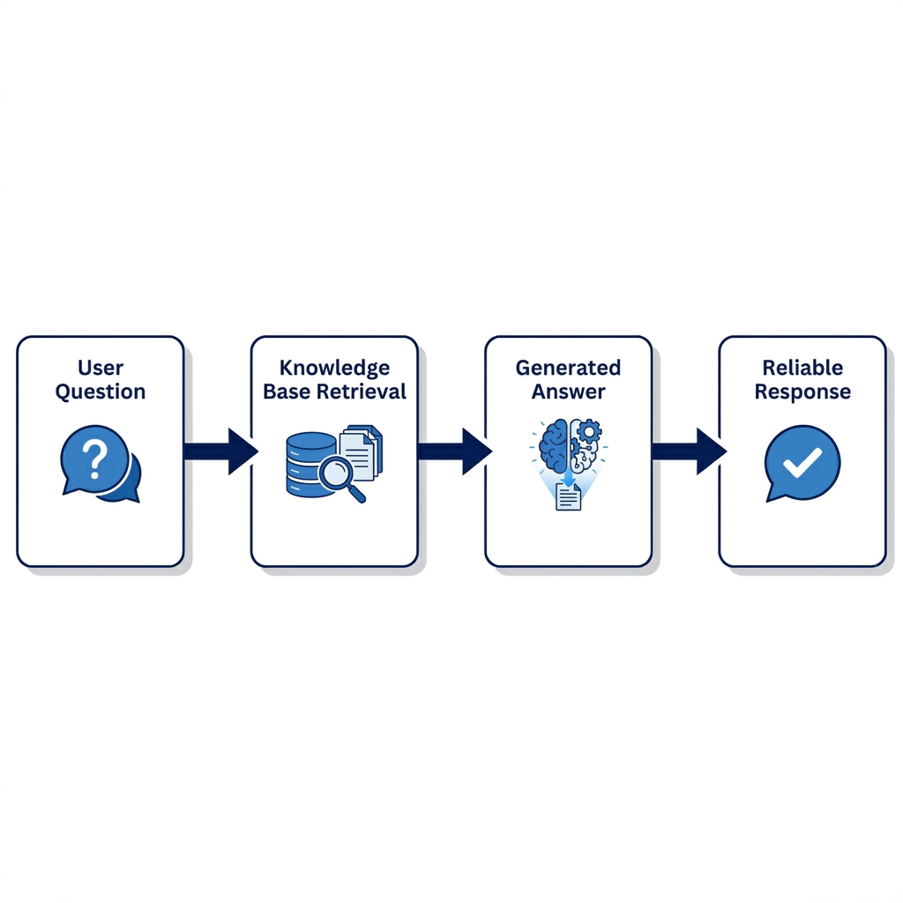
State of the Art
Retrieval-Augmented Generation (RAG)
A technique that combines information retrieval with text generation to produce more grounded answers.
12

Slide 13
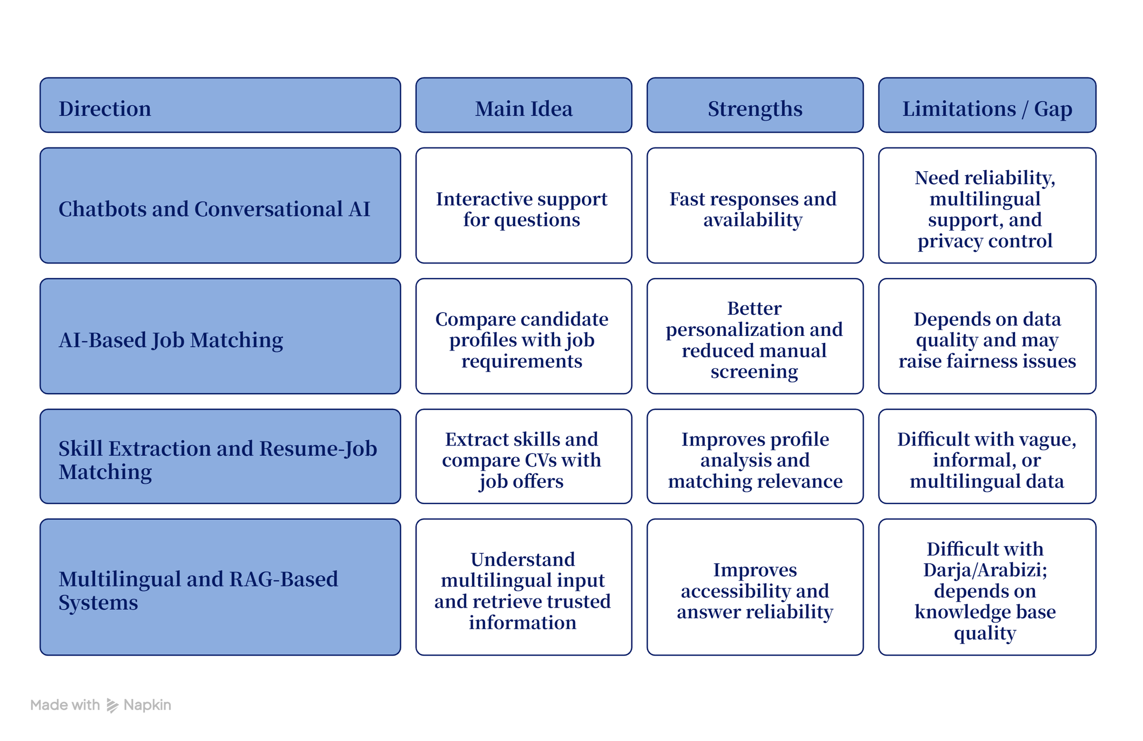
State of the Art
Relevant Work
13

Slide 14
Proposed Solution
14

Slide 15
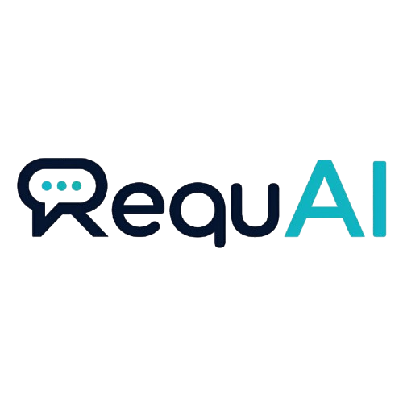
Proposed Solution
Our Solution
RequAI
Combining
Purpose
An AI-based web recruitment assistant for job seekers in Algeria.
Natural Language Processing,
Knowledge Retrieval,
Job Matching
Interactive and personalized recruitment guidance.
16

Slide 16
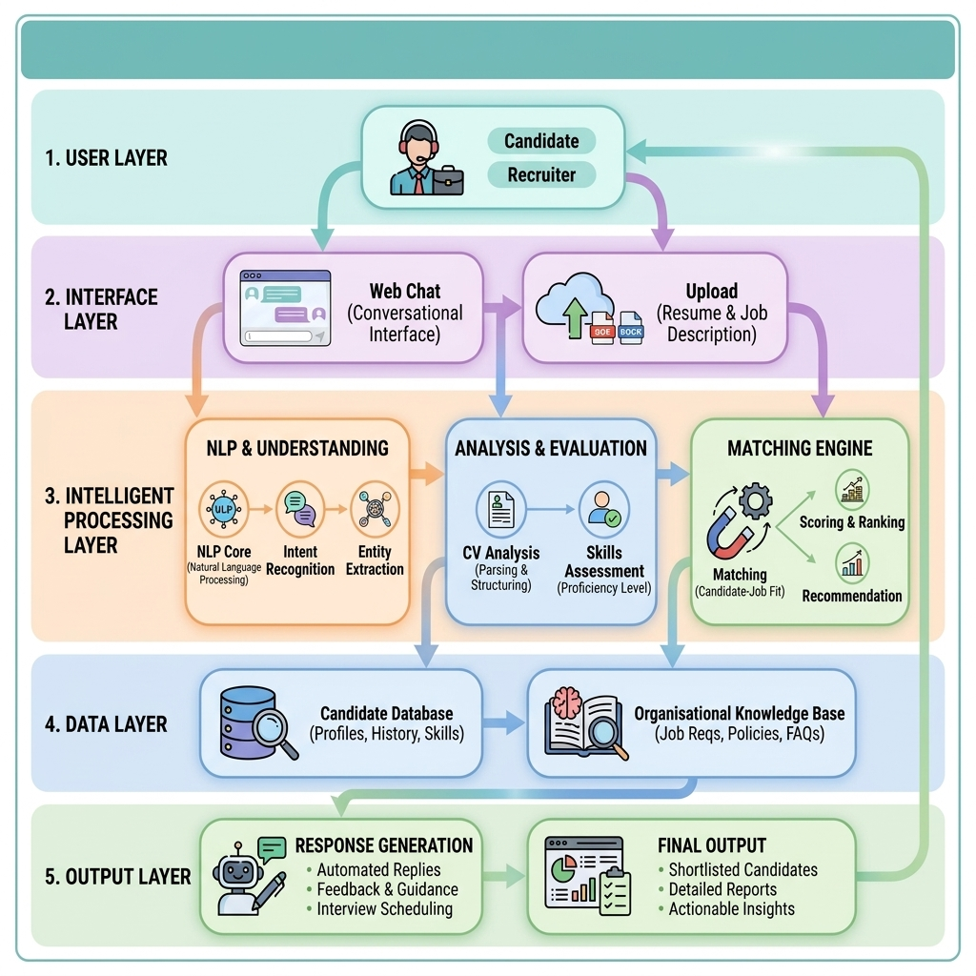
System Architecture
Proposed Solution
16

Slide 17
Two-Approach Methodology
17

Slide 18



Two-Approach Methodology
Functional Modules
MODULE 01
MODULE 02
NLU & Conversation
CV & Skill Extraction
Detects language and classifies intent, then
manages the dialogue flow with the user.
Parses uploaded résumés into structured skills,
experience and profile attributes.
MODULE 03
MODULE 04
Matching & Recommendation
Knowledge Response
Ranks job offers by cosine similarity between
candidate and offer representations.
Retrieves grounded answers about ANEM and
the platform via a RAG pipeline.
18

Slide 19

Two-Approach Methodology
Two-Approach Methodology
We designed and evaluated two complementary approaches to the
chatbot's understanding engine.
APPROACH 1
APPROACH 2
Classical NLP
Multilingual Deep Learning
Lightweight, interpretable pipeline using
character TF-IDF features with linear
classifiers.
Adds explicit language detection and
transformer-based entity extraction for robust
six-language support.
TF-IDF
Linear SVM
Cosine similarity
Language ID
XLM-RoBERTa
18 intents
19

Slide 20


Two-Approach Methodology
Approach 1 — Classical NLP
Interpretable pipeline built on character TF-IDF features.
→
Intent classification with char TF-IDF and a
Linear SVM.
83%
100%
→
Job matching via cosine similarity between
profile and offers.
Intent accuracy
Answers found in KB
→
Knowledge retrieval over the ANEM RAG
knowledge base.
Strengths
Fast, transparent and cheap to run, with no GPU
required.
→
Fairness analysis by masking identity signals in
input.
20

Slide 21

Fairness: Eliminating Recruitment
Bias
Two-Approach Methodology
Identity Masking Logic
RequAI reduces bias by focusing strictly on
professional suitability rather than identity signals.
• Masking: Automatic removal of Name, Gender, and Age markers.
• Skill-Centric: Matching is calculated only on experience and skills.
• Recovery: Match scores improve for diverse profiles after bias signals are removed.
22

Slide 22


Two-Approach Methodology
Approach 2 — Multilingual
Language-aware pipeline across six languages and code-mixed text.
STAGE 01
STAGE 02
STAGE 03
Language Detection
Intent Classification
Entity Extraction
Logistic Regression selected as
the best detector.
Char TF-IDF and SVM over
45,330 examples, 18 intents.
XLM-RoBERTa identifies skills,
roles and locations in
multilingual text.
99.34%
99.74%
Transformer-based,
cross-lingual entity recognition.
Test accuracy
Test accuracy
97.15%
6
Challenge set
Languages covered
23

Slide 23
Training Strategy: Logic & Data
Two-Approach Methodology
Data Foundation
Hybrid Logic
We curated a massive dataset of 45,330 examples
covering 18 intents across 6 languages. This includes
specific Algerian code-mixed inputs.
NLU: Trained on SVM for speed.
Entities: XLM-RoBERTa for precision.
LLM: Prompt Engineering to ground LLMs
in official ANEM procedures (RAG).
The LLM is not "retrained" but "grounded" in reliable knowledge to prevent hallucinations.
24

Slide 24

Evaluation & Results
Evaluation & Results
99.74%
97.15%
100%
6
Intent accuracy
Language detection
Answers retrieved
Languages
Multilingual approach
Challenge set
Knowledge base
Including Darija & Arabizi
18 intents learned from 45,330
labelled examples.
Cosine matching surfaces
semantically relevant offers.
Bias analysis confirms fairer
ranking when identity is masked.
25

Slide 25
Comparative Analysis
Evaluation & Results
Approach 1
Approach 2
Classical NLP
Multilingual DL
Intent accuracy
83%
99.74%
Language support
Limited
6 languages
Entity extraction
Rule-based
XLM-RoBERTa
Compute cost
Low
Higher
Interpretability
High
Moderate
Approach 2 is the production choice for accuracy and language coverage; Approach 1 remains a fast,
transparent fallback.
26

Slide 26



Implementation & Stack
Implementation & Stack
A containerized full-stack deployment around the chatbot engine.
FRONTEND
BACKEND
DATA
React + Vite
Flask + Gunicorn
SQLite
Chat interface embedded into
the Wassit Online experience.
Serves the models and
orchestrates the processing
pipeline.
Stores profiles, offers and the
knowledge base content.
LLM
DEPLOY
GATEWAY
Groq Cloud
Docker Compose
Nginx
Hosted LLM with prompt
engineering for grounded
generation.
Reproducible multi-container
deployment of all services.
Reverse proxy routing traffic to
frontend and backend.
27

Slide 27

Inference Speed: The Groq LPU
Implementation & Stack
Why Groq for RequAI?
Traditional GPUs create bottlenecks for real-time
multilingual generation. We utilize Groq's LPU
(Language Processing Unit) infrastructure.
• Real-time Speed: Inference 10x-20x faster than standard GPUs.
• Cost Effectiveness: Free tier API allows research deployment without budget strain.
• Zero Lag: Essential for a fluid conversational experience on Wassit Online.
21

Slide 28


Slide 29
Startup aspect​ 1275
29

Slide 30
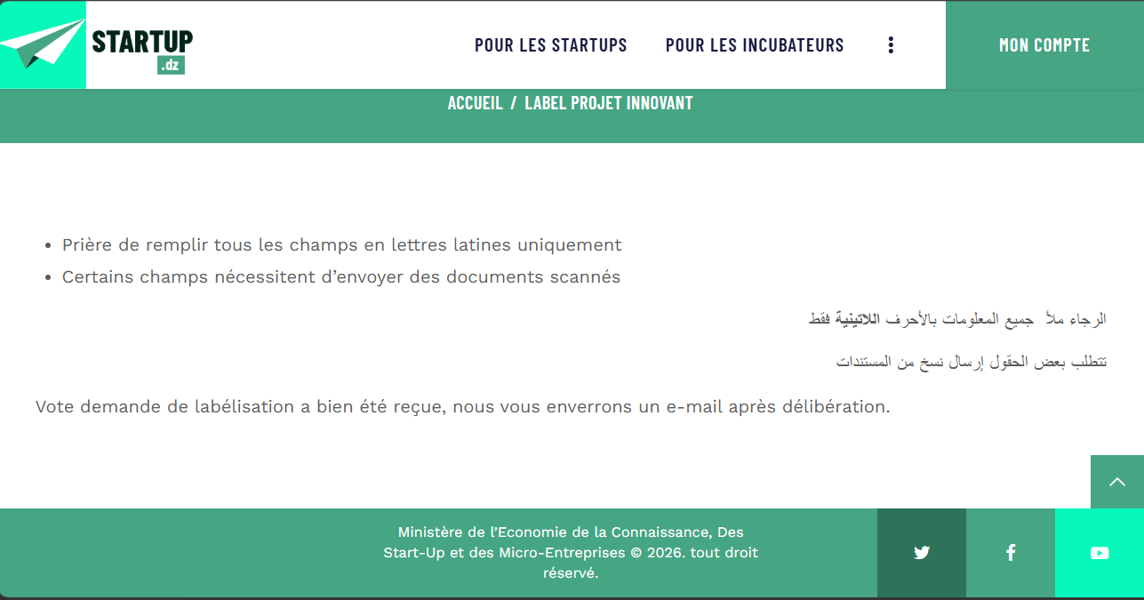
Label Application Submission
Startup aspect​ 1275
30

Slide 31
Added Values
Startup aspect​ 1275
01
Easy Access to Employment Information: quick accessto information about job offers, application steps, required documents, and recruitment procedures.
02
Clear Guidance: ask questions and receive direct, simple, and understandable answers.
03
Interactive Assistance: ask questions and receive direct, simple, and understandable answers.
04
Personalized Job Recommendations: guidance adapted to the user’s profile, skills, and professional goals.
05
CV and Profile Improvement: Helps users identify their strengths and present their skills more clearly.
06
Time and Effort Reduction: Reduces the time and effort needed to search for information, procedures, and relevant opportunities.
31

Slide 32









Business Model Canvas
Startup aspect​ 1275
Key Partners
Key Activities
Value Propositions
Customer Relationship
Customer Segments
Development and improvement of the RequAI platform
Design and maintenance of the Requi chatbot
Recruitment content preparation and organization
Data collection, cleaning, organization, and processing
CV support, skill identification, and job matching assistance
Prototype testing, validation, and user feedback analysis
Partnership and communication management
Easy access to employment information
Clear guidance for job seekers
Interactive assistance through the Requi chatbot
Personalized job support based on user profiles and skills
CV and profile improvement support
Time and effort reduction during job search
User-friendly digital experience
Support for employment service digitalization in Algeria
Self-service assistance through the Requi chatbot
Personalized guidance based on user needs and profiles
Continuous support for job search and recruitment procedures
Simple answers to employment-related questions
Feedback collection to improve the platform
Regular updates to improve guidance and recommendations
Job seekers in Algeria
Young graduates entering the job market
First-time job seekers needing guidance
Students preparing for professional integration
Career clubs and training centers
Employment agencies and recruitment support services
Employers and companies in future versions
ANEM and Wassit Online ecosystem as a potential collaboration environment
Local employment agencies and recruitment support services
Training centers and professional development organizations
Entrepreneurship support programs
Key Resources
Channel
Web-based platform and chatbot interface
Recruitment knowledge base and employment guidance content
AI/NLP tools and job matching support modules
Recruitment-related data and user profile information
Skilled team in software engineering, AI, and data processing
Practical recruitment insights
Financial resources and workspace
Web-based RequAI platform
Mobile-friendly chatbot interface
Social media and digital communication channels
University events, career clubs, and workshops
Partnerships with employment agencies and training centers
Future collaboration with recruitment institutions
Cost Structure
Revenue Stream
Platform development, chatbot design, and maintenance costs
Data collection, processing, and recruitment content preparation costs
Hosting, domain name, workspace, internet, and technical equipment costs
Marketing, legal, administrative, support, and update costs
Free basic access for job seekers with paid advanced features
Premium subscription for personalized job seeker support
Paid CV and profile improvement services
Institutional subscriptions for training centers and recruitment support services
Training and workshops related to job search and platform use
Custom support or integration for partner organizations
Future employer-side service packages
32

Slide 33
Startup aspect​ 1275
Summary of Project Cost
Category
Description
Total Cost (DA)
Administrative/legal setup, name and logo protection, domiciliation, internet, domain name, hosting, UI/UX design, tools, data preparation, testing, and contingency expenses
Initial Costs and Burdens
263,000
Legal consultation, communication materials, branding, technical equipment, office equipment, content review, training, transport, and field meetings
Additional Initial Costs and Burdens
495,500
Total Initial Investment
744,500
33

Slide 34
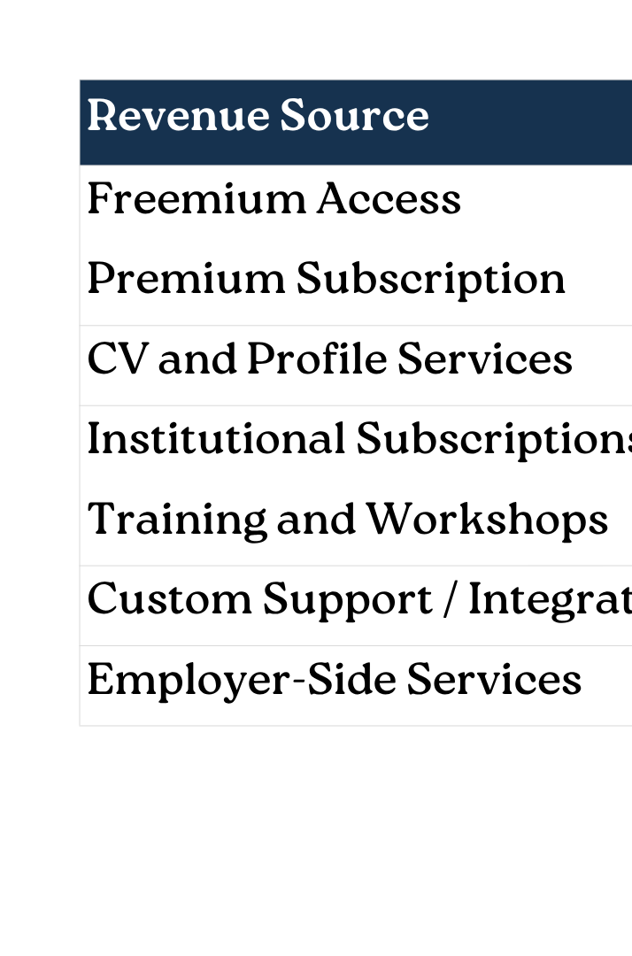
Startup aspect​ 1275
REVENUE ESTIMATION
34

Slide 35
Conclusion
35

Slide 36
Limitations & Future Work
LIMITATIONS
FUTURE WORK
Partly synthetic data: may not fully represent real user behavior.
extend the hosted RequAI platform toward Wassit/ANEM integration and real user testing.
Limited evaluation: needs further testing with real users and specialists.
Voice input and broader Darija dialect
coverage.
Limited live data access: the prototype is not connected to real-time Wassit Online or ANEM databases.
Improve job matching by considering soft skills and user preferences.
Add employer-side features such as publishing offers and managing applications.
36

Slide 37


CONCLUSION
RequAI brings semantic,
multilingual recruitment
assistance to Wassit Online.
37

Slide 38
Thank You!
Questions? Discussion Welcome.
RequAl: Smart Recruitment Assistant
Benameur Khaoula & Nedjem Mohamed Anis
University Constantine 2 - Abdelhamid Mehri
38

