Slide 1

VEHICLE SERVICE MANAGEMENT SYSTEM

Slide 2
VEHICLE SERVICE MANAGEMENT SYSTEM
Vehicle repair service business is all about the time and quality
In todays world most of the things are done online – booking, payment etc.
Vehicle Service Management System has two sections user and the admin.
Our idea is to provide a interface where user can look into :-
1) Different service option
2) Service booking form
3) slot availability (for booking)

Slide 3
IDEA
GRAPHICAL AND TABULAR REPRESENTAION
SLOT AVAILABILITY

Slide 4
The main concept is online slot booking
Usually whenever a customer books his slot at a particular time he has to wait until he gets a confirmation message from the admin(company)
The admin has to check (database) if the customer who has requested for particular time (service) is available or not .
To avoid this we can provide user available slot timing while he is booking a service (live slot availability by a pop-up message ).

Slide 5
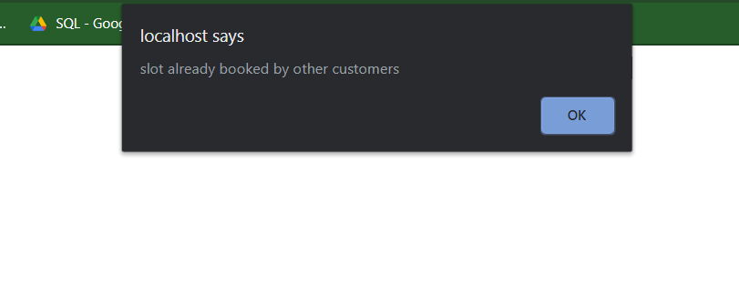
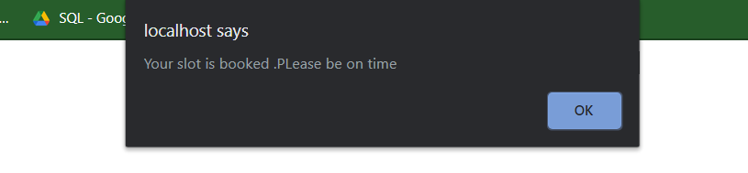
A example showing pop up message to user that slot is booked instead of waiting to get confirmation message via email or message Booked slot confirmation pop-up

Slide 6
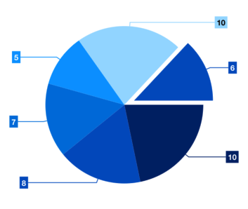

GRAPHICAL AND TABULAR VIEW OF DATA WE CAN PLOT THE GRAPHS AND REPORTS FROM THE DATA AVAILABLE IN DATABASE AND GET IDEAS LIKE WHAT TYPE OF SERVICES PEOPLE PREFER, NUMBER OF VEHICE SERVICED IN MONTH,YEAR OR A DAY.

Slide 7
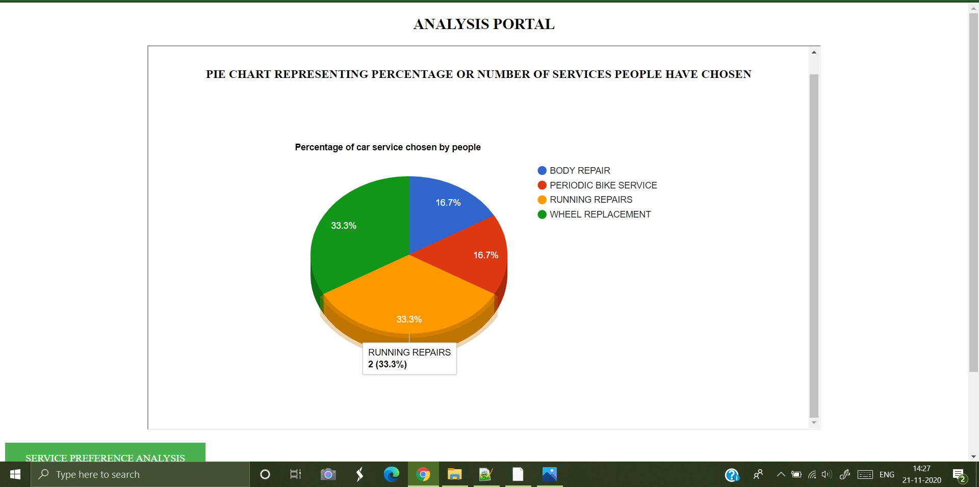

Slide 8
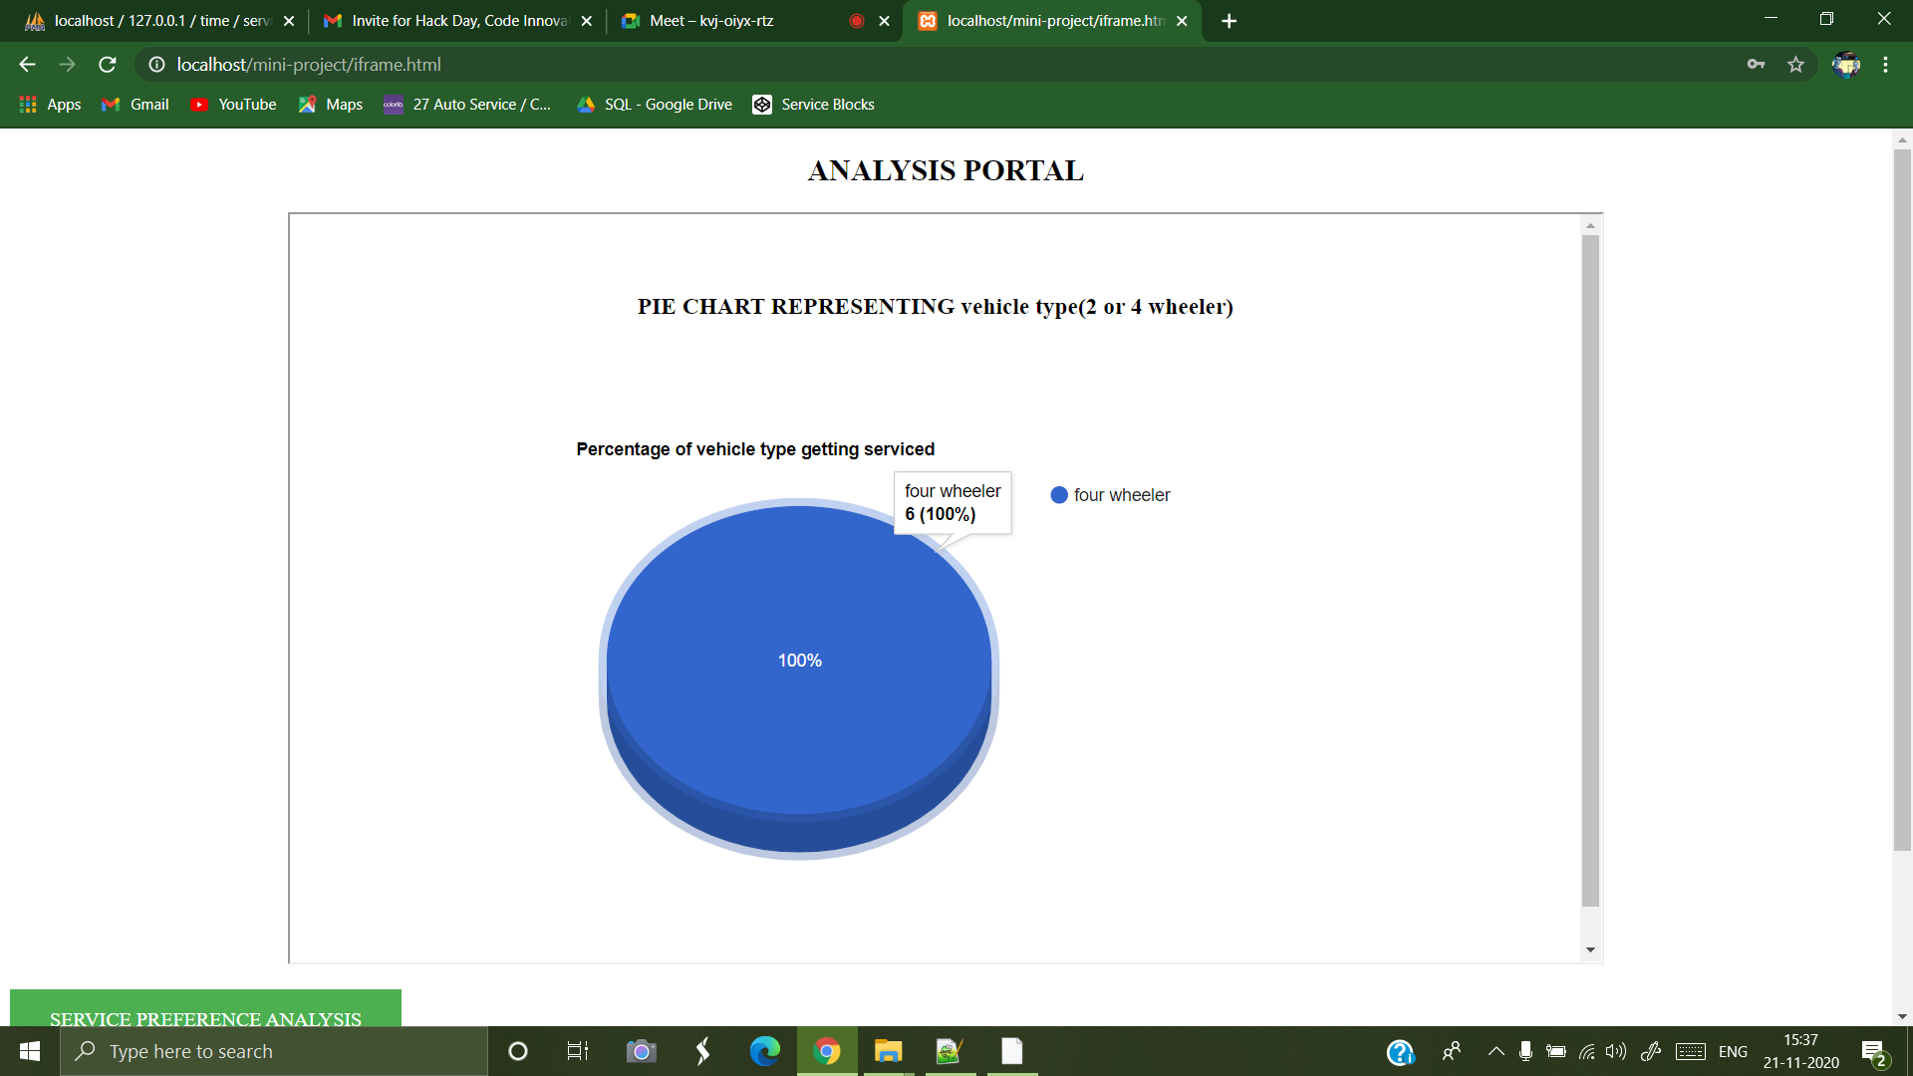

Slide 9
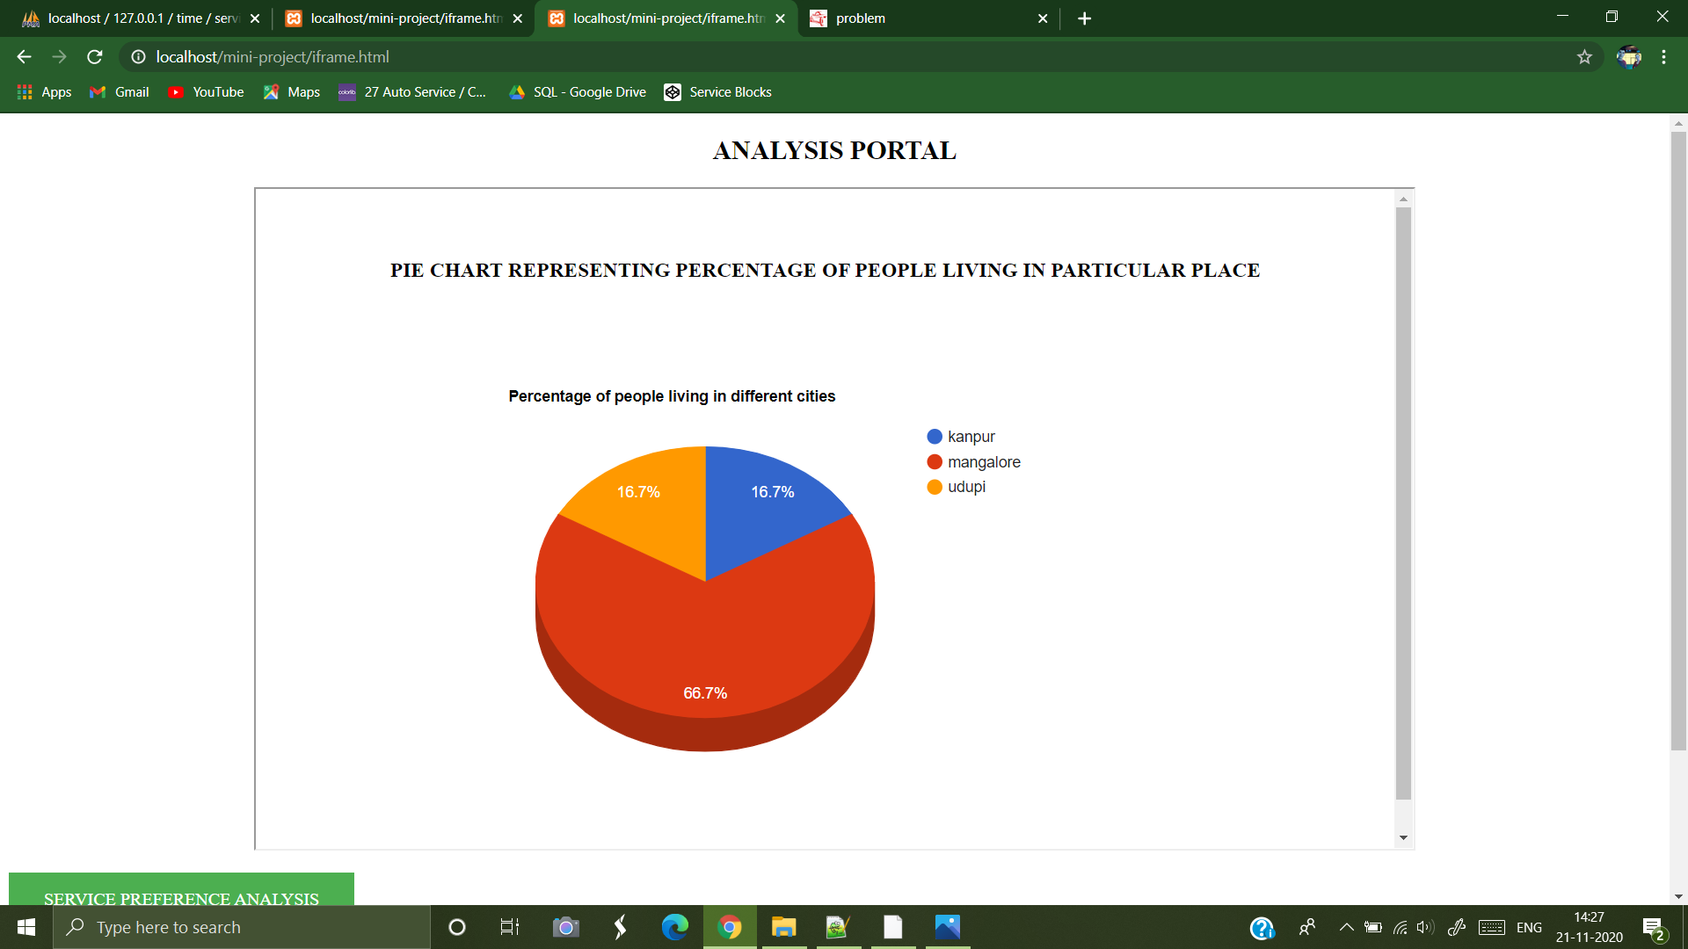

Slide 10
Technology(programming languages used)
HTML
CSS
JAVASCRIPT
AJAX
JQUERY
PHP
SQL
BOOTSTRAP
GOOGLECHARTS

Slide 11
THANK YOU
BY TEAM INFINITY
SAMIT D MANVAR
SACHINKRISHNA
RYAN MENEZES

