Slide 1
Idea Pitch

Slide 2
THE PROBLEM
Farmers in developing countries are heavily dependent on bank loans. Due to this heavy debt , farmers can't maintain a steady production of agriculture.
Micro-finance can help these farmers out of debt.
In the recent past, we have read many incidents regarding the farmer suicides due to debts and poor yield from farming.
For a country like India, fertile land for farming is dwindling and more yields have to be produced to satisfy the need of the country. Even though the demand increase, the farmers are suffering from some major issues like :
Raising the initial investment for setting up the field due to high bank interest rates.
Fetch reasonable prices for their produce due to the intervention of middlemen in market.
Inefficient supply chain and issues in storage and transportation, leading to deterioration of crops.

Slide 3
SOLUTION
A blockchain based transparent market place where the farmers and consumers could implement a co-operative farming method.
Here, the farmers can list the potential crops and the expected yield on his farm on the distributed public ledger.
The consumers can view the details and check for the farmer credibility based on the previous cultivation and supply.
This creates a transparent and tamper-proof digital market platform for farm products.
Thus an agreement (consensus) can be formed between farmer and consumer, such that the consumer can fund individual crops or a field and can acquire or the yield from the farm or the profit percentage of its market value.
There will be a rating mechanism to build the credibility of farmer and consumer based on the previous experiences in the agromarket.

Slide 4
Uniqueness
Smart contracts can provide a better agreement between the farmers and consumers in case of discrepancies arising with regard to natural calamities, climate changes or other crop loss situations
The farmer does not have to wait for bank loan or other lending mechanisms to raise the initial investment.
The consumers could provide the fund with zero interest.
The consumers could get quality products at cheaper rates as they are funding the crops/fields right from the time of cultivation.
No need to have huge farmlands.
Even the small scale farmers and household farmers can also sell their products and yield better profit.

Slide 5
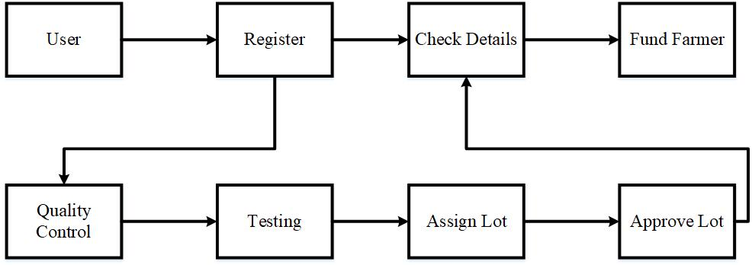
System Architecture

