Slide 1

Team:Bugoverflow
jobly
By Rahul Sharma and Dhruva S

Slide 2
jobly (Category:- Fintech)
It is a two-way freelancing platform.
1)On one hand it helps people improve their business by hiring affordable, quality, and reliable freelancers .
2)And on the other hand helps freelancers in getting jobs.

Slide 3
Problems
Difficulty in finding people to get job done.
Lack of job opportunities around.
Finding the right pay for the job.
Transfer of funds.
Finding Reliable/quality Clients.
Difficulty in client/freelancer communication.

Slide 4
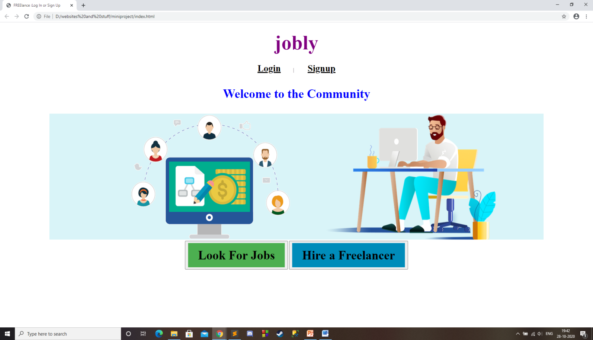
Solution
A reliable network which enables people to get their job done.

Slide 5
A website which provides payment gateway.
Finding the best freelancers that allows clients to verify.
Provides a powerful database to store information.
Bridges the client/freelancer communication gap.

