Slide 1
PYTHON BASICS COURSE

Slide 2
BRIEF CONTENTS
Chapter 1: Getting Started
Chapter 2: Variables and Simple Data Types
Chapter 3: Introducing Lists
Chapter 4: Working with Lists
Chapter 5: if Statements
Chapter 6: Dictionaries
Chapter 7: User Input and while Loops
Chapter 8: Functions
Chapter 9: Classes
Chapter 10: Files and Exceptions
Chapter 11: Testing Your Code
Project : Data Visualization

Slide 3
INTRODUCTION

Slide 4
What is python ?
Python is an interpreted ,first launched in 1992
Python is an object-oriented (based around data),
High-level programming language (easier for humans to understand).
It’s built in a way that it’s relatively intuitive to write and understand.

Slide 5
Why python ?
Python's simple, easy to learn syntax emphasizes readability
Python’s for many purposes: purposes: to make games, build web applications, solve business problems, window application, data analytics , image processing , machine learning , IOT
well-connected and supportive community (checking programming language ranking https://statisticstimes.com/tech/top-computer-languages.php)

Slide 6
Goal
Understanding basic python concepts
you’ll be able to write programs that sift through large data sets and make visual representations of that stored information.

Slide 7
Getting Started
Chapter 1

Slide 8
Requirements
Visual studio code 2019 (source: https://code.visualstudio.com/docs/python/python-tutorial)
Miniconda (source: https://docs.conda.io/en/latest/miniconda.html)

Slide 9
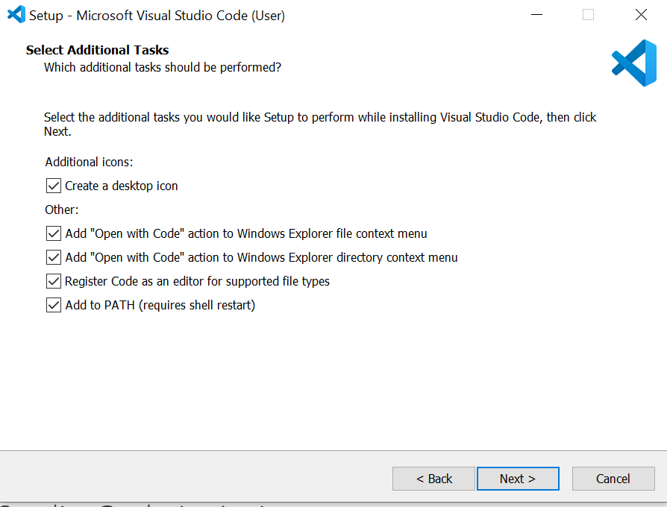
Setting up vs code

Slide 10
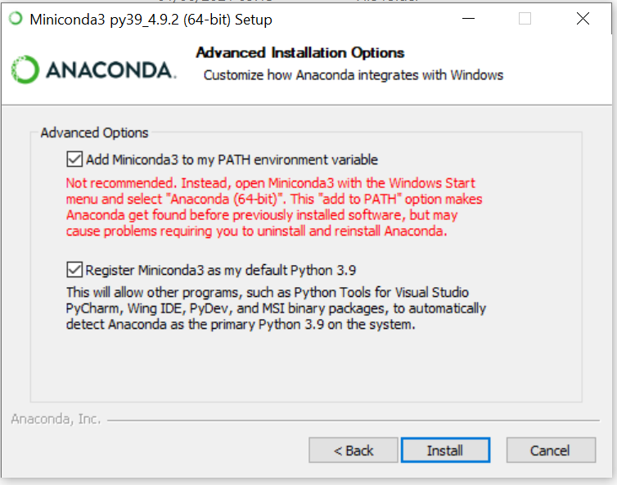
Setting up miniconda

Slide 11
Extension(visual studio code)
Python
python snippets

Slide 12
Create env miniconda
Conda list
Conda create –n basic_python python
Conda activate basic_python

Slide 13
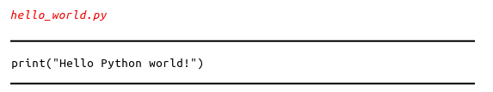
Running Hello world program

Slide 14
VARIABLES AND SIMPLE DATA TYPES
Chapter 2

Slide 15
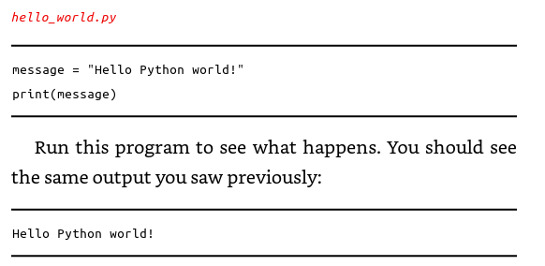
Variable
Message is a variable
“Hello python world!” is a value

Slide 16
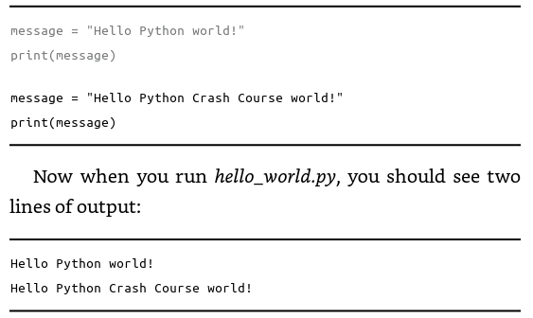
Variable(2)
Python will always keep track of its current value.

Slide 17
Naming and Using Variables
Variable names can contain only letters, numbers, and underscores.
- except. message_1 but not 1_message.
Spaces are not allowed in variable names
e.g. greeting_message works but greeting message will cause errors.
Avoid using Python keywords and function names as variable names
e.g. print (See https://www.w3schools.com/python/python_ref_keywords.asp
https://docs.python.org/3/library/functions.html)
Variable names should be short but descriptive.
e.g. name is better than n, student_name is better than s_n, and name_length is better than length_of_persons_name.

Slide 18

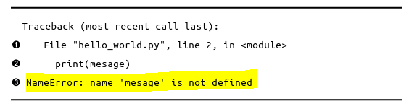
Avoiding Name Errors When Using Variables
including the misspelled word “mesage”

Slide 19
EXAMPLE
Create program named simple_messages.py, assign variables (employee name ,employee surname, employee number, division name, a RFID value of employee card) ,and then print the variables
In program simple_messages.py, change the value of the variable to a new message, and print the again

Slide 20

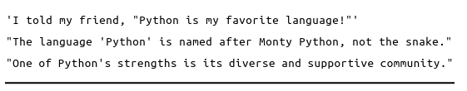
String
A string is a series of characters.

Slide 21

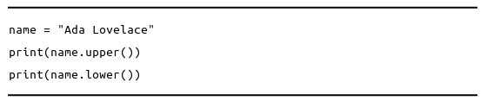
Changing Case in a String with Methods
name.py
The lower() is useful for storing data.

Slide 22
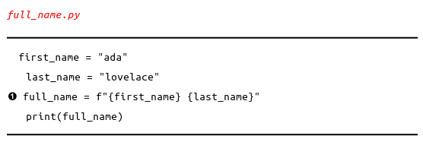
Using Variables in Strings
To use a variable’s value in side a string.
Noted f is called f-strings. The f is for format

Slide 23
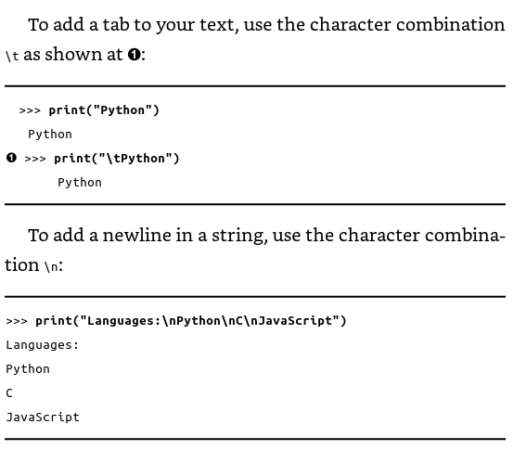
Adding Whitespace to Strings with Tabs or Newlines

Slide 24

Adding Whitespace to Strings with Tabs or Newlines(2)
Combine tabs and newlines “\n\t”

Slide 25
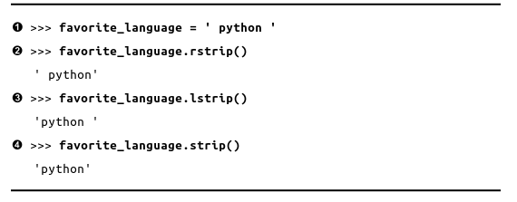
Stripping Whitespace

Slide 26
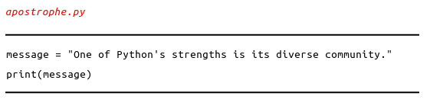
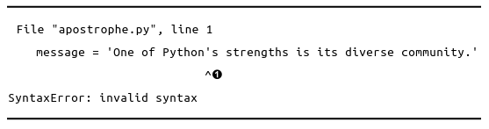
Avoiding Syntax Errors with Strings

Slide 27
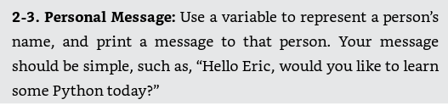

EXAMPLE

Slide 28
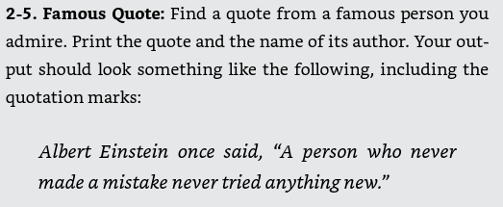
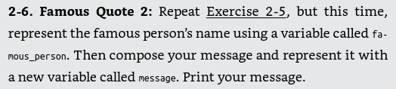
EXAMPLE(2)

Slide 29
EXAMPLE(2)

Slide 30
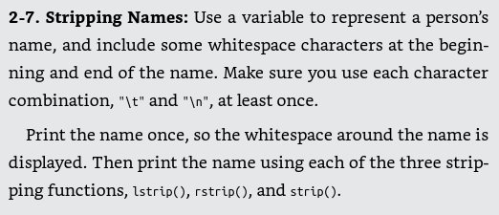
EXAMPLE(3)

Slide 31
Numbers
Integers
Floats

Slide 32
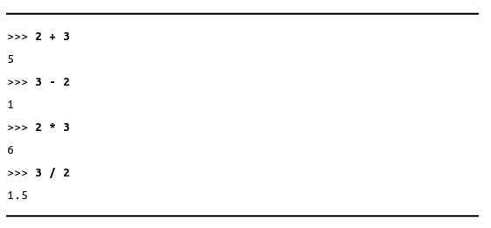
Integers
You can add (+), subtract (-), multiply (*), and divide (/) integers in Python

Slide 33
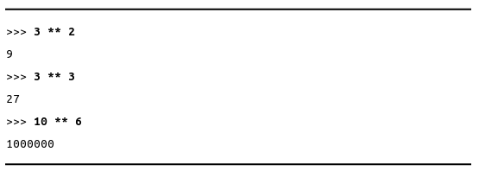
Integers
multiplication

Slide 34
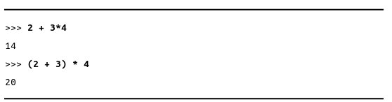
Integers
The order of operations

Slide 35
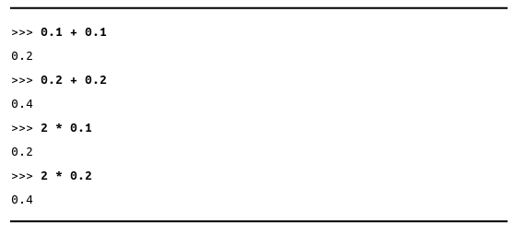
Floats
A float is any number with a decimal point

Slide 36

Integers and Floats
When divide any two numbers(integers), even the result is integers, will always get a float

Slide 37
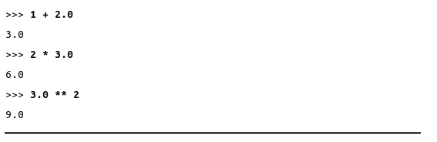
Integers and Floats
If you mix an integer and a float in any other operation. You’ll get a float as well

Slide 38

Underscores in Numbers
Grouping digits using underscores to make large numbers more readable

Slide 39

Multiple Assignment
For easier to read

Slide 40

Constants
Python programmers use all capital letters to indicate a variable should be treated as a constant and never be changed:

Slide 41
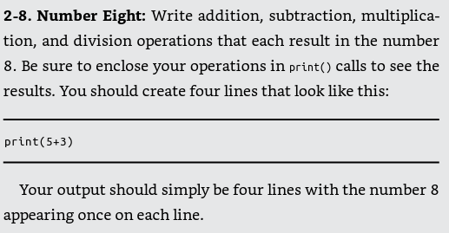
EXAMPLE

Slide 42
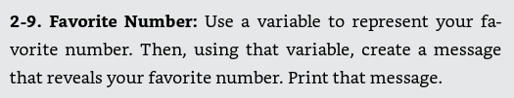
EXAMPLE(2)

Slide 43
EXAMPLE(3)

Slide 44
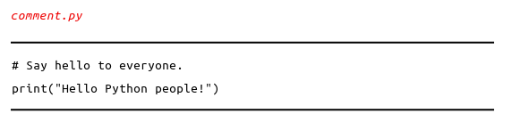

Comments
The hash mark (#)
Use ‘’’___’’’

Slide 45
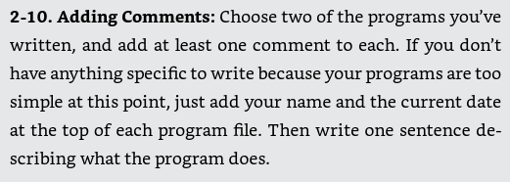
EXAMPLE

Slide 46
The Zen of python
Import this (See https://towardsdatascience.com/the-zen-of-python-a-guide-to-pythons-design-principles-93f3f76d088a)

Slide 47
INTRODUCING LISTS
Chapter 3

Slide 48
What is a List?
A list is a collection of items in a particular order, don’t have to be related into a list
Square brackets ([]) indicate a list, and individual elements in the list are separated by commas.
Make the name of list plural such as letters, digits, or names.

Slide 49
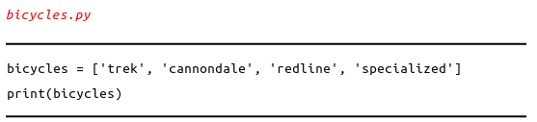
What is a List?(2)

Slide 50


Accessing Elements in a List
Use index for ordered collections
Using title() method

Slide 51
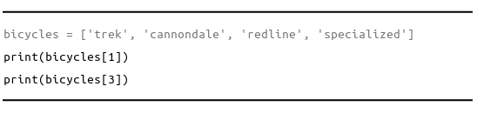
Index Positions Start at 0, Not 1

Slide 52

special syntax for accessing the last element in a list. By asking for the item at index -1

Slide 53
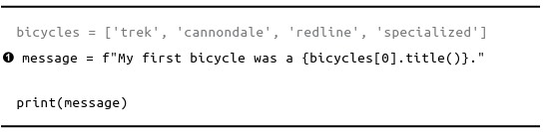
Using Individual Values from a List

Slide 54

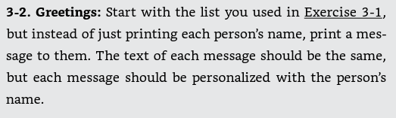
EXAMPLE

Slide 55
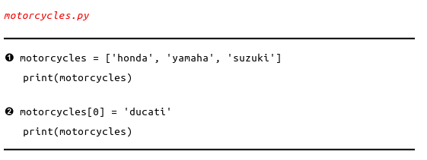
Modifying Elements in a List

Slide 56
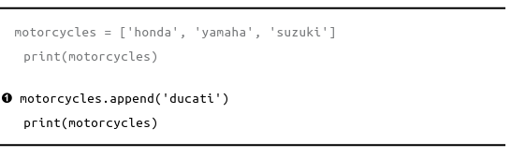
Appending Elements to the End of a List

Slide 57
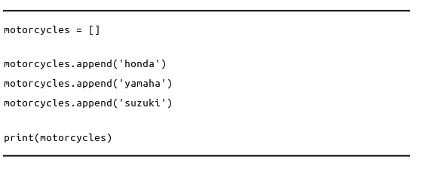
Appending Elements to the End of a List(2)
Build lists dynamically from a empty list

Slide 58
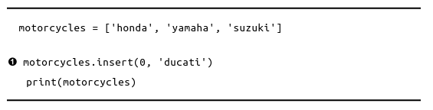
Inserting Elements into a List
Add a new element at any position in lists

Slide 59
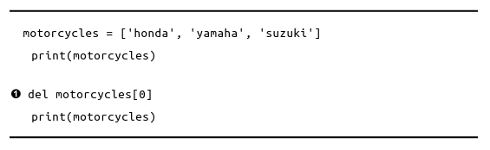
Removing an Item Using the del Statement
Use del statement

Slide 60
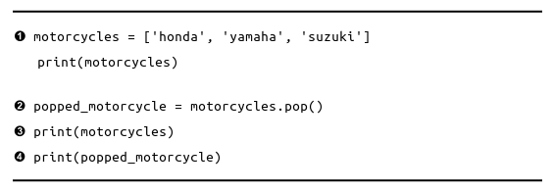
Removing an Item Using the pop() Method
The pop() method removes the last item in a list, but it lets you work with that item after removing it.

Slide 61
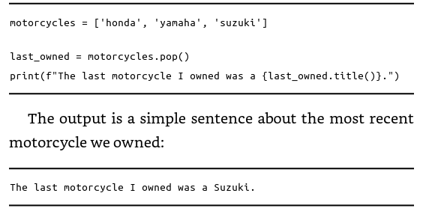
Removing an Item Using the pop() Method (2)
The pop() method be useful as

Slide 62
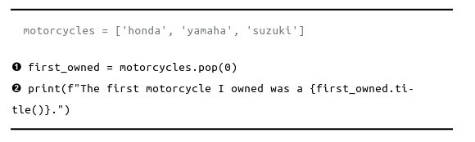
Popping Items from any Position in a List
Use pop() to remove an item from any position in a list by including the index of the item you want to remove in parentheses.

Slide 63
When pop() or del() ?
Use del() when not use that item in any way
Use pop() when want to use an item

Slide 64
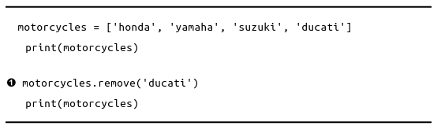
Removing an Item by Value
Only know the value if the item

Slide 65
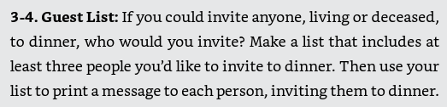
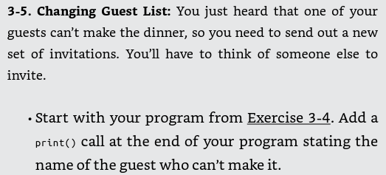
EXAMPLE

Slide 66
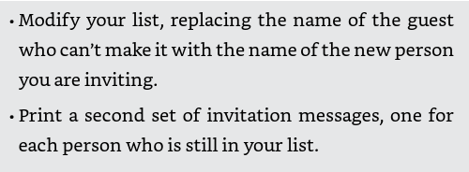
EXAMPLE

Slide 67
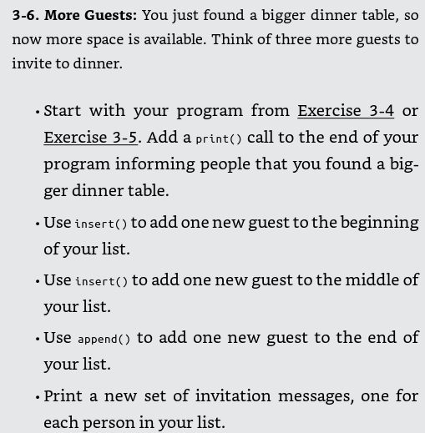
EXAMPLE

Slide 68
Organizing a list
Sorting a list permanently
Sorting a list permanently in reverse alphabetical order
Sorting a list temporarily
Reversing the order of a list

Slide 69
List length
Find the length of a list

Slide 70
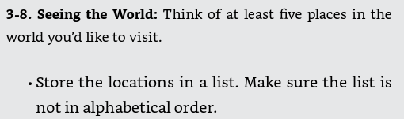
EXAMPLE

Slide 71
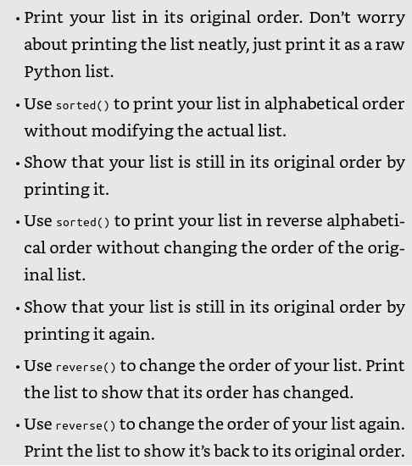
EXAMPLE

Slide 72
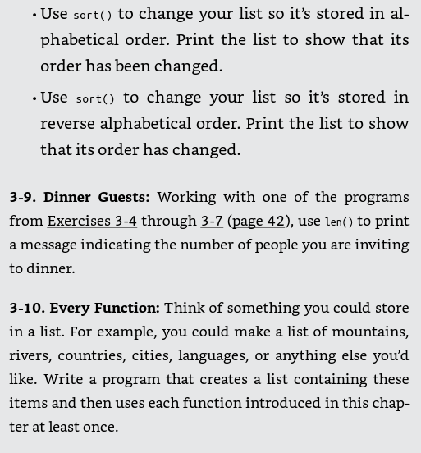
EXAMPLE

Slide 73
Avoiding Index Errors When Working with Lists
Index error
[-1] error in empty list

Slide 74
WORKING WITH LISTS
Chapter 4

Slide 75
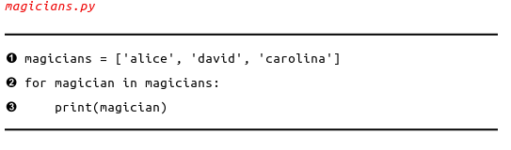
Looping with list
Printing all items in a list
Do something work within a for loop
Do something work after a for loop

Slide 76
Avoiding Indentation Errors
Forgetting to Indent
Forgetting to Indent Additional Lines
Indenting Unnecessarily
Indenting Unnecessarily After the loop
Forgetting the Colon

Slide 77
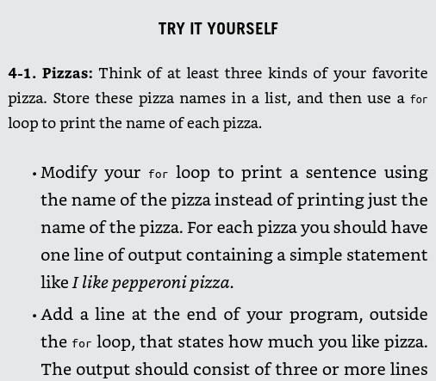
EXAMPLE

Slide 78
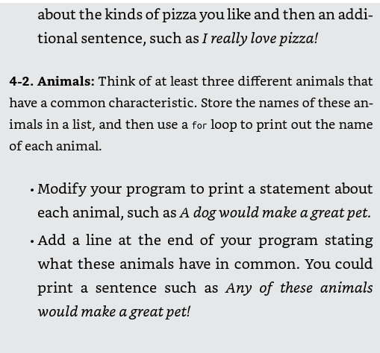
EXAMPLE

Slide 79
Making Numerical Lists
Using the range() function
Using the range() to Make a List of Numbers
Even numbers of list
Squares
Simple Statistics with a List of Numbers

Slide 80
List Comprehensions
Making squares

Slide 81
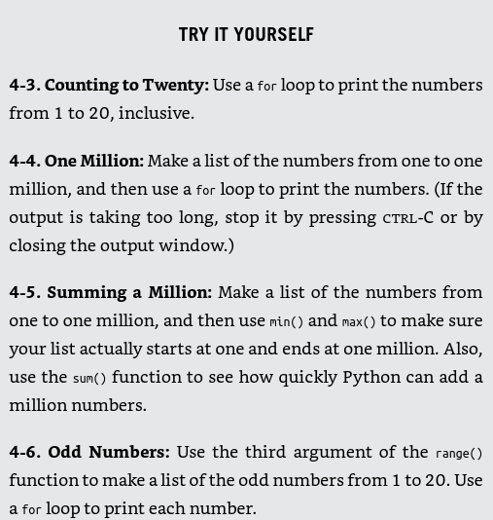
EXAMPLE

Slide 82

EXAMPLE

Slide 83
Working with a part of list
Slicing a List
Looping Through a Slice
Copying a List
Copy
Append
Copy a list without using a slice

Slide 84

EXAMPLE

Slide 85

EXAMPLE

Slide 86
Tuples
A tuple is like a list, except you can't change the values in a tuple once it's defined.
Tuples are good for storing information that shouldn't be changed throughout the life of a program.
You can overwrite an entire tuple, but you can't change the individual elements in a tuple.

Slide 87
Tuples
Looping Through All Values in a Tuple
Writing over a Tuple

Slide 88

EXAMPLE

Slide 89
IF STATEMENTS
Chapter 5

Slide 90
IF STATEMENTS
If statements allow you to examine the current state of a program and respond appropriately to that state.
You can write a simple if statement that checks one condition, or you can create a complex series of if statements that identify the exact conditions you're looking for.

Slide 91

IF STATEMENTS
A simple example

Slide 92
IF STATEMENTS
A simple example

Slide 93
IF STATEMENTS
Conditional Tests, an expression that can be evaluated as True or False
Checking for Equality
Ignoring case when checking for equality
Checking for Inequality
Numerical comparisons

Slide 94
Checking Multiple Conditions
Using and to check Multiple Conditions
Using or to Check Multiple Conditions
Checking Whether a Value Is in a List
Checking Whether a Value Is not in a list
Boolean Expressions

Slide 95

EXAMPLE

Slide 96

EXAMPLE

Slide 97

EXAMPLE

Slide 98
If Statements
Simple of Statements
If-else Statements
The if-elif-else Chain
Using Multiple elif blocks
Omitting the else Block
Testing Multiple conditions

Slide 99

EXAMPLE

Slide 100

EXAMPLE

Slide 101

EXAMPLE

Slide 102

EXAMPLE

Slide 103
Using if Statements with Lists
Checking for Special Items
Checking That a List Is not Empty
Using Multiple Lists

Slide 104

EXAMPLE

Slide 105

EXAMPLE

Slide 106

EXAMPLE

Slide 107

Styling Your if Statements

Slide 108
DICTIONARIES
Chapter 6

Slide 109
What are dictionaries?
Python's dictionaries allow you to connect pieces of related information each piece of information in a dictionary is stored as a key-value pair.
Can provide a key, Python returns the value associated with that key.
Can loop through all the key-value pairs, all the keys, or all the values.

Slide 110

A Simple Dictionary

Slide 111
Working With Dictionaries
Accessing values
Adding new key-value pairs
Starting with an empty dictionary
Modify values
ex. Track the position of an alien that move at different speeds
Removing key-value pairs
Using get() to access values

Slide 112

EXAMPLE

Slide 113

EXAMPLE

Slide 114
Looping Through a Dictionary
Looping through all key-value pairs
Looping through all the keys
Looping through a dictionary’s keys in a particular order
Looping though all values in a dictionary

Slide 115

EXAMPLE

Slide 116

EXAMPLE

Slide 117

EXAMPLE

Slide 118
Nesting
A list of dictionaries
A list in a dictionaries
A dictionary in a dictionary

Slide 119

EXAMPLE

Slide 120

EXAMPLE

Slide 121

EXAMPLE

Slide 122
USER INPUT AND WHILE LOOPS
Chapter 7

Slide 123
Input() Function
A simple case
Writing clear prompts
Using int() to accept numerical input

Slide 124


EXAMPLE

Slide 125
Introducing while loops
The while loop in action
Letting the user choose when to quit
Using a flag
Using break to exit a loop
Using continue in a loop
Avoiding infinite loops

Slide 126

EXAMPLE

Slide 127

EXAMPLE

Slide 128
Using a while loop with lists and Dictionaries
Moving items from one list to another
Removing all instances of specific values from a list
Filling a dictionary with user input

Slide 129

EXAMPLE

Slide 130

EXAMPLE

Slide 131
FUNCTIONS
Chapter 8

Slide 132
What are functions ?
Functions are named blocks of code designed to do one specific job.
Functions allow you to write code once that can then be run whenever you need to accomplish the same task.
Functions can take in the information they need, and return the information they generate.
Using functions effectively makes your programs easier to write, read, test, and fix.

Slide 133

Function
Passing information to a function

Slide 134

Passing information to a function

Slide 135
Arguments and parameters
Positional argument
Multiple function calls
Order matters in positional arguments
Keyword arguments
Default values
Equivalent function calls
Avoiding argument errors

Slide 136

EXAMPLE

Slide 137

EXAMPLE

Slide 138
Return values
Returning a simple value
Making a argument optional
Returning a dictionary
Using a function with a while loop

Slide 139
Working with list
Passing a list
Modifying a list in a function

Slide 140
Passing an arbitrary number of arguments
Mixing position and arbitrary arguments
Using arbitrary keyword arguments

Slide 141
Storing functions in modules
Import an entire module
Importing specific functions
Using as to give a function an alias
Using as to give a module an alias
Importing all functions in module

Slide 142
Styling functions
Functions should have descriptive names, and these names should use lowercase letters and underscores.
Every function should have a comment that explains concisely what the function does. This comment should appear immediately after the function definition and use the doc string format.

Slide 143
CLASSES
Chapter 9

Slide 144
What are classes ?
Classes are the foundation of object-oriented programming.
Classes represent real-world things you want to model in your programs: for example dogs, cars, and robots.
You use a class to make objects, which are specific instances of dogs, cars,
and robots.
A class defines the general behavior that a whole category of objects can have, and the information that can be associated with those objects.
Classes can inherit from each other – you can write a class that extends the functionality of an existing class. This allows you to code efficiently for a wide variety of situations.

Slide 145
Creating and Using a Class
Creating the Dog Class
The __init__() Method
Variables that are accessible through instances like this are called attributes.
Making an instance from a class
Accessing attributes
Calling methods
Creating multiple instances

Slide 146

EXAMPLE

Slide 147

EXAMPLE

Slide 148
Working with Classes and Instances
The Car class
Setting a default value for an attribute

Slide 149
Modifying attribute values
Modifying an attribute’s value directly
Modifying an attribute’s value through a method
Roll back condition
Incrementing an attribute’s value through a method

Slide 150
Inheritance
The original class is called the parent class, and the new class is the child class.
The __init__() Method for a Child Class
Defining Attributes and Methods for the Child Class
Overriding methods from the parent class
Instances as attributes

Slide 151
Importing classes
Importing a single class
Storing multiple classes in a module
Import Multiple classes from a module
Importing an entire module
Importing all classes from a module
Importing a module into a module
Using Aliases

Slide 152


The python standard library

Slide 153

EXAMPLE

Slide 154

EXAMPLE

Slide 155
Styling Classes
Class names should be written in CamelCase. To do this, capitalize the first letter of each word in the name, and don’t use underscores. Instance and module names should be written in lowercase with underscores between words.
Should have a doc string immediately following the class definition.
Within a class you can use one blank line between methods, and within a module you can use two blank lines to separate classes.

Slide 156
FILES AND EXCEPTIONS
Chapter 10

Slide 157
Reading from a File
Reading an entire file
File paths
Reading line by line

Slide 158
Writing to a file
Writing to an empty file
Writing multiple lines
Appending to a file

Slide 159
Exceptions
Handling the ZeroDivisionError Exception
Using try-except blocks
Using exceptions to prevent crashes
The else block
Handling the file not found error exception
Analyzing text
Working with multiple files
Failing silently

Slide 160
Storing data
Using json.dump() and json.load()
Saving and reading user-generated data

Slide 161
Refactoring
you’ll come to a point where your code will work, but you’ll recognize that you could improve the code by breaking it up into a series of functions that have specific jobs. This process is called refactoring.

Slide 162
TESTING YOUR CODE
Chapter 11

Slide 163
Why test your code ?
When you write a function or a class, you can also write tests for that code.
Testing proves that your code works as it's supposed to in the situations it's designed to handle, and also when people use your programs in unexpected ways.
Writing tests gives you confidence that your code will work correctly as more people begin to use your programs.
You can also add new features to your programs and know that you haven't broken existing behavior.
A unit test verifies that one specific aspect of your code works as it's supposed to. A test case is a collection of unit tests which verify your code's behavior in a wide variety of situations.

Slide 164

Testing a function

Slide 165

Testing a function

Slide 166
Unit Tests and Test Cases
A passing test
A failing test
Adding new tests

Slide 167


A variety of assert methods

Slide 168
A class to test
Testing the anonymous survey class
The setUp() method

Slide 169
DATA VISUALIZATION
Chapter 12

Slide 170
Matplotlib
A simple line graph
Changing the label type and line thickness
Correcting the plot
Using built-in styles
Plotting and styling individual points with scatter()
Plotting a series of points with scatter()
Calculating data automatically
Defining custom colors
Using a color map
Saving plots
Example : randomwalks

Slide 171
Plotly
Rolling Dice with plotly
Creating the die class
Rolling the die
Analyzing the results
Making a histogram
Rolling two dice
Rolling dice of different sizes

Slide 172
Working with csv file
Downloading data
The CSV file format
Parsing the csv file headers
Printing the headers and their positions
Extracting and reading data
Plotting data in a temperature chart
The datetime module
Plotting dates
Plotting a longer timeframe
Plotting a second data series
Shading an area in the chart
Error checking

Slide 173
Working with JSON
Examining JSON data(See: https://earthquake.usgs.gov/earthquakes/feed/.)
Making a list
Extracting magnitudes
Extracting location data
Building a world map
A different way of specifying chart data
Customizing marker size
Customizing marker colors
Other color scales
Adding hover text

