Slide 1
PRODUCTION MONTHLY REPORT
MIC division

Slide 2
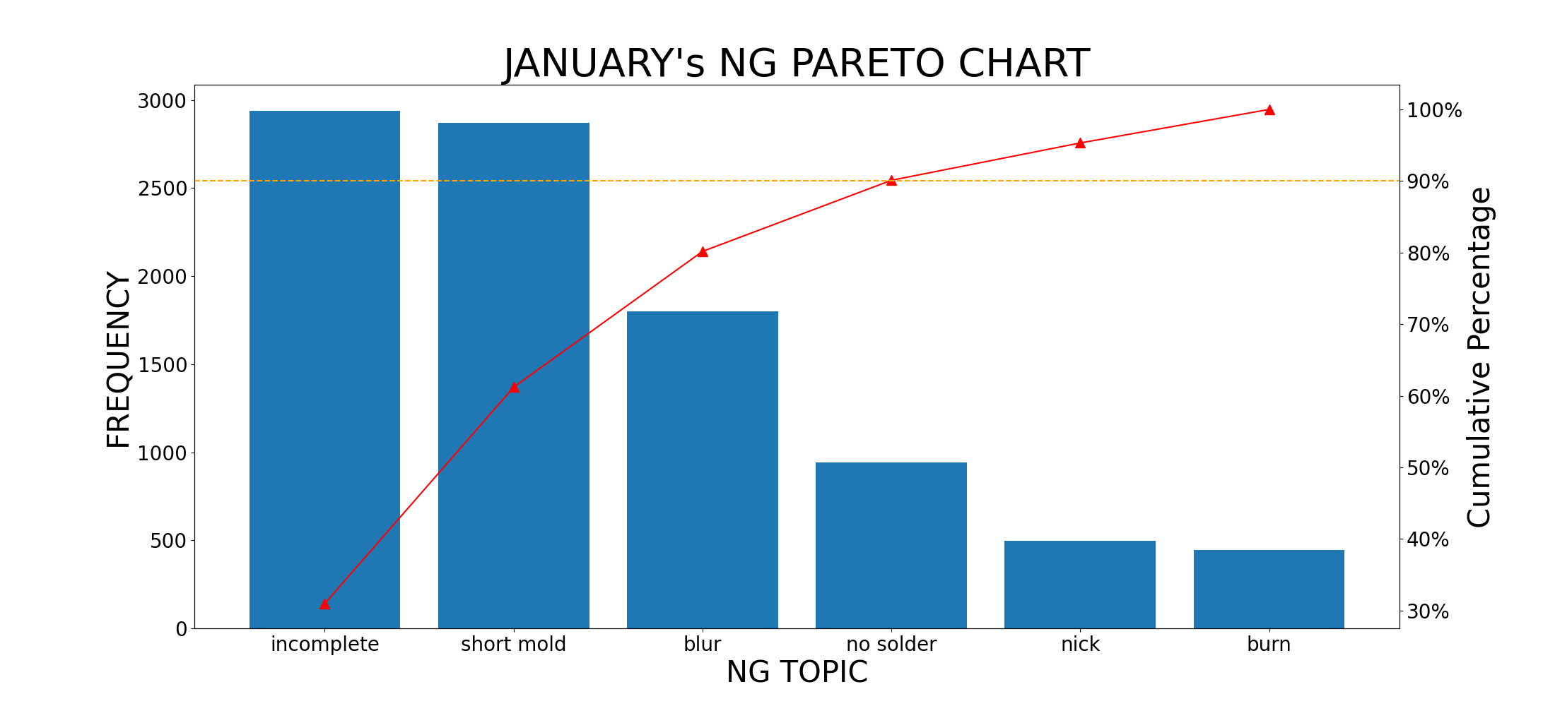
january's NG PARETO

Slide 3
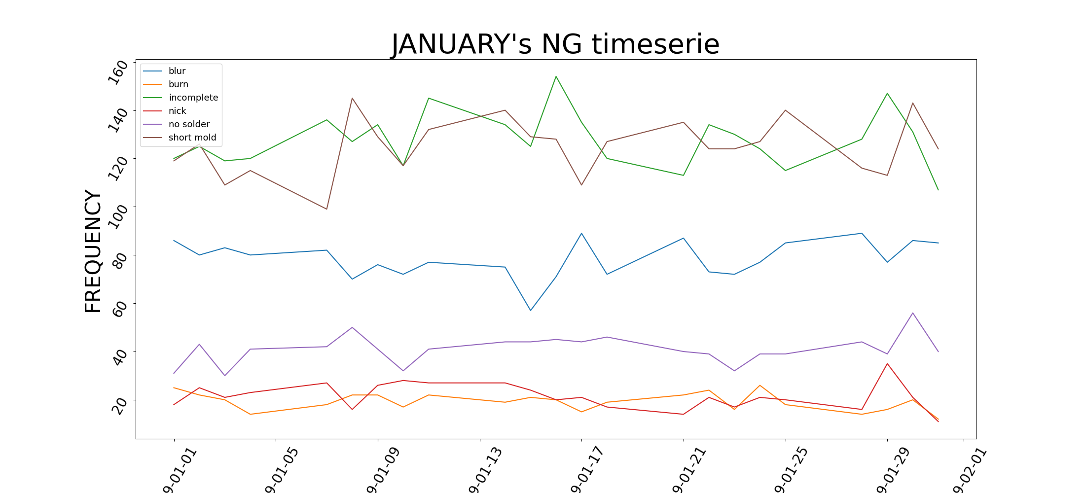
january's NG TIME SERIES

Slide 4
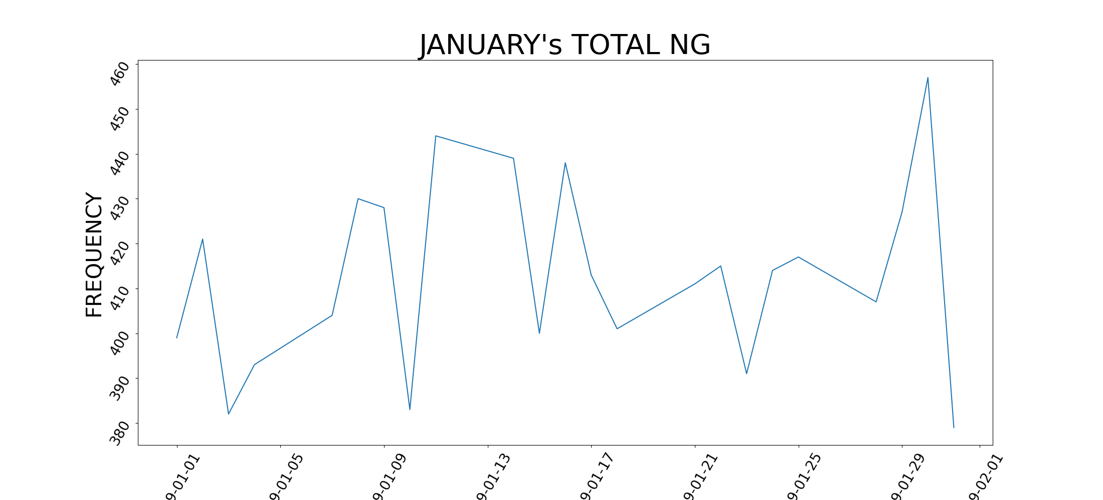
january's NG TIME SERIES

