Slide 1
PRODUCTION MONTHLY REPORT
MIC division

Slide 2
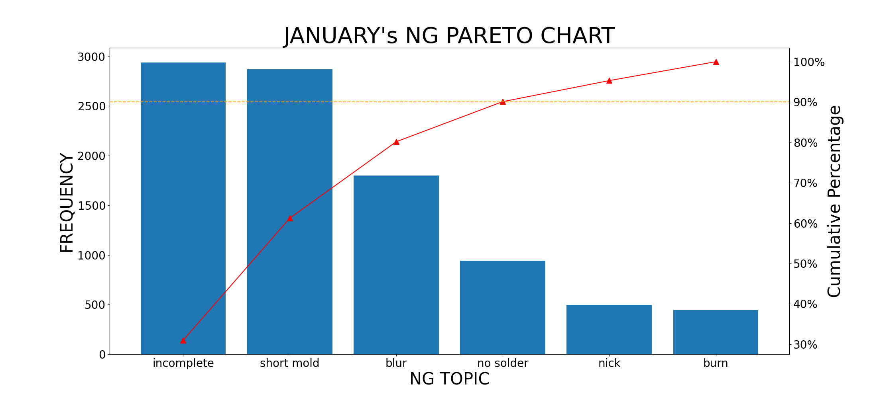
JANUARY's NG PARETO

Slide 3
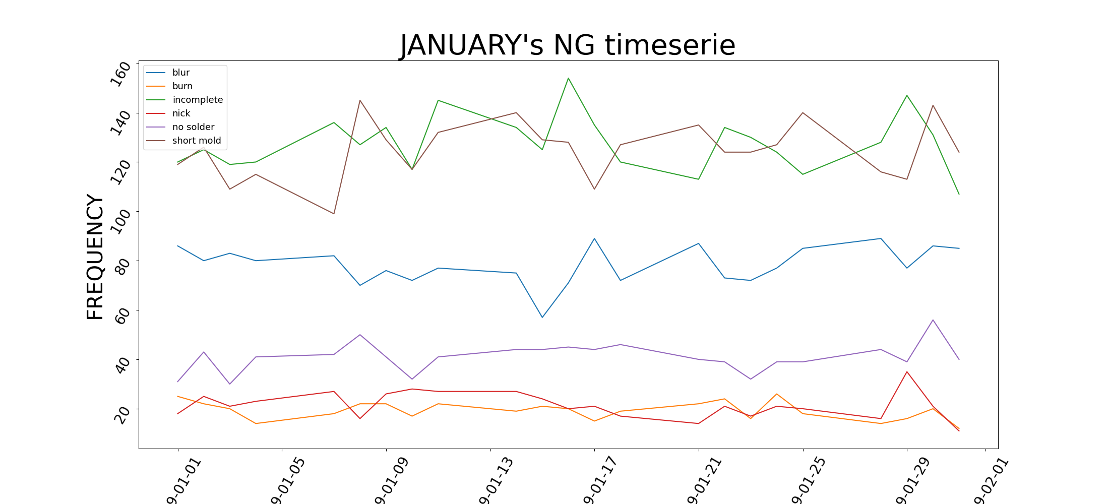
JANUARY's NG TIME SERIES

Slide 4
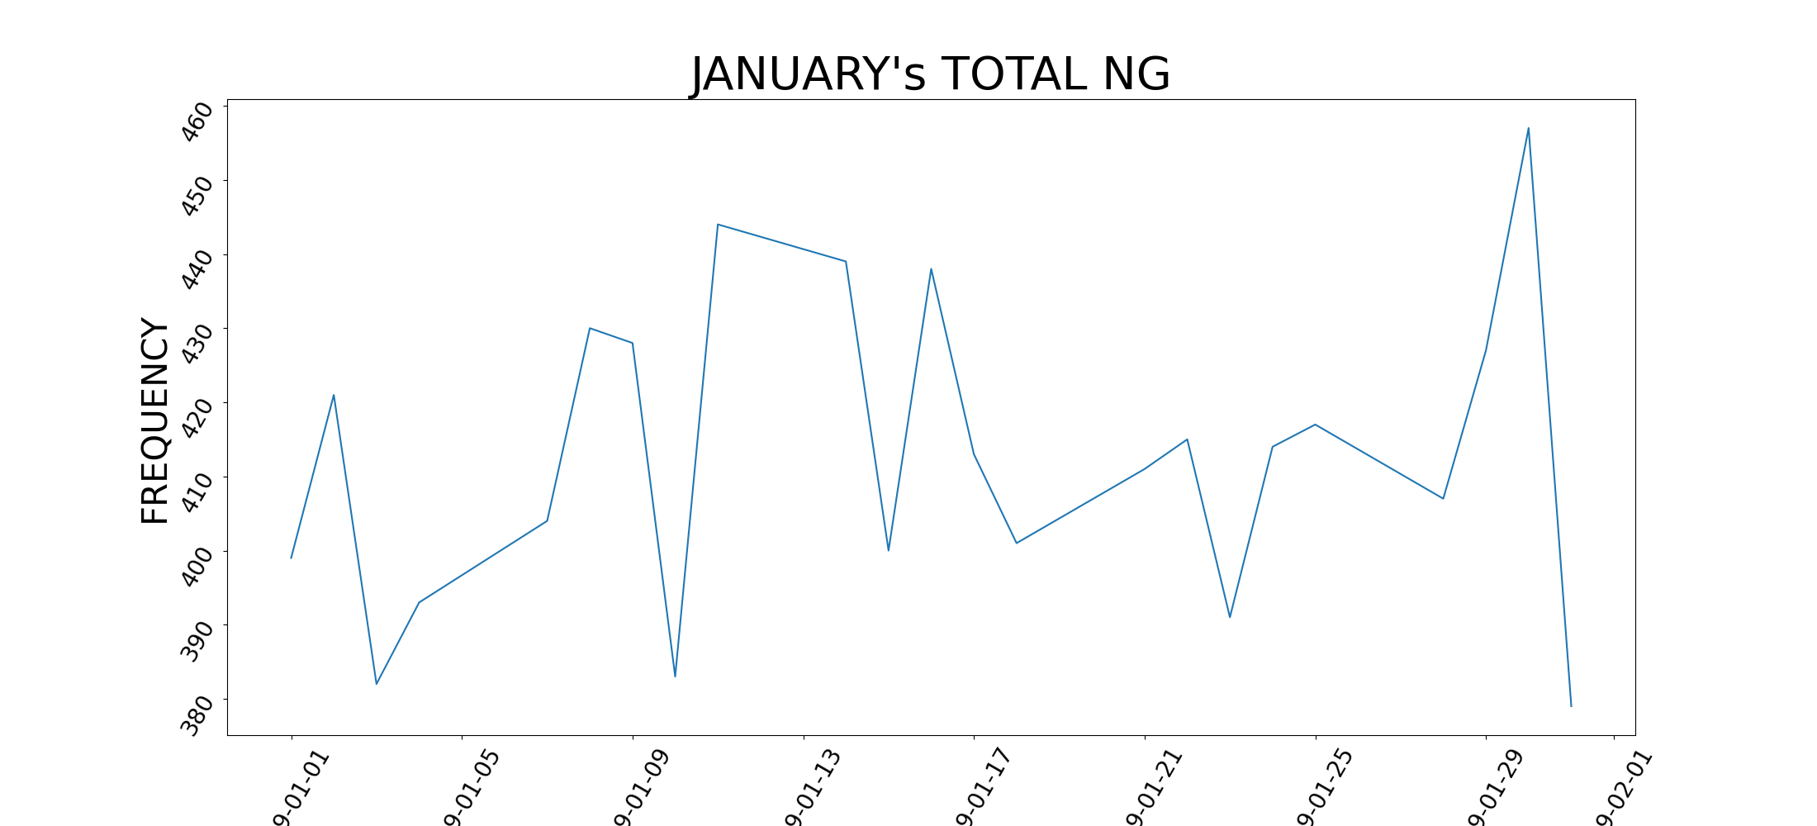
JANUARY's NG TIME SERIES

Slide 5
JANUARY's PIVOT
1 | a
2 | b
3 | c

