Slide 1
PRODUCTION MONTHLY REPORT
MIC division

Slide 2
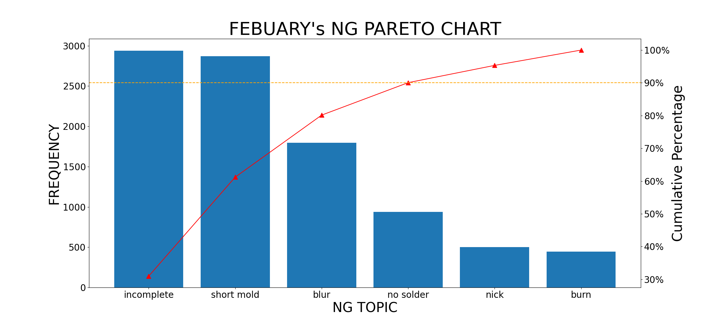
FEBUARY's NG PARETO

Slide 3
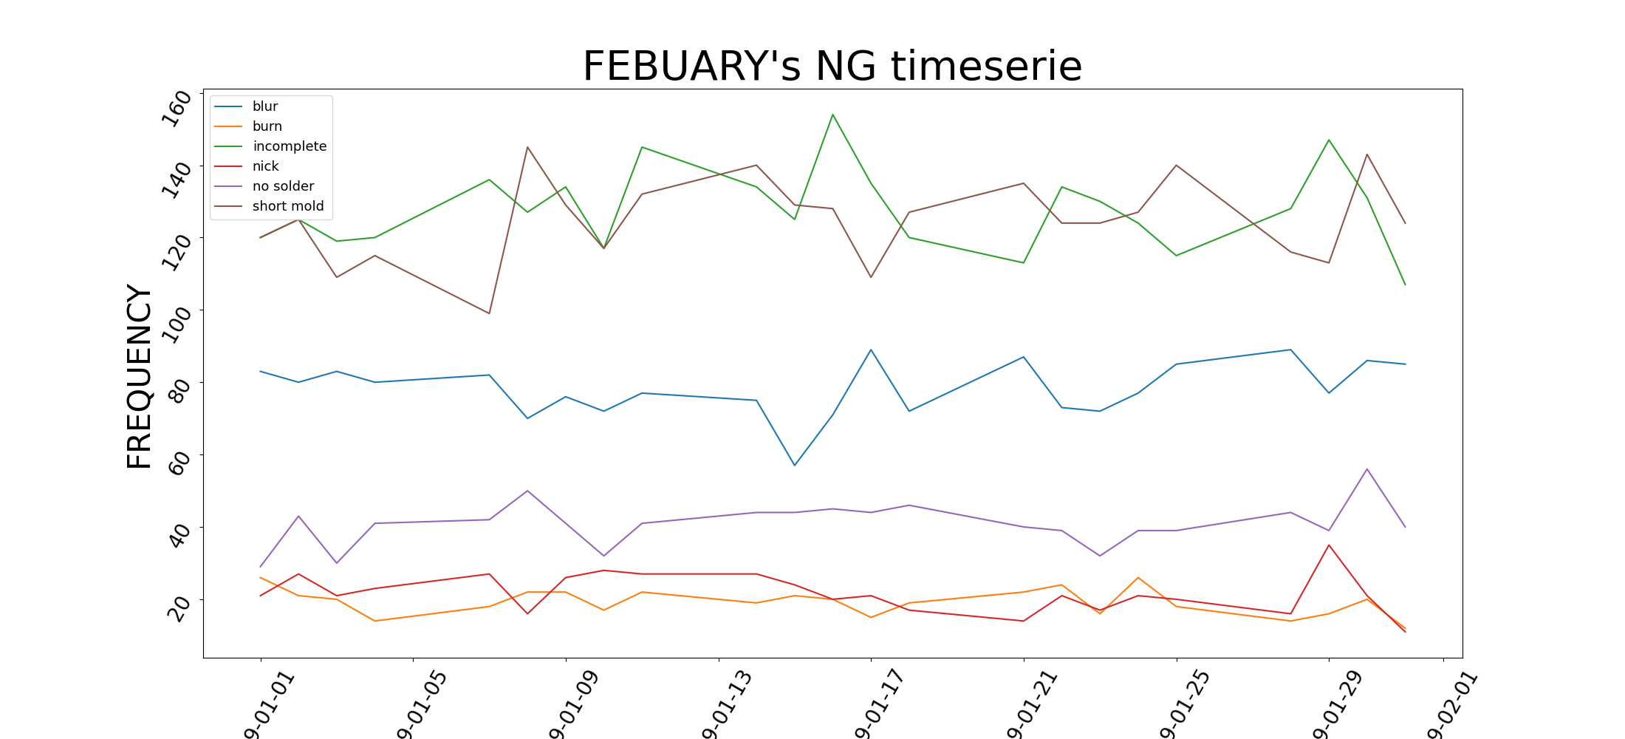
FEBUARY's NG TIME SERIES

Slide 4
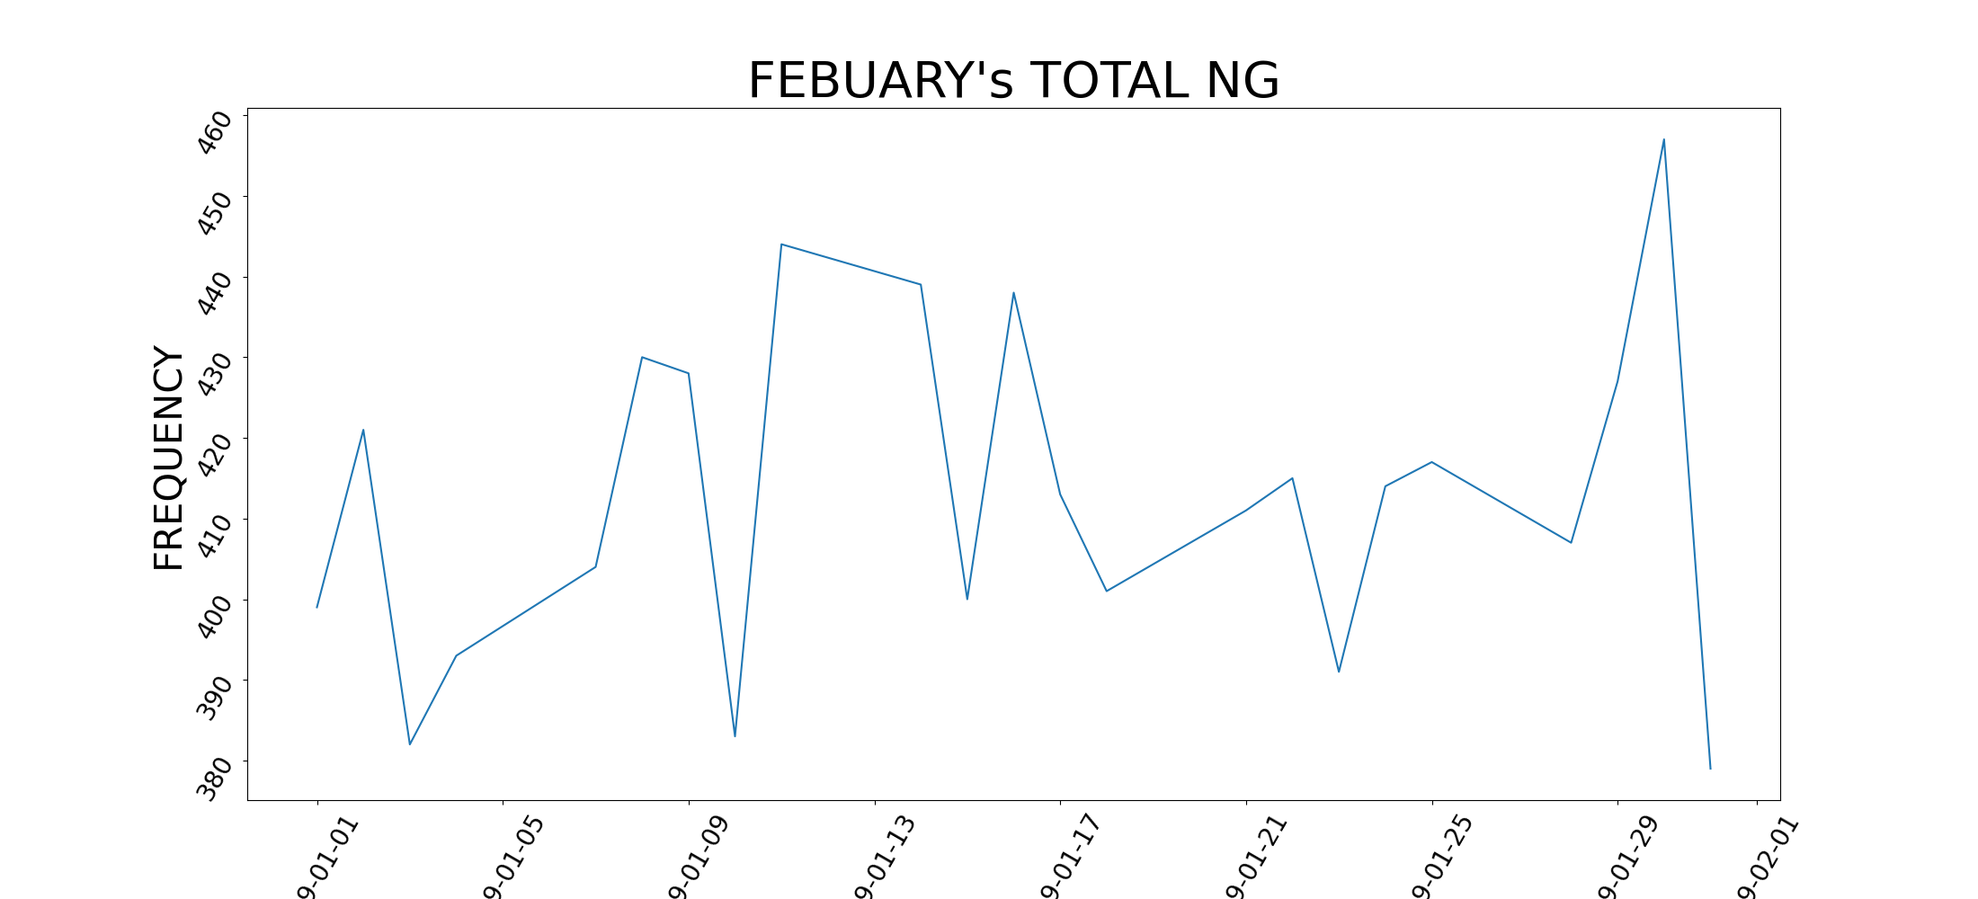
FEBUARY's NG TIME SERIES

