Slide 1
PRODUCTION MONTHLY REPORT
MIC division

Slide 2
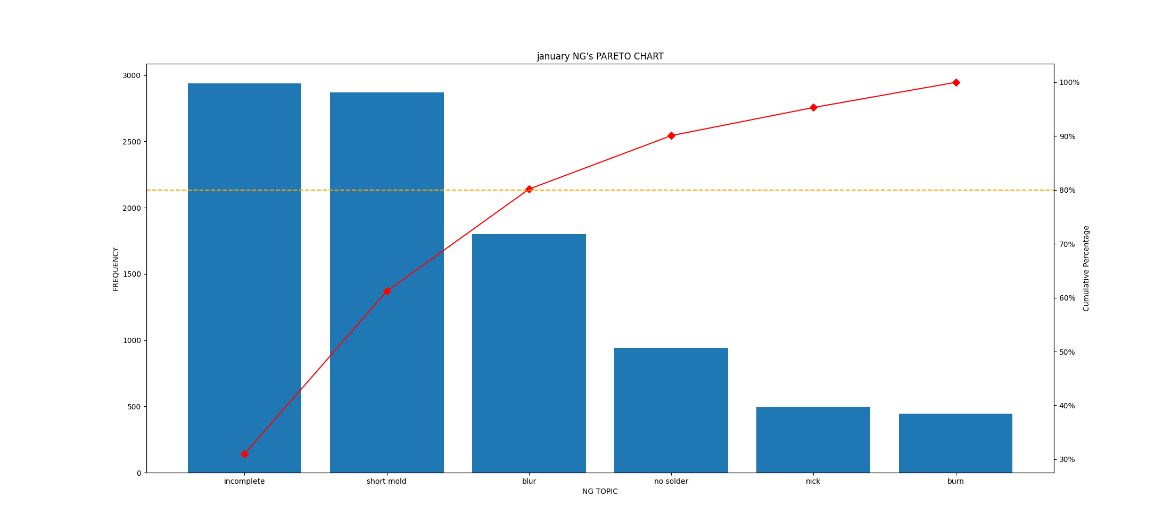
Summary result week 1

