Slide 1
PRODUCTION MONTHLY REPORT
MIC division

Slide 2
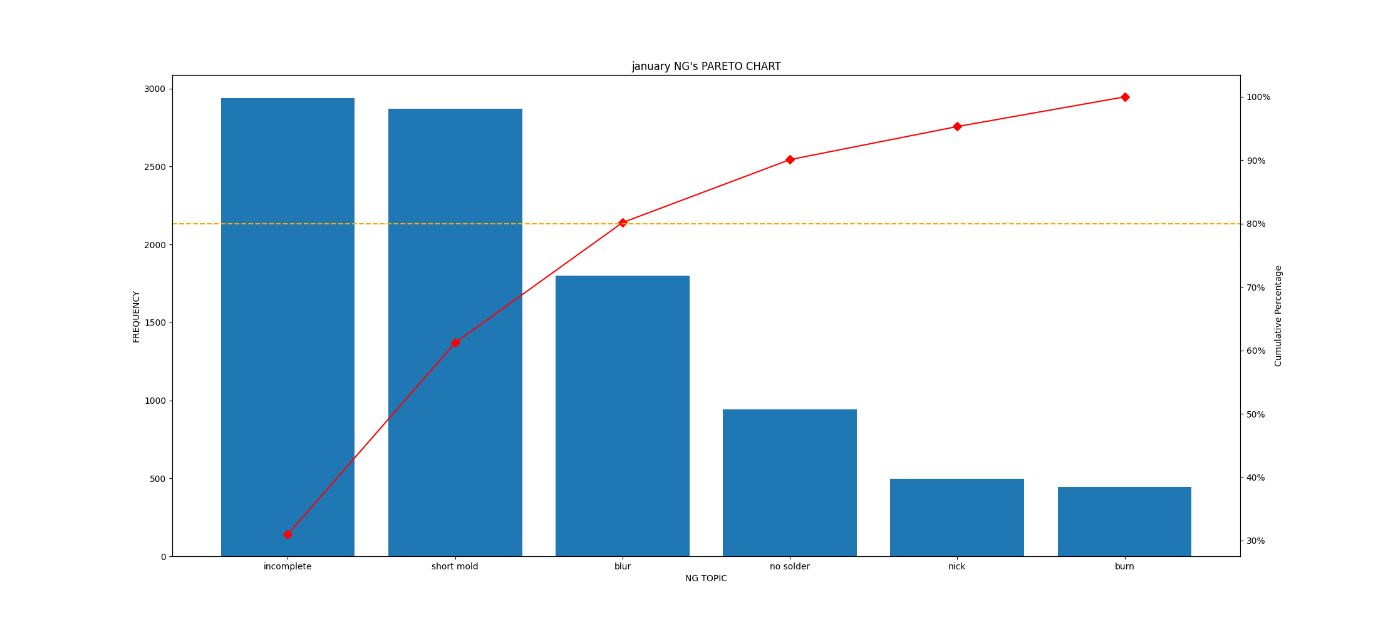
Summary result week 1
Analysis
• TOP 3 worst are blur,incomplate and nick
- blur 78.4%

